Slide 1
A Comparative Analysis of Different Pre-processing Pipelines for EEG-based Preference Prediction in Neuromarketing
PRESENTED BY
Student name: Ummul Kainatt Neha Student name : Md Ebrahim
ID no. 1911008 ID no. 1911006
SUBMITTED TO
Md Fazlul Karim Khondakar
Assistant Professor
Department of Biomedical Engineering, CUET

Slide 2
Content
Objective
Methodology
Pre-Processing
Feature Extraction
Classification
Results
Conclusion

Slide 3
Objectives
To develop and compare EEG pre-processing pipelines to enhance classification accuracy in EEG-based preference prediction for neuromarketing applications.
To predict consumer preferences by classifying individual responses into two categories:
Like (Label 1)
Dislike (Label 0)
DOI: https://doi.org/10.1109/PuneCon58714.2023.10450086

Slide 4
Pre-Processing
Raw Data import
FIR BPF
CLEANLINE
COMMON AVERAGE REFERENCE
INTERPOLATE LESS IMPORTANT NOISY CHANNEL
ASR REJECTION
ICA
EXPORT PROCESSED DATA
Fig 01: PRE PROCESSED DATA PIPELINE

Slide 5
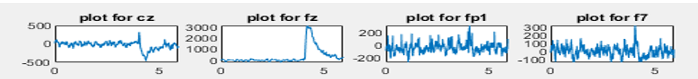
Pre-Processing
Fig 02: Raw Data of Cz Channel
Fig 03: Preprocessed Data of Cz Channel

Slide 6
Methodology
Data Preprocessing
Epoch Data
Transpose Data
Feature Extraction for each band of each channel
Create Feature Matrices Csv
Perform Classifier
Performance Analysis
Fig 04: Proposed Methodology - 01

Slide 7
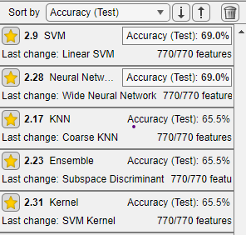
Performance Analysis
Data Length is Not increased properly because epoch doesn't work efficiently
Labeled Manually

Slide 8
Methodology
Data Preprocessing
Segment Data by 10
Transpose Data
Feature Extraction for each band of each channel
Create Feature Matrices Csv
Perform Classifier
Performance Analysis
Fig 05: Proposed Methodology - 02

Slide 9
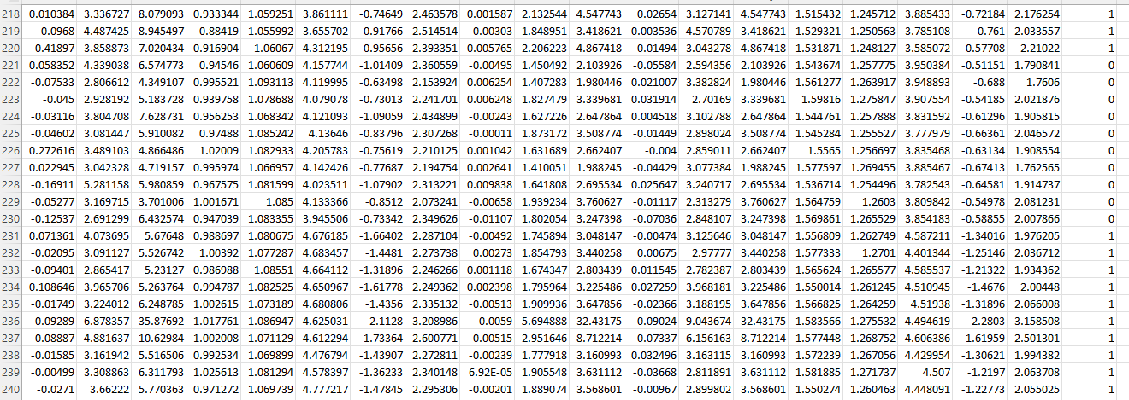
Feature Matrices
Fig 06:Some Portion Feature Matrices of BPF

Slide 10
Classification
Classifier | Accuracy | Precision | Recall | F1-Score
Tree | 72.3% | 0.83 | 0.68 | 0.75
KNN | 80.9% | 0.74 | 0.85 | 0.79
Ensemble | 83% | 0.87 | 0.80 | 0.83
Neural Network | 83% | 0.77 | 0.85 | 0.81
SVM | 80.9% | 0.78 | 0.82 | 0.80.
Classifier | Accuracy | Precision | Recall | F1-Score
Tree | 78.7% | 0.71 | 0.74 | 0.73
KNN | 83% | 0.67 | 0.88 | 0.76
Ensemble | 87.2% | 0.68 | 0.84 | 0.75
Neural Network | 83% | 0.65 | 0.81 | 0.72
SVM | 87.2% | 0.66 | 0.81 | 0.73
TABLE1: BPF CLASSIFICATION RESULT
TABLE2: DWT CLASSIFICATION RESULT

Slide 11
Conclusion
Classifier | BPF | DWT
Tree | 72.3% | 78.7%
KNN | 80.9% | 83%
Ensemble | 83% | 87.2%
Neural Network | 83% | 83%
SVM | 80.9% | 87.2%
TABLE3 . COMPARATIVE SUMMARY OF THE CLASSIFIERS’ TEST ACCURACIES FOR BPF & DWT.

Slide 12
Thank You
Question?

