Slide 1
K-MEANS CLUSTERING

Slide 2
INTRODUCTION- What is clustering?
Clustering is the classification of objects into different groups, or more precisely, the partitioning of a data set into subsets (clusters), so that the data in each subset (ideally) share some common trait - often according to some defined distance measure.

Slide 3
Types of clustering:
Hierarchical algorithms: these find successive clusters
using previously established clusters.
1. Agglomerative ("bottom-up"): Agglomerative algorithms begin with each element as a separate cluster and merge them into successively larger clusters.
2. Divisive ("top-down"): Divisive algorithms begin with the whole set and proceed to divide it into successively smaller clusters.
2. Partitional clustering: Partitional algorithms determine all clusters at once. They include:
K-means and derivatives
Fuzzy c-means clustering
QT clustering algorithm

Slide 4

Common Distance measures:
Distance measure will determine how the similarity of two elements is calculated and it will influence the shape of the clusters.
They include:
1. The Euclidean distance (also called 2-norm distance) is given by:
2. The Manhattan distance (also called taxicab norm or 1-norm) is given by:

Slide 5
K-MEANS CLUSTERING
The k-means algorithm is an algorithm to cluster n objects based on attributes into k partitions, where k < n.

Slide 6
Simply speaking k-means clustering is an algorithm to classify or to group the objects based on attributes/features into K number of group.
K is positive integer number.
The grouping is done by minimizing the sum of squares of distances between data and the corresponding cluster centroid.

Slide 7
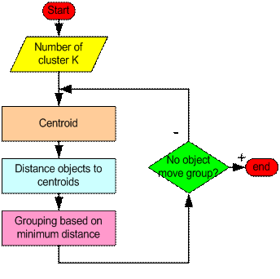
How the K-Mean Clustering algorithm works?

Slide 8
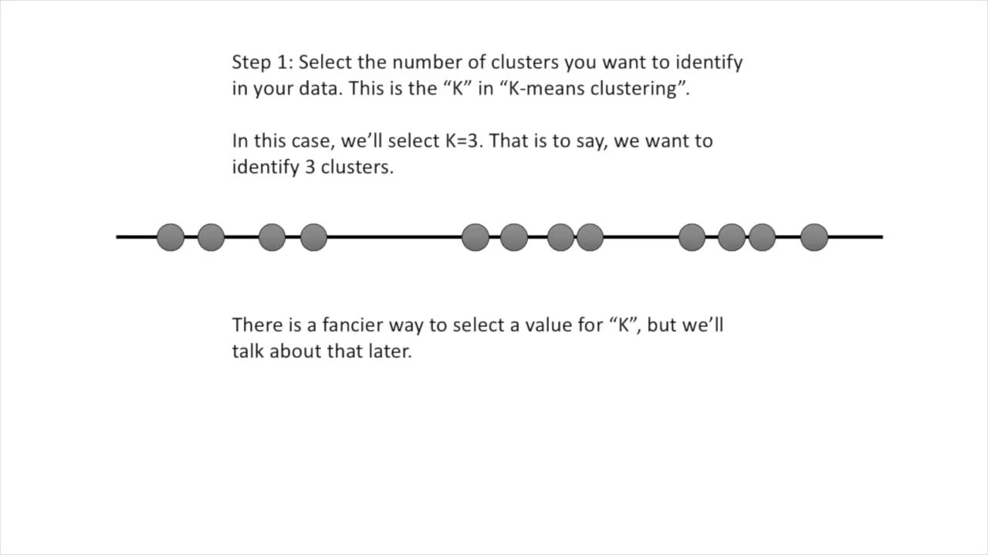

Slide 9
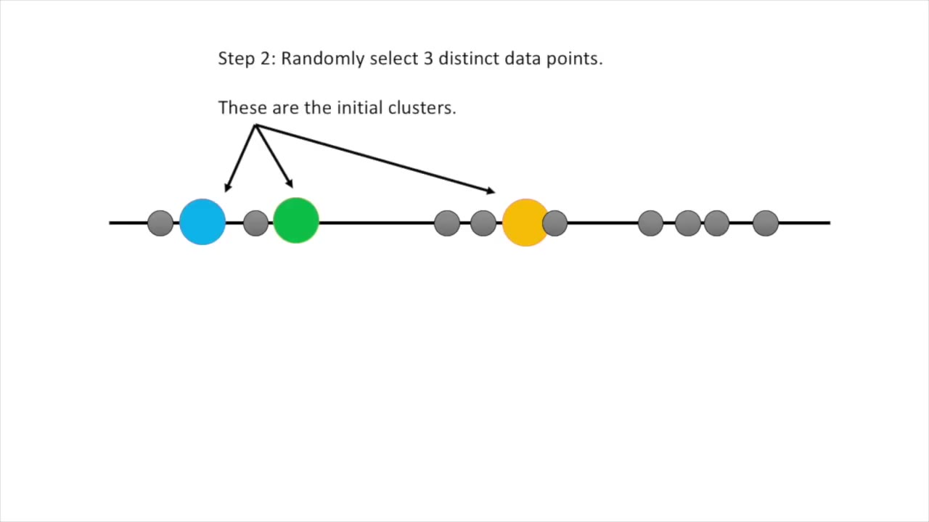

Slide 10
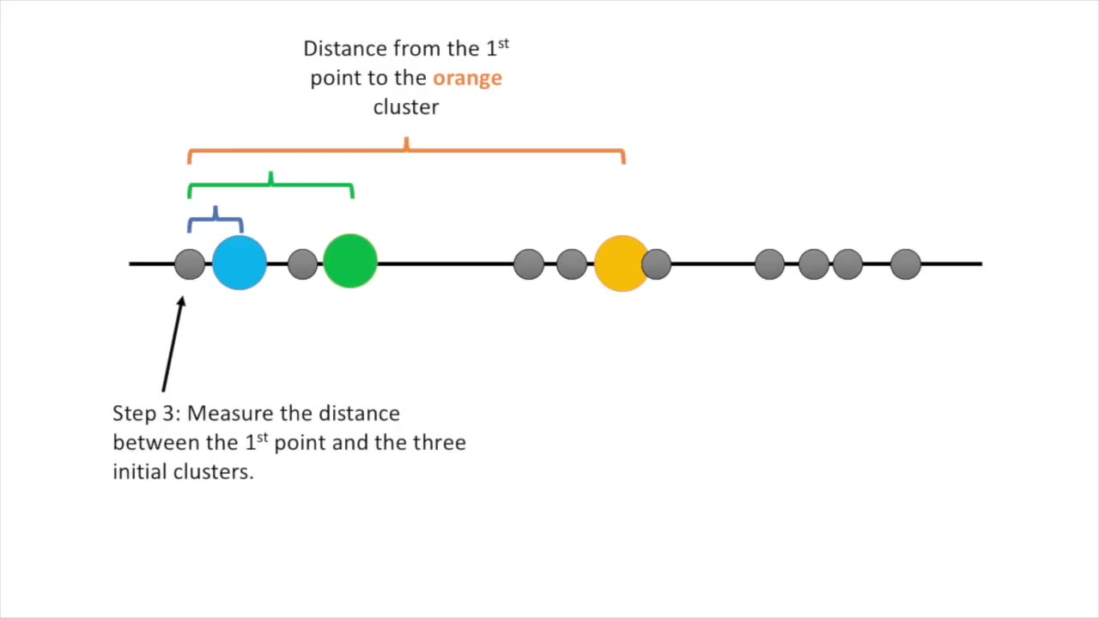

Slide 11
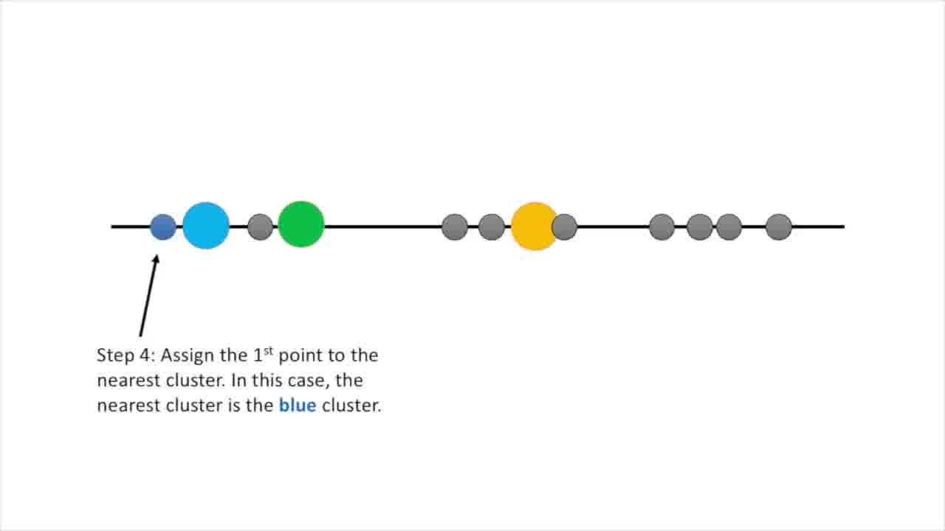
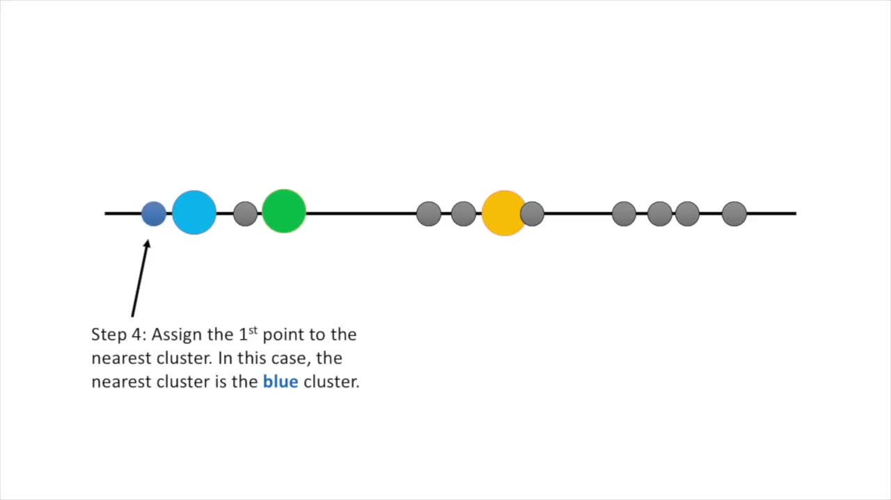

Slide 12
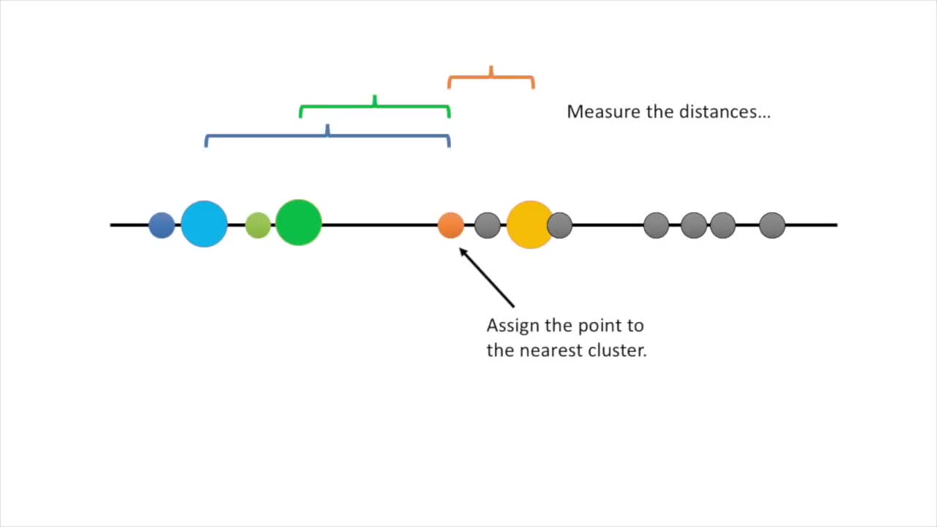

Slide 13
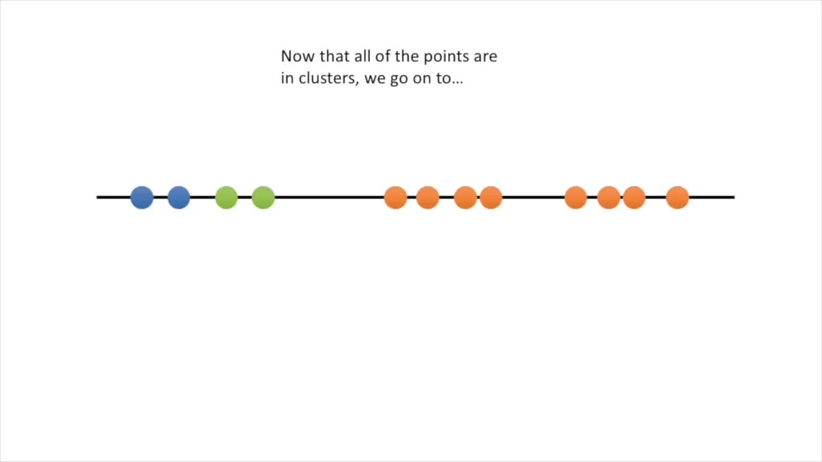

Slide 14
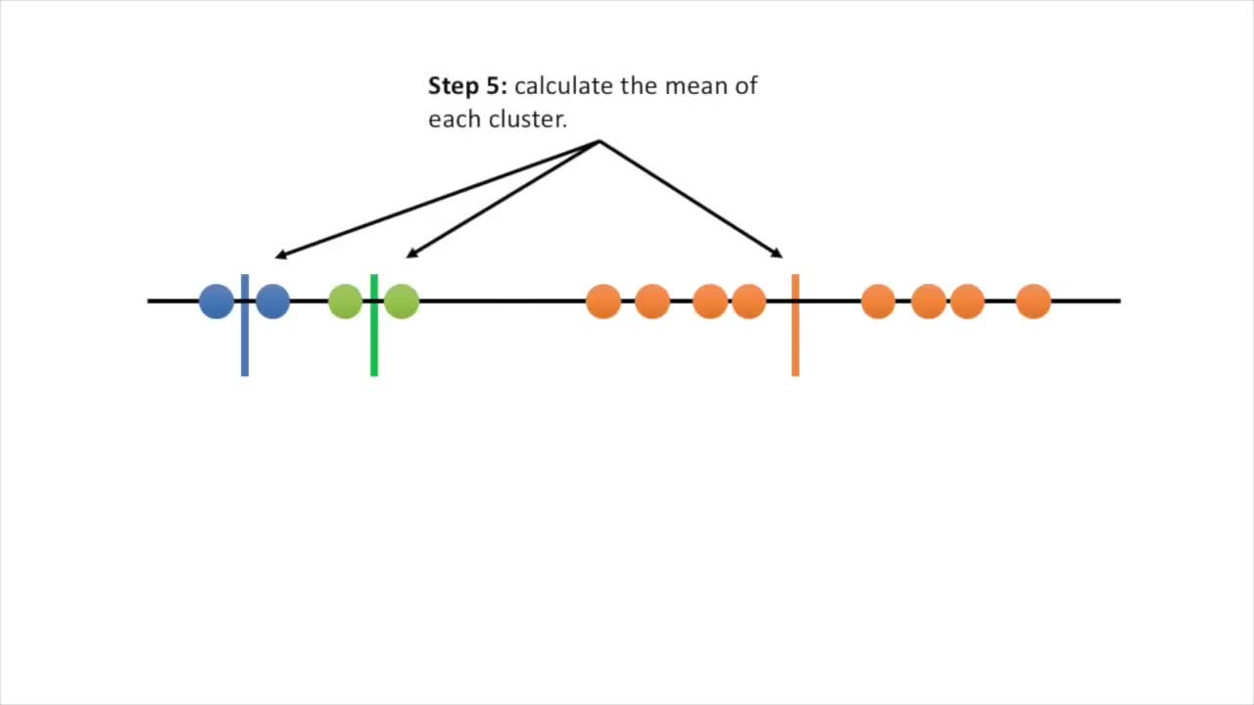

Slide 15
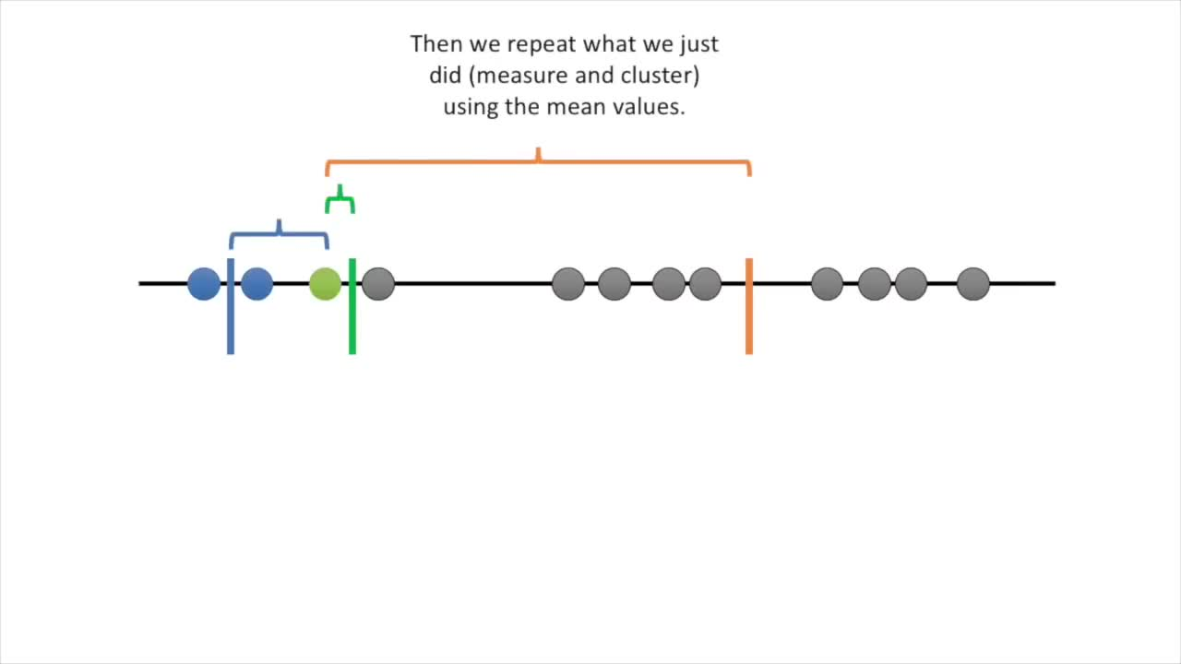

Slide 16
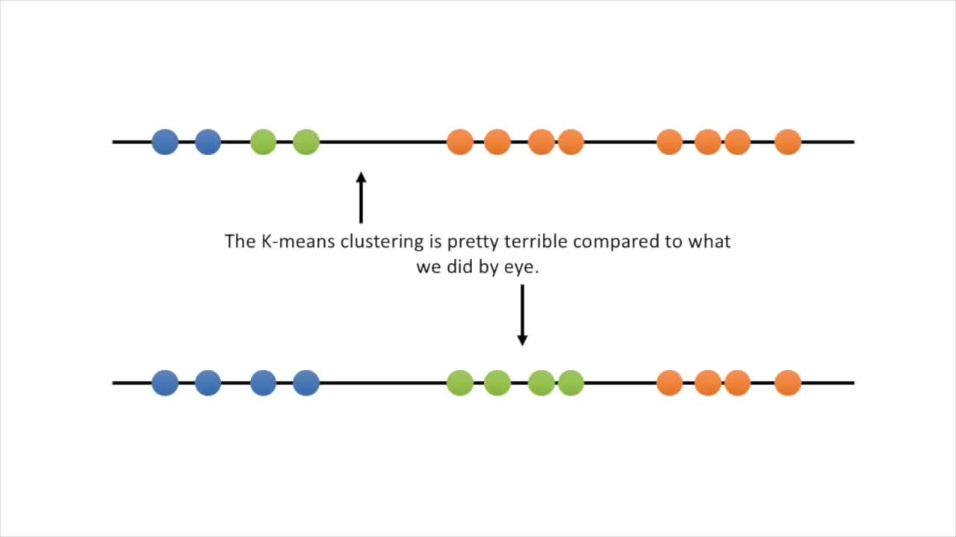

Slide 17
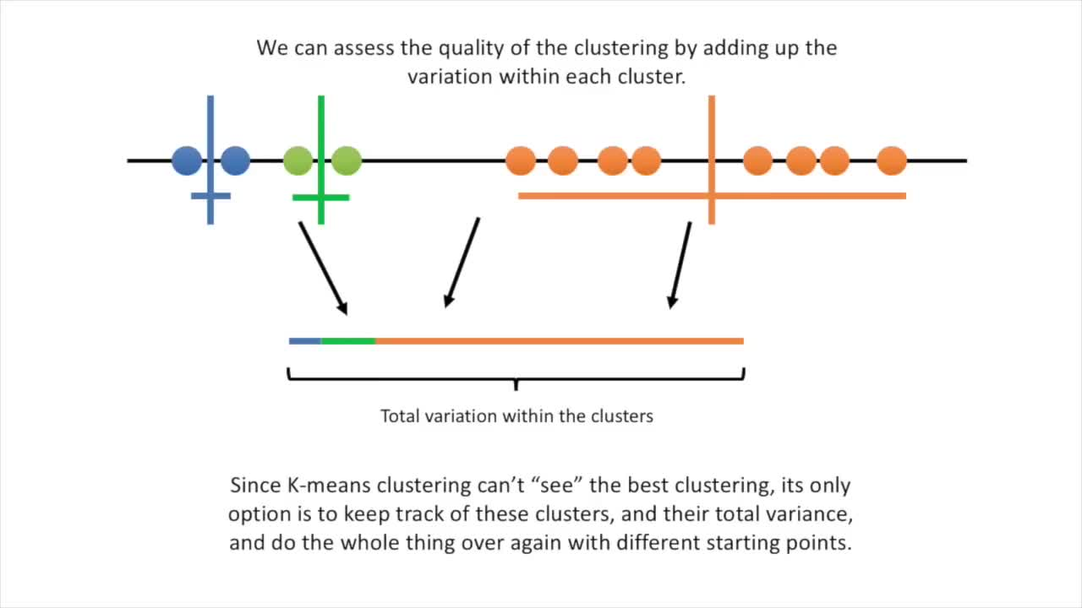

Slide 18
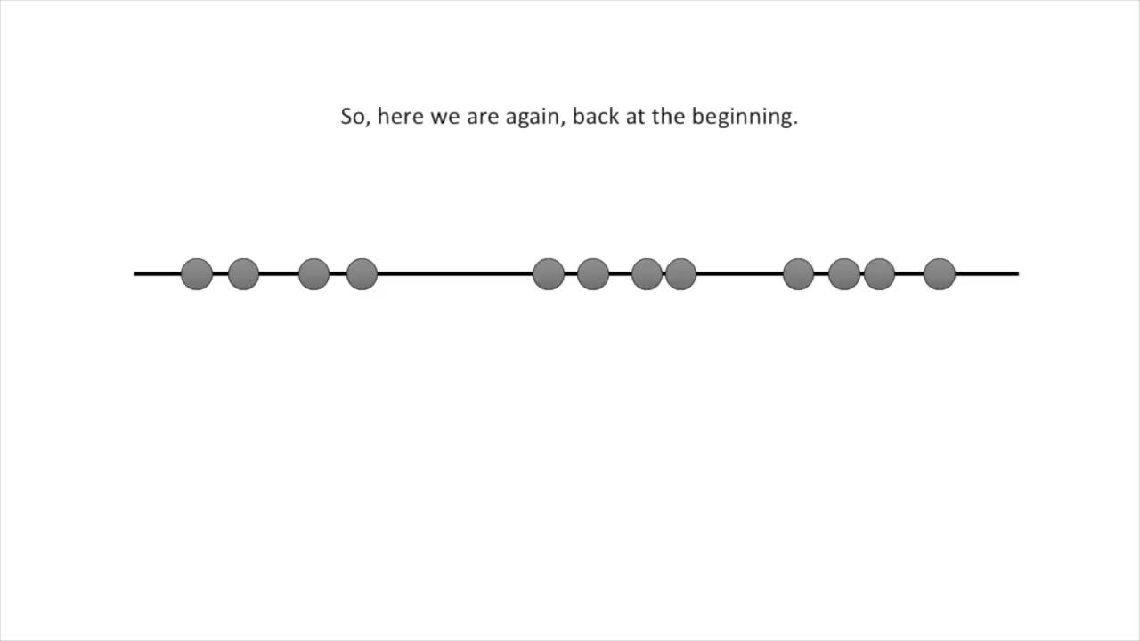

Slide 19
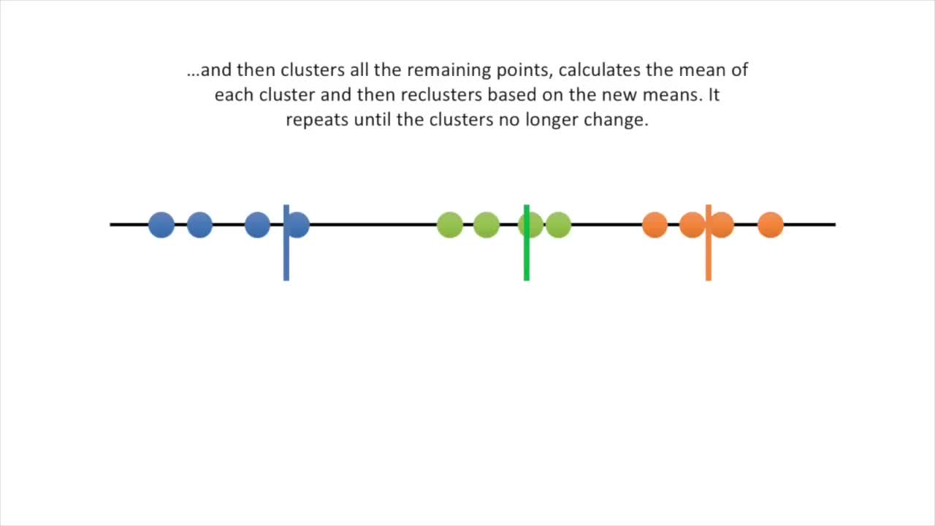

Slide 20
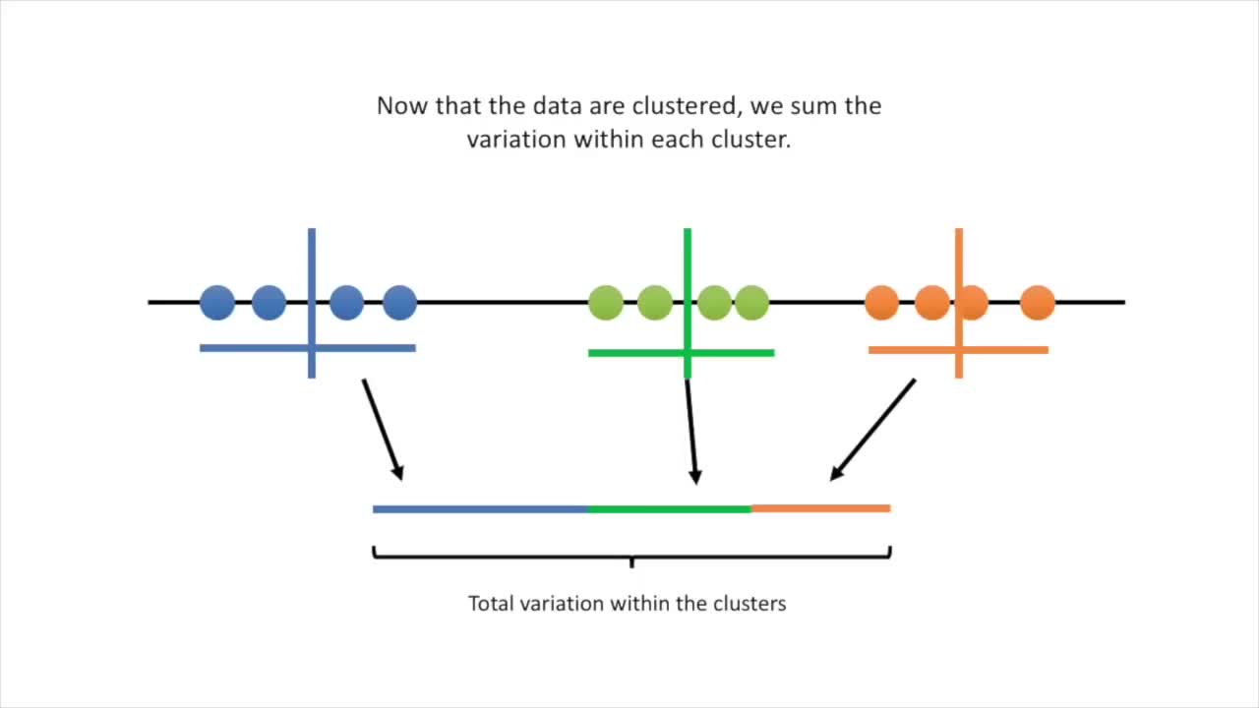

Slide 21
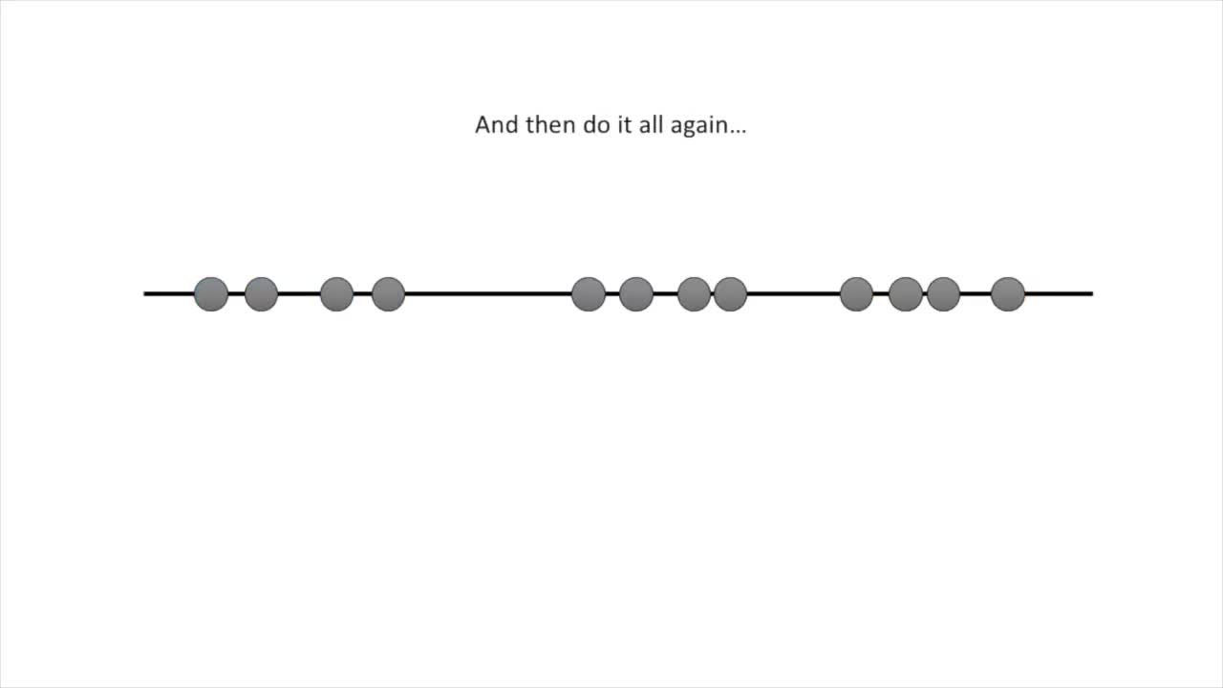

Slide 22
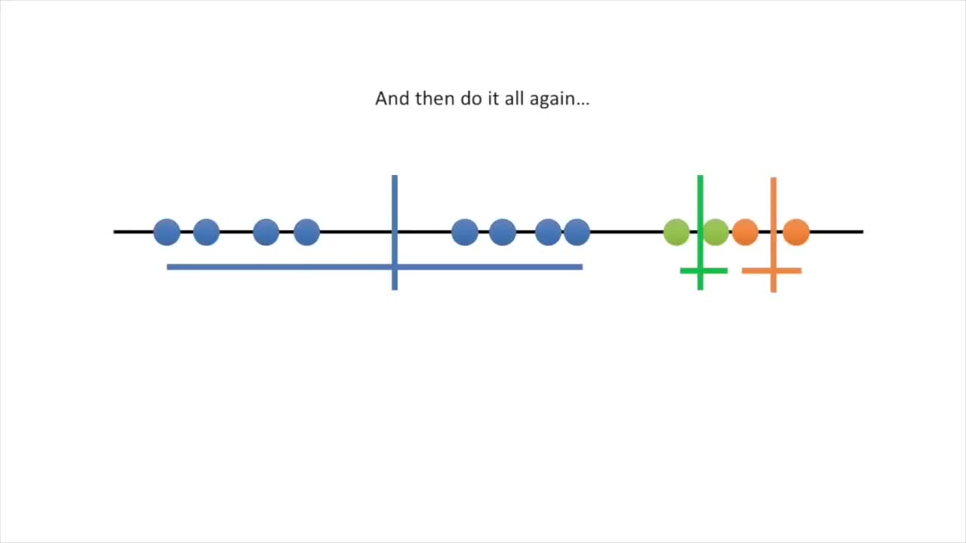

Slide 23
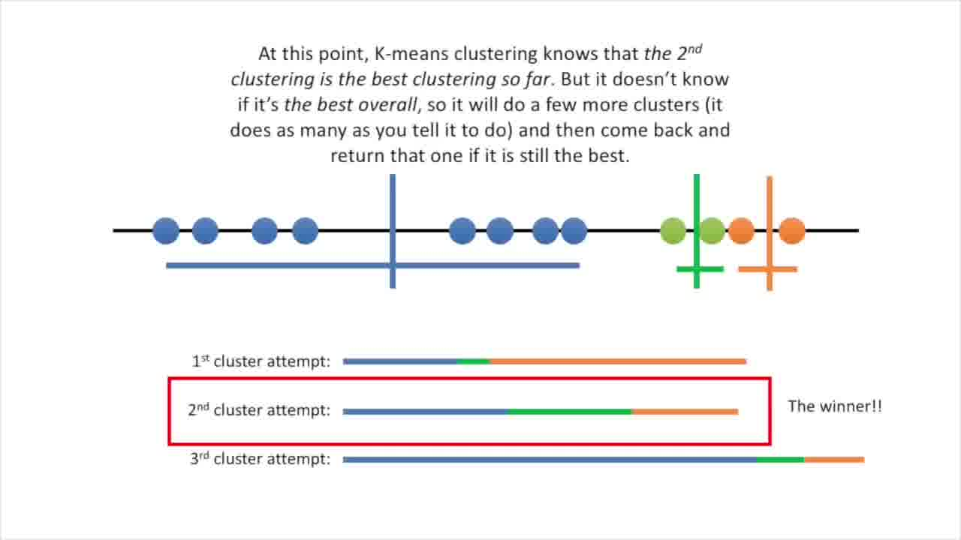

Slide 24
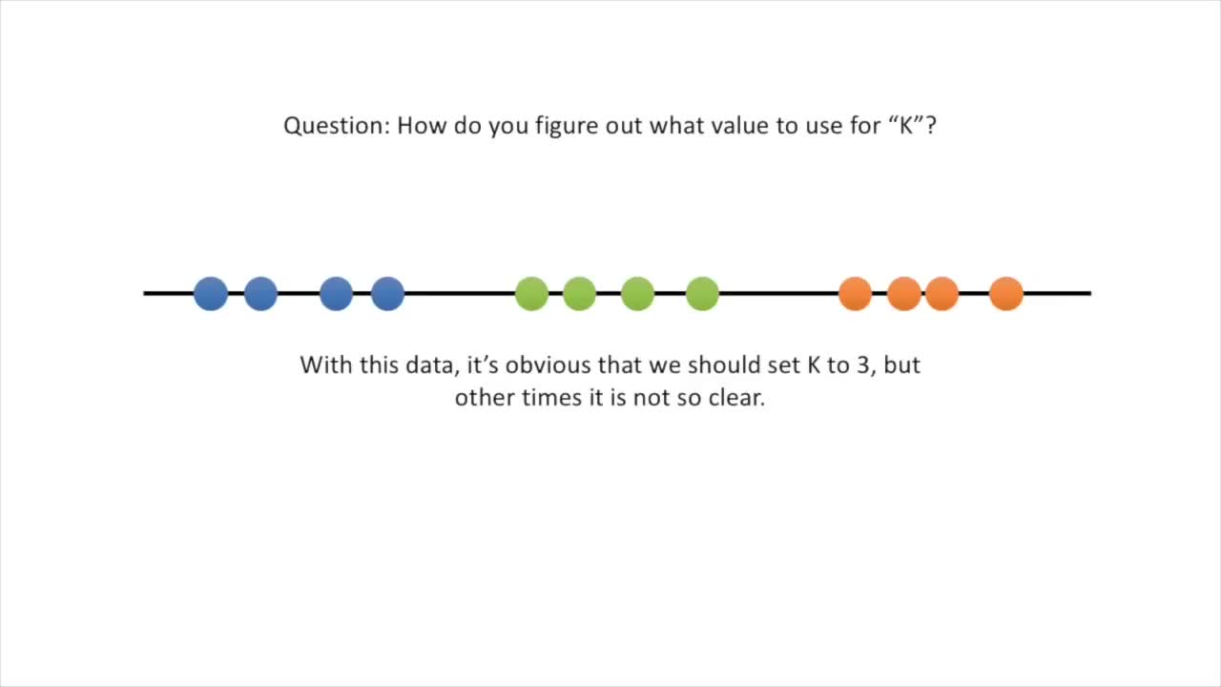

Slide 25
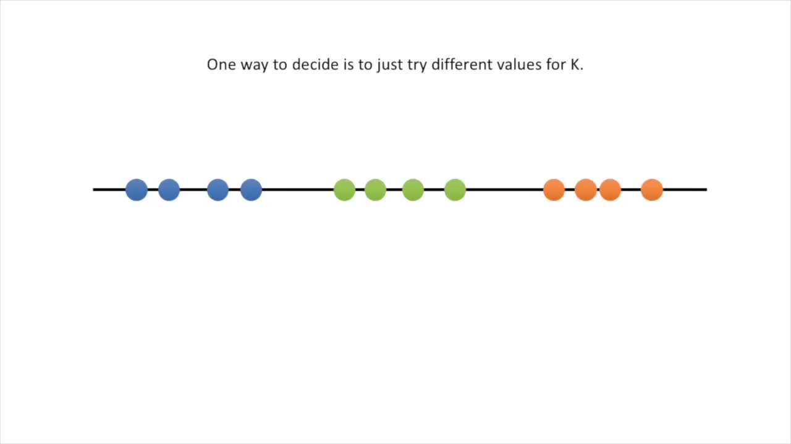

Slide 26
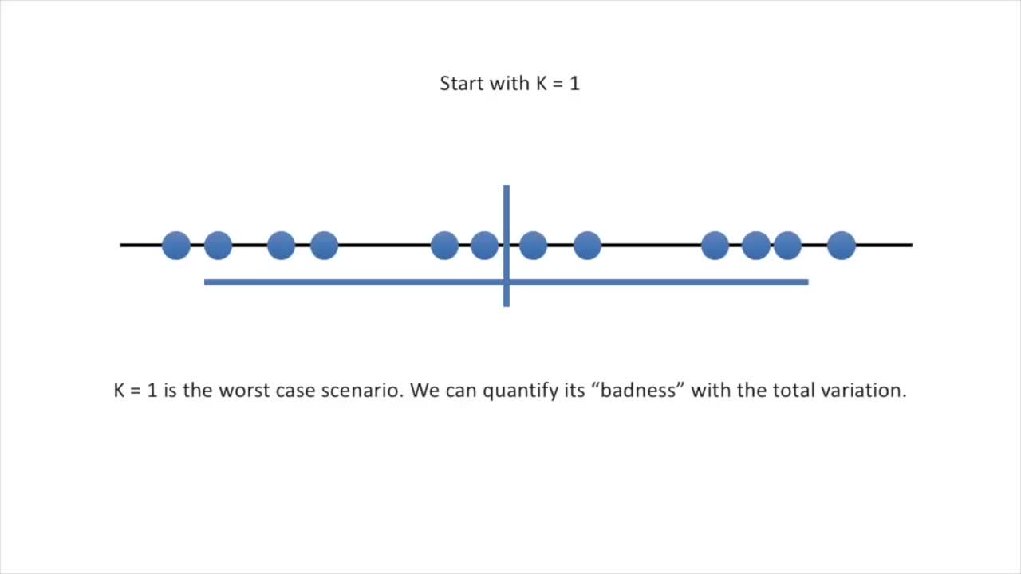

Slide 27
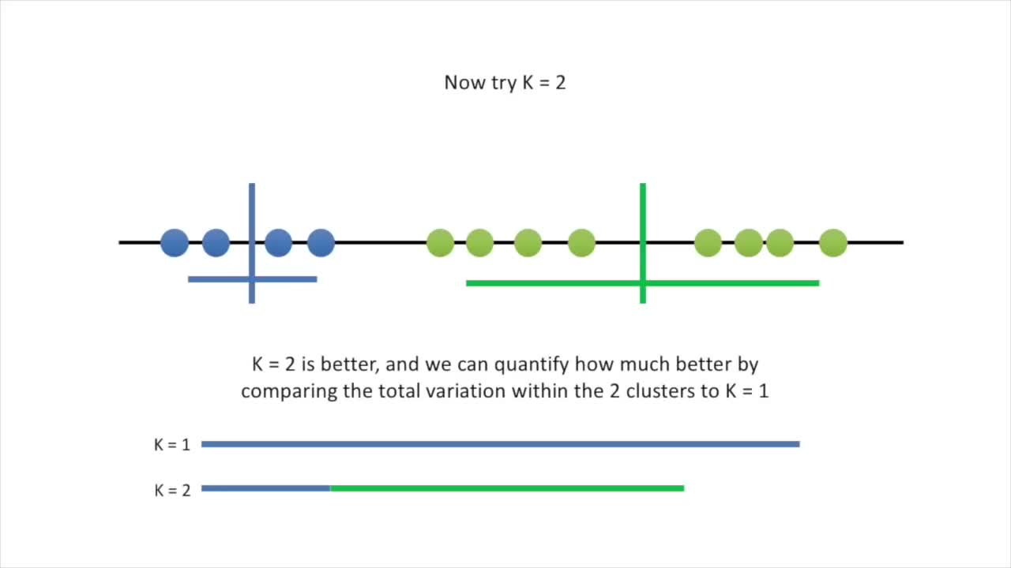

Slide 28
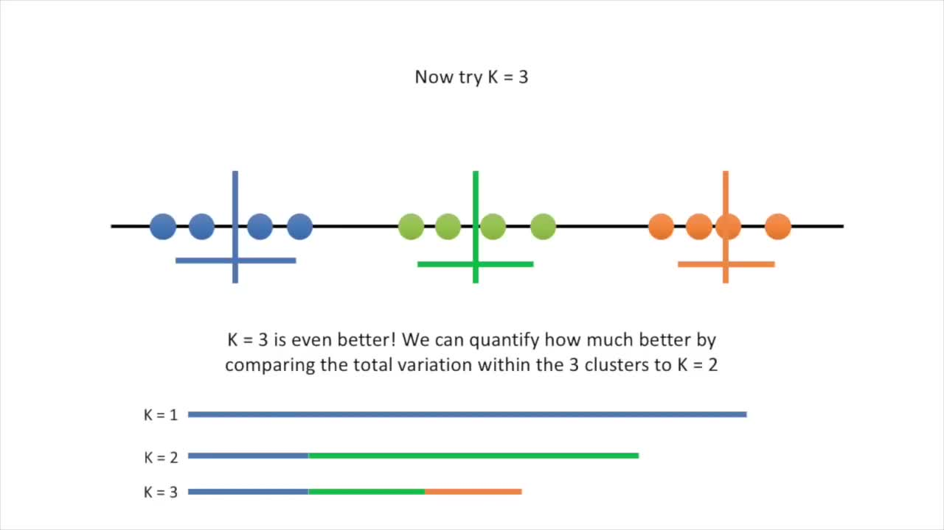

Slide 29
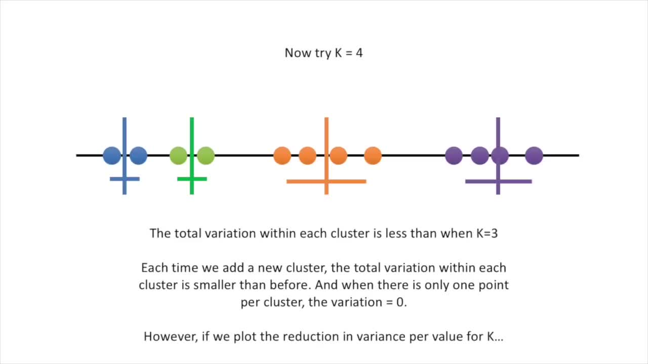

Slide 30
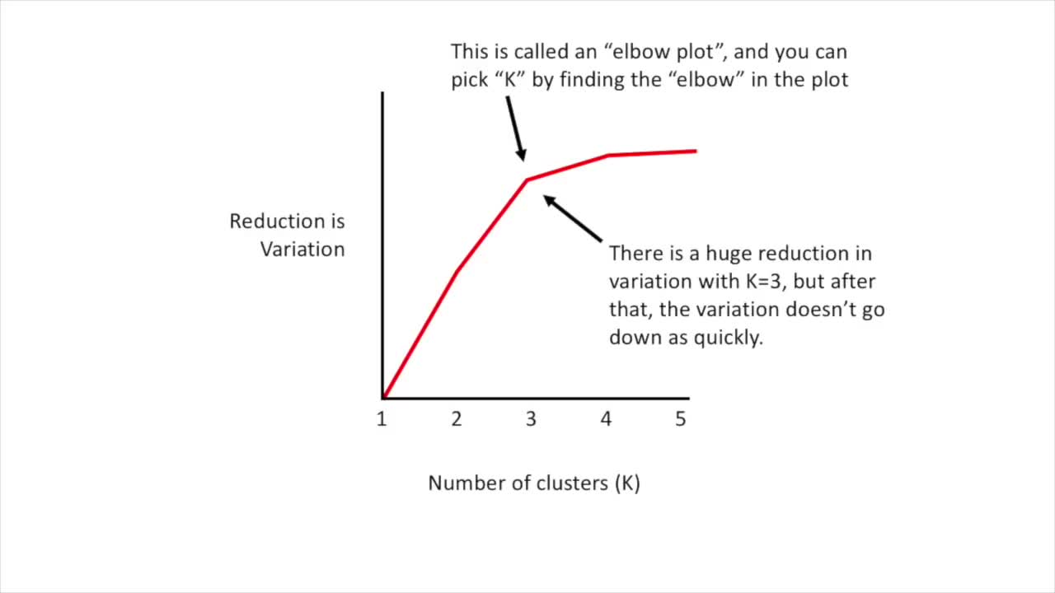

Slide 31
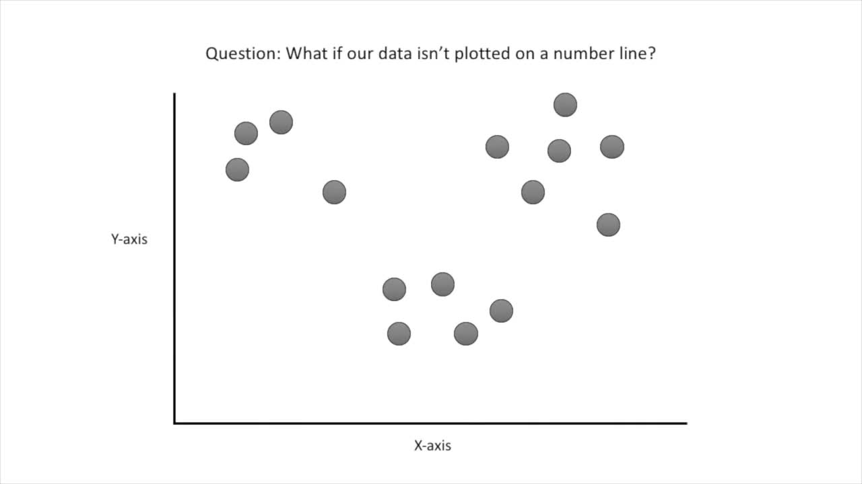

Slide 32
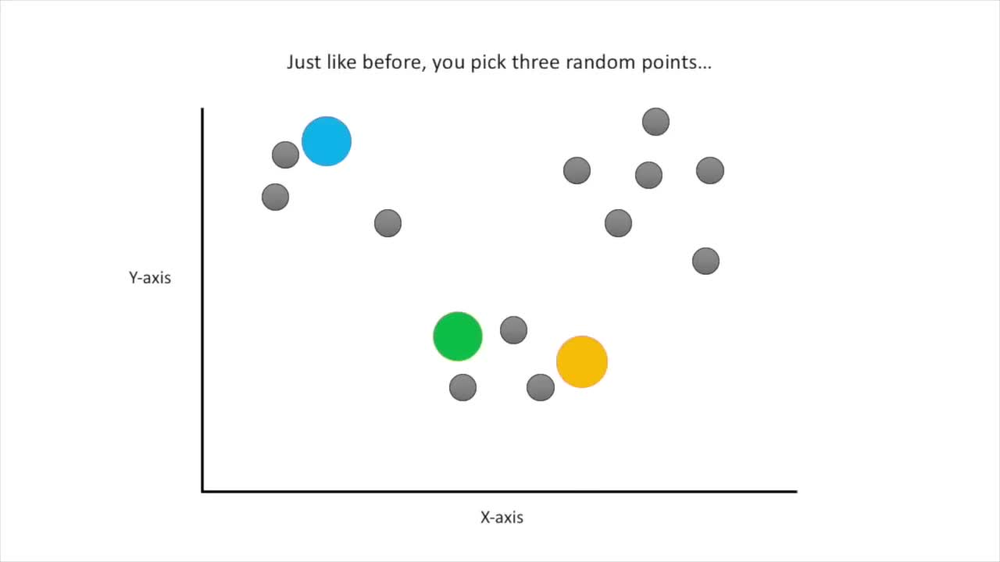

Slide 33
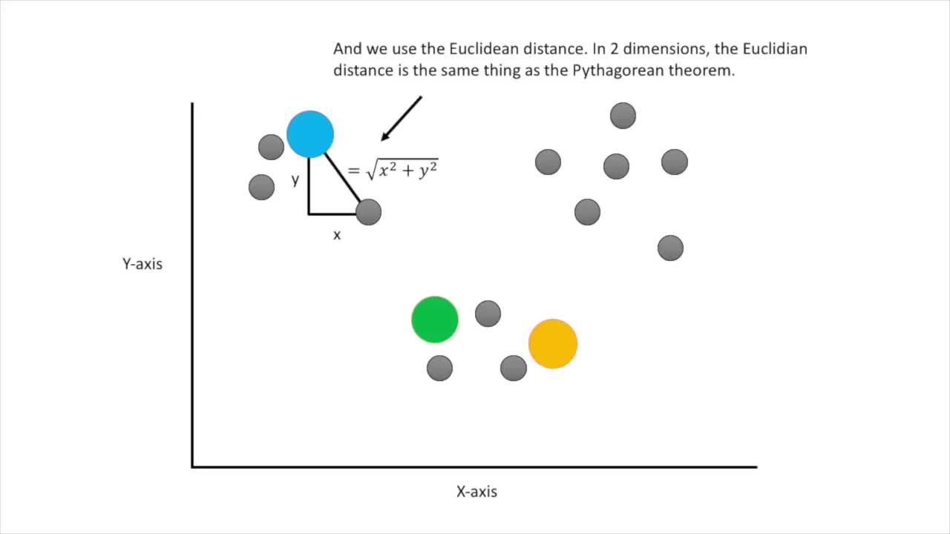

Slide 34
