Slide 1
Covid-19 Vaccine in Turkey MIS376- H.Kemal İlter
Ebru Çıplak
17030411031

Slide 2
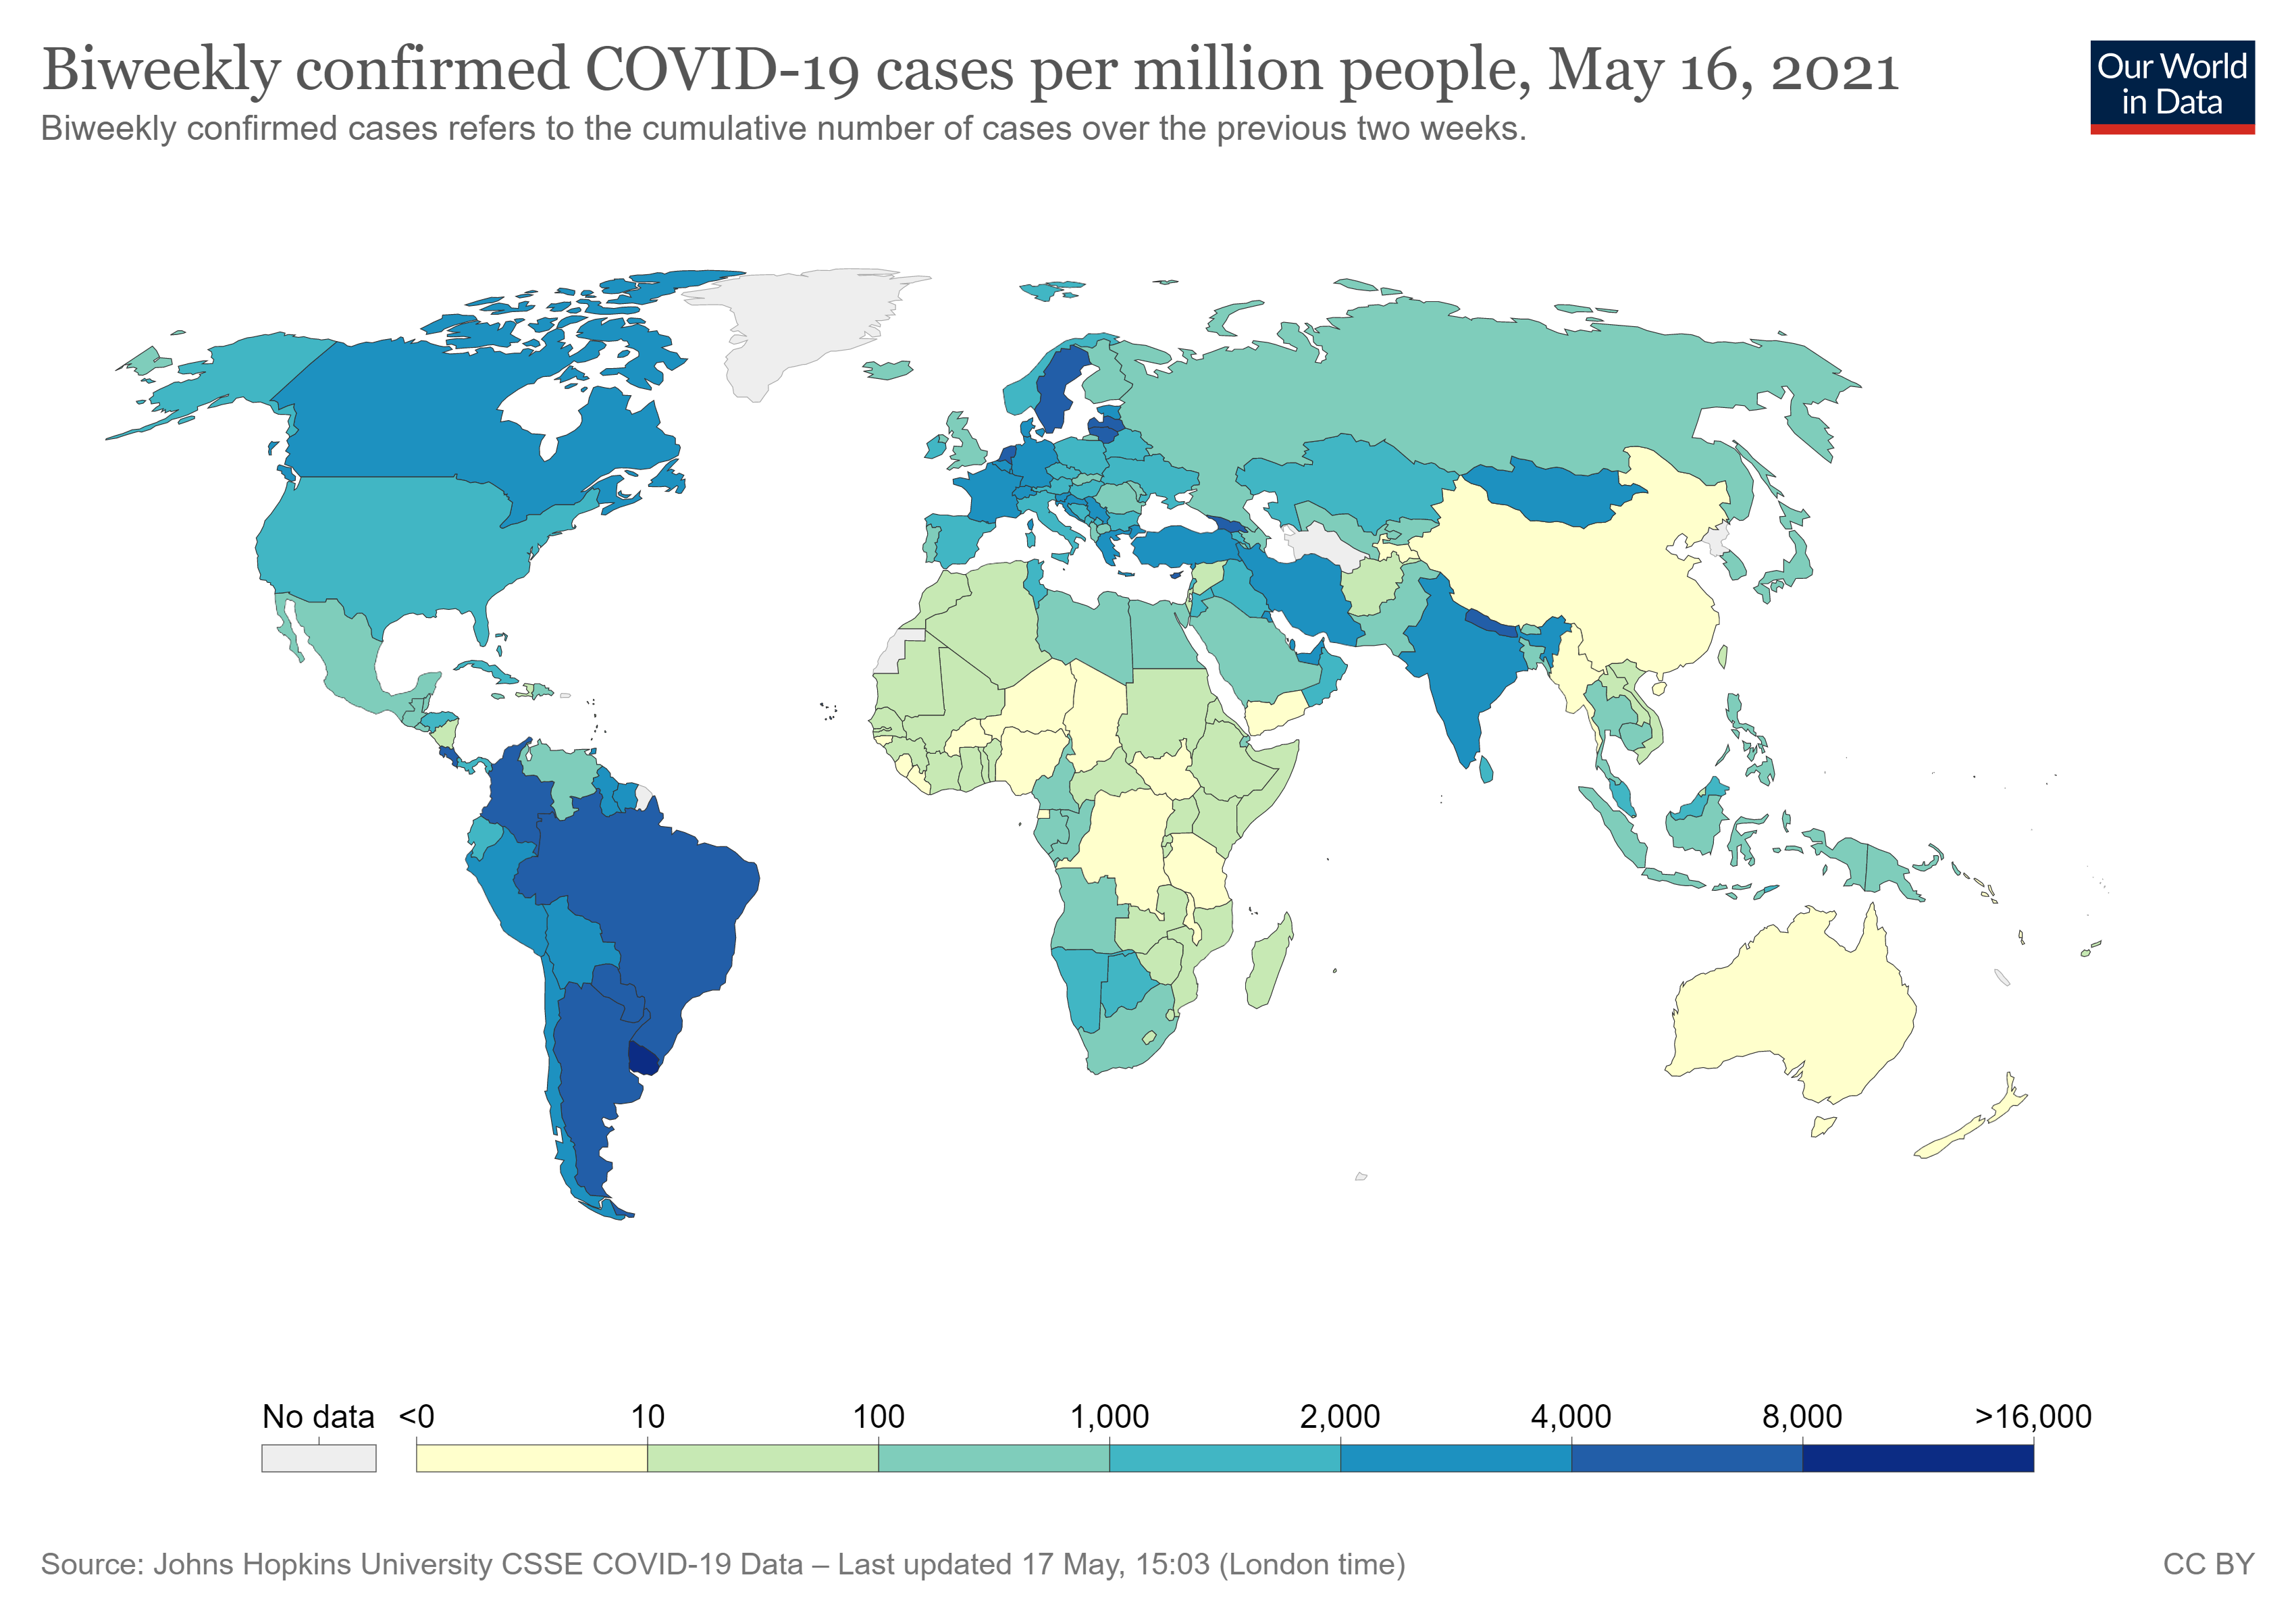
Covid-19 has been a virus that shook our country and our world. The health sector, economy and tourism sector of the countries have been adversely affected by this virus. Health, economy and tourism are interlinked. Citizens have been highly affected by the loss of their lives, the loss of their families' relatives or permanent damage to their bodies due to the Covid-19 virus. Countries have implemented closures taking into account the economic conditions. With closures for about 15-20 days, citizens were banned from going out on the streets, only the places where compulsory items such as markets can be bought open. There is only one solution to this epidemic, which affects the whole world so badly.

Slide 3
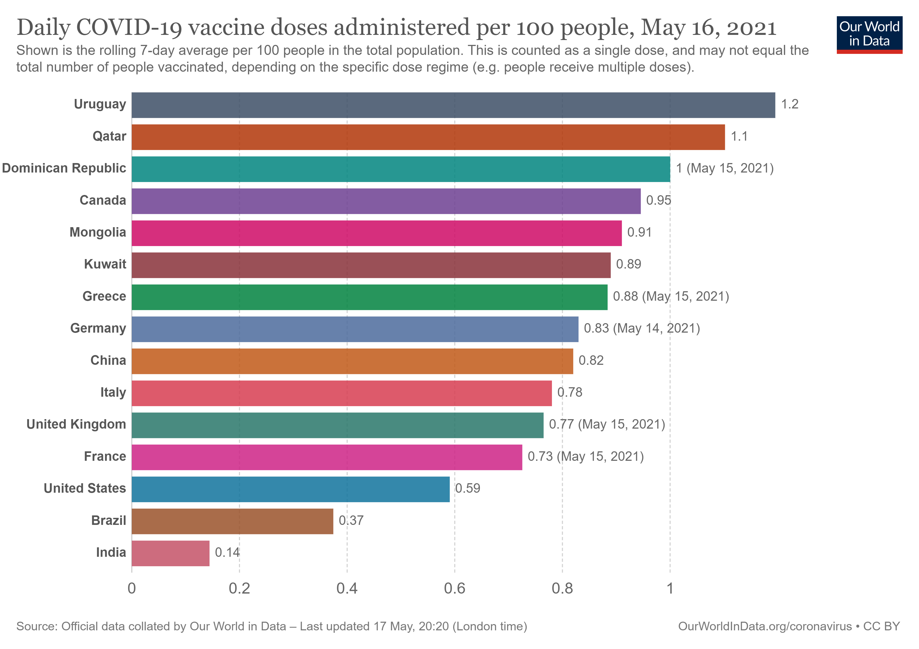
Questions such as which countries have vaccinated all their citizens, what is the status of vaccination in our country, will be sought with data visualization. There are many people who are victims of the vaccine. One of these people is my mother. Since Covid started, she was afraid to even go to the grocery store because my mother had diabetes, blood pressure and kidney disease. His social life has disappeared. We took care to constantly wash everything we bought from outside, not to accept guests at home, and not to go out except when forced to leave. This situation started to get boring after a while. He has been waiting to be vaccinated for 1 year. There are many people waiting for the vaccine, like my mother. Vaccination of all countries brings citizens back to their normal lives. They don't have to live with fear. In this study, we will see how quickly countries were able to intervene in the difficulties faced by citizens and in how long did they vaccinate all their citizens.

Slide 4
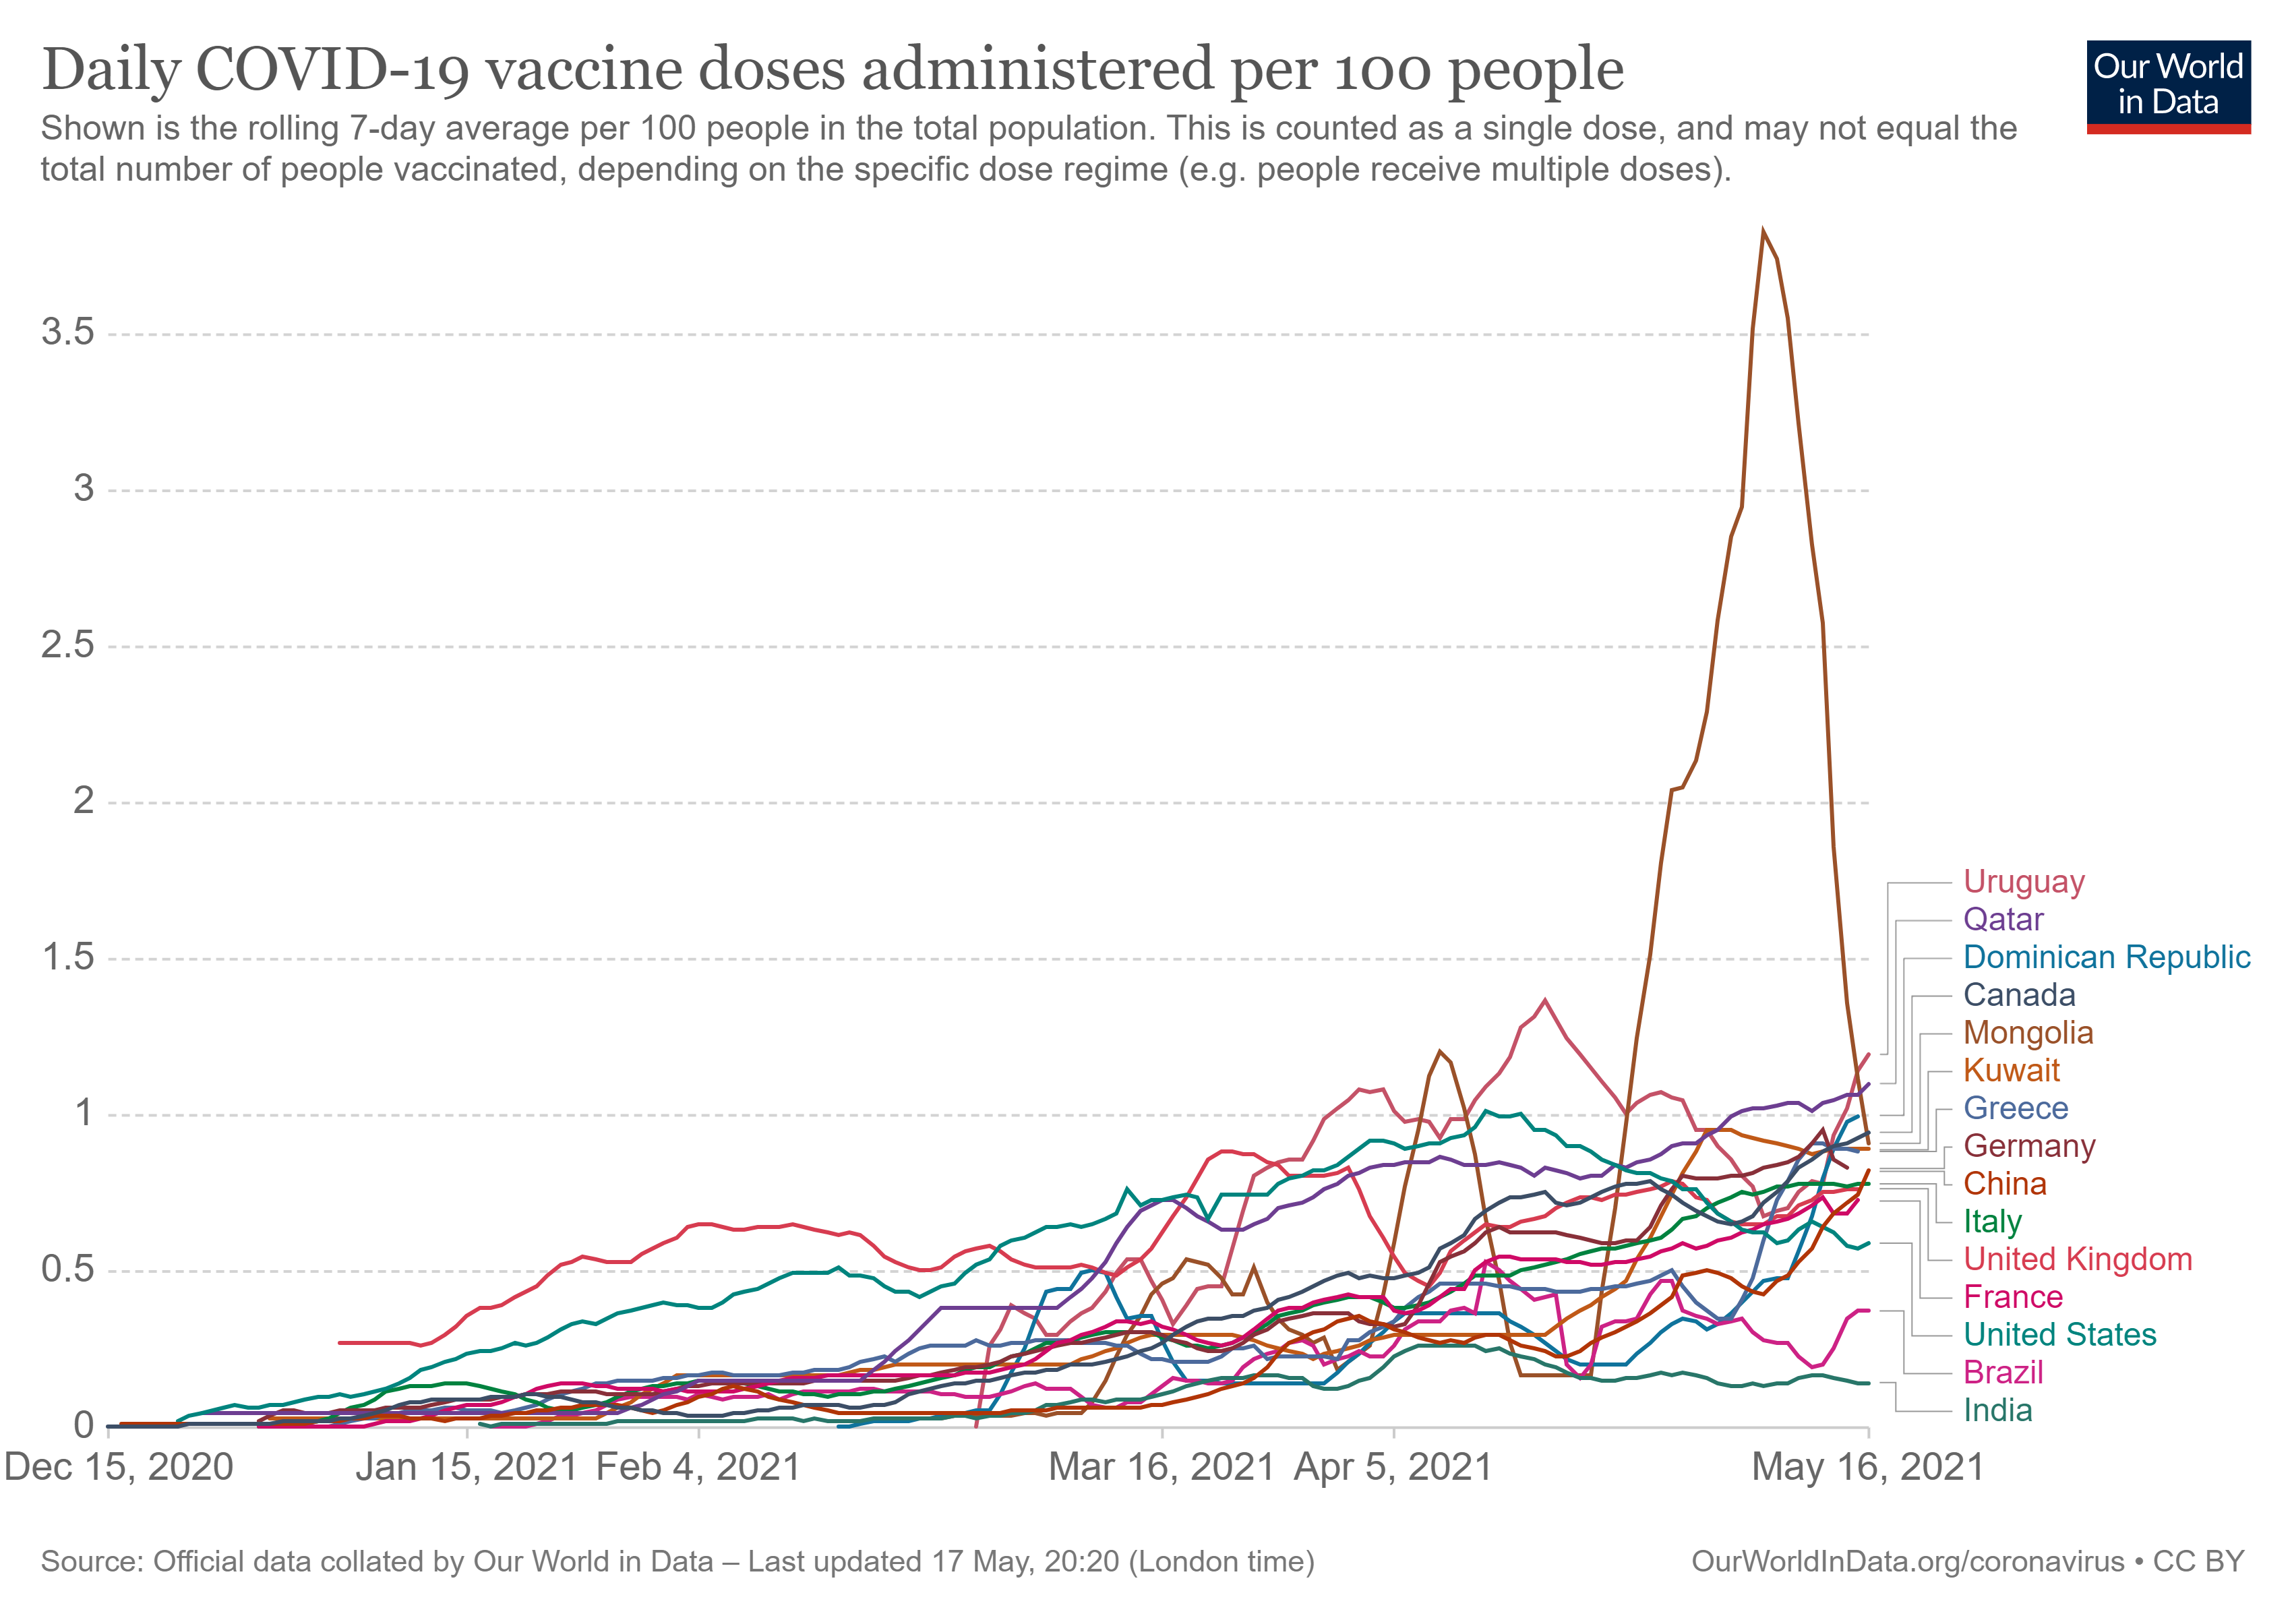
With the increase of Covid-19 Virus, the number of scientists trying to find a vaccine has increased. Some are continuing these studies for world health, but some scientists are conducting vaccination studies because of their economic interests. Considering these concerns, false statements emerged in the media. Most news organizations have started to spread rumors that a chip will be placed in our body with the vaccine. With these rumors, some citizens do not want to be vaccinated. On the other hand, some citizens did not want to be vaccinated because they did not know the effects of the vaccine on their bodies. Within these events, vaccination studies have slowed somewhat. Turkey acted quickly in procuring vaccines and bought vaccines from China, but soon after, the vaccine problem occurred in the world. Countries wanted to buy vaccines but could not supply them. Thus, the process was prolonged.

Slide 5
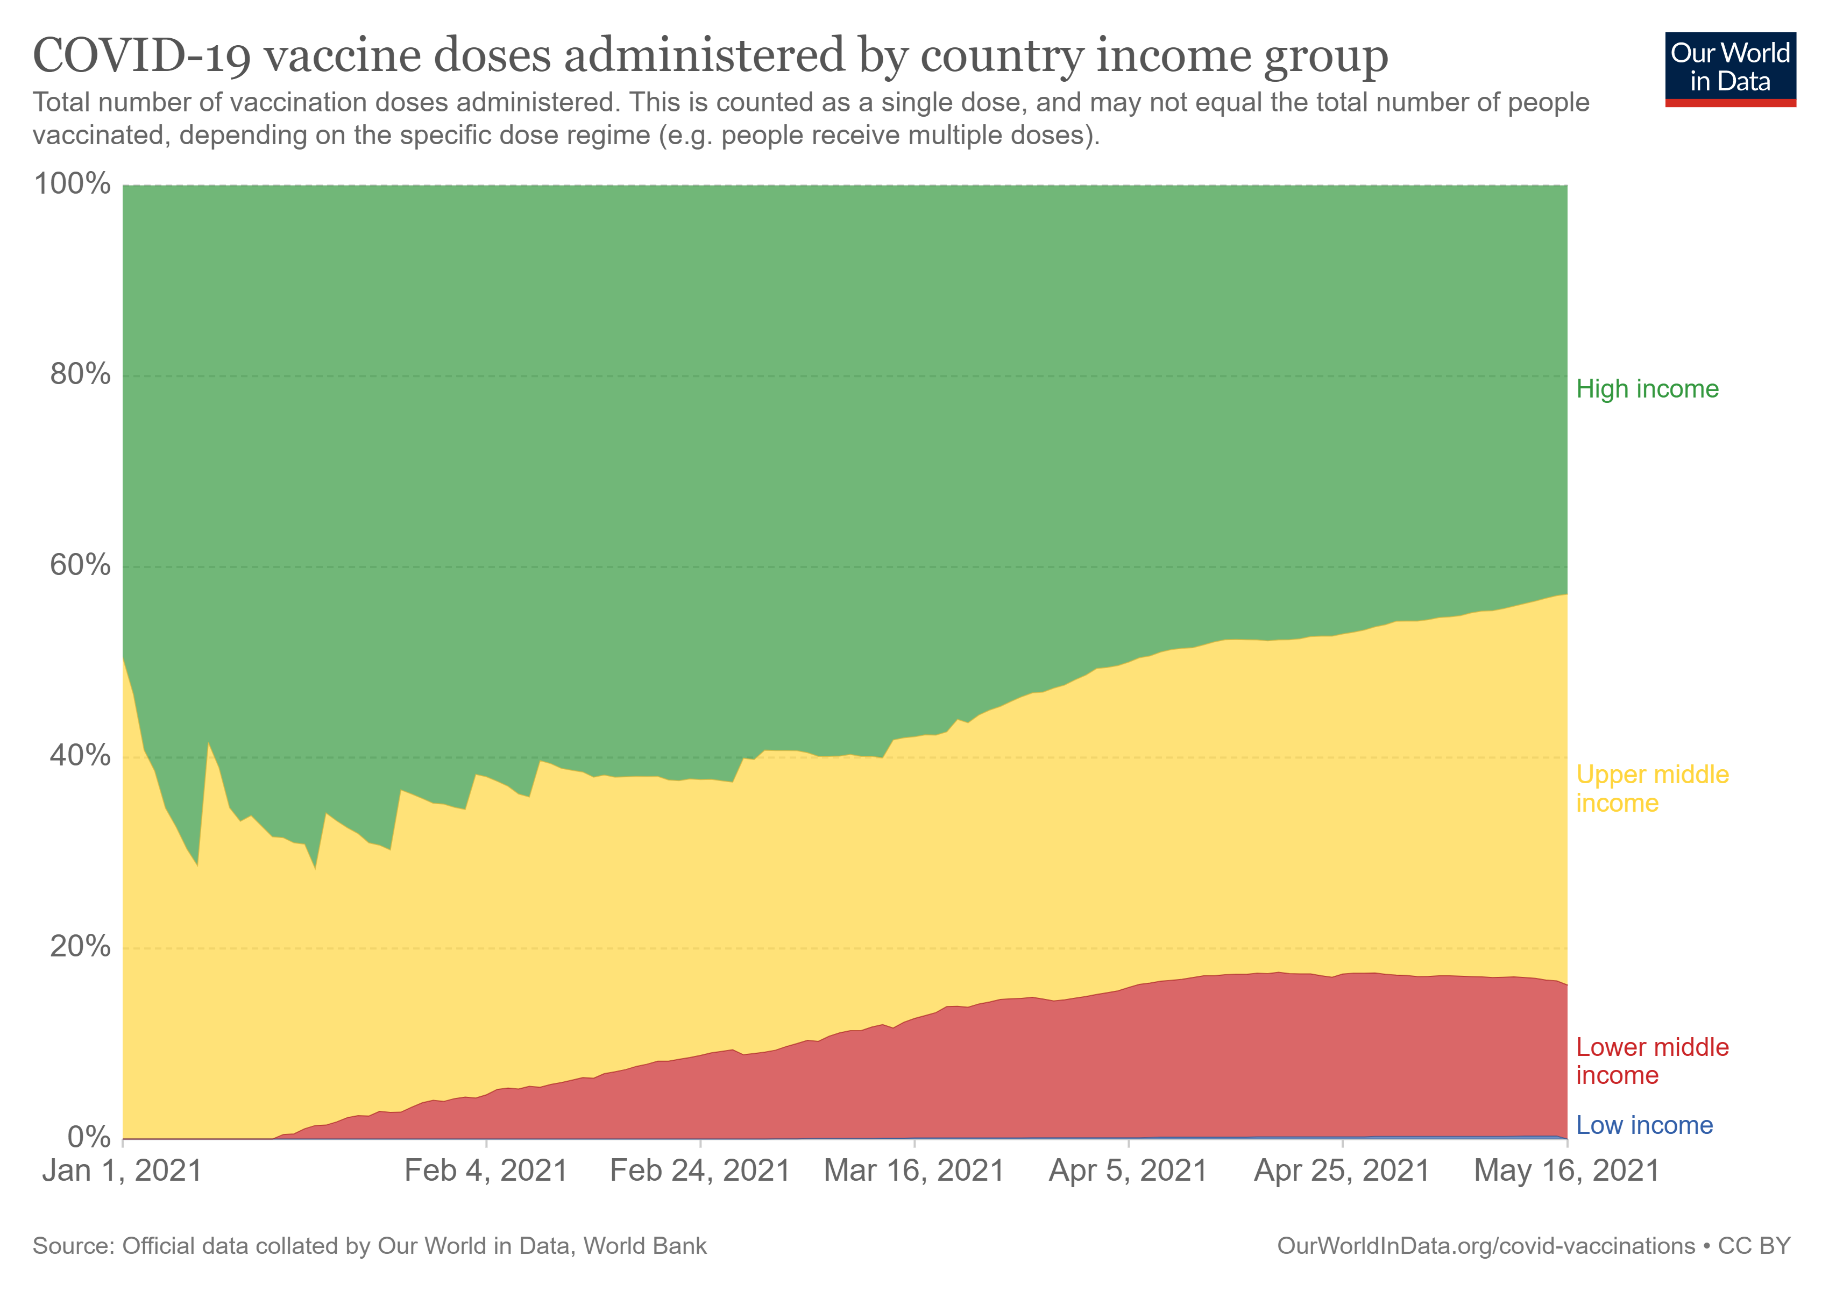
Many citizens, like my mother, have been victims of the prolonged process. Schools have switched to distance education, and citizens from many sectors such as craftsmen and farmers have suffered due to the prohibitions. The country's economy collapsed due to the prolongation of the vaccine supply phase and the slow vaccination in the country. Other countries have completed the vaccination, although Turkey could not do this despite vaccinating all its citizens. The competition in both the population of the country and the supply of vaccines did not allow this. Citizens are afraid of leaving their homes for more than 1 year and have no social life. In this study, I focused on my mother. My mother's social life is over for the last 1 year. She even does grocery shopping online due to her chronic illnesses. With the data I collected, I examined the vaccination studies of Turkey in detail.

Slide 6
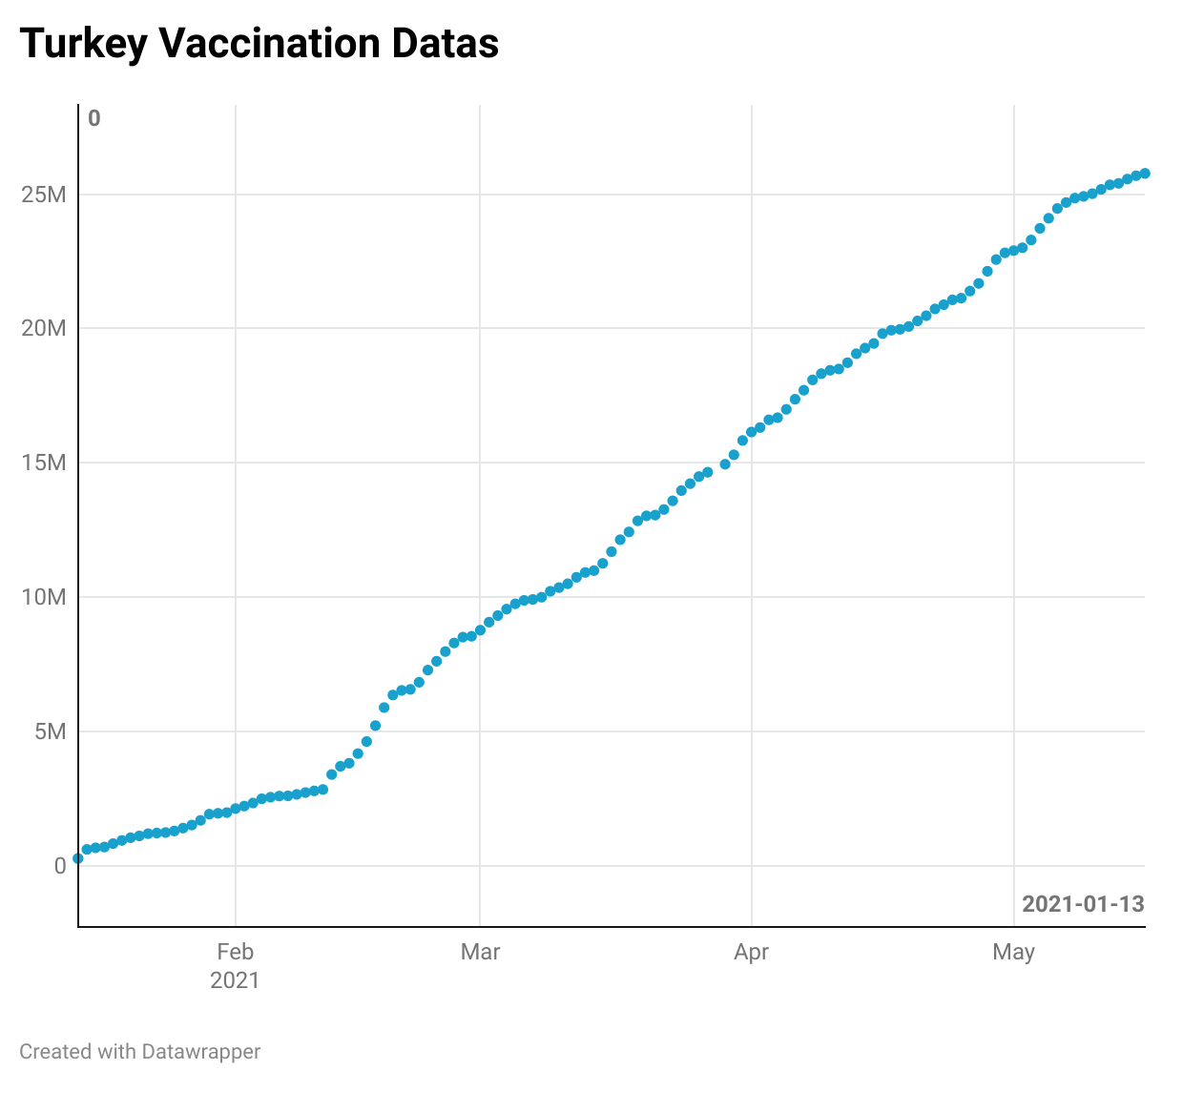
I used the Datawrapper application to visualize the data I collected in my project. I collected Turkey Covid-19 vaccination data for data visualization. I have reached the vaccination charts and data in the world on this site. I have reached these data with the help of foreign sources in Turkey. These sources are not the official sources of Turkey. Since the websites I have found contain data from all countries in the world, I had a hard time collecting the data of Turkey. I created an excel file by combining the data from the sources I found. Then I examined this data and used the necessary parts. I took care to use the necessary and correct data for the visualization process. The graph on the right is the graph that I visualize by collecting the data.

