Slide 1
Blockchain
An introduction

Slide 2
overview
Why?
-> Which problems do we encounter?
What?
-> What do we need to solve them?
How?
-> How does it work? Exemplified by Bitcoin

Slide 3
Why: Current Web 1.0 & 2.0
Internet of communication
1.0 Websites with consumers (read)
2.0 Websites with prosumers (read & write)
-> Users can share content and interact (Youtube, Twitter.. )
3.0 Software Agents – Systems that can interact through APIs (read, write & execute)
-> Interconnect all applications (computer – to – computer)

Slide 4



WHY: Internet of value
Digital vs. Analog problem
Double spend problem
=> Rely on intermediaries with established trust.

Slide 5
WHY: Problems
Efficiency – Transaction take days and go through various systems
Availability – Service requires authentication of personality etc. (Problematic for machines of bootstraping)
Integrity – Data is stored in a central database of intermediary
Reliability – Trust is dependent on trusted intermediary
Cost – Fees etc. Make micropayments hard to impossible
Security, Privacy ...

Slide 6
WHY: VALUE ≠ money (Not only)
Everything of value e.g. not easily replicated
Government bureaucracy – Land registry, Company Ownership, People engagement, Votes etc.
IoT – Physical devices (E.g. Library books), self-driving cars etc.
-> Need communication and value exchange between them
Financial Services – easy access and reliable transfer is essential for economic development
...

Slide 7
What: The blockchain
A distributed ledger, which guarantees immutable data, equal and universal access and establishes trust without middle parties.
Everyone can access and have a record
No corruption of data – immutable
Data owned by you – only publish what's needed/wanted ("Cash-Pay")
Payments, no matter what size, in seconds/minutes (micropayments)
Enables automated agreements "smart contracts" (agree & settle one step)
Software Agents can trade value without human interaction

Slide 8
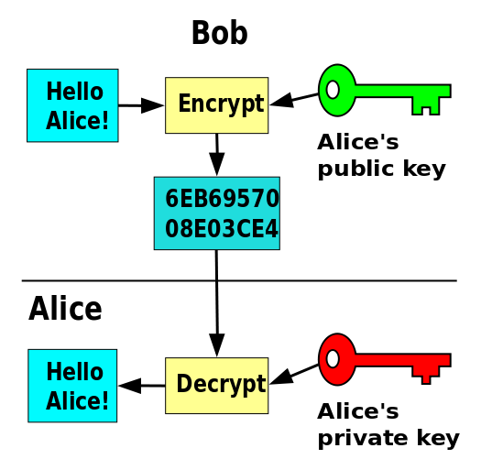
HOW: The magic behind
Researched and a lot of different approaches
Main difference e.g. private, public or hybrid blockchains
All different industries or general
Example in finance: Bitcoin – Crypto Currency
Hash function
Public/Private Key pair
Data
F(x)
QmQ7AE8HiXKYyqW8jEYK4b7dqWNxmQqYVdPeUY8nxbzGBB

Slide 9
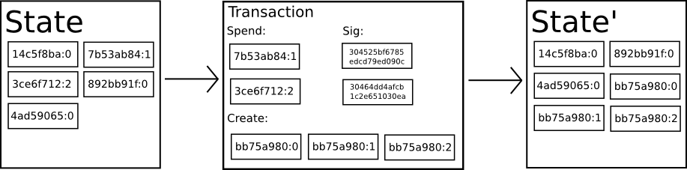
HOW: Transition System
State Transition System
State = Ownership status of bitcoins

Slide 10
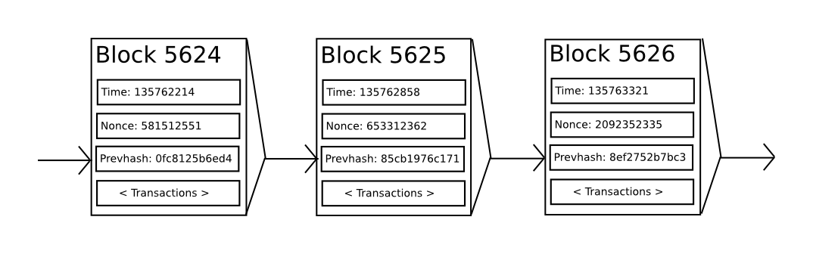
HOW: Consensus system (Proof of work)
Consensys system – Longest chain is always the main one.
Packages of tranactions = Blocks

Slide 11
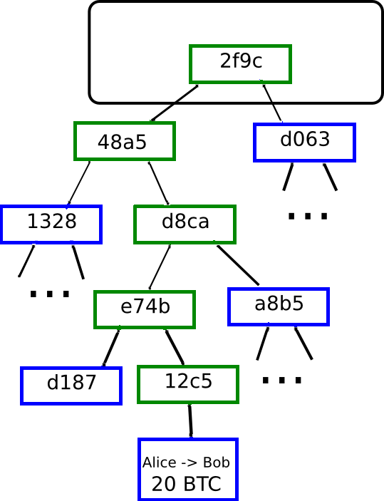
How: Mining
Merkel Tree
Check validity of block –
timestamp correct?
prev hash exists?
Check transactions validity
Proof of work => trial & error Nonce (computational power)
Scalability feature = Only hash block-header
~ 200bytes : Timestamp, Nonce, prev. Hash, root of data
Transaction data is stored in Merkel tree

Slide 12
Additional
Scripting in BTC
Lack of turing completeness = no loops => inefficient, long code
Value blidness => No fine grained control over amounts
Lack of state => Only spent/unspent (no intermediary state e.g. „In contract“/“reserved“)
Blockchain blindness => Can‘t use prev. Hash/Nonce => harder to archive randomness

Slide 13
Blockchain space
Ethereum – Bootstrap applications on a blockchain
Hyperledger – supported from IBM & Linux foundation
Zcash – anynomity through encrypted transactions
Abra – Remittance service replacing expensive fees like western union (on bitcoin)
Slock.it – Universal sharing network on the blockchain (ethereum)
Consensys – A firm structured as a DAO (Decentralized Autonomous Organisation)
Enigma.co – Collaboration with private data

