Slide 1

Respective Technologies, Concepts and live-demo
Ebubechukwu Godwin-Ojukwu
Ilka Matzeit
Konstantin Kataman
Majid Farhat

Slide 2

What is Apache Cassandra?
Introduction
Definiton:
Non-relational, distributed DBMS.
Hybrid NoSQL solution combining Column Family and key-value data models.
Background & History:
Developed by Avinash Lakshman and Prashant Malik at Facebook to enhance message search functionalities.
Created in Java by Facebook in 2008, transferred to Apache Software Foundation in 2009.
High performance & high fault-tolerance
Built for scalable and reliable storage of large data arrays, represented as hashes.
Main Properties:
1

Slide 3
What is Apache Cassandra?
Brewer's CAP theorem
Cassandra is classified as an AP database, prioritizing availability and partition tolerance. Not always guarantee consistency across all nodes at all times.
Partition Tolerance
Distributed system can deliver only two of three desired characteristics: consistency, availability and partition tolerance
Consistency ensures that all clients simultaneously view the same data, regardless of the node they access.
Availability ensures that every client receives a response to their data request, even if one or more nodes in the system are non-operational.
A partition in a distributed system refers to a disruption or delay in communication between two nodes
(Cassandra)
(MongoDB)
Availability
(MySQL)
Consistency
Brewer, E., & Fox, A. (1999). Harvest, yield, and scalable tolerant systems. In Proceedings of the 7th Workshop on Hot Topics in Operating Systems - HotOS-VII (pp. 174-178). IEEE. Retrieved from https://s3.amazonaws.com/systemsandpapers/papers/FOX_Brewer_99-Harvest_Yield_and_Scalable_Tolerant_Systems.pdf
2

Slide 4
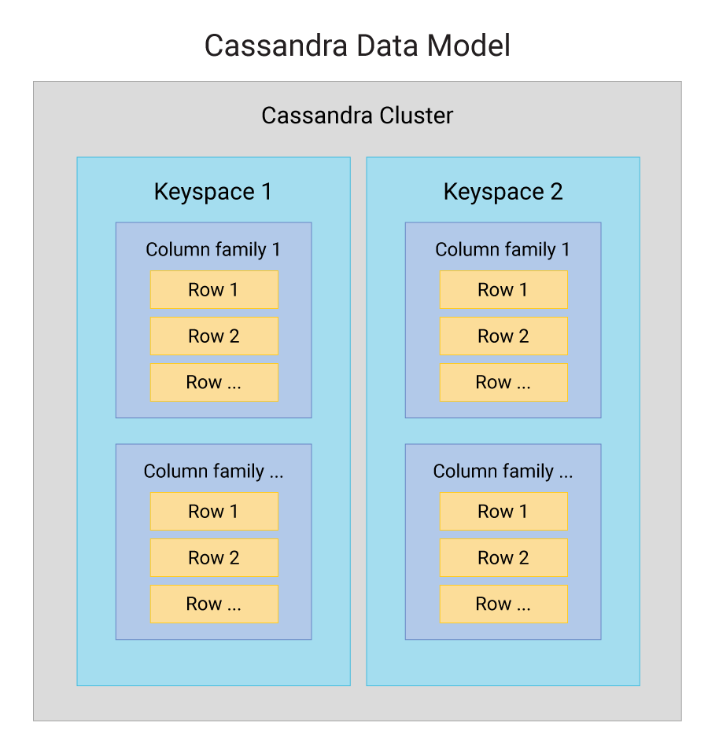
Data Model
Overview
Cluster is a collection of nodes and can be distributed across multiple datacenters.
Keyspace defines how a dataset is replicated, per datacenter. Replication is the number of copies saved per cluster. Keyspaces contain tables.
Tables are referred to as Column Families. Tables are composed of rows and columns.
Column is a single datum with a type which belongs to a row. Columns define the typed schema for a single datum in a table. Tables are partitioned based on the columns provided in the partition key. Tables can flexibly add new columns to tables with zero downtime.
Row contains a collection of columns identified by a unique primary key made up of the partition key and optionally additional clustering keys.
3
DataStax. (n.d.). Architecture introduction. Retrieved 19.05.2024, from https://docs.datastax.com/en/cassandra-oss/3.0/cassandra/architecture/archIntro.html

Slide 5
Data Model
Comparison to RDBMS
RDBMS | Cassandra
RDBMS deals with structured data | Cassandra deals with unstructured data
It has a fixed schema | Cassandra has a flexible schema
In RDBMS, a table is an array of arrays. (ROW x COLUMN) | In Cassandra, a table is a list of “nested key-value pairs”. (ROW x COLUMN key x COLUMN value)
Database is the outermost container that contains data corresponding to an application | Keyspace is the outermost container that contains data corresponding to an application
Tables are the entities of a database | Tables or column families are the entity of a keyspace
Row is an individual record in RDBMS | Row is a unit of replication in Cassandra
Column represents the attributes of a relation | Column is a unit of storage in Cassandra
RDBMS supports the concepts of foreign keys, joins. | Relationships are represented using collections
4
TutorialsPoint. (n.d.). Cassandra data model. Retrieved 19.05.2024, from https://www.tutorialspoint.com/cassandra/cassandra_data_model.htm

Slide 6
Data Model
Peer-to-Peer Model and Data Distribution
Design Philosophy
There is no single point of failure, maintaining operational continuity even if one or multiple nodes fail. Failed nodes can be replaced with no downtime.
Node Architecture
The data is stored in the Node. Every node in the cluster has the same role.
Decentralized Design eliminates master nodes, preventing bottlenecks and single points of failure.
Nodes are logically arranged in a ring to facilitate data distribution.
Data Management
Automatically and evenly distributed across all nodes in the cluster.
Replicated across nodes to ensure redundancy and high availability.
Primarily stored in memory and is written to disk as needed
Data Distribution
Uses hash values of keys to distribute data among the nodes
Query language
Cassandra Query Language (CQL). CQL is a simple interface for accessing Cassandra, as an alternative to the traditional Structured Query Language (SQL).
Node
Node
Cassandra
Node
Node
Node
Node
5
Apache Cassandra Project. (n.d.). Cassandra basics. Retrieved 19.05.2024, from https://cassandra.apache.org/_/cassandra-basics.html

Slide 7
Usage
Data Writing Mechanics
Write Requests
Clients send write requests directly to a node in the cluster.
Coordinator node is responsible for routing the write requests to the appropriate nodes based on the partition key.
Data Handling
Every write operation is first written to the commit log for durability.
Concurrently, data is stored in the memory structure called memtable.
Persistence
When the memtable reaches its threshold, it is flushed to disk as an immutable SSTable (Sorted String Table). SSTables store data frequently in a sequential manner.
Replication
To ensure redundancy and fault tolerance, the data is also replicated to other designated nodes based on the replication strategy defined in the cluster configuration.
Write data
Memtable
Flush
(to disk)
Operation
Commit log
SSTable
Disk
6
Ploetz, A., Malepati, T., & Neeraj, N. (2018). Mastering Apache Cassandra 3.x (3rd ed.). Packt Publishing

Slide 8
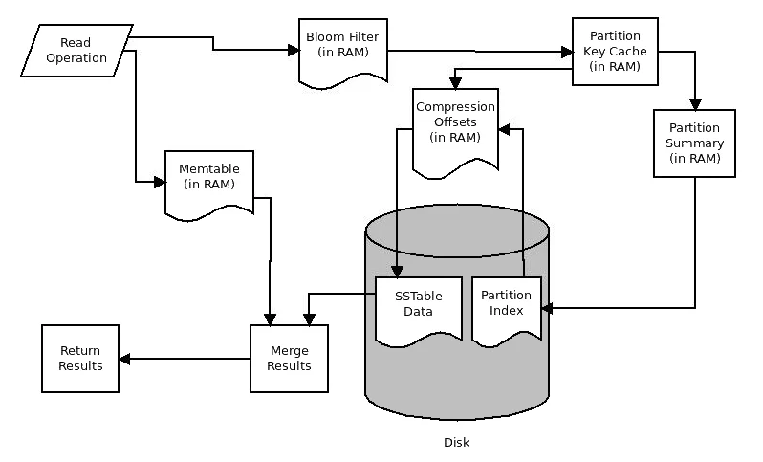
Usage
Data Reading Mechanics
Data will be processed at several stages to discover where the data is stored, starting with the data in the memtable and finishing with SSTables:
Check Memtable: First point of data check.
Row Cache: Checks if enabled for faster access.
Bloom Filter: Ensures data presence in SSTable.
Partition Key Cache: Checks for direct data location if enabled.
Compression Offset Map:
Direct access if partition key is found.
Otherwise, checks partition summary.
Partition Index: Accessed if partition summary indicates.
Locate on Disk: Uses compression offset map to find exact data location.
Fetch Data: Retrieves the required data from SSTable.
Ploetz, A., Malepati, T., & Neeraj, N. (2018). Mastering Apache Cassandra 3.x (3rd ed.). Packt Publishing
7

Slide 9
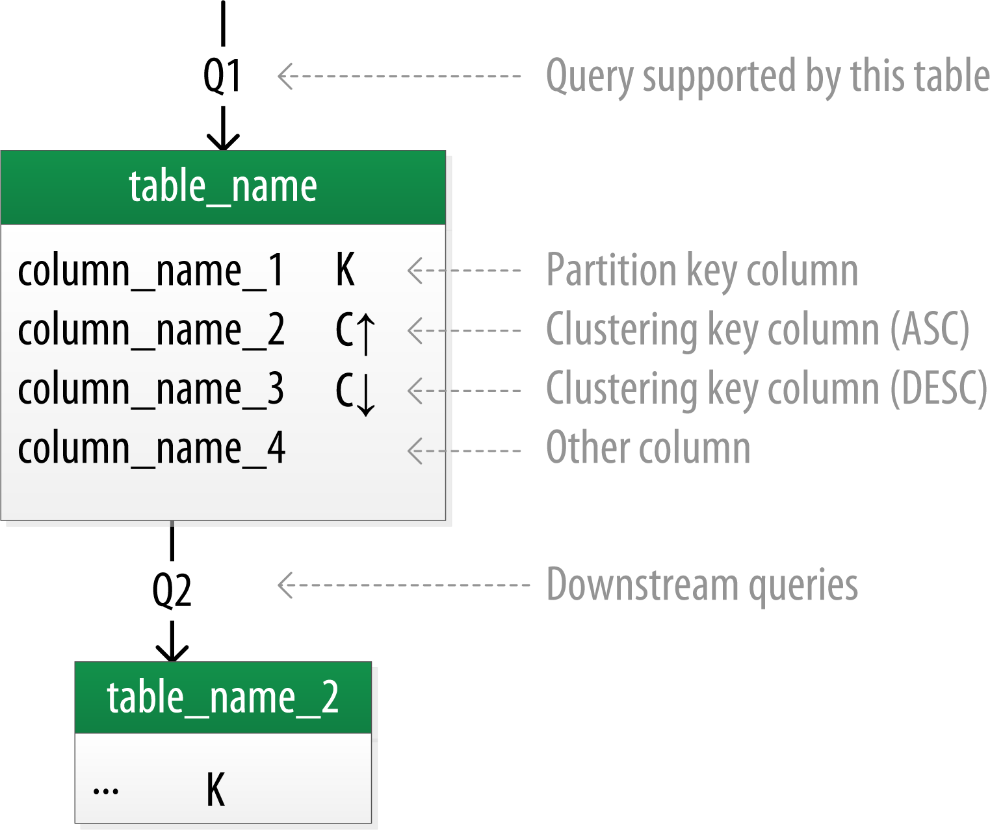
Usage
Logical Data Modeling
Table Structure:
Each table displays a title and a list of columns.
Symbols identify key columns:
'K' for partition key columns.
'C↑' or 'C↓' for clustering columns indicating ascending or descending order.
Query Support:
Lines between tables or entering tables illustrate the specific queries that each table supports.
Apache Cassandra Project. (n.d.). Data modeling—logical. Retrieved 19.05.2024, from https://cassandra.apache.org/doc/stable/cassandra/data_modeling/data_modeling_logical.html
8

Slide 10
Key Components to Configure Cassandra
Gossip
Partitioner
Replication Factor
Snitch
Merkle
Tree
Mem
table
Gossip: A protocol that allows nodes to exchange information about the cluster's state.
Partitioner: Determines the distribution of data across nodes by assigning data based on a hash of the partition key.
Replication Factor: Specifies the number of copies of data across nodes, enhancing redundancy and availability.
Snitch: Manages how Cassandra recognizes network topology to efficiently route requests and manage data replication.
Merkle Tree: Used for quick data synchronization checks across nodes by summarizing data in a tree structure for fast comparison.
Memtable: An in-memory structure where data is stored temporarily before being written to disk as SSTables when full.
9
DataStax. (n.d.). Architecture introduction. Retrieved 19.05.2024, from https://docs.datastax.com/en/cassandra-oss/3.0/cassandra/architecture/archIntro.html

Slide 11






Use Cases
Industry: Digital Entertainment
Functional Use Case: Personalization, Recommendation, Analytics
Industry: Technology Software
Functional Use Case: Time Series, Internet of Things/ Sensor Data, Analytics, AI/ML
Industry: Banking eCommerce
Functional Use Case: Messaging, Data Store, Fraud Detection
Industry: Shipping Government
Functional Use Case: Internet of Things/ Sensor Data, Time Series
Industry: Manufacturing Technology
Functional Use Case: Time Series, Data Store, Analytics
Industry: Transportation
Functional Use Case: Data Store, Time Series
Source: Planet Cassandra
10

