Slide 1
US – Income project
Ebubekir Kocadag
Melvin Leroy
@BeCode

Slide 2
Data splitting
We split our data in three :
  Training set;
  Cross-validation set;
  Test set.
We don’t want to use the test set in our research so we have an unbiased estimation of our algorithm’s performances.

Slide 3
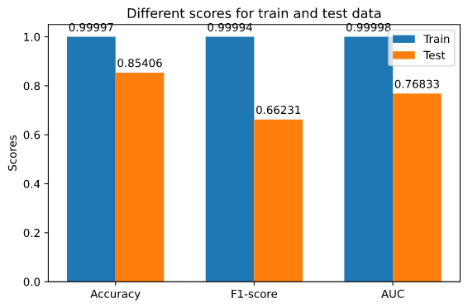
Baseline accuracy

Slide 4
Grid search
We used four different hyper parameters :
  n_estimators : 200, 400, 800;
  max_depth : 8, 12, 16, None;
  max_features : log2, sqrt, auto, None;
  oob_score : True, False.
So it has to try 96 different candidates.

Slide 5
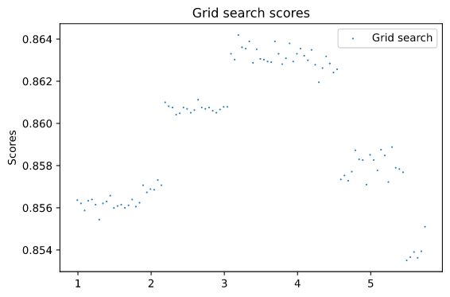
Grid search

Slide 6
Grid search
It seems that the best configuration is :
  max_depth : 12;
  max_features : None;
  n_estimators : 400;
  oob_score : True.
Strangely, we ran multiple times the grid search and we didn’t always had the same answer.

Slide 7
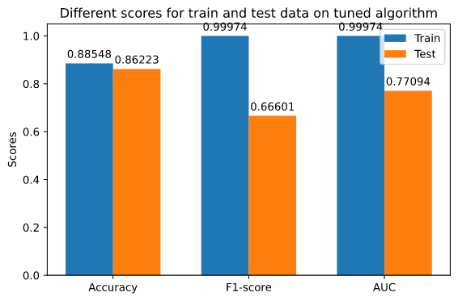
Model tuned with grid’s hyper paramaters

Slide 8
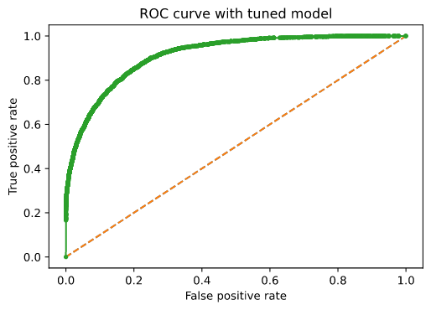
Model tuned with grid’s hyper paramaters

Slide 9
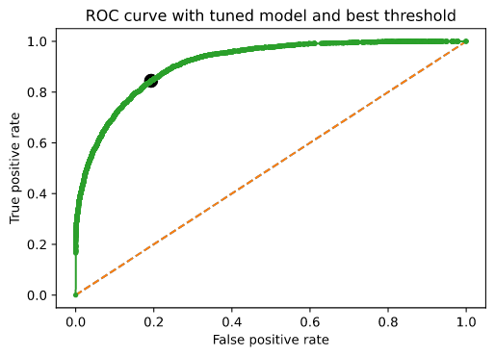
Model tuned with grid’s hyper paramaters

Slide 10
Up and down sample
 | Up sample calculated threshold (0.2669) | Up sample found threshold (0.345) | Down sample calculated threshold (0.2761) | Down sample found threshold (0.363)
Accuracy | 85.10 % | 84.61 % | 81.54 % | 85.10 %
f1_score | 68.23 % | 69.75 % | 68.45 % | 69.84 %

Slide 11
Baseline accuracy

