Slide 1
FLOATING POINT ALU project assigned by DR.Sanjeev Manhas sir
MUKKA SAI MANISH(13116044)
NALLAGATLA MAINKANTA(13116045)
NISANTH D(13116046)
PALAKONDA SHIVA PRASAD(13116047)
PEYUSH JAIN(13116048)

Slide 2
PROBLEM STATEMENT
Design an 8 bit floating point ALU that supports the arithmetic and logic operations: addition, subtraction, multiplication, division, AND, OR, NOT, XOR on floating point numbers as shown in the table below:

Slide 3
WHAT IS AN FLOATING POINT ALU?
An ALU( Arithmetic Logic Unit) is a combinational circuit that can perform both Arithmetic operations ( such as Addition, Subtraction, Division, Multiplication)
and Logical operations( such as AND,NAND,OR, NOR) on FLOATING POINT NUMBERS.

Slide 4
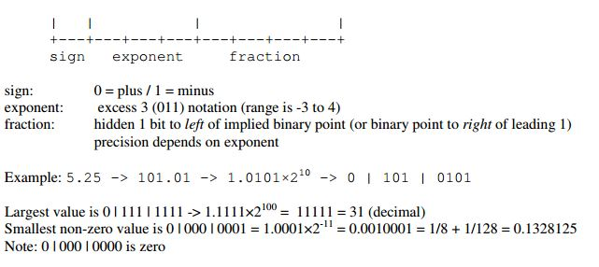
Floating Point Representation

Slide 5
EXAMPLE

Slide 6
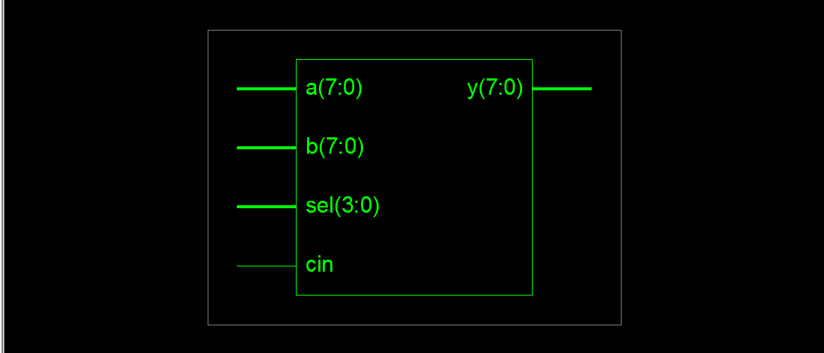
Addition
x= 5.5 y =2.75
In binary
101.1 10.11
RTL Schematic

Slide 7
OUR APPROACH

Slide 8
For Logic unit
By using case syntax seeing the selector output will be the required operation on a and b.

Slide 9
FOR ARITHMETIC BLOCK
Floating-Point Addition and Subtraction Algorithm studied here is similar to what is done in most traditional processors, however, the computation is performed in three stages and is presented in this section. The notation si, ei and fi are used to represent the sign, exponent and mantissa fields of the floating point numbers. Procedure for floating point addition and subtraction is given in the following slides. Similarly other operations can be performed on it.

Slide 10
STEPS FOR FLOATING POINT ADDITION AND SUBTRACTION
Step 1:
If the absolute value of v1 is less than the absolute value of v2 then swap v1 and v2. The absolute value is checked by comparing the exponent and mantissa of each value. Subtract e2 from e1 in order to calculate the number of positions to shift f2 to the right so that the decimal points are aligned before addition or subtraction .
Step 2:
Shift 1.f2 to the right (e2 - e1) places calculated in the
previous stage.
Add 1.f1 to 1.f2 if s1 equals s2, else subtract 1.f2 from1.f1.Set the sign and the exponent of the final result, v3, to the sign and the exponent of the greater value v1.

Slide 11
Step 3:
Normalization of f3 is done by seeing the carry. If there is no carry then mantissa of output will be last 4 bits of f3_var and exponent of output would be the maximum exponent of the two numbers A and B . If there is a carry then mantissa of output will be middle 4 bits of f3_var and exponent of output would be the maximum exponent of the two numbers A and B plus 1.

Slide 12
Coding basics
To implement it in vhdl:
We have used a floating point adderSubtracter as an entity block for addition of two floating point numbers.
As another entity cannot used inside process we have used case syntax to select the two inputs to be given as two numbers for floating point adderSubtracter portmap
At the end this block calculates output for the two numbers which are given every time. And by using selector we can finalise the output.

Slide 13
SUMMARY

