Slide 1


Hariharan Mudaliar – RA2211026010183 [CSE – AI/ML]
Manya Mehrotra – RA2211003010399 [CSE Core]

Slide 2
PROBLEM STATEMENT
PROBLEM TAKEN : App Development
PROBLEM STATEMENT:
To develop an app that uses geolocation to connect users with nearby farmers and farmers markets and to promote healthy eating

Slide 3
INTRODUCTION
TIRED OF TRAVELLING LONG DISTANCES FOR FRESH VEGETABLES ?
Introducing the FARM HAND app – an application that offers you information on all the fresh vegetables being sold by local farmers near your area. It provides a wide selection of farmers, their products, prices, and other options to choose from. Customers have the freedom to personalize their cart, and their route of the shortest distance will be planned accordingly.

Slide 4
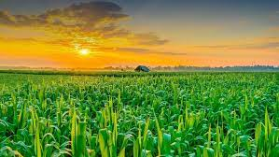
FARMERS, ARE U TIRED OF MIDDLE MEN RUINING YOUR SALES AND PROFITS?
FarmHand will be your companion during your journey as it assists you in showcasing your inventory at a price you set for a vast audience of potential buyers. It helps you to draw in customers to your location and ensures that you achieve the sales you merit.

Slide 5

SOLUTION
We went for an effective yet simple approach i.e.
Connecting the Farmers and Consumers directly without any middlemen between them.
This makes it both profitable for both Farmers and Consumers as the highest margin takers have been removed from the model.

Slide 6
FEATURES
SOME FEATURES OF THIS APPLICATION INCLUDE :
CROSS PLATFORM: This application can run on multiple Operating Systems including
-Android and iOS
-macOS, Linux, Unix
- Windows
B. User friendly interface
C. An easy to learn and use application

Slide 7
WORKING
During our early phase, we will gather information on the farmers, their crops, and their current whereabouts. Whenever a customer looks for a particular fruit or vegetable to purchase, FarmHand will present the details of the closest farmers and their location, as well as their ratings and popular reviews. This approach will enable us to effectively eliminate intermediaries in the agricultural industry and offer nutritious and fresh farm produce at lower prices and at the nearest location of the customer

Slide 8
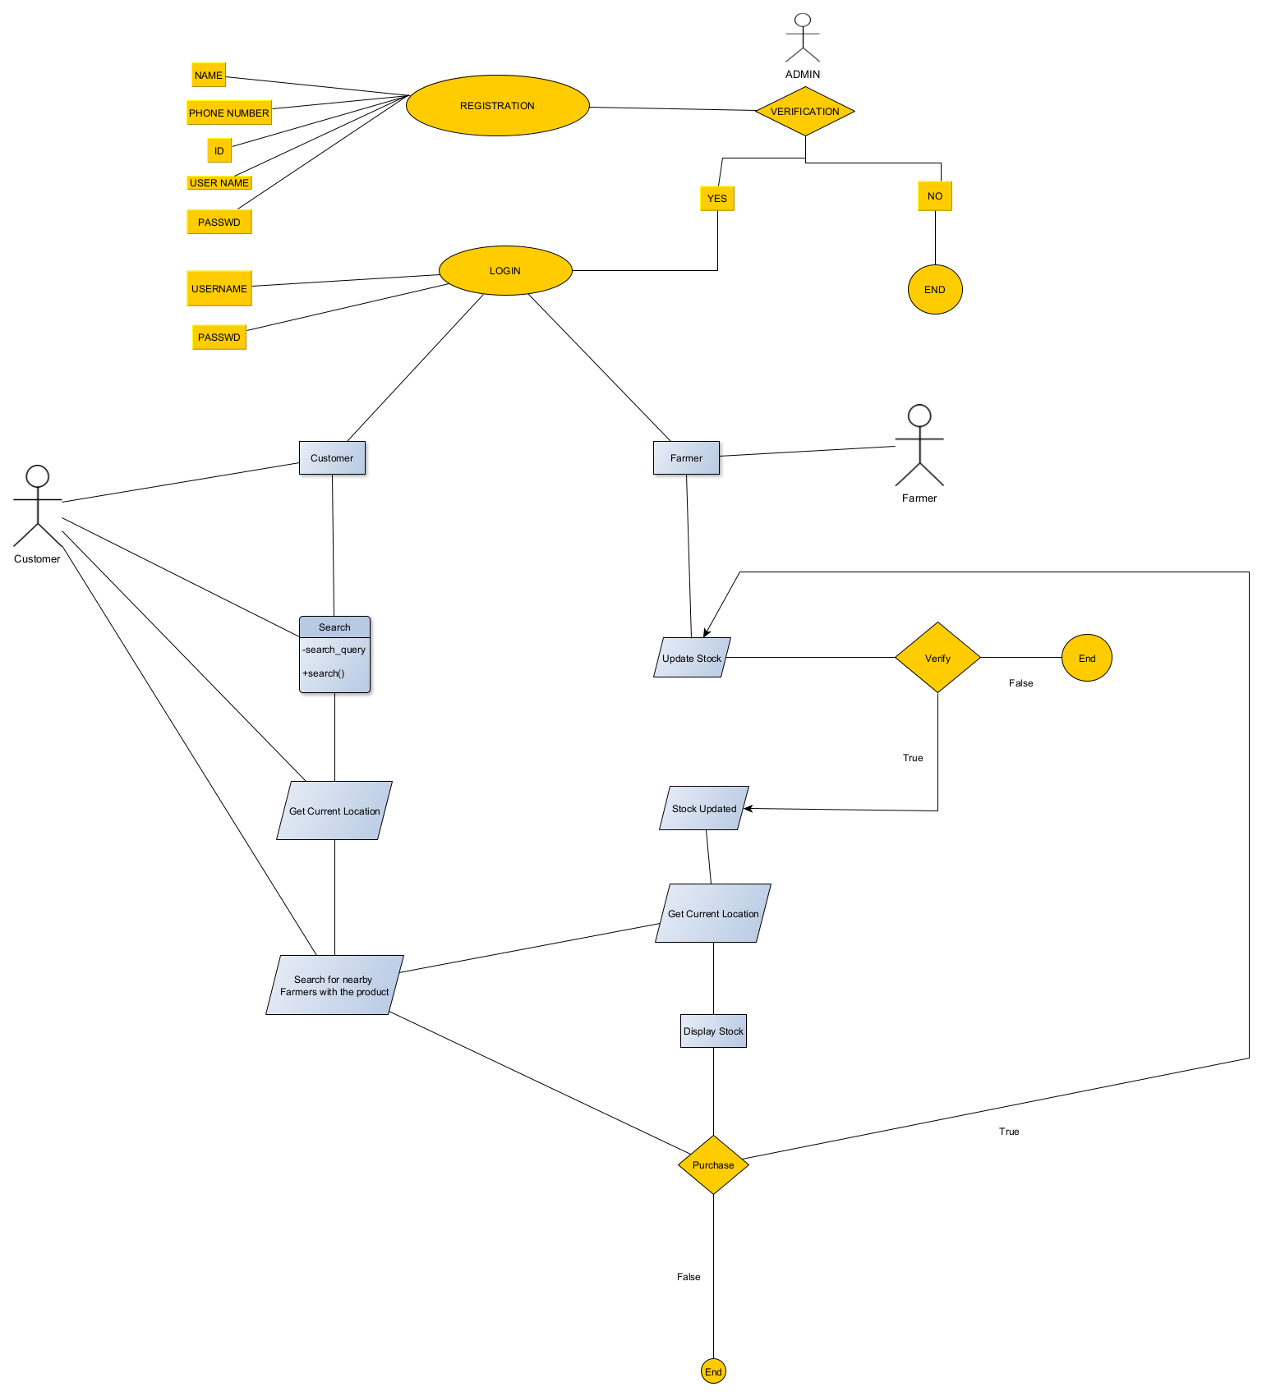




Flow diagram

Slide 9
TECH STACK
FRONT END
PYTHON
A.KIVY
B.KIVYMD
LIBRARIES USED
1.Python
2.C
3.C++
4.Java(for android)
5.SWIFT(for ios)
BACK END
DATABASE
MYSQL

Slide 10



FUTURE PROSPECTS
Firebase for real time data handling
Shifting to a revenue based model
Scaling up and providing more opportunities

Slide 11
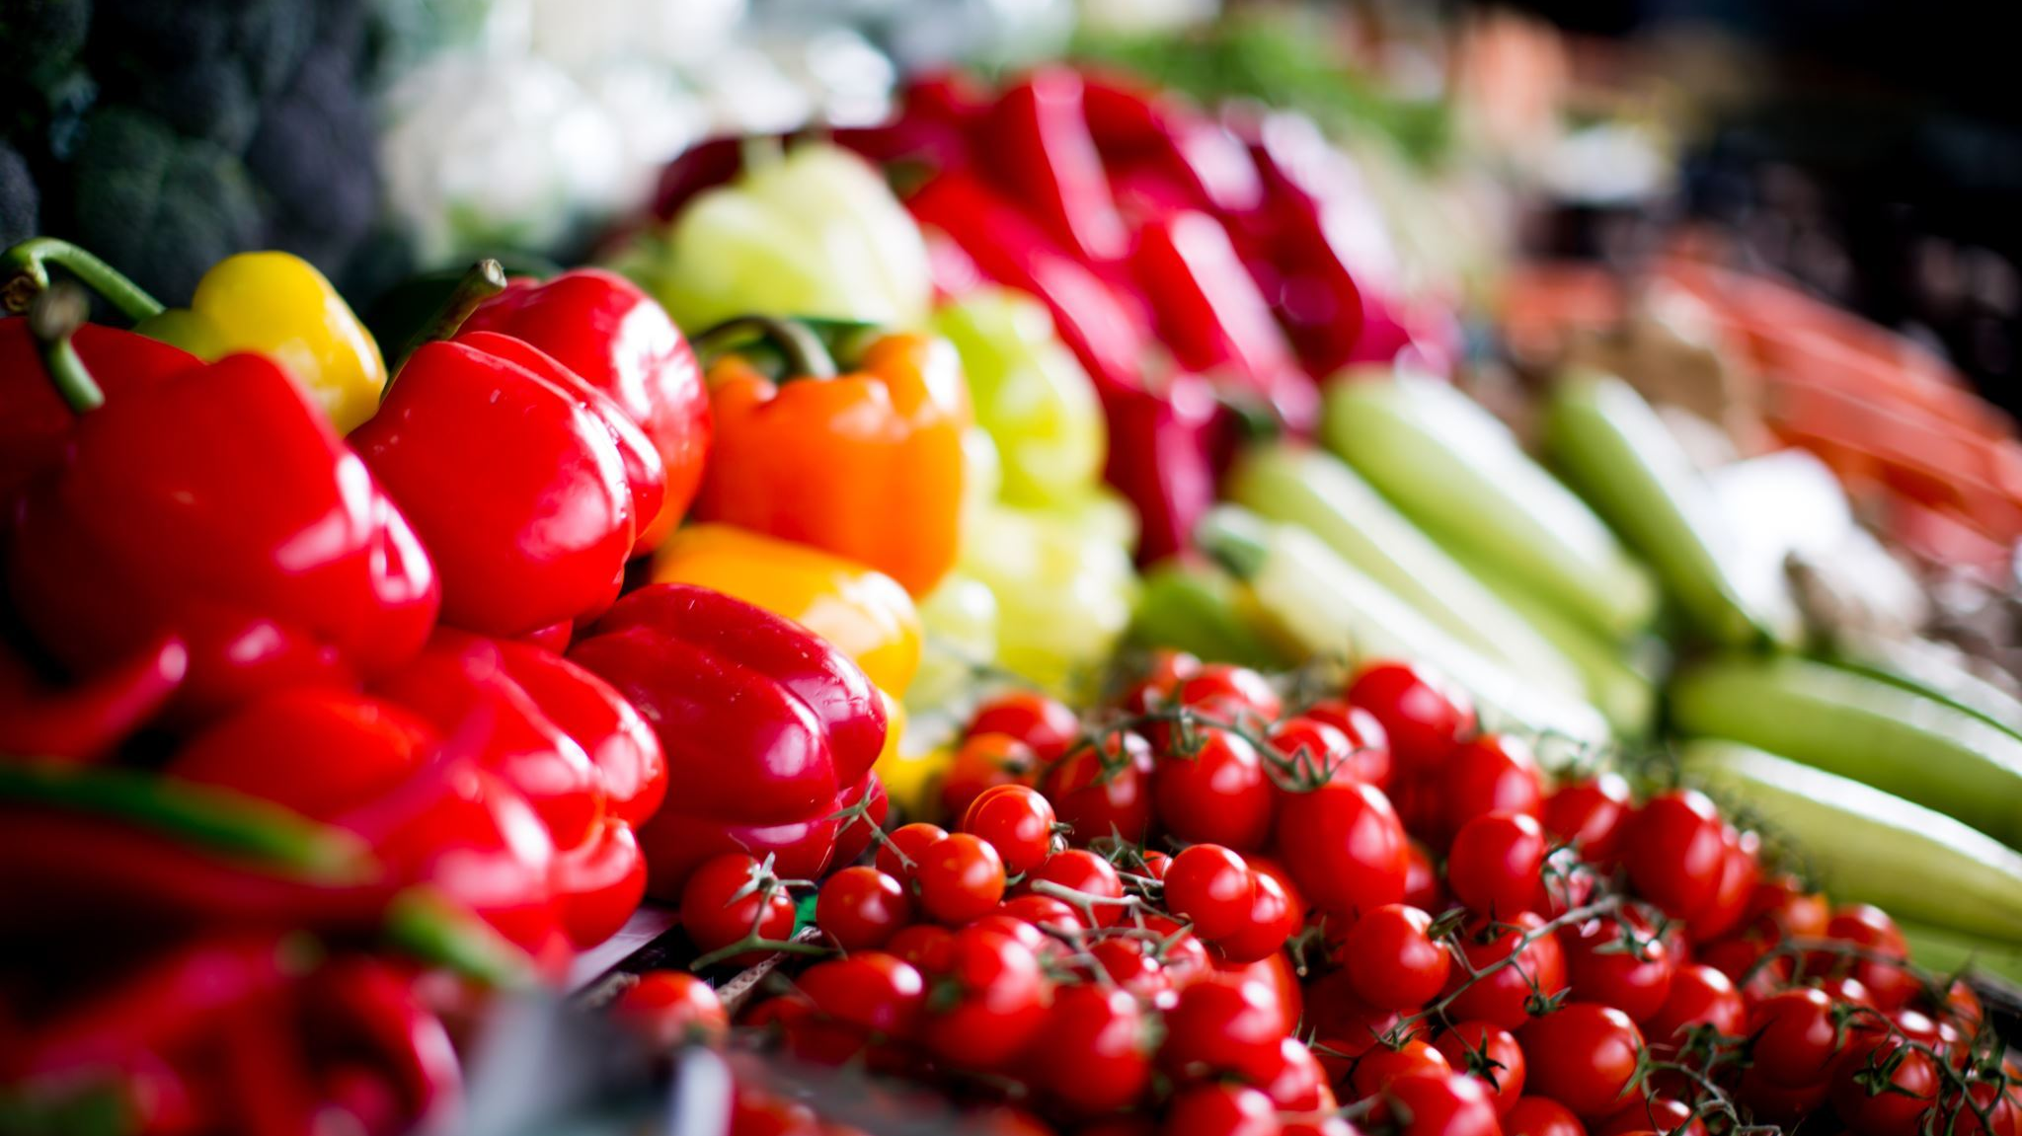
Eat Healthy, Spend Less, Smile More:)
Thank You

