Slide 1

Orca Math ChatBot
Hariharan Mudaliar (RA2211026010183)
Tumati Omkar Chowdary (RA2211026010188)
Akula Satya Sesha Sai (RA2211026010168)

Slide 2
Problem Statement
Transformers are primarily designed for natural language processing (NLP) tasks and might not always produce accurate results for complex mathematical computations.
The results provided by transformers can be opaque. Unlike traditional mathematical algorithms, it can be difficult to understand how a transformer arrived at a specific solution.
Transformers can be computationally intensive, which might make them less efficient compared to specialized mathematical software or algorithms for certain types of problems.

Slide 3
Features
Access to a wide range of state-of-the-art pretrained models such as BERT, GPT-3, RoBERTa, T5, and many more, covering diverse NLP tasks.
Simple and intuitive APIs that allow for easy integration and deployment of models with minimal code.
Ability to fine-tune models on custom datasets to meet specific needs and improve performance on domain-specific tasks.
Support for customizing model architecture and training processes.
Pretrained models available for multiple languages, enabling NLP applications across different linguistic contexts.

Slide 4
Unique Idea Propositions (UIPs)
Utilize Hugging Face transformers to parse and comprehend mathematical problems expressed in natural language, extracting relevant information and converting it into a structured format.
Integrate with symbolic math engines (like SymPy or Mathematica) to handle symbolic manipulation, equation solving, and other algebraic tasks.
Assist students and educators by providing detailed explanations and step-by-step solutions to mathematical problems.

Slide 5
Features of Fine Tuned:
Improves understanding of complex mathematical problems through natural language interaction.
Accelerates problem-solving by combining the strengths of NLP and mathematical engines.
Enhanced Comprehension:
Adapts to a wide range of problems, from basic algebra to advanced differential equations.
Efficiency:
Scalability:

Slide 6
Tech Stack
PYTHON
Hugging Face Transformers
Lang Chain
Stream Lit
Chain Lit
DJango
Pytorch
TensorFlow

Slide 7
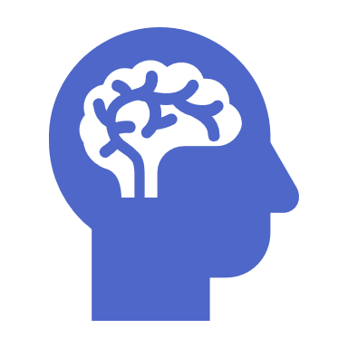
DataSet
PARQUET
Type:
English (US)
Language:
https://huggingface.co/Ebullioscopic/orca-math-word-problems-200k
Link to Dataset:

Slide 8
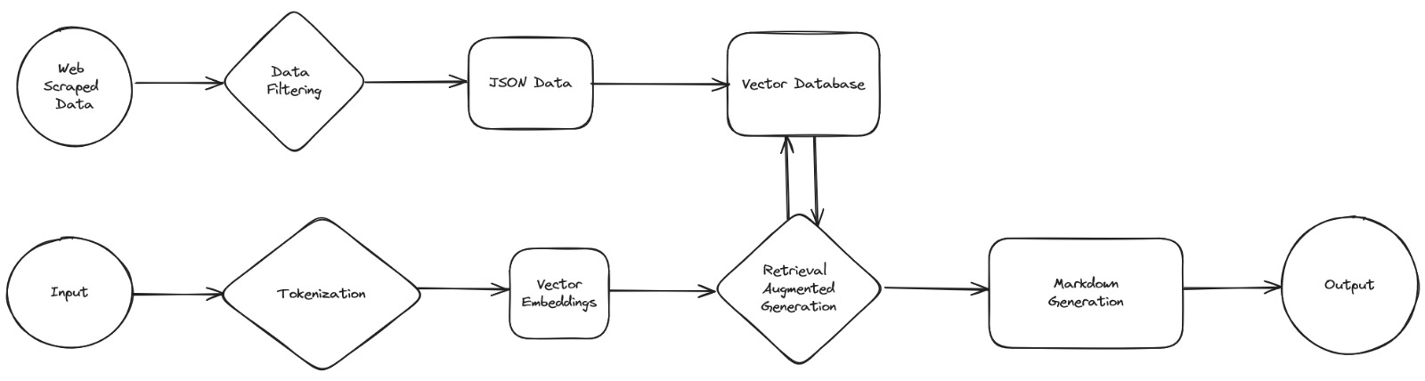
Architecture Diagram

Slide 9
Team Members and Contribution
Hariharan Mudaliar (RA2211026010183) – Transformer Model
Tumati Omkar Chowdary (RA2211026010188) – Dataset and Integration
Akula Satya Sesha Sai (RA2211026010168) – References and Presentation

Slide 10
Conclusion
Integrating Math Orca with Hugging Face transformers presents a groundbreaking approach to solving complex mathematical problems articulated in natural language. This hybrid system leverages the strengths of both advanced natural language processing and sophisticated mathematical reasoning, offering a comprehensive solution that bridges the gap between human language and mathematical computation.
By utilizing Hugging Face transformers, the system can accurately understand and parse natural language queries, extracting the relevant mathematical information needed for problem-solving. Math Orca then processes this structured information, performing symbolic manipulation and numerical computation to arrive at precise solutions.

Slide 11
Thank You ☺

