Slide 1
Predicting Property Prices in the A.C.T.
Mitchell Blyth
Coursera Capstone Project, 2020

Slide 2
The Issue
Many young families in Australia are struggling to find affordable housing in Canberra.
We can use historical real-estate data and suburb data to develop a predictive model for house prices in the A.C.T.
This model can be used to determine the key factors which drive housing prices, and guide future homeowners in their financial decisions

Slide 3
How will we approach the issue?
We set out to develop a Multiple Linear Regression (MLR) model, which would predict house prices from a set of linearly-independent variables
We need to collect “property-level” data on properties sold in the A.C.T, such as number of beds or baths
As well as suburb-level information, such as availability of different venues like shopping centres in each suburb

Slide 4
The Data
Historical Real-Estate Data was scraped from https://www.auhouseprices.com/act/ using BeautifulSoup in a Jupyter notebook.
We collected information about:
Suburb Names of most-popular suburbs (by number of sales)
Sold Prices
Sold Date
Property Type
Number of beds, baths, and car spaces
Property latitude and longitude
We later appended suburb-level venue data from the Foursquare API, location data from the OpenCage API, and suburb definitions from data.gov.au

Slide 5
First Impressions
Before developing a predictive model, we took a deep-dive into the data to see if we could extract meaningful insights, (and assert that the data was accurate)

Slide 6
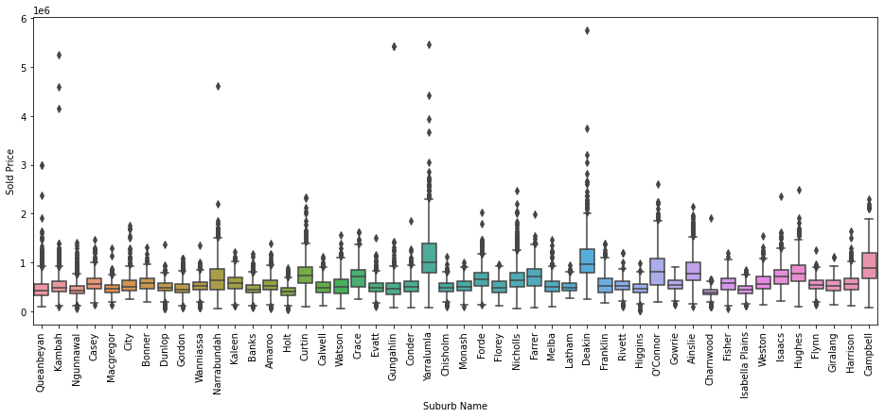
There is significant geographical variation in median property price

Slide 7
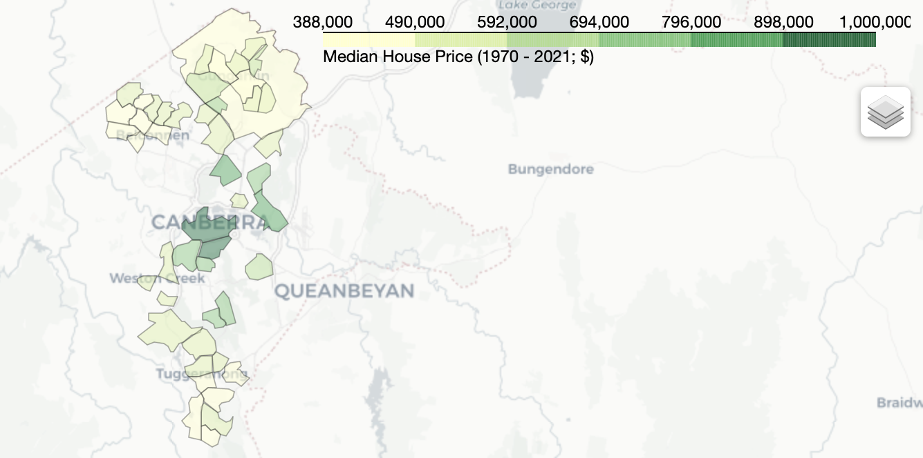
This variation is linked to longitudinal distance from the C.B.D

Slide 8
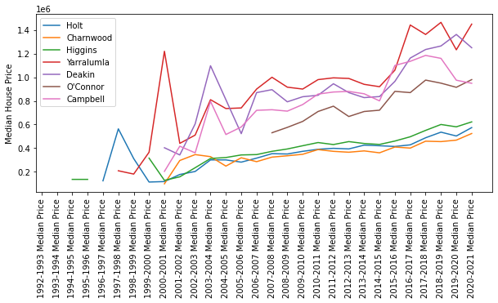
House prices in Canberra are invariably increasing over time, regardless of location

Slide 9
Model Development
We trained three MLR models on different subsets of the complete dataset, or under different conditions. All models were trained and tested using a 80/20 split, on sales data from 2016-2021.
Model 1
Full feature set, no regularization or backward elimination
Model 2
Feature set without FourSquare suburb profile, with regularization and backward elimination
Model 3
Full feature set, with regularization and backward elimination

Slide 10
Model Results; The Quick Version
Model 2 can predict house prices in the Canberra region with an R² = 0.45.
It only requires information about the number of recent sales in the area, the longitude of the property, the numbers of beds and baths, and a binary indication of the property type (i.e. house or not-house).
Factors such as the number of car spaces, or the property latitude did not appear to have a significant effect upon property values.

Slide 11
Model Results; The Quick Version
Model 2 is more appropriate than Models 1 and 3, despite having the lowest R² value. This is because Models 1 and 3 suffer from some combination of over-fitting or collinearity, as determined by other metrics.
However, our central thesis, (that house prices are some linear combination of various factors or proximity to certain venues), should likely be reviewed in favour of a polynomial model.

Slide 12
Conclusion
We developed a series of linear models to predict house prices in the A.C.T, using historical sales data from the region and suburb profiles.
The best model relied only on intuitive aspects of real-estate like the number of beds and baths, and the property location; it did not incorporate information about venues in the surrounding region.
It also revealed some surprising trends, such as that the number of car spaces does not significantly affect house prices (one might speculate about the reasons for this)
Future efforts would involve developing non-linear models from this dataset, with a particular eye toward improving the model’s predictive power

Slide 13
Thanks for your attention
Models and data can be found at: https://github.com/Ecaloota/Coursera_Capstone/blob/main/safe_copy.ipynb

