Slide 1



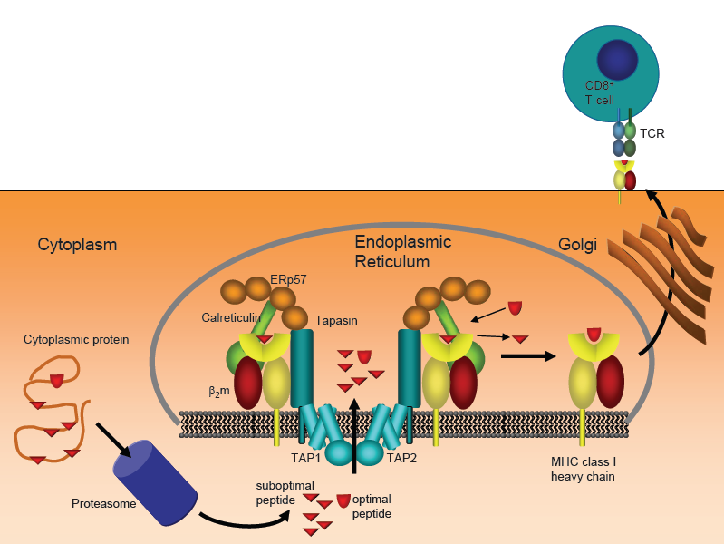
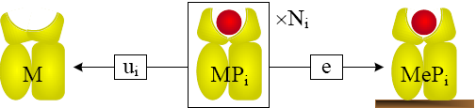
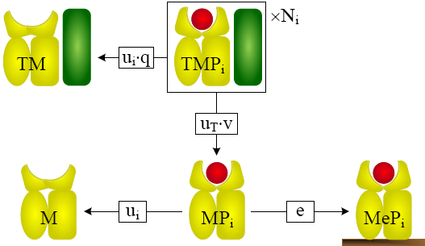
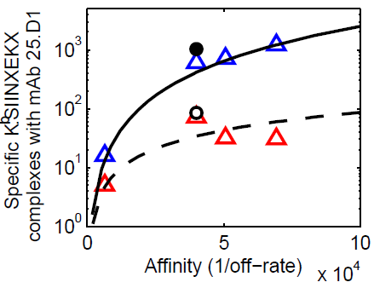
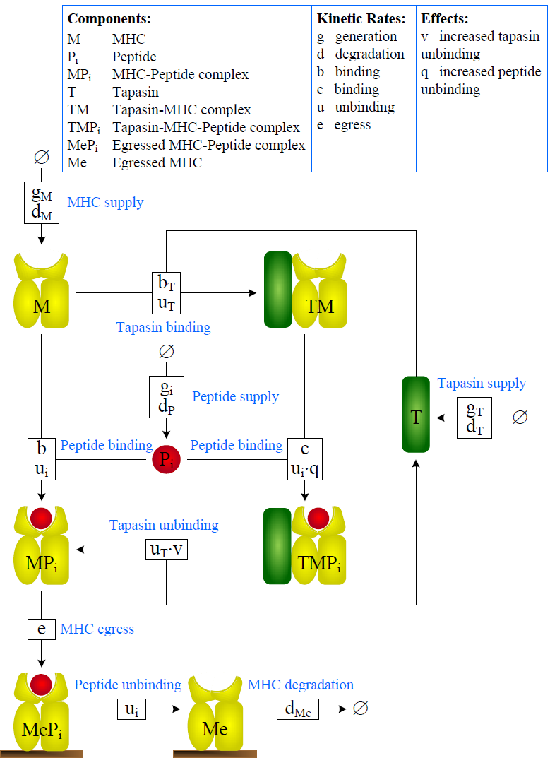
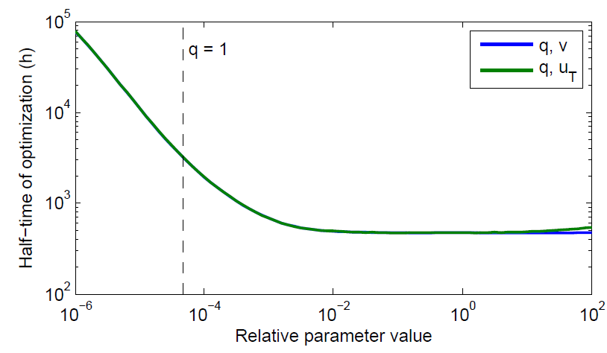
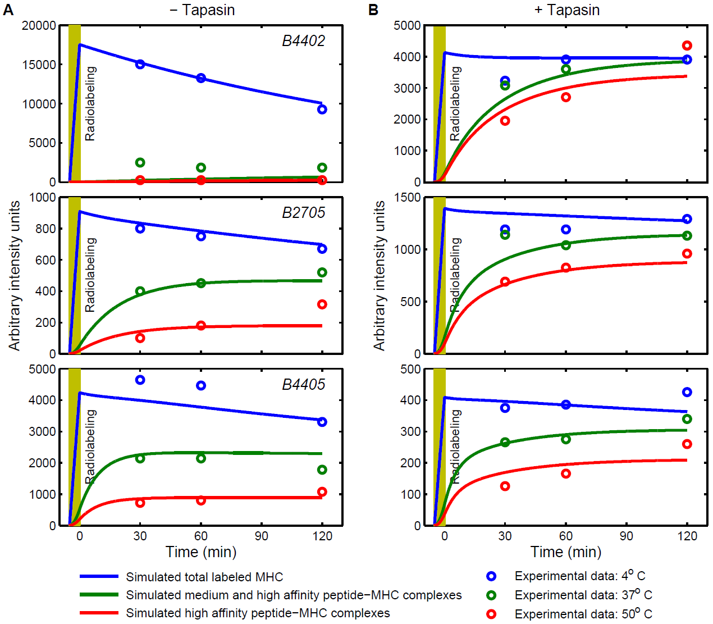
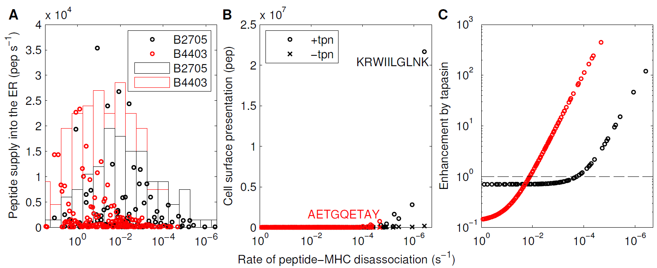
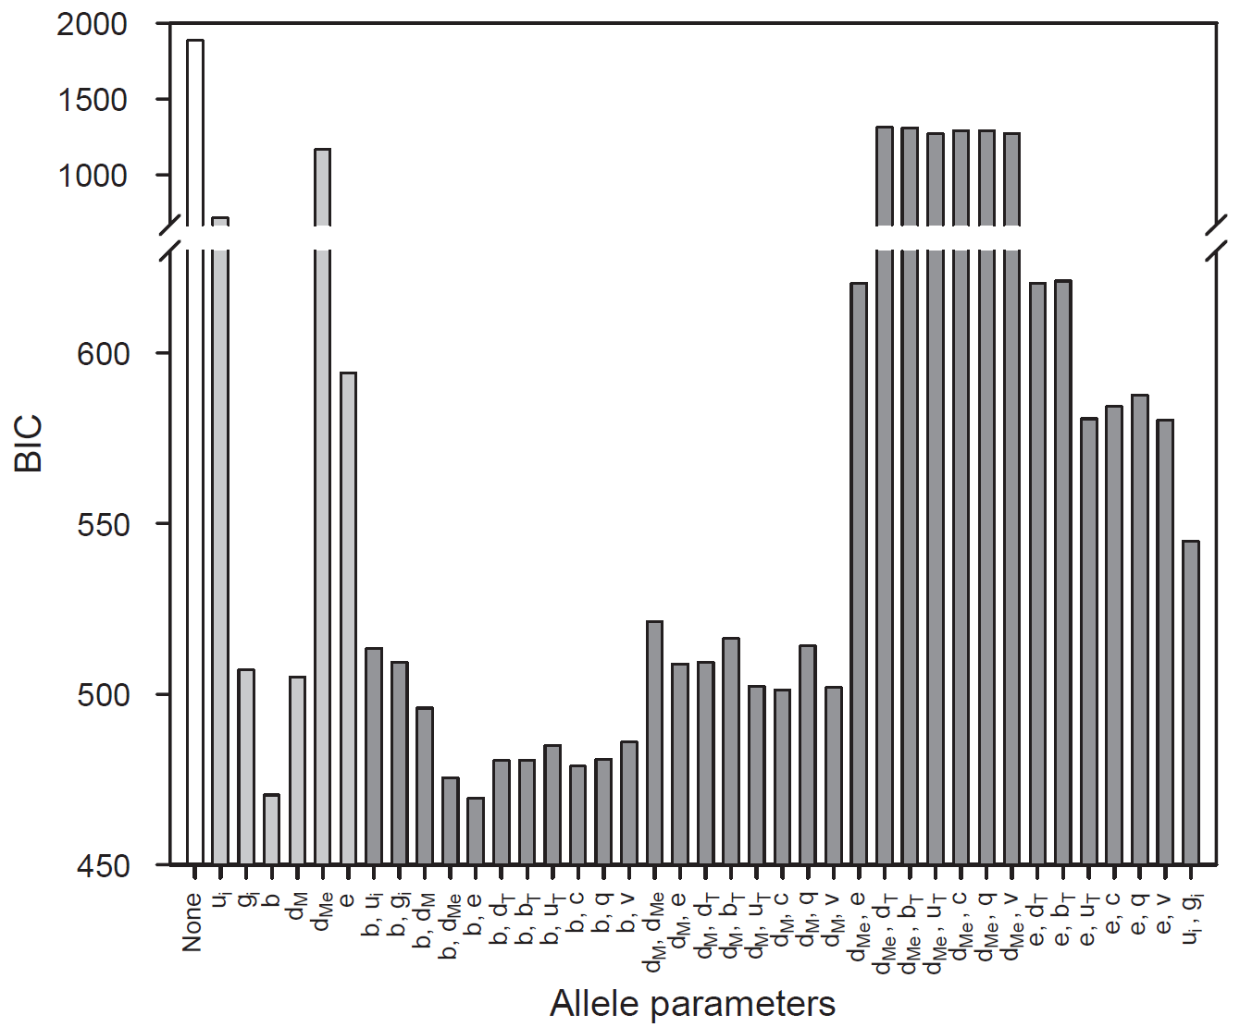
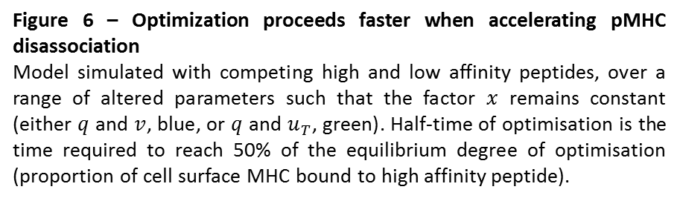


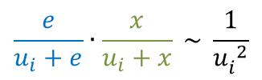

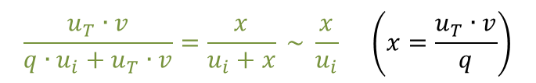
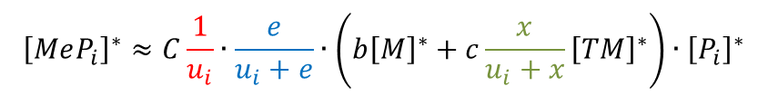
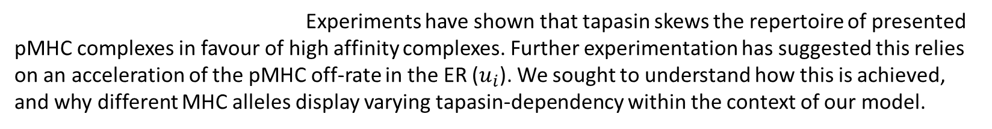

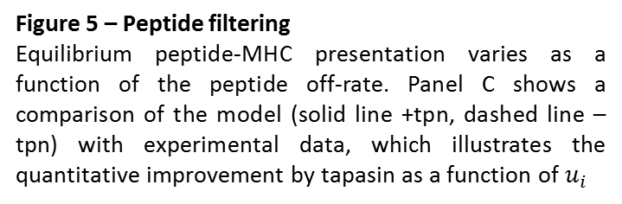
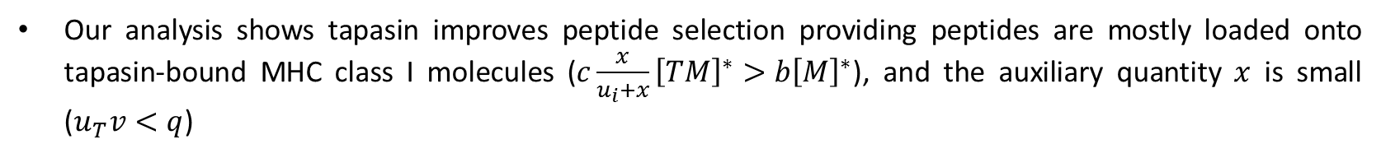
A kinetic model for predicting MHC class I presentation of competing peptides
Neil Dalchau¹, Andrew Phillips¹, Leonard Goldstein¹, Mark Howarth², Luca Cardelli¹, Stephen Emmott¹, Tim Elliott², Joern Werner²
¹Microsoft Research, Cambridge, UK ²University of Southampton
1. Introduction
5. Principle of peptide filtering
A
Antigen processing is the means by which infections and vaccines are made ready for the T cells of our immune system to recognise. As T cells only recognise peptide fragments of larger protein antigens, the generation, selection and presentation of these peptides plays a major role in determining whether an immune response will be effective or not, and the ability to manipulate these events lies at the heart of new immunotherapeutic
strategies such as vaccination against
infection, autoimmunity and cancer.
Progress in understanding the
mechanism of antigen processing
at the resolution required for rational
manipulation is part limited by the
lack of quantitative predictive models.
To understand how tapasin improves peptide editing, we propose the principle of peptide filtering:
In absence of tapasin, pMHC complexes egress with probability
+tpn, pMHC complexes first need to disassociate from tapasin, which occurs with probability
Therefore, the probability of egression becomes
Steady state analysis of the (mass action) ODEs yields a similar story:
$$\frac{e}{u_{i}+e} \sim \frac{e}{u_{i}}$$
B
$$\frac{u_{T}∙v}{{q∙u}_{i}+u_{T}∙v}=\frac{x}{u_{i}+x} \sim \frac{x}{u_{i}} \left(x=\frac{u_{T}∙v}{q}\right)$$
C
$$\frac{e}{u_{i}+e}∙\frac{x}{u_{i}+x} \sim \frac{1}{{u_{i}^{}}^{2}}$$
Figure 1 – Basic process of MHC class I antigen presentation
Degradation of cytosolic and nuclear proteins predominantly by the proteasome generates peptides that are actively transported into the lumen of the endoplasmic reticulum (ER). Loading and optimisation of peptide cargo on MHC class I is achieved in the peptide loading complex (PLC) resulting in optimally loaded MHC class I being released in to the Golgi and transported to the cell surface where the MHC class I peptide complex is presented to the immune system via the T-cell receptor. Known constituents of the PLC such as the transporter for antigen processing (TAP), Tapasin, ERp57, calreticulin and MHC heavy-chain together with β₂m are shown explicitly.
$${\left[MeP_{i}\right]}^{∗}≈C\frac{1}{u_{i}}∙\frac{e}{u_{i}+e}∙\left(b{\left[M\right]}^{∗}+c\frac{x}{u_{i}+x}{\left[TM\right]}^{∗}\right)∙{\left[P_{i}\right]}^{∗}$$
Cell surface filter
Egress filter
Tapasin filter
2. Central dilemma of peptide loading
Tapasin improves filtering to $\frac{1}{{u_{i}}^{3}}$ rather than $\frac{1}{{u_{i}}^{2}}$
Figure 5 – Peptide filtering
Equilibrium peptide-MHC presentation varies as a function of the peptide off-rate. Panel C shows a comparison of the model (solid line +tpn, dashed line –tpn) with experimental data, which illustrates the quantitative improvement by tapasin as a function of $u_{i}$
Cells need to present MHC class I peptide complexes that are stable for many hours or days in order to elicit an immune response. Therefore, peptide off-rates must be slow. However, MHC generation and acquisition of peptide cargo in the endoplasmic reticulum (ER) is limited to 10’s of minutes. Hence, the cell has to skew the distribution of resulting peptide-MHC complexes to favour slow off-rate peptides. Tapasin is the only component of the PLC which is known to improve peptide selection in this way.
A two-compartment model simulates multiple competing peptides (P_{i}) as they are presented at the cell surface by MHC class I molecules
Tapasin:
accelerates peptide exchange, factor q (> 1)
increases peptide binding to MHC class I, rate c (> a)
unbinds from MHC faster in presence of peptide, factor v (> 1)
Simulation:
Gillespie stochastic simulation algorithm (SSA)
ordinary differential equations (assuming mass action)
Kinetic rate parameters:
only partially known
likely variability between MHC alleles
6. Understanding tapasin-dependent pMHC optimisation
3. A reaction-based model
Our analysis shows tapasin improves peptide selection providing peptides are mostly loaded onto tapasin-bound MHC class I molecules ($c\frac{x}{u_{i}+x}{\left[TM\right]}^{∗}>b{\left[M\right]}^{∗}$), and the auxiliary quantity $x$ is small ($u_{T}v<q$)
Hypothesis 1: $u_{T}v$ low (retaining MHC in the ER for longer, enabling more peptide exchange)
Hypothesis 2: $q$ high (accelerating the rate of peptide exchange)
Experimental evidence suggests $q>1$ and $v>1$; our parameter estimation in Section 4 agrees with these constraints
Why has evolution has selected an accelerated exchange mechanism rather than an ER retention mechanism?
We hypothesised that while both mechanisms could achieve an equivalently optimised equilibrium state, the rate at which it converges toward this equilibrium might differ
Figure 6 – Optimization proceeds faster when accelerating pMHC disassociation
Model simulated with competing high and low affinity peptides, over a range of altered parameters such that the factor $x$ remains constant (either $q$ and $v$, blue, or $q$ and $u_{T}$, green). Half-time of optimisation is the time required to reach 50% of the equilibrium degree of optimisation (proportion of cell surface MHC bound to high affinity peptide).
Figure 2 – Basic model of MHC class I antigen presentation
7. Simulating virus-infected cells: HIV-1 Gag-Pol polyprotein
4. Polymorphism in MHC is explained by allele-specific rates of pMHC binding
Viral epitopes derived from protein sequences
pMHC disassociation rates can be predicted from the peptide sequence using peptide binding prediction algorithms (BIMAS, NetMHC, etc.)
Assuming something about the generation of different peptides, we can simulate any number of competing viral/host peptides
Can predict presentation of known epitopes for specific MHC alleles (KRWIILGLNK is immunodominant in patients expressing HLA-B2705)
Parameter estimation:
using Markov Chain Monte Carlo (MCMC) methods (Filzbach software)
able to reproduce experimental data with good accuracy
Multimodel selection:
Allelic variation encoded by allele parameters
Bayesian model selection (BIC) used to quantify most likely allele hypothesis
Experiments have shown that tapasin skews the repertoire of presented pMHC complexes in favour of high affinity complexes. Further experimentation has suggested this relies on an acceleration of the pMHC off-rate in the ER ($u_{i}$). We sought to understand how this is achieved, and why different MHC alleles display varying tapasin-dependency within the context of our model.
Figure 3 – Parameter estimation for the model of MHC class I (above)
The basic model was used to simulate an experiment which shows allele-dependent peptide editing, with respect to tapasin. More stable pMHC complexes (stable at 50°C, red points) can be observed in the presence of tapasin. The simulations (solid lines) used representative peptides for complexes stable at 4°C (low affinity), 37°C (medium affinity) and 50°C (high affinity).
Figure 4 – Multimodel selection for allelic variation hypotheses (left)
Analysis of competing model hypotheses for allele-specific tapasin-dependency in HLA-B. The horizontal axis indicates the parameters which were allowed to vary between HLA-B alleles. BIC penalises deviations of the model simulation from the experimental data, whilst also penalising models with more variable parameters, implying that low BIC values correspond to more representative models.
8. Conclusions
Derived first model of multiple antigen processing and presentation by MHC class I
Action of tapasin includes accelerated peptide off-rate and accelerated peptide on-rate
Allelic variation in MHC class I molecules is explained by variations in the on-rate of peptide to MHC class I molecules not bound to tapasin
Principle of peptide filtering predicts equilibrium cell surface presentation varies with $1/{{u_{i}}^{3}}$ with tapasin and $1/{{u_{i}}^{2}}$ without tapasin, as long as $x\left(={u_{T}v}/q\right)$ is small
$x$ is held low by high $q$, not low $u_{T}v$, so that peptide optimisation occurs rapidly
Simulation of HIV-1 Gag-Pol polyprotein illustrates the general applicability of the multiple-peptide model, as entire sequences may be simulated
Provides a framework for a dynamic model of the complete pathway of intracellular antigen recognition by the immune system

