Slide 1
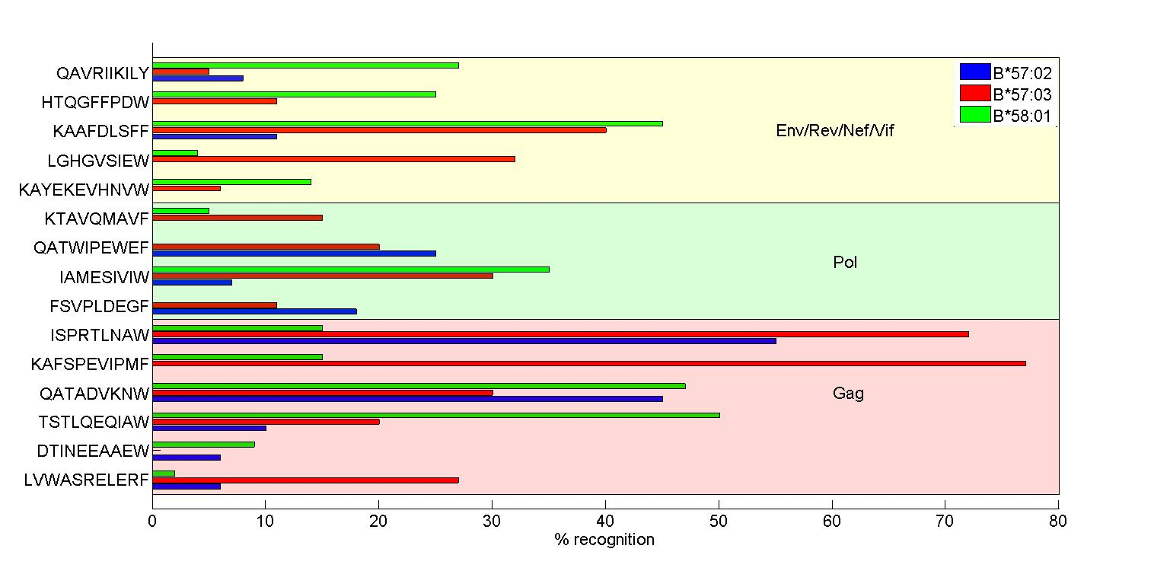
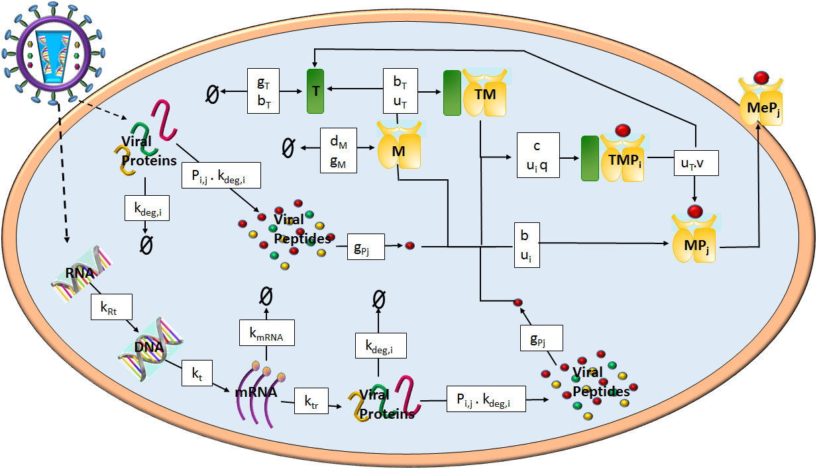
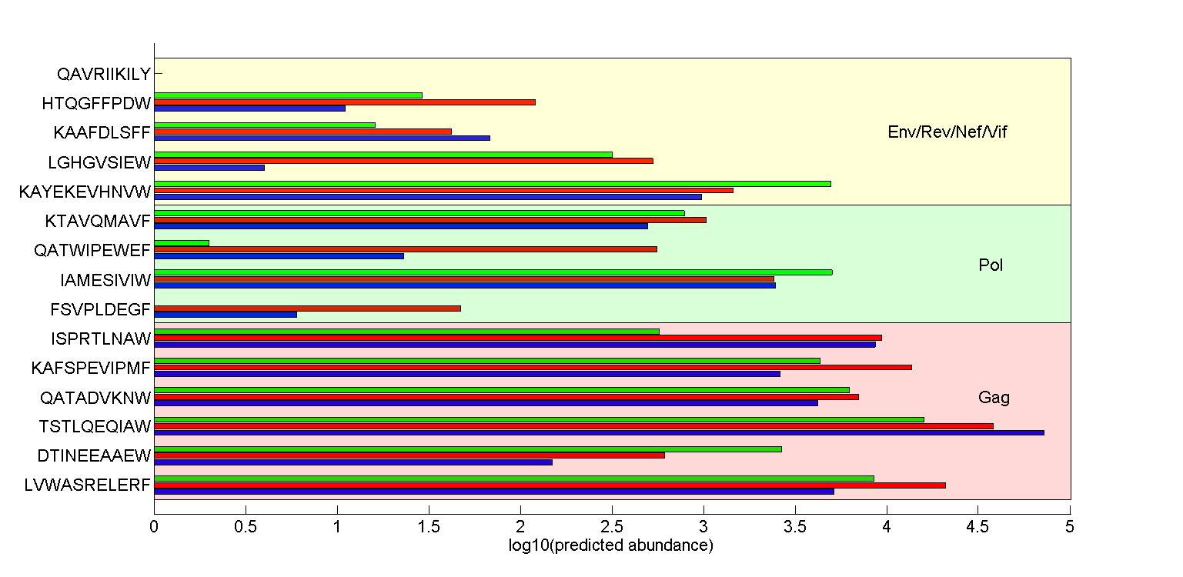






Predicting the Cell Surface Presentation of Viral Peptides by MHC Class-I Molecules
Ruth Charlotte Eccleston¹, Neil Dalchau², Peter Coveney³
1. CoMPLEX, UCL, Gower St, WC1E 6BT, 2. Microsoft Research , 21 Station Rd,, CB1 2FB 3.Department of Chemistry, UCL, Gower St, WC1E 6BT
Introduction
The progression rates of infection from human immunodeﬁciency virus (HIV-1) to acquired immune deﬁciency syndrome (AIDS) varies between individuals, and is inﬂuenced by a part of the human genome known as the Major Histocompatability Complex (MHC). The MHC proteins allow the immune system to survey the protein content of cells by presenting small fragments of these proteins, known as peptides, on the cell surface. Here we create a mathematical model of HIV antigen presentation and compare the predicted peptide abundance with data of T-cell responses to a selection of HIV peptides [1], for three MHC alleles associated with HIV control: HLA-B*57:02, -B*57:03 and –B*58:01.
Results
The cell surface presentation of 15 HIV peptides by HLA-B*57:02, -B*57:03 and –B*58:01 was simulated. All three HLA alleles are associated with control of HIV infection, however HLA-B*57:03 is associated with a significantly lower viral load than the other two alleles [1]. Kloverpris et al [1] studied a cohort of over 1000 HIV-1 clade C infected individuals, and found the two Gag peptides KF11 and ISW9 when presented by HLA-B*57:03 are associated with the highest percent recognition (Figure 2a, data from [1]). Peptide specific properties, such as the half-life and the affinity to the allele in question, are known to influence cell surface abundance. However, measurement of these properties revealed that peptides originating from other HIV proteins, such as Pol and Nef, had much longer half-lives and higher affinities than the Gag peptides. However, simulations of the peptide cell surface presentation predict that Gag peptides are in general presented in much higher abundance than peptides from other proteins. Furthermore, KF11 and ISW9 are presented in higher abundance by B*57:03 than the other two alleles (Figure 2b). The rank order of abundance can directly explain the order of percent recognition for KF11 and ISW9 along with 2 other peptides (those marked by a ), whilst a general positive correlation between abundance and response is observed for 6 other peptides (those marked by a ). The percent response for the remaining 5 peptides could not be explained by the predicted abundance (those marked by a ).
Conclusions
The comparison between the simulated abundances and the percent recognition data suggests that the a high cell surface abundance increases the likelihood of an immune response. However, differences in abundance will not always translate in to differences in CD8+ T-cell response. For example, TW10 Gag is presented in very high abundance by B*57:02 compared to B*58:01, however the largest percent recognition of this peptide is associated with B*58:01 and the lowest with B*57:02. This suggests that other factors influence T-cell response, such as the allele which is presenting the peptide. An important factor in HIV control is the breadth of the Gag-specific CD8+ T-cell response [2]. The simulations show that Gag peptides are the most abundantly presented peptides for the dataset studied here, however they are not the peptides with the highest affinity or longest half-lives to the HLA alleles in question. This suggests that the immunodominance of Gag peptides
Methods
Once a peptide is produced in the cytoplasm it is transported to the Endoplasmic Reticulum via the transporter associated with antigen processing (TAP) where it can bind with MHC molecules and egress to the cell surface. Only peptides whose unbinding rate to the MHC molecules is less than the rate of egression to the cell surface will be presented. Its cell surface abundance thus depends on its abundance in the cytoplasm, the rate of transport to the ER and its affinity with the MHC allele it is binding to. Therefore a model of intracellular viral kinetics must be combined with a model of peptide presentation in order to capture these effects. The biochemical interactions were modelled by a system of ordinary differential equations and the main interactions with their kinetic rates are illustrated in Figure 1.
a)
b)
Acknowledgments
I would thank UCL CoMPLEX and my supervisors Prof. Peter Coveney and Dr. Neil Dalchau for their help with this project.
Figure 1: Main components required to model peptide presentation
References
[1] Kloverpris H N, et al. 2012. HLA-B*57 Micropolymorphism Shapes HLA Allele-Speciﬁc Epitope Immunogenicity, Selection Pressure, and HIV Immune Control. Journal of Virology, 86(2):919–929.
[2] Matthews P C, et al. 2012. Differential Clade-Specific HLA-B*3501 Associations with HIV-1 Disease Outcome Is Linked to Immunogenicity of a Single Gag Epitope. Journal of Virology, 86(23):12643-12654.
Figure 2: a) The recognition of 15 HIV peptides was tested in IFN-γ ELISPOT assays and represented as the percent of subjects who recognised the peptide. The data plotted is presented in Kloverpris et al. 2012 [1]. b) The predicted cell surface abundance of the 15 HIV peptides at 72 hours post infection by the three HLA alleles B*57:02, B*57:03 and B*58:01.

