Slide 1

G2M Case Study
Virtual Internship
21-10-2022

Slide 2
Background –G2M(cab industry) case study
XYZ is a private equity firm in US. Due to remarkable growth in the Cab Industry in last few years and multiple key players in the market, it is planning for an investment in Cab industry.
Objective : Provide actionable insights to help XYZ firm in identifying the right company for making investment.
The analysis has been divided into four parts:
Data Understanding
Finding the most profitable Cab company
Recommendations for investment

Slide 3
Data Exploration
24 Features( including 9 derived features)
Timeframe of the data: 2016-01-31 to 2018-12-31
Total data points :355,032
Assumptions:
Outliers are present in Price_Charged feature but due to
unavailability of trip duration details ,we are not treating this as outlier.
Profit of rides are calculated keeping other factors constant and only
Price_Charged and Cost_of_Trip features used to calculate profit.
Users feature of city dataset is treated as number of cab users in the city.
we have assumed that this can be other cab users as well(including Yellow and
Pink cab)
Cab_Data.csv
Customer_ID.csv
Transaction_ID.csv
City.csv
USholiday.csv
Final cab data

Slide 4
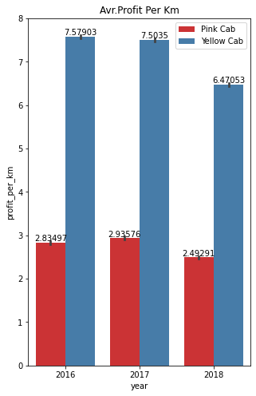
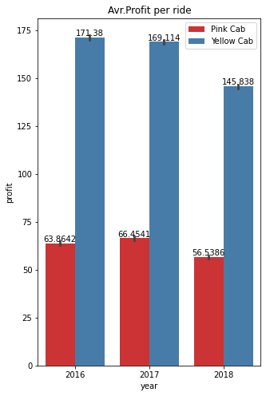
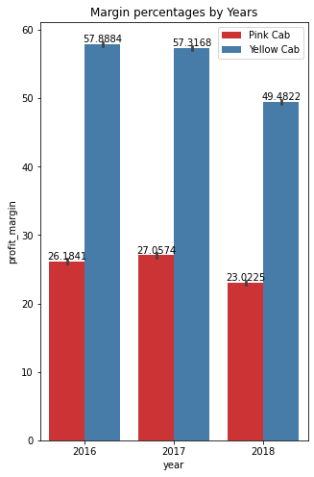
Profit Analysis
Profit Analysis

Slide 5
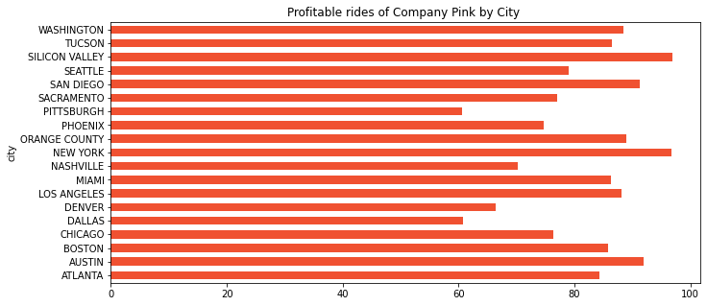
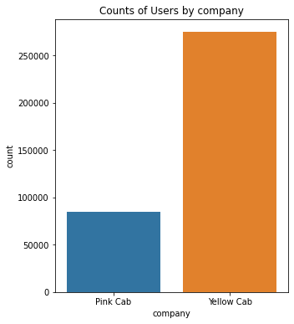
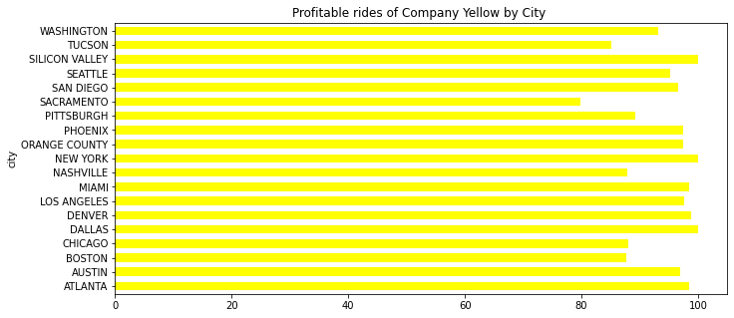
Profit Analysis
Profit Analysis
AS we can see the figures Company Yellow has almost more profitable rides percentages than Company pink.We also know that from below figure Yellow has more users.

Slide 6
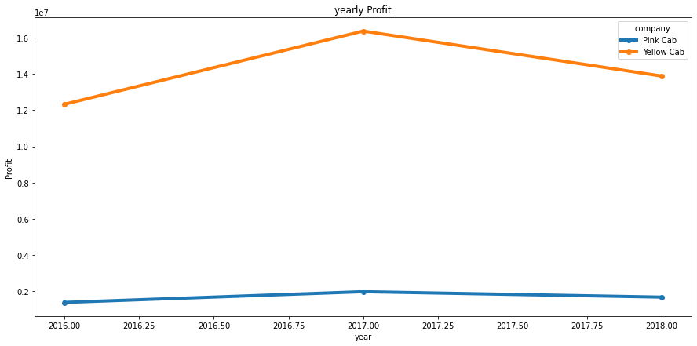
Yearly Profit Analysis

Slide 7
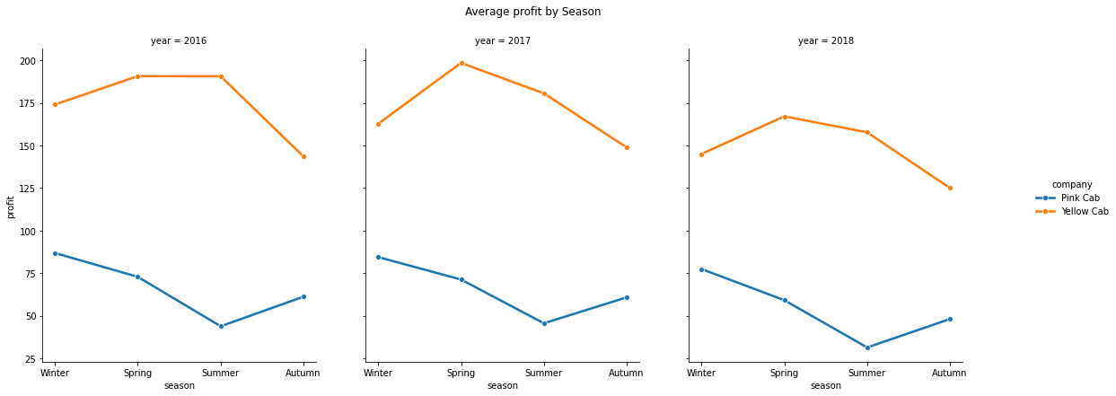
Average Profit by Season

Slide 8
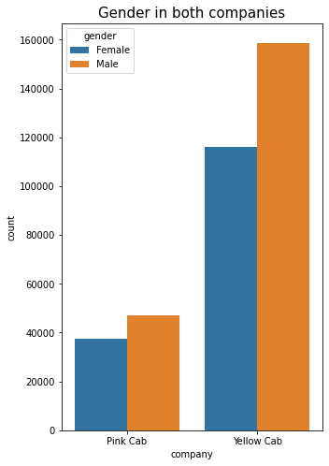
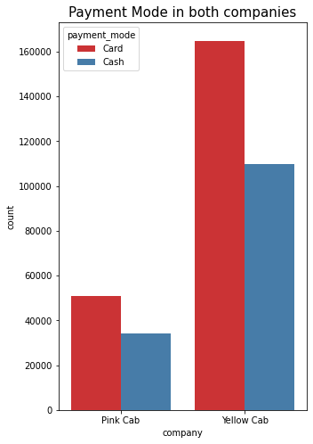
Payment mode and Gender effect of Users
There is no effect of gender to the user disturbition. And also payment mode seems not quite diffrent for both company

Slide 9
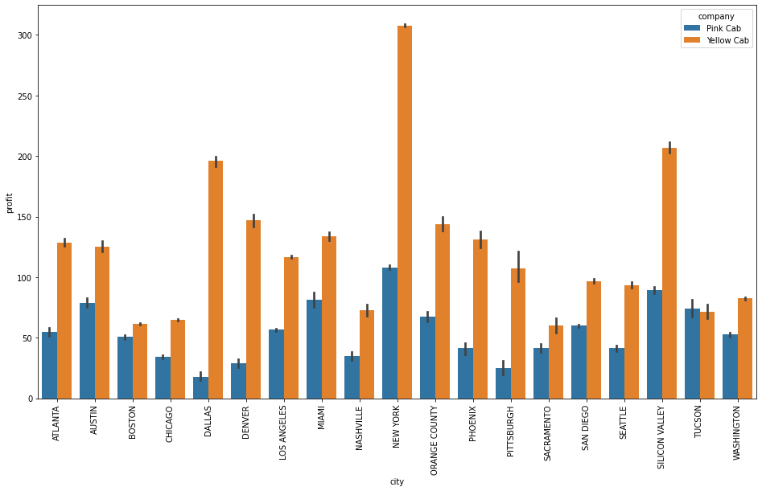
Profit analysis by City
Middle class and high class contributes more in the profit as well as in the customer base of both the cabs

Slide 10
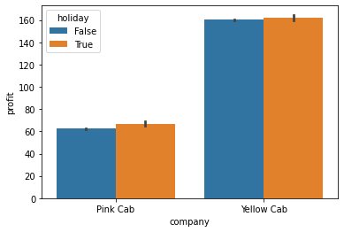
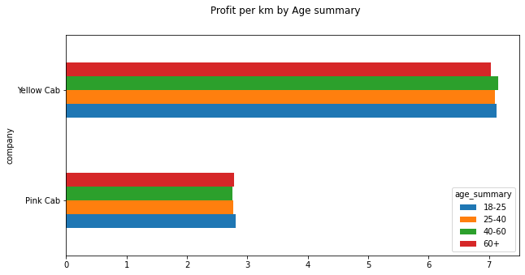
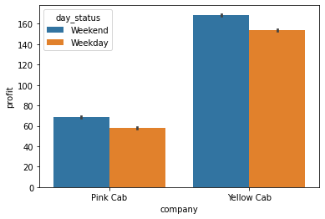
Age GroupWise Profit And Day status Analysis
Seems like there is not much correlatiın between day status,holiday status or age summary with profit of companies.

Slide 11
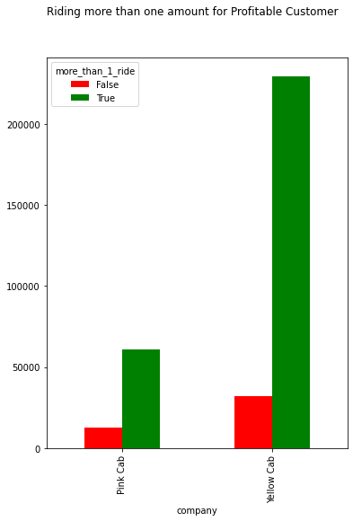
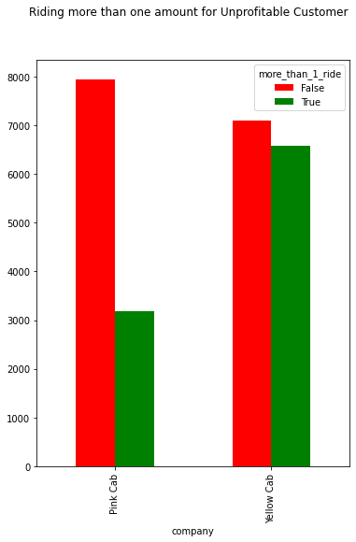
İnvestigation of unprofitable Customers
As we can see from both figures, there is no significance in the number of more than one ridings in the unprofitable ridings, which we estimate to be discounted

Slide 12
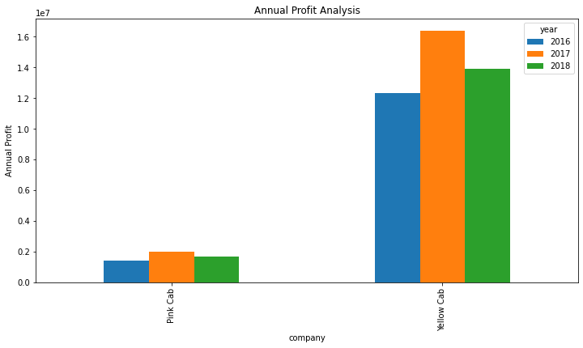
Annual Profit
Finally, this simple but very useful figure shows us the company we should invest in.

Slide 13
Recommendations
We have evaluated both the cab companies on following points and found Yellow cab better than Pink cab:
The number of users of the yellow cab is much higher
When we sort profits by city, New York is at the top for the two companies.
Profit percentages per ride Yellow cab is 54.3 Pink cab is 25.5.
Yellow Cab is seen having more profit than the Pink Cab.
Yellow taxi should be preferred as the company to be invested.

Slide 14
Thank You

