Slide 1
Notification Service
Kafka and Notification Integration
Kaan mert terzi 2001102

Slide 2
Project Overview
Objective: Implement a notification service that polls messages from a Kafka topic and sends emails for subscriber package notifications.
Components:
Kafka for message polling (mocked for this demo)
Email service for notifications

Slide 3
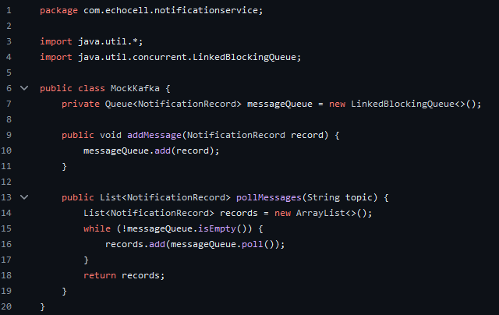
MockKafka.java
Purpose: Simulates Kafka operations by generating mock messages.
Key Method:
pollMessages: Returns a list of mock NotificationRecord objects to simulate messages from Kafka.

Slide 4
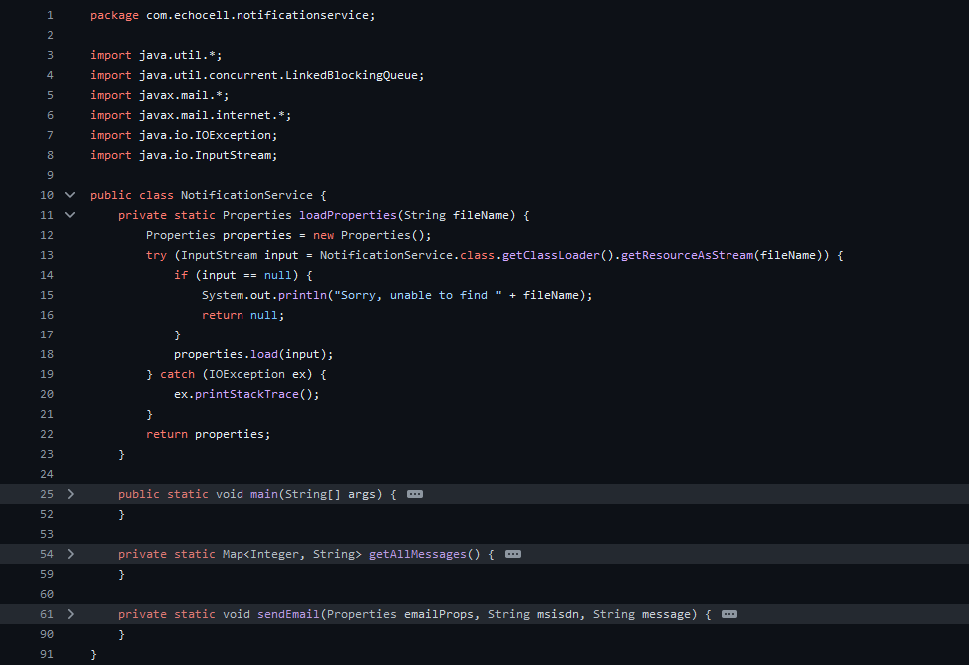
NotificationService.java
Purpose: Main logic for processing messages and sending notifications.
Key Methods:
startService: Main loop for polling messages and sending notifications.
sendEmail: Sends an email using the SMTP server.

Slide 5
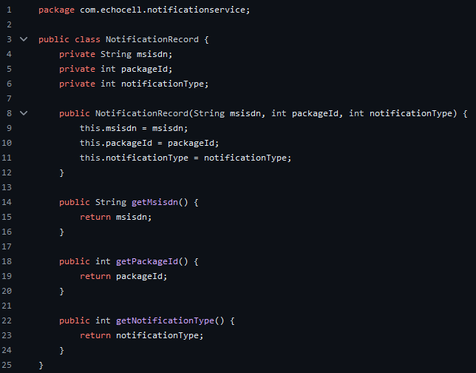
NotificationRecord.java
Purpose: Represents the structure of a notification record.
Attributes:
msisdn: Subscriber's phone number.
packageId: Identifier for the package.
notificationType: Type of notification (e.g., 80% usage, 100% usage).

Slide 6

Configuration Files
kafka.properties:
Purpose: Kafka configuration settings.
Example:
bootstrap.servers=localhost:9092
group.id=notification-group
topic.name=NotificationTopic

Slide 7
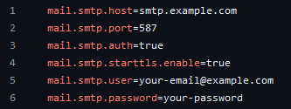
Configuration Files
email.properties:
Purpose: SMTP server settings for sending emails.
mail.smtp.host=smtp.example.com
mail.smtp.port=587
mail.smtp.auth=true
mail.smtp.starttls.enable=true
mail.smtp.username=myemail@example.com
mail.smtp.password=mysecretpassword

Slide 8
Conclusion and Notes
Summary:
Successfully implemented a notification service that integrates Kafka for message polling and an email service for notifications.
The service is designed to handle different notification types based on the content of the messages polled from Kafka.
Challenges and Solutions:
Challenge: The actual Kafka methods were not available.
Solution: Implemented a mock Kafka class (MockKafka.java) to simulate the message polling process and allow the demonstration of the service's functionality.
Future Work:
Enhance the notification service to handle additional notification types and improve robustness.

