Slide 1
I/O Devices

Slide 2
I/O
Lets introduce the concept of an input/output (I/O) device.
We will show how the operating system might interact with such an entity.
I/O is quite critical to computer systems, of course.
Imagine a program without any input (it produces the same result each time)
Now imagine a program with no output (what was the purpose of it running?)
Clearly, for computer systems to be interesting, both input and output are required.
How do we integrate I/O into systems?

Slide 3
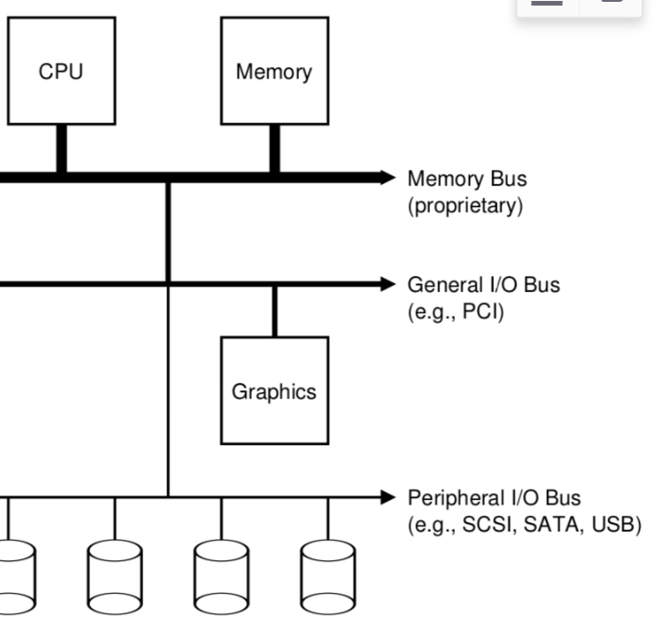
I/O
let’s look at a “classical” diagram of a typical system
The picture shows a single CPU attached to the main memory of the system via some kind of memory bus or interconnect.
Some devices are connected to the system via a general I/O bus, which in many modern systems would be PCI (or one of its many derivatives); graphics and some other higher-performance I/O devices might be found here.
Finally, lower down are one or more of what we call a peripheral bus, such as SCSI, SATA, or USB. These connect slow devices to the system, including disks, mice, and keyboards.

Slide 4
I/O
One question you might ask is: why do we need a hierarchical structure like this?
Put simply: physics, and cost. The faster a bus is, the shorter it must be;
Thus, a high-performance memory bus does not have much room to plug devices and such into it.
In addition, engineering a bus for high performance is quite costly.
Thus, system designers have adopted this hierarchical approach, where components that demand high performance (such as the graphics card) are nearer the CPU.
Lower performance components are further away. The benefits of placing disks and other slow devices on a peripheral bus are manifold; in particular, you can place a large number of devices on it.

Slide 5
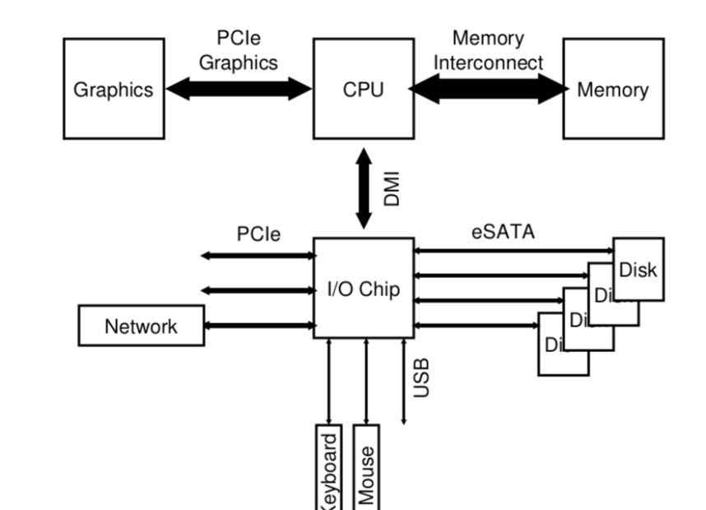
Modern System Architecture
Of course, modern systems increasingly use specialized chipsets and faster point-to-point interconnects to improve performance.
The figure on the right shows an approximate diagram of Intel’s Z270 Chipset.
Along the top, the CPU connects most closely to the memory system, but also has a high-performance connection to the graphics card (and thus, the display) to enable gaming (oh, the horror!) and other graphics-intensive applications.

Slide 6
Modern System Architecture Cont..
The CPU connects to an I/O chip via Intel’s proprietary DMI (Direct Media Interface), and the rest of the devices connect to this chip via a number of different interconnects.
On the right, one or more hard drives connect to the system via the eSATA interface;
The SATA represent an evolution of storage interfaces over the past decades, with each step forward increasing performance to keep pace with modern storage devices.
Below the I/O chip are a number of USB (Universal Serial Bus) connections, which in this depiction enable a keyboard and mouse to be attached to the computer.
USB is used for low-performance devices such as these.
Finally, on the left, other higher performance devices can be connected to the system via PCIe (Peripheral Component Interconnect Express).
Higher performance storage devices are often connected here.

Slide 7
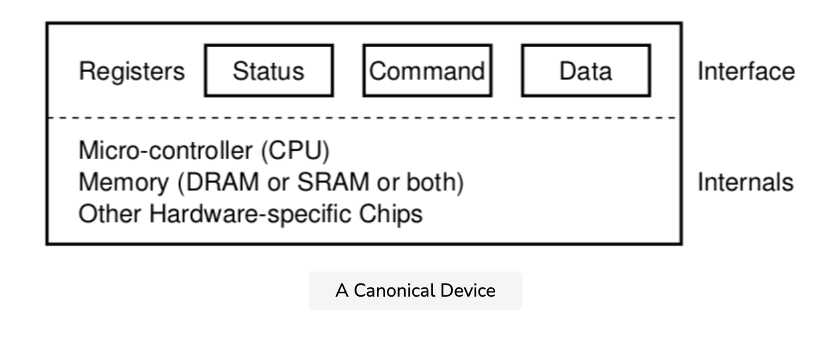
A Canonical Device
Let us now look at a canonical device (not a real one), and use this device to drive our understanding of some of the machinery required to make device interaction efficient.

Slide 8
Canonical Device – Continued
We can see that a device has two important components.
The first is the hardware interface it presents to the rest of the system. Just like a piece of software, hardware must also present some kind of interface that allows the system software to control its operation.
Thus, all devices have some specified interface and protocol for typical interaction.
The second part of any device is its internal structure.
Very simple devices will have one or a few hardware chips to implement their functionality.
More complex devices will include a simple CPU, some general-purpose memory, and other device-specific chips to get their job done.
For example, modern RAID controllers might consist of hundreds of thousands of lines of firmware (i.e., software within a hardware device) to implement its functionality.

Slide 9
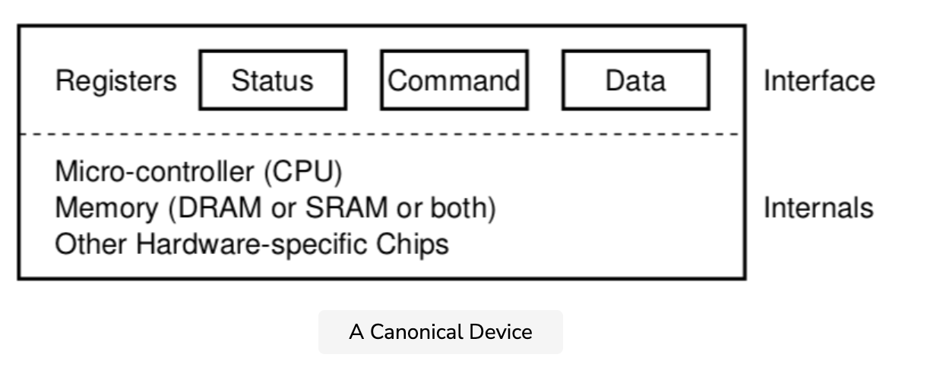
The Canonical Protocol
We will take a look at the protocol used by the OS to communicate with a canonical device
In the picture on the right, the (simplified) device interface is comprised of three registers:
A status register, which can be read to see the current status of the device.
A command register, to tell the device to perform a certain task.
A data register to pass data to the device or get data from the device.

Slide 10
The Canonical Protocol
By reading and writing these registers, the operating system can control device behavior.
Let’s describe a typical interaction that the OS might have with the device in order to get the device to do something on its behalf.
The protocol has 4 steps
While (STATUS == BUSY)
; // wait until device is not busy
Write data to DATA register
Write command to COMMAND register
(starts the device and executes the command)
While (STATUS == BUSY)
; // wait until device is done with your request

Slide 11
Canonical Device – Continued
We can see that a device has two important components.
The first is the hardware interface it presents to the rest of the system. Just like a piece of software, hardware must also present some kind of interface that allows the system software to control its operation.
Thus, all devices have some specified interface and protocol for typical interaction.
The second part of any device is its internal structure.
Very simple devices will have one or a few hardware chips to implement their functionality.
More complex devices will include a simple CPU, some general-purpose memory, and other device-specific chips to get their job done.
For example, modern RAID controllers might consist of hundreds of thousands of lines of firmware (i.e., software within a hardware device) to implement its functionality.

Slide 12
Polling
In the first, the OS waits until the device is ready to receive a command by repeatedly reading the status register
We call this polling the device (basically, just asking it what is going on).

Slide 13
Writing to the data register
Second, the OS sends some data down to the data register
One can imagine that if this were a disk, for example, that multiple writes would need to take place to transfer a disk block (say 4KB) to the device
When the main CPU is involved with the data movement (as in this example protocol), we refer to it as programmed I/O (PIO)

Slide 14
Writing to the command register
Third, the OS writes a command to the command register.
Doing so implicitly lets the device know that both the data is present and that it should begin working on the command.

Slide 15
Polling Again
Finally, the OS waits for the device to finish by again polling it in a loop, waiting to see if it is finished (it may then get an error code to indicate success or failure).
This basic protocol has the positive aspect of being simple and working.

Slide 16
Cost of Polling
However, there are some inefficiencies and inconveniences involved in the previous 4 steps.
The first problem you might notice in the protocol is that polling seems inefficient; specifically, it wastes a great deal of CPU time just waiting for the (potentially slow) device to complete its activity, instead of switching to another ready process and thus better utilizing the CPU.
How do we avoid the costs of polling?

Slide 17
Lowering CPU Overhead with Interrupts
The invention that many engineers came upon years ago to improve this interaction between OS and a device, is something we’ve covered already: the interrupt.
Instead of polling the device repeatedly, the OS can issue a request, put the calling process to sleep, and context switch to another task.
When the device is finally finished with the operation, it will raise a hardware interrupt, causing the CPU to jump into the OS at a predetermined interrupt service routine (ISR).
The routine is just a piece of operating system code that will finish the request (for example, by reading data and perhaps an error code from the device) and wake the process waiting for the I/O, which can then proceed as desired.

Slide 18
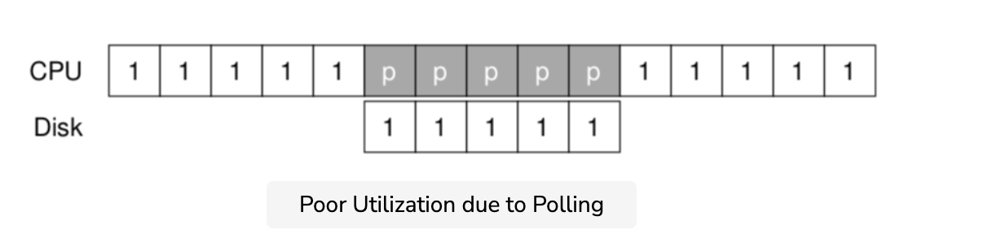
Improved Utilization
Interrupts thus allow for overlap of computation and I/O, which is key for improved utilization. This timeline shows the problem:
Process 1 runs on the CPU for some time, and then issues an I/O request to the disk to read some data.
Without interrupts, the system simply spins, polling the status of the device repeatedly until the I/O is complete (indicated by a p). The disk services the request and finally Process 1 can run again.

Slide 19
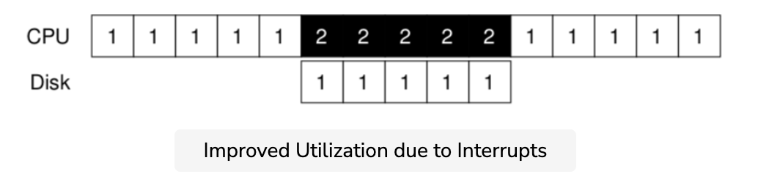
Improved Utilization - Interrupts
If instead we utilize interrupts and allow for overlap, the OS can do something else while waiting for the disk:
In this example, the OS runs Process 2 on the CPU while the disk services Process 1’s request.
When the disk request is finished, an interrupt occurs, and the OS wakes up Process 1 and runs it again. Thus, both the CPU and the disk are properly utilized during the middle stretch of time.

Slide 20
Problems with Interrupts
Using interrupts is not always the best solution.
For example, imagine a device that performs its tasks very quickly: the first poll usually finds the device to be done with a task.
Using an interrupt, in this case, will actually slow down the system because switching to another process, handling the interrupt, and switching back to the issuing process is expensive.
Thus, if a device is fast, it may be best to poll. If it is slow, interrupts, which allow overlap, are best.

