Slide 1
Operating Systems 1: 2021-2022 News

Slide 2
Contents
Windows 11
Android 12
iOS 12
macOS 12
Linux 5

Slide 3
Windows 11
NEW RELEASE: 21H2 (Build 10.0.22000.438)
RELEASE DATE: October 2021
KEY CHANGES:
New design with a centred Start menu and Taskbar
Improved performance, virtual desktop support & widgets
Teams & Android apps integration
Xbox gaming enhancements
BUG FIXES: https://docs.microsoft.com/en-us/windows/release-health/resolved-issues-windows-11-21h2

Slide 4
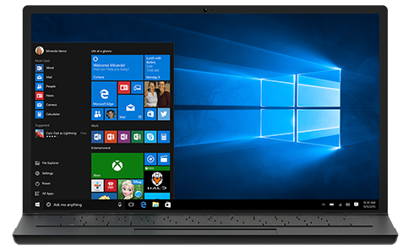
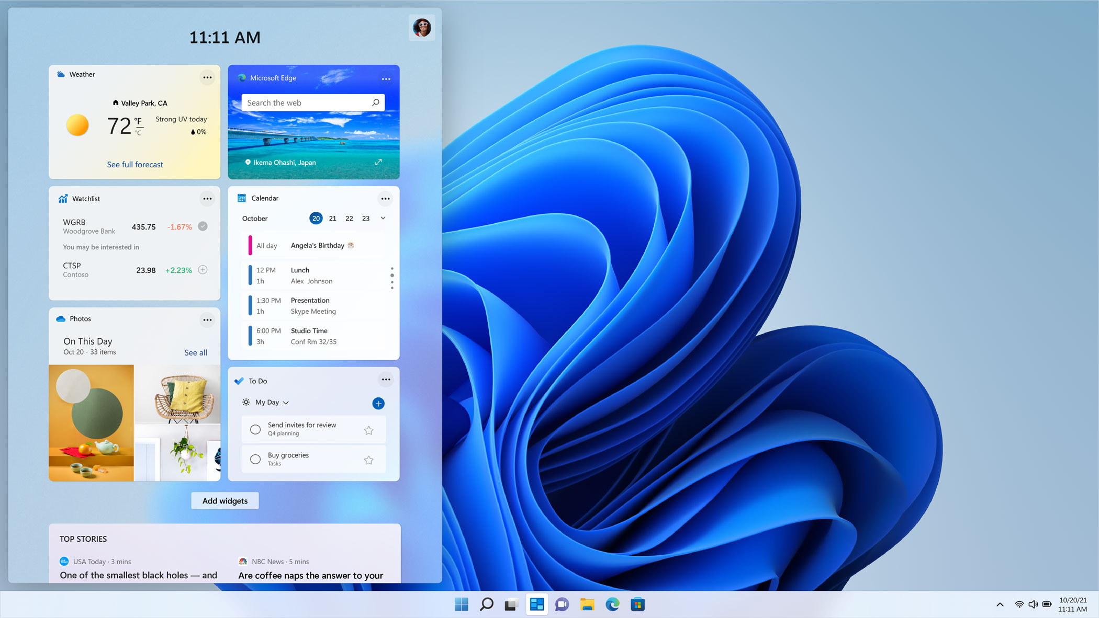
Windows 11

Slide 5
Android 12
NEW RELEASE: Version 12.0 (12.0.0_r26)
RELEASE DATE: October 2021
KEY CHANGES:
Performance enhancements to improve transitions, power efficiency, and reduce app startup times
One Handed Mode & Gestures can work in immersive mod
Privacy Dashboard
Easier Wi-Fi sharing.
BUG FIXES: https://developer.android.com/about/versions/12/12L/feedback

Slide 6
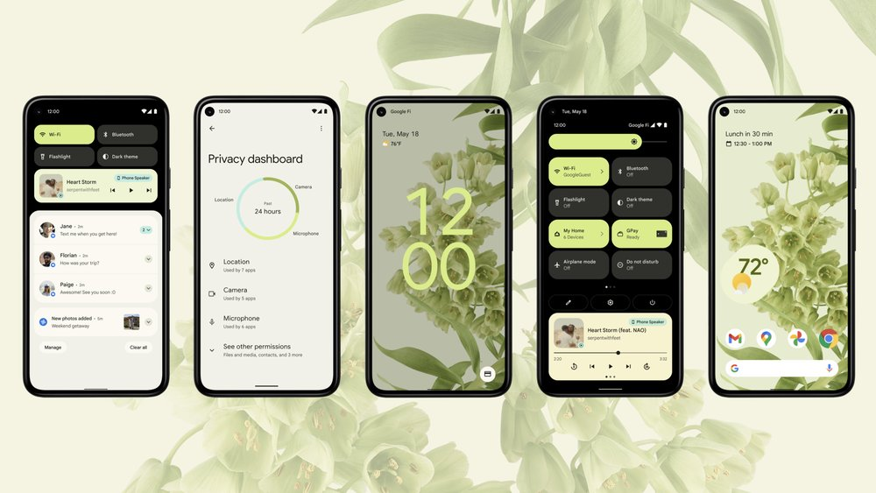
Android 12

Slide 7
iOS 12
NEW RELEASE: Version 15.2.1
RELEASE DATE: September 2021
KEY CHANGES:
Redesigned notifications.
"Focus" for reducing distractions.
Spatial Audio and SharePlay in FaceTime calls.
Text recognition in images.
ID cards in Wallet app.
Added privacy features.
Safari, Maps, Weather, and Notes app redesigns.
BUG FIXES: https://support.apple.com/en-us/HT201222

Slide 8
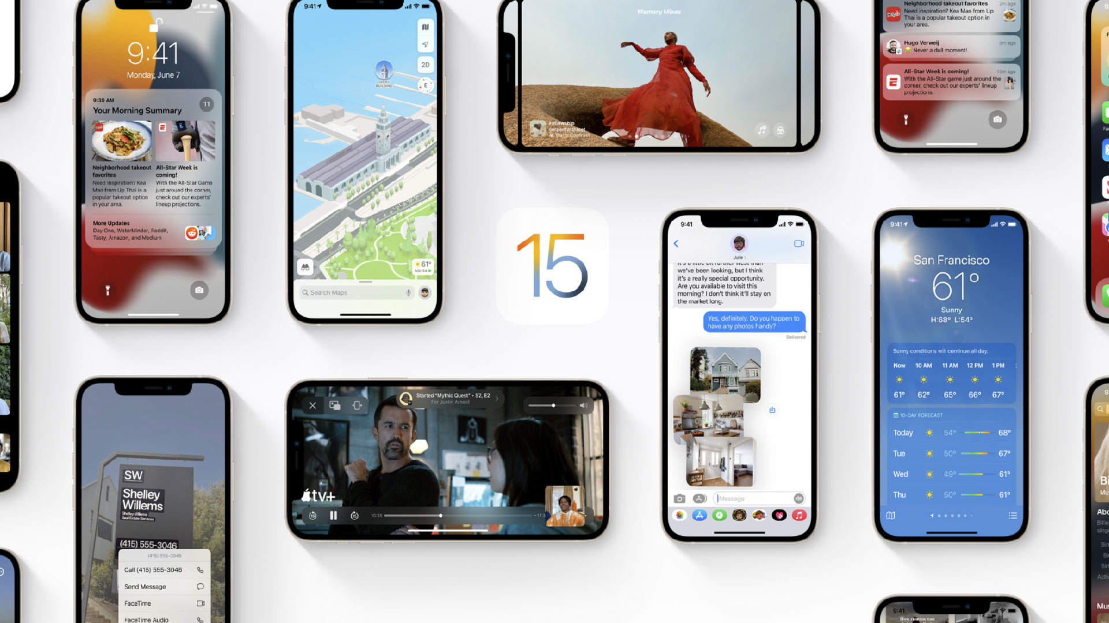
iOS 12

Slide 9
macOS 12
NEW RELEASE: Version 12 Monterey
RELEASE DATE: October 2021
KEY CHANGES:
FaceTime upgrades: SharePlay, spatial audio, and more
Universal Control across devices with single mouse or trackpad
Safari revamp
Shortcuts app
Live Text and Visual Lookup
Privacy enhancements
BUG FIXES: https://developer.apple.com/documentation/macos-release-notes/

Slide 10
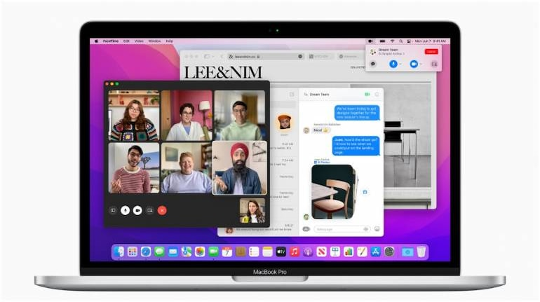
macOS 12

Slide 11
Linux 5
NEW RELEASE: Version 5.16
RELEASE DATE: January 2022
KEY CHANGES:
“This mainly contains some driver fixes (mainly networking and rdma), a cgroup credential use fix, a few core networking fixes, a couple of last-minute reverts, and some other random noise. The appended shortlog is so small that you might as well scroll through it..."
https://lore.kernel.org/lkml/CAHk-=wgUkBrUVhjixy4wvrUhPbW-DTgtQubJWVOoLW=O0wRKMA@mail.gmail.com/T/#u

Slide 12

Linux 5

