Slide 1
Network Management

Slide 2
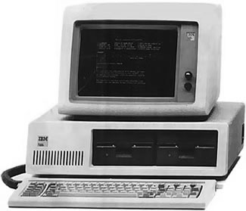
Computer Networks
When we hook up computers together using data communication facilities, we call this a computer network.

Slide 3
Computer Networks
When we hook up computers together using data communication facilities, we call this a computer network.

Slide 4
Computer Networks
When we hook up computers together using data communication facilities, we call this a computer network.

Slide 5
Computer Networks
By creating a network computers get to share resources, CPU, memory, etc.
There are two ways to configure operating systems to make them network enabled
Network Operating System (NOS)
Distributed Operating System (D/OS)

Slide 6
Computer Networks
A Network Operating System (NOS) is for a single-user operating system. Users are aware of other resources and computer on the network and can access them by logging into the appropriate remote host.
A Distributed Operating System (D/OS) is for a multi-user operating system. Users can access other resources and computer on the network in a unified way. Every resource is visible on every site.

Slide 7
Computer Networks
A Site is a specific location in a network containing two or more computer systems.
A Host is a is a specific computer system in a site that provides services.
A Node is the name assigned to the host to identify it to other computers.

Slide 8
Computer Networks
Site
Host
Node

Slide 9
Network Topologies

Slide 10
Network Topologies
Computer networks can also be categorized in terms of network topologies
We can hook up the network into various shapes (or topologies). The most common shapes are:
Star
Ring
Bus
Tree
Hybrid
There are advantages and disadvantages to each shape (or topology).

Slide 11
Star Topologies
All end systems talk to each other through one central device such as a router or switch.
Routers and switches are discussed in-depth in the data link layer chapter

Slide 12
Star Topologies
This topology make routing very easy since the central controller is connected to all other hosts and knows the path to all hosts.
It allows for more direct connections as each host is directly connected to the central controller. This should also result in better performance.

Slide 13
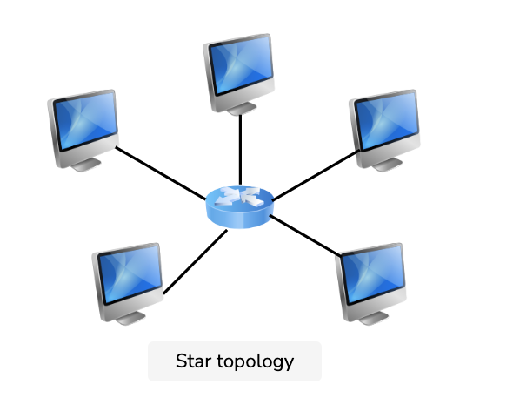
Star Topologies

Slide 14
Star Topologies
ADVANTAGES
It is very reliable and robust – if one cable or device fails then all the others will still work.
Each device only need one I/O port as it is connected only to the central controller with one cable.
No disruptions to the network when connecting or removing devices.
No data collisions can occur.
Easy to put in and to troubleshooting.

Slide 15
Star Topologies
DISADVANTAGES
If the central controller goes down everything goes down, none of the devices can work without it.
The central controller requires more resources and regular maintenance because it’s the central system of star.
Performance is predicated on the one concentrator: the central controller.

Slide 16
Ring Topologies
A ring topology is one where all hosts are connected together in a closed loop.

Slide 17
Ring Topologies

Slide 18
Ring Topologies

Slide 19
Ring Topologies
Host
1
Host
2
Host
6
Host
3
Host
5
Host
4

Slide 20
Ring Topologies
Data is passed around in packets and typically is passed in one direction around the loop.
The packet knows its Source and Destination hosts.
It will loop from the Source, around to the Destination host, which makes a copy of the packet, and the original packet continues the loop back to the Source.

Slide 21
Ring Topologies
Sending a message from
Host 1 to Host 6
Host
1
Host
2
Host
6
Host
3
Host
5
Host
4

Slide 22
Ring Topologies
ADVANTAGES
Data flows in one direction which reduces the chance of packet collisions.
Additional workstations can be added without impacting performance.
Equal access to the resources.
No need of server to control the connectivity among the nodes.
It is cheap to install and expand.
Speed to transfer the data is very high in this type of topology.
Easy to manage.

Slide 23
Ring Topologies
DISADVANTAGES
In the uni-directional ring, a data packet (token) must have to pass through all the nodes.
If one workstation shuts down, it affects whole network or if a node goes down entire network goes down.
Addition and removal of any node during a network is difficult and may cause issue in network activity.
Difficult to troubleshoot the ring.
Total dependence in on one cable.

Slide 24
Bus Topologies
A bus topology is one where all the sites are connected to a single communications line (or bus) running the length of the network.
Every end system will receive any signal that is sent on the main or backbone medium. The medium can be guided or unguided.

Slide 25
Bus Topologies

Slide 26
Bus Topologies

Slide 27
Bus Topologies
Host
1
Host
2
End-point
Controller
End-point
Controller
Host
3
Host
4
Host
5

Slide 28
Bus Topologies
Hosts can send data from one host to another via the bus, the message will usually be sent in both directions, and will keep travelling until they reach the End-Point Controllers.
So, if I want to send from Host 1 to Host 3.

Slide 29
Bus Topologies
Sending a message from
Host 1 to Host 3
Host
1
Host
2
End-point
Controller
End-point
Controller
Host
3
Host
4
Host
5

Slide 30
Bus Topologies
Sending a message from
Host 1 to Host 3
Host
1
Host
2
End-point
Controller
End-point
Controller
Host
3
Host
4
Host
5

Slide 31
Bus Topologies
Some bus topologies only allow a packet to travel in one direction until it reaches the end-point controller, who can send it back in the opposite direction if the destination hasn’t received the packet yet.

Slide 32
Bus Topologies
ADVANTAGES
It is the easiest network topology for connecting peripherals or computers in a linear fashion.
It works very efficient well when there is a small network.
Length of cable required is less than a star topology, thus it is cheaper.
It is easy to connect or remove devices without affecting any other device.
It is easy to understand and expand as this requires joining two cables.

Slide 33
Bus Topologies
DISADVANTAGES
Not great for large networks.
Troubleshooting of individual device issues can be very hard especially when the whole network goes down.
Need of terminators are required at both ends of main cable and these additional devices can slow the network down.
If a main cable is damaged, whole network fails or splits into two.
Packet loss is high.
Very slow as compared to other topologies.

Slide 34
Tree Topologies
A tree topology is a combination of bus topologies. The cables branch out, and there are no closed loops.
The tree begins at a Head End Controllers and each branch terminates at an End Point Controller.

Slide 35
Tree Topologies
A packet from one node to another will be sent down all branches and will be absorbed by the End Point Controllers of the branches that does not contain the Destination host.
Let’s do an example of going from Host 4 to Host 5.

Slide 36
Tree Topologies

Slide 37
Tree Topologies

Slide 38
Tree Topologies
Host
1
Host
2
End point
Controller
Host
3
Host
4
Head end
Controller
End point
Controller
Host
5
Host
6
End point
Controller

Slide 39
Tree Topologies
Host
1
Host
2
Sending a message from
Host 5 to Host 4
End point
Controller
Host
3
Host
4
Head end
Controller
End point
Controller
Host
5
Host
6
End point
Controller

Slide 40
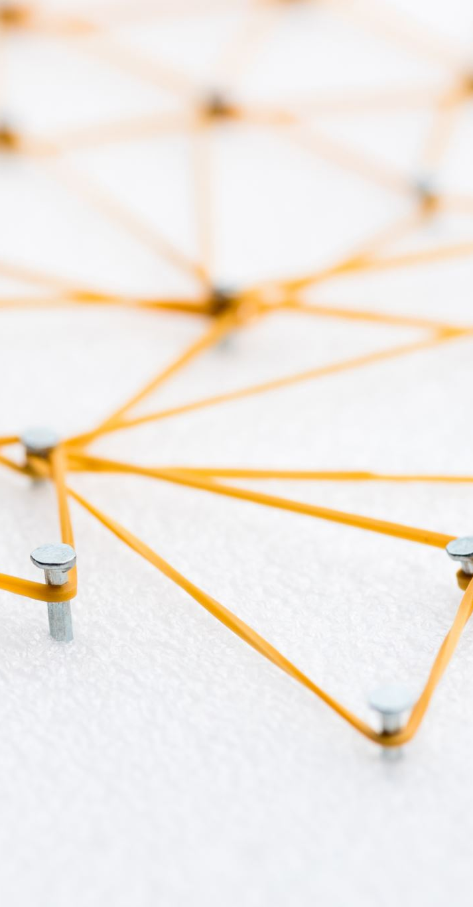
Tree Topologies
ADVANTAGES
This topology is also known as the star-bus topology. It essentially consists of a bunch of star networks connected together with a large bus.
It provides high scalability as leaf nodes can be easily added to the hierarchical chain.
If one or more nodes are not working, the other nodes are not affected.
It provides easy maintenance and fault identification.
A callable topology. Leaf nodes can hold more nodes.

Slide 41

Tree Topologies
DISADVANTAGES
Difficult to configure and troubleshooting as compared to the other topologies.
Due to the large number of nodes, the performance is a bit slower than other topologies.
Requires large number of cables compared to star and ring topologies, thus it is more expensive.
As all data needs to travel through the central cable, this creates dense network traffic.
Damages to a central cable affect the entire segment of the network.

Slide 42
Hybrid Topologies
A hybrid topology is one which combines any two of the previous topologies.

Slide 43
Hybrid Topologies
STAR + BUS

Slide 44
Hybrid Topologies
H1
H2
H7
H8
H6
CC
H3
EPC
EPC
H5
H4
H9
H10

Slide 45
Hybrid Topologies
H1
H2
H7
H8
H6
CC
EPC
H5
H4
H9
H10

Slide 46
Hybrid Topologies
RING + BUS

Slide 47
Hybrid Topologies
H1
H2
H7
H8
H6
H3
EPC
EPC
H5
H4
H9
H10

Slide 48
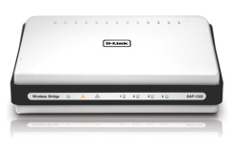
Hybrid Topologies
H1
H2
H7
H8
H6
EPC
H5
H4
H9
H10

Slide 49
Hybrid Topologies
H1
H2
H7
H8
H6
EPC
Switch
H5
H4
H9
H10

Slide 50
Hybrid Topologies
STAR + RING

Slide 51
Hybrid Topologies
H1
H2
H7
H8
H6
CC
H3
H12
H9
H5
H4
H11
H10

Slide 52
Hybrid Topologies
H1
H2
H7
H8
H6
CC
H9
H5
H4
H11
H10

Slide 53
Hybrid Topologies
H1
H2
H7
H8
H6
CC
H9
Switch
H5
H4
H11
H10

Slide 54
Network Types

Slide 55
Network Types
We can classify networks by the geographical distance they cover:
Local Area Network (LAN)
Metropolitan Area Network (MAN)
Wide Area Network (WAN)
Wireless Local Area Network (WLAN)

Slide 56
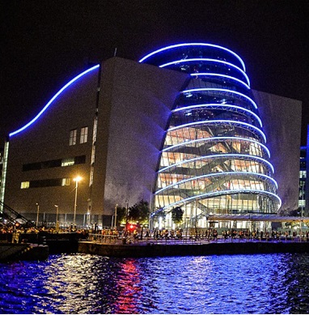
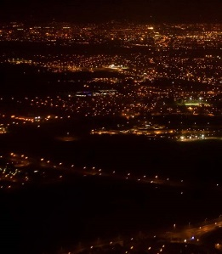
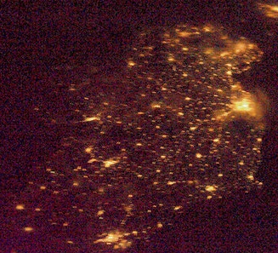
Network Types
LAN
MAN
WAN

Slide 57
Network Types
A Local Area Network (LAN) is a network within a single building or campus, such as an office, a college, or a warehouse. It is typically owned and used by a single organisation. Typically, it’s a cluster of PCs or workstations. A LAN can be linked to larger networks via a bridge or gateway.

Slide 58
Network Types
A Metropolitan Area Network (MAN) is a network that covers a full street, a neighbourhood, or even a city, as long as it doesn’t exceed a circumference of 100 kilometres. The MAN is often owned and run as a public utility and are typically configured as a Ring Topology.

Slide 59
Network Types
A Wide Area Network (WAN) is a network that a country or connects countries. The WAN is often owned and run as a public utility, but telephone companies have WANs also. WANs can use anything for satellites to microwaves transmissions. The most common example of a WAN is the Internet, but there are other commercial WANs.

Slide 60
Network Types
A Wireless Local Area Network (WLAN) is a wireless LAN. It works the same as a normal LAN, but the technology means that the network uses a wireless protocol such as IEEE 802.11a, IEEE 802.11b, IEEE 802.11g, or IEEE 802.11n. Additionally 802.16 (the mobile WiMAX standard) is available.

Slide 61
IP Addresses & Subnets

Slide 62
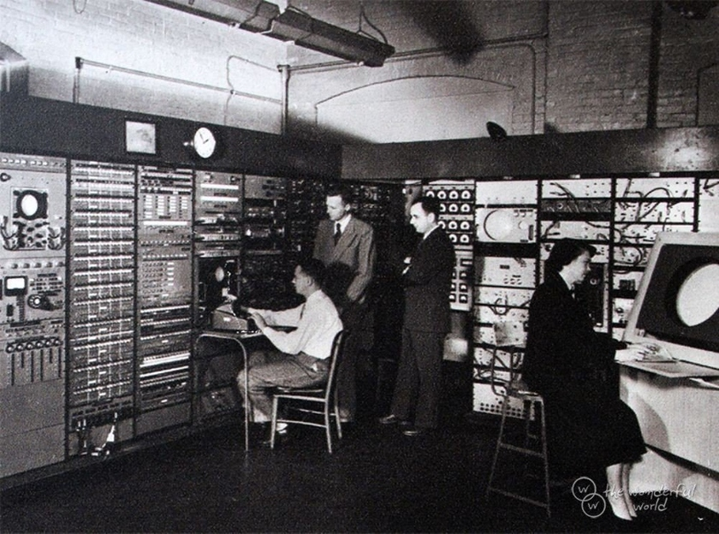
ARPANET
Advanced Research Projects Agency Network (ARPANET)
First modern computer network (1969)
Each address is 1 byte long
Maximum Capacity (11111111)?

Slide 63



Network Congestion
Too many devices on a network leads to chatter
Smaller subnetworks are the solution
IP address subnets ensure traffic stays within a subnet
A
B
workstation
workstation
workstation
hub
workstation
printer

Slide 64
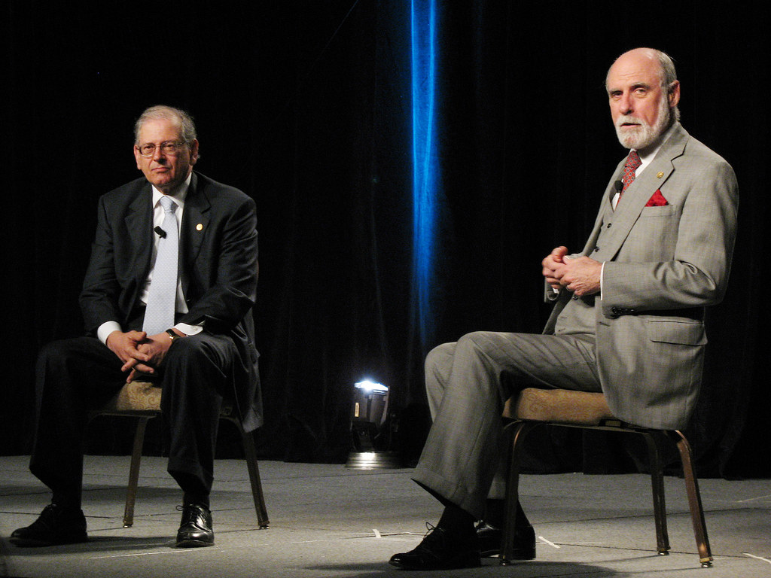
IPv4
Cheaper networks = more nodes
TCP/IP needs to scale
Vint Cert and Bob Kahn created the modern version: IPv4
They won the presidential medal of honor in 2005 for their work

Slide 65
Introduction to IP Subnetting
IP subnetting is a very important aspect of the design and functionality of computer networks.
If it’s not organized in an efficient way, it can lead to increased costs and lower network performance.
In the physical world, there are different street names and house numbers on each street to uniquely identify different buildings.
Similarly, different networks are identified by different network addresses, and devices on a given network are differentiated by means of a unique host address.
Both network and host identification is part of the IP address.
Some bits are reserved for network addresses, while the others are used for the host portion.

Slide 66
Why is IP Subnetting Necessary
The way IP addresses are constructed makes it relatively simple for Internet routers to find the right network to route data into. However there could be millions of connected devices, and it could take some time for the data to find the right device.
This is why subnetting comes in handy: subnetting narrows down the IP address to usage within a range of devices.

Slide 67
What does an IP Address look like?
Now, let’s take an in-depth look at what an IP address looks like:
The Network portion: The size, in bits, dictated by the network mask.
The Host portion: The remaining bits out of the total 32 as determined by the network mask.
The Network Mask: Indicates the size of a network (the total number of IP addresses that make up the network).

Slide 68
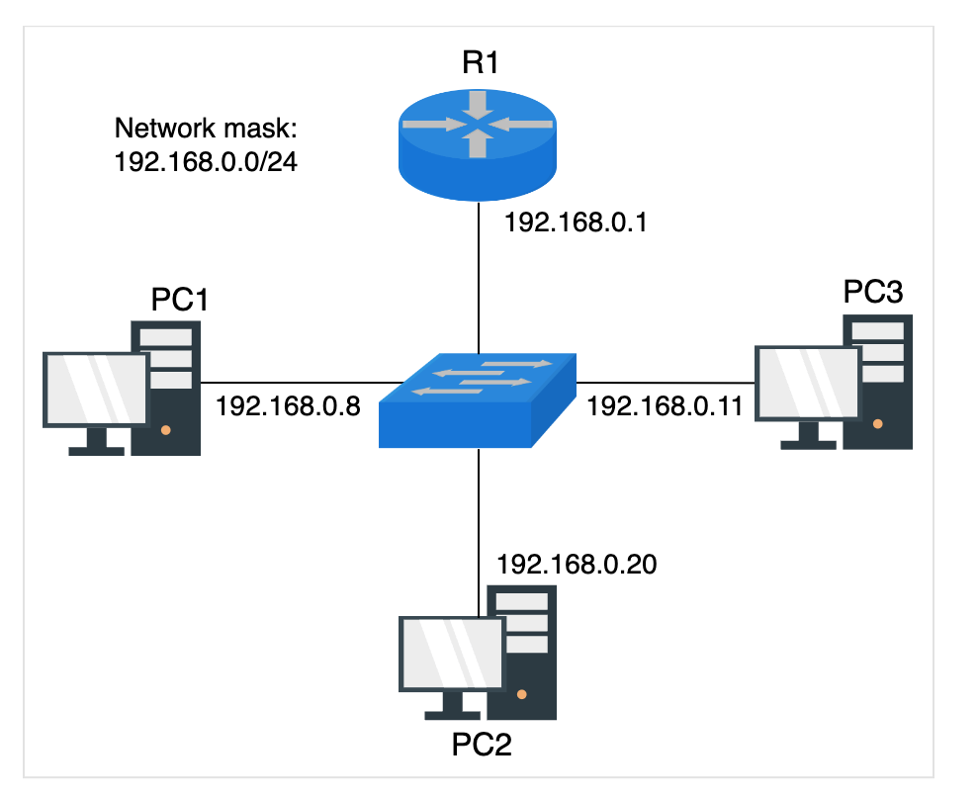
Assigning the IP Address
Let’s assign IP addresses to three devices PC1, PC2, and PC3 as shown in the figure on the right.
Here is an example with the IP address 192.168.0.0/24, which is a network address.
The /24 represents the mask, meaning that the first 24 bits represent the network portion, and the remaining 8 bits represent the host portion.
If we want to allocate IP addresses on the 192.168.0.0 network, then the first three fields will remain the same (192.168.0), and the last field will be used to identify each device (from .1 to .254 – these are picked at random)

Slide 69
Why do we subnet
As networks grow larger and more complex day by day, traffic also requires fast and efficient routes.
Subnetting provides a mechanism named route aggregation that limits the size of the routing table that each router has to maintain.
This helps maintain efficient network speed and enhances performance.
Benefits
Some benefits of subnetting are listed below:
Subnetting splits broadcast domains, thus improving network speed and performance.
It reduces congestion and bottleneck problems.
It enhances network security, as devices don't access the whole network.

Slide 70
Classful Addressing in IPv4
Classful addressing divides the available IP address into five classes: A, B, C, D, and E. This architecture divides the address into classes based on the fixed number of blocks assigned to the host ID and network ID.
Class A networks can connect millions of devices. Class B networks and Class C networks are progressively smaller in size.
Class A network: Everything before the first period indicates the network, and everything after it specifies the device within that network. Using 203.0.113.112 as an example, the network is indicated by "203" and the device by "0.113.112.” resulting in 2²⁴ hosts
Class B network: Everything before the second period indicates the network. Again using 203.0.113.112 as an example, "203.0" indicates the network and "113.112" indicates the device within that network, resulting in 2¹⁶ hosts
Class C network: For Class C networks, everything before the third period indicates the network. Using the same example, "203.0.113" indicates the Class C network, and "112" indicates the device, resulting in 2⁸ hosts

Slide 71
Classless Inter-Domain Routing (CIDR)
Classful addressing caused a lot of wastage of the hosts due to its rigid architecture.
To resolve this issue, the IP addresses required flexibility over the number of host IDs assigned to the network. Therefore, CIDR was introduced. It is also referred to as classless addressing.

Slide 72
Classless Inter-Domain Routing (CIDR)
CIDR lets us say how to split an IP address into network / host
135.70.2.2 / 24
24 bits (3 bytes) network

Slide 73
Classless Inter-Domain Routing (CIDR)
CIDR lets us say how to split an IP address into network / host
135.70.2.2 / 24
network
host

Slide 74
Classless Inter-Domain Routing (CIDR)
CIDR lets us say how to split an IP address into network / host
135.70.2.2 / 24
24 bits (3 bytes) network
135.70.2.2 / 16
16 bits (2 bytes) network
135.70.2.2 / 8
8 bits (1 byte) network

Slide 75
Classless Inter-Domain Routing (CIDR)
CIDR lets us say how to split an IP address into network / host
135.70.2.x / 24
24 bits (3 bytes) network
135.70.x.x / 16
16 bits (2 bytes) network
135.x.x.x / 8
8 bits (1 byte) network

Slide 76
Pre-requisites of subnetting
Before we start with IP subnetting, we must first answer the following questions.
How many IP addresses can we assign with a given mask? (for example, /24)
What are the first and last IP addresses for a given network address?
Which IP addresses from the network can be used?

Slide 77
Subnetting Examples
Let’s take another example with the 10.222.24.0/24 network and answer the three questions:
The maximum number of IP addresses from a network mask of /24 is 256256 (32−24=8, 28=256).(32−24=8, 28=256).
First IP: 10.222.24.0. Last IP: 10.222.24.255
All of the IP addresses from 10.222.24.1 to 10.222.24.254 are usable in the network.
Note: The addresses 10.222.24.0 and 10.222.24.255 are not usable because they are network and broadcast addresses respectively.

Slide 78
Subnetting Examples Continued
In this example, let’s take the 172.22.9.0/27 network and answer the three questions:
The maximum number of IP addresses from a network mask of /27 is 3232 (32−27=5, 25=32).(32−27=5, 25=32).
First IP: 172.22.9.0. Last IP: 172.22.9.31.
All of the IP addresses from 172.22.9.1 to 172.22.9.30 are usable in the network.
Note: The addresses 10.222.24.0 and 10.222.24.31 are not usable because they are network and broadcast addresses respectively.

Slide 79
Subnet Mask
A subnet mask allows us to specify network and host from an IP address.
255.255.255.0
135.70 .2 .2

Slide 80
Subnet Mask
A subnet mask allows us to specify network and host from an IP address.
255.255.255.0
135.70 .2 .2
network
host

Slide 81
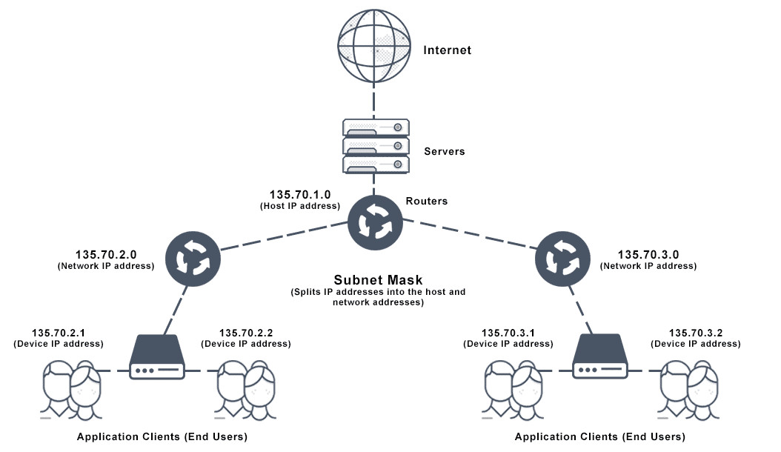
Subnets
135.70.2.2

Slide 82
Subnets
135.70.2.2

Slide 83
Subnets
135.70.2.2

Slide 84

Introduction to IPv6
Currently, there are more than 20 billion devices connected to the Internet all around the world, and the number increases every day.
This is a major problem for Internet Service Providers (ISPs) because this number far exceeds the 4.3 billion provided by IPv4.

Slide 85
Introduction to IPv6
IPv6 is a new addressing protocol with a hexadecimal address format.
Because of this, it has a much larger address space IPv4.
IPv6 is 128 bits, therefore it allows:
2^{128} = 340,282,366,920,938,463,463,374,607,431,768,211,4562128=340,282,366,920,938,463,463,374,607,431,768,211,456 possible IP addresses.
Compared to 4.34.3 billion, this is infinitely long!

Slide 86
Introduction to IPv6
IPv6 will streamline the communication process of devices on the internet, making it faster and more secure.
An IPv6 address looks like 2003:4581:A7C1:EFDB:0000:0000:1327:0001
As we can see, this address is quite different from an IPv4 address such as 192.168.1.1.
The IPv6 addresses are formed out of hexadecimal characters.
Note: Hexadecimal characters use numbers from 0 to 9 and capital letters from A to F.

Slide 87
IPv6 Address Types
There are two types of IPv6 addresses:
Global addresses such as 2000::/3 (used on the Internet).
Link-local addresses such as FE80::/10 (used in LANs).
We will discuss them both in detail

Slide 88
IPv6 Global Addresses
The IPv6 global addresses are similar to public IPv4 addresses in that they can be used on the internet as well as on LANs.
It is easy to recognize these global addresses because they always start with the number 2 or 3 (due to their subnet mask -> 2000::/3).
In the next slide we can see the structure of such an IPv6 address:

Slide 89
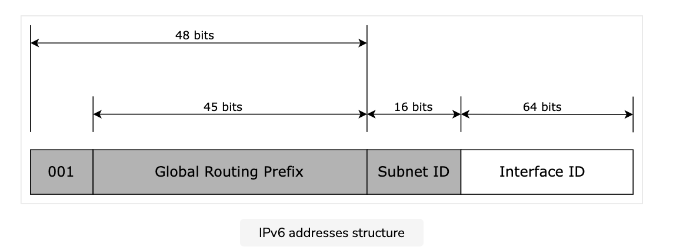
IPv6 Global Addresses
The first three bits are reserved, which is why the IPv6 Global addresses start with 2).
After this resides the global routing prefix (the addressing space that has been reserved for the ISP).
The subnet ID represents the ID of the networks (a total of 2^{16} = 65536216=65536).
The last field, the Interface ID, is basically the device’s IPv6 address.

Slide 90
IPv6 Link-Local Addresses
There are special addresses that make the communication, between devices (PCs, Laptops, Smartphones, etc.), within a local area network (LAN), possible.
The advantage of these types of addresses is that they have configured automatically and do not require any user intervention.
Link-local IPv6 addresses are in the FE80:: /10 format.
This means that they begin with FE80, and the rest of the address is generated automatically by EUI-64.

Slide 91

Questions

