Slide 1
Data Structures

Slide 2
Data Structures
Data Structures are a specialized means of organizing and storing data in computers in such a way that we can perform operations on the stored data more efficiently.

Slide 3

What is a queue?
Queue is linear data structure that stores the elements in a sequential manner.
Queue implements the FIFO method, which is short for First in First Out.
According to FIFO, the first element inserted is the one that comes out first.
You can think of a queue as a pipe with both ends open. Elements enter from one end (back) and leave from the other (front).

Slide 4
What are Queues used for?
Most operating systems also perform operations based on a Priority Queue (a kind of queue) which allows operating systems to switch between appropriate processes.
We generally use Queues when:
We want to prioritize something over another
A resource is shared between multiple devices

Slide 5
Operations on a queue
A typical Queue needs the following set of functions to work perfectly. These operations are listed below in the table:
Function | What does it do?
enqueue(value) | inserts element to the end of queue
dequeue() | removes an element from the start of queue
getFront() | returns the first element of the queue
isEmpty() | checks if the queue is empty

Slide 6

What is a stack?
Stack is a linear data structure in which the element inserted last is the element to be deleted first.
It is also called Last In First Out (LIFO).
In a stack, the last inserted element is at the top.
The last item to join the stack is the first item to be served (peek).

Slide 7

Operations on a stack
Operations of the stack are
push(): inserts an element into the stack at the end
pop(): deletes and returns the last inserted element from the stack
peek(): returns the last inserted element

Slide 8
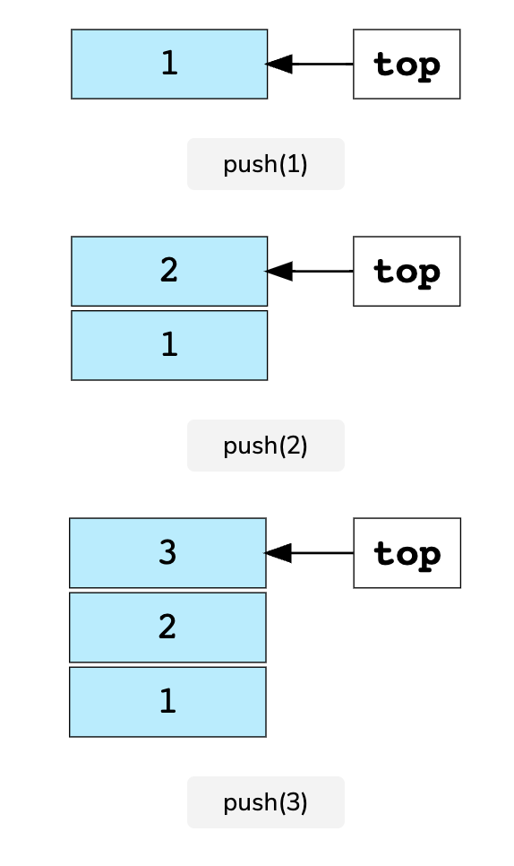
Stack, illustration
After inserting three elements in the stack, it will look like this:

Slide 9
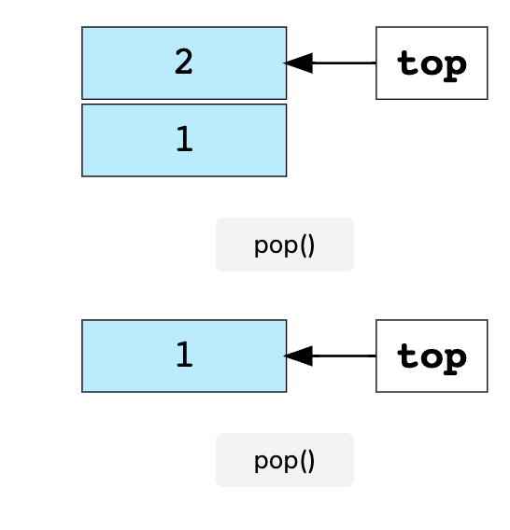
Stack, illustration
After performing the pop operation twice, the stack elements will look like:

Slide 10
Stack – Use Cases
A stack is one of the most fundamental data structures.
Its implementation is very simple, yet it can be used to solve complex problems!
Stacks are used for the below actions:
To backtrack to the previous task/state, e.g., in a recursive code, or undo in Microsoft Word
Back buttons for navigation

Slide 11
What is a heap?
A heap is a specialized tree-based data structure which is a complete tree that satisfies the heap property.
Max heap - In a max heap the value of a node must be greatest among the node values in its entire subtree.
The same property must be recursively true for all nodes in the tree.
Min heap - In a min heap the value of a node must be smallest among the node values in its entire subtree. The same property must be recursively true for all nodes in the tree.
A heap is a useful data structure when it is necessary to repeatedly remove the object with the highest (or lowest) priority, or when insertions need to be interspersed with removals of the root node.

Slide 12
Heap - Use Cases
The hospital triage process is a quintessential priority queue.
Patients are sorted based on the severity of their condition.
For example, a person with the cold comes in and he is placed near the end of the queue.
Then a person who had a car accident comes in, and he is placed before the person with the cold even though he came in later because his condition is more severe.
Severity is the key in this case

