Slide 1
Processor Management

Slide 2
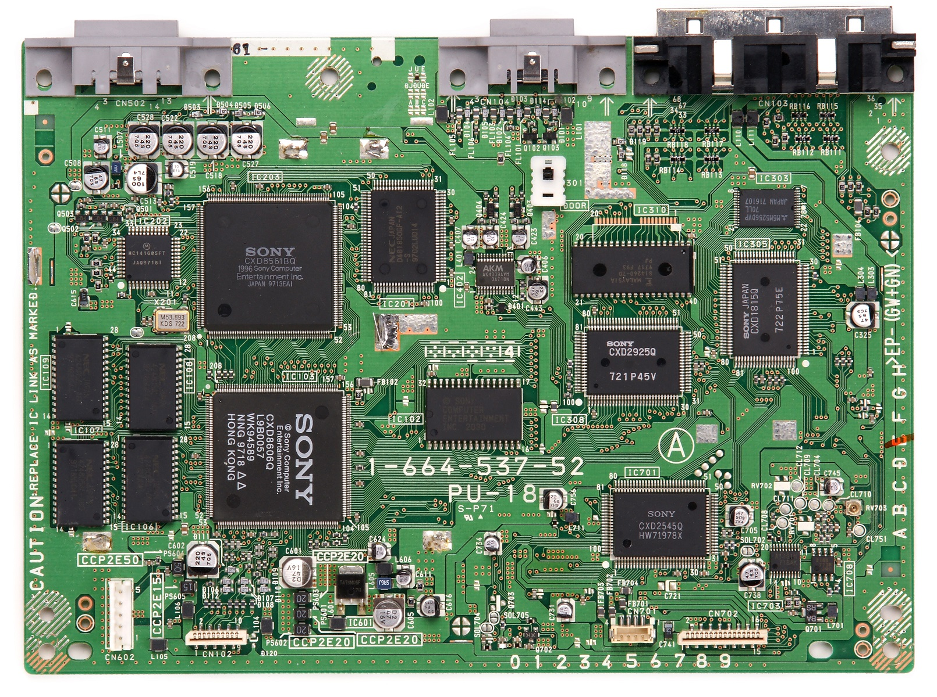

Slide 3
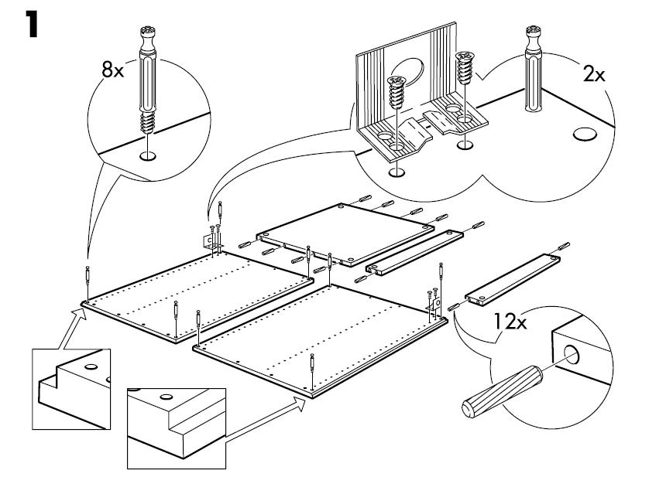
Processor Management
If you were assembling some IKEA furniture and following the step-by-step guide of 20 steps.
Imagine you did step 1, then step 2, then step 3, suddenly the doorbell rang,
and you are interrupted.

Slide 4
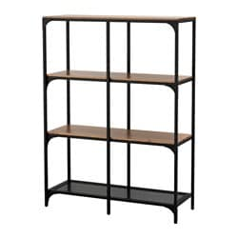
Processor Management
You would stop what you are doing and deal with whoever is at the door.
Then you would return to the assembly, check what step you were on, and then continue
on from there (step 4).

Slide 5
Processor Management
This is how the computer runs multiple processes simultaneously … you do a few steps on one process, get interrupted, work on other processes, then return to the first process, remembering where you left off from, and continue on.
This swapping of processes is called a pre-emptive scheduling policy.

Slide 6
Processor Management
A “Process” is the basic unit of execution in the operating system
A “Process” is the name we give to a program when it is running in memory
So, a “Program” is the complied executable
And a “Process” is the running executable with the execution state.

Slide 7
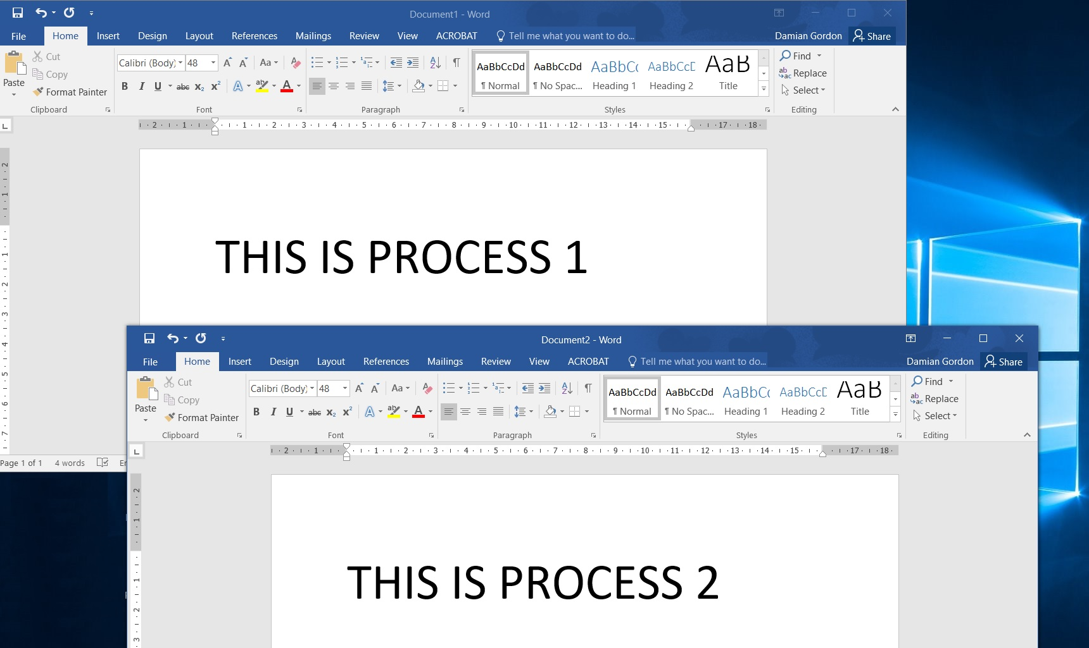

Slide 8
Processor Management
The same program being run by two different users in the operating system are two different processes
User 1
Process
1
Running
Executable 1
Execution
State 1
User 2
Process
2
Running
Executable 1
Execution
State 2

Slide 9
Processor Management
The Processor Manager is made up of two sub-managers:
Job Scheduler
Process Scheduler

Slide 10
Processor Management
Process
5
Process
4
Process
3
Process
2
Process
1
Job Scheduler
Process Scheduler

Slide 11
Processor Management
Job Scheduler
Process Scheduler

Slide 12
Processor Management
Job Scheduler
Process
2
Process
3
Process
4
Process
5
Process
6
Process Scheduler
Process
1

Slide 13
Job Scheduler
We describe a collection of processes as a “job”.
When the operating systems is presented with a job (or group of processes) to run, the Job Scheduler has the task of deciding which order to run the processes.
The Job Scheduler wants to ensure that the all components of the operating system are busy, and there is no component that is idle.

Slide 14
Job Scheduler
Let’s think about this program:
PROGRAM PrintValue:
BEGIN
Input A;
Input B;
C = A + B;
D = A – B;
Print “The sum of inputs is: “, C;
Print “The Difference of inputs is: “, D;
END.

Slide 15
Job Scheduler
Let’s think about this program:
PROGRAM PrintValue:
BEGIN
Input A;
Input B;
C = A + B;
D = A – B;
Print “The sum of inputs is: “, C;
Print “The Difference of inputs is: “, D;
END.
I/O

Slide 16
Job Scheduler
Let’s think about this program:
PROGRAM PrintValue:
BEGIN
Input A;
Input B;
C = A + B;
D = A – B;
Print “The sum of inputs is: “, C;
Print “The Difference of inputs is: “, D;
END.
Reading from keyboard
I/O

Slide 17
Job Scheduler
Let’s think about this program:
PROGRAM PrintValue:
BEGIN
Input A;
Input B;
C = A + B;
D = A – B;
Print “The sum of inputs is: “, C;
Print “The Difference of inputs is: “, D;
END.
I/O
I/O

Slide 18
Job Scheduler
Let’s think about this program:
PROGRAM PrintValue:
BEGIN
Input A;
Input B;
C = A + B;
D = A – B;
Print “The sum of inputs is: “, C;
Print “The Difference of inputs is: “, D;
END.
I/O
I/O
Writing To
screen

Slide 19
Job Scheduler
Let’s think about this program:
PROGRAM PrintValue:
BEGIN
Input A;
Input B;
C = A + B;
D = A – B;
Print “The sum of inputs is: “, C;
Print “The Difference of inputs is: “, D;
END.
I/O
CPU
I/O

Slide 20
Job Scheduler
Let’s think about this program:
PROGRAM PrintValue:
BEGIN
Input A;
Input B;
C = A + B;
D = A – B;
Print “The sum of inputs is: “, C;
Print “The Difference of inputs is: “, D;
END.
I/O
Doing computation
CPU
I/O

Slide 21
Job Scheduler
Some programs do a lot of I/O, e.g. Graphics programs:
I/O
CPU
I/O

Slide 22
Job Scheduler
Others do a lot of computation, but little I/O, e.g. maths programs:
I/O
CPU
I/O

Slide 23
Job Scheduler
If the job scheduler gets jobs like this:

Slide 24
Job Scheduler
If the job scheduler gets jobs like this:
I/O Heavy
CPU Heavy

Slide 25
Job Scheduler
So, the job scheduler will take these jobs:
I/O Heavy
CPU Heavy

Slide 26
Job Scheduler
And swap them around, and pass them onto the Process Scheduler
CPU Heavy
CPU Heavy
CPU Heavy
I/O Heavy
I/O Heavy

Slide 27
Job Scheduler
In this case, the Job Scheduler wants to balance the processes coming in, so that the components of the operating system are all kept busy.
If we don’t change the order of processes, the CPU will be very busy, but the I/O component will be idle, and then vice versa.
This is not an optimal use of resources, so we swap them around.

Slide 28
Job Scheduler
We'll call jobs that are CPU-bound Batch Jobs, and we’ll call jobs that have a lot of I/O operations Interactive Jobs.
This is the first level of swapping of processes that will occur, and more will be done by the Process Scheduler. The Job Scheduler is looking at jobs (or groups of processes) and looking at the whole process from a high-level.
For obvious reasons, the Job Scheduler is also called the High-Level Scheduler.

Slide 29
Job Scheduler
Every process has a field that records their current status, called the Process Status.
When the process is first passed to the Job Scheduler from the operating system, its status is always set as HOLD.
When the Job Scheduler passes the process onto the Process Scheduler, its status is always changed to READY.

Slide 30
Processor Management
Process
5
Process
4
Process
3
Process
2
Process
1
Job Scheduler
HOLD
Process Scheduler
READY

Slide 31
Processor Management
Other statuses that a process can have are:
Job Scheduler
HOLD
FINISHED
Process Scheduler
RUNNING
READY
WAITING

Slide 32

Process Scheduler
Think about traffic lights:

Slide 33
Process Scheduler
This is the sequence:

Slide 34
Process Scheduler
HOLD
FINISHED
READY
RUNNING
WAITING

Slide 35
Process Scheduler
JOB SCHEDULER
HOLD
FINISHED
PROCESS SCHEDULER
READY
RUNNING
WAITING

Slide 36
Process Scheduler
HOLD
FINISHED
Admitted
Scheduler
Dispatch
Exit
READY
RUNNING
Interrupt
I/O or
Event completion
I/O or
Event wait
WAITING

Slide 37
Process Scheduler
As mentioned previously the process is first passed to the Job Scheduler from the operating system, its status is always set as HOLD. When the Job Scheduler passes the process onto the Process Scheduler, its status is always changed to READY.

Slide 38
Process Scheduler
When the CPU is available, the Process Scheduler will look at all the upcoming processes and will select one of them (based on a predefined algorithm).
Assuming there is memory free, the process will start running and its status is changed to RUNNING by the Process Scheduler.

Slide 39
Process Scheduler
After a predefined time, the process will be interrupted, and another process will take over the CPU, and the interrupted process will have its status changed to READY by the Process Scheduler. The status is saved the Process Control Block (PCB) assigned to the process. We will remember that this swapping of processes is called a pre-emptive scheduling policy.
When the CPU is available for this process again, the process status is changed to RUNNING by the Process Scheduler.

Slide 40
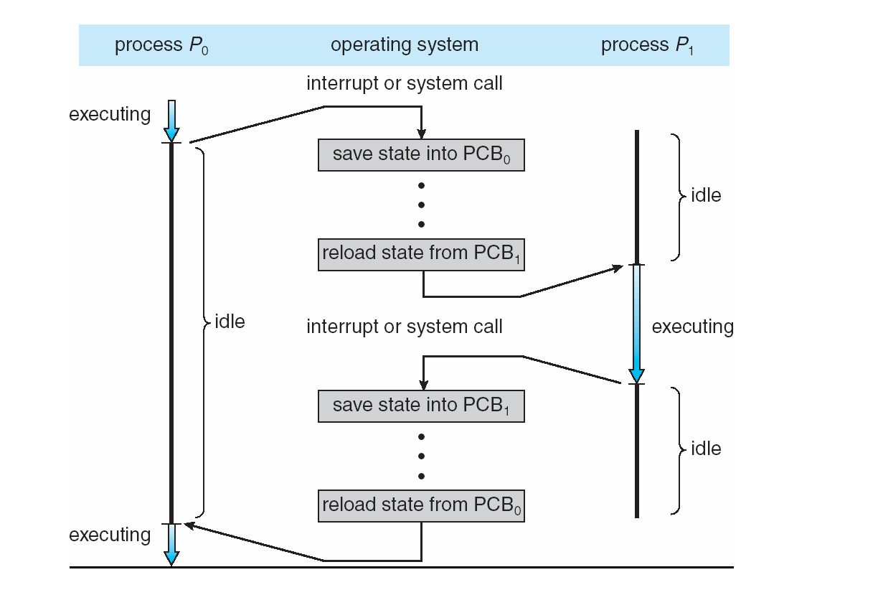
Process Scheduler

Slide 41
Process Scheduler
If the process must wait for some I/O from the user or some other event, it is put in a status of WAITING by the Process Scheduler.
When the I/O device lets the Process Scheduler know that the I/O is completed, the process status will be changed to READY by the Process Scheduler.

Slide 42
Process Scheduler
Finally, the process status will be changed to FINISHED either when the process has successful completed, or if an error occurs and the process has to terminate prematurely. The status change is usually handled by the Process Scheduler informing the Job Scheduler of the process completion, and the Job Scheduler of changing the status.

Slide 43
Processor Management
JOB SCHEDULER
HOLD
FINISHED
PROCESS SCHEDULER
READY
RUNNING
WAITING

Slide 44
Process Control Block (PCB)
The Process status is only one of a collection of descriptors that are associated with a process.
Each process has a data structure called a Process Control Block (PCB) associated with it, rather like a passport.

Slide 45

Process Control Block (PCB)
Operating System
Process Control Block (PCB)

Slide 46
Process Control Block (PCB)
Process ID
Process Status
Process State
Program Counter
Register Contents
Main Memory
Resources
Process Priority
Accounting

Slide 47
Process Control Block (PCB)
PROCESS IDENTIFIER
Each process is uniquely identified by both the user’s identification, and a pointer connecting it to its descriptor.

Slide 48
Process Control Block (PCB)
PROCESS STATUS
The current status of the process, it is either:
READY
HOLD
RUNNING
FINISHED
WAITING

Slide 49
Process Control Block (PCB)
PROCESS STATE
Program counter
Record the current value of the program counter, which is a pointer to the address of the next instruction to be executed for the process
08

Slide 50
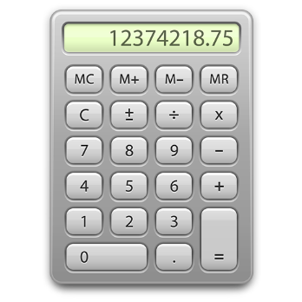
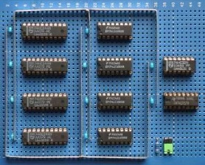
Process Control Block (PCB)
PROCESS STATE
Register Contents
Record the values of the CPU register set where process needs to be stored for execution for running state.

Slide 51
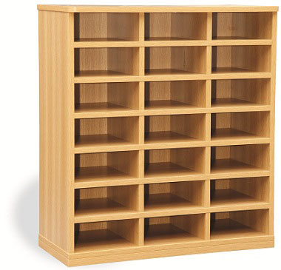
Process Control Block (PCB)
PROCESS STATE
Main Memory
Record all important information from memory, including most importantly the process location.
0
1
2
3
4
5
7
8
6
10
11
9
13
14
12
16
17
15
19
20
18

Slide 52
Process Control Block (PCB)
PROCESS STATE
Resources
Record the resources that have been allocated to this job, including files, disk drives, and printers.
ID | TYPE | DETAILS
1 | FILE | TXT file starting at memory address 0x456
2 | FILE | DAT file starting at memory address 0x087
3 | DISK | Disk Drive 4
4 | FILE | TXT file starting at memory address 0x673
5 | PRINTER | Printer at IP address 172.242.34.65

Slide 53
Process Control Block (PCB)
PROCESS STATE
Process Priority
The process is assigned a priority, and the operating system uses priorities to schedule processes.

Slide 54
Process Control Block (PCB)
PROCESS STATE
Process Priority
The process is assigned a priority, and the operating system uses priorities to schedule processes.
12
54
66
23
13
32

Slide 55
Process Control Block (PCB)
PROCESS STATE
Process Priority
The process is assigned a priority, and the operating system uses priorities to schedule processes.
12
54
66
23
13
32
1
1
5
2
1
1

Slide 56
Process Control Block (PCB)
ACCOUNTING
This section records some of the performance statistics associated with this process, including:
CPU time used so far
Time process has been in the system
Time taken in memory (Main and secondary)
Space taken in memory (Main and secondary)
System programs used, compliers, editors, etc.
Number and type of I/O operations
Time spent waiting for I/O operations completion
Number of Input records read, and Output records written

Slide 57
Process Control Block (PCB)
Process ID
Process Status
Process State
Program Counter
Register Contents
Main Memory
Resources
Process Priority
Accounting

Slide 58
Process Control Block (PCB)
Process ID
475
Process Status
“WAITING”
Process State
Program Counter
Register Contents
Main Memory
Resources
Process Priority
Process State
245
R1:23, R2:63, R3:71
Process Address: 345
File1, File5, Disk4
5
Accounting
CPU: 3, Total Time:34…..

Slide 59
Questions?

