Slide 1
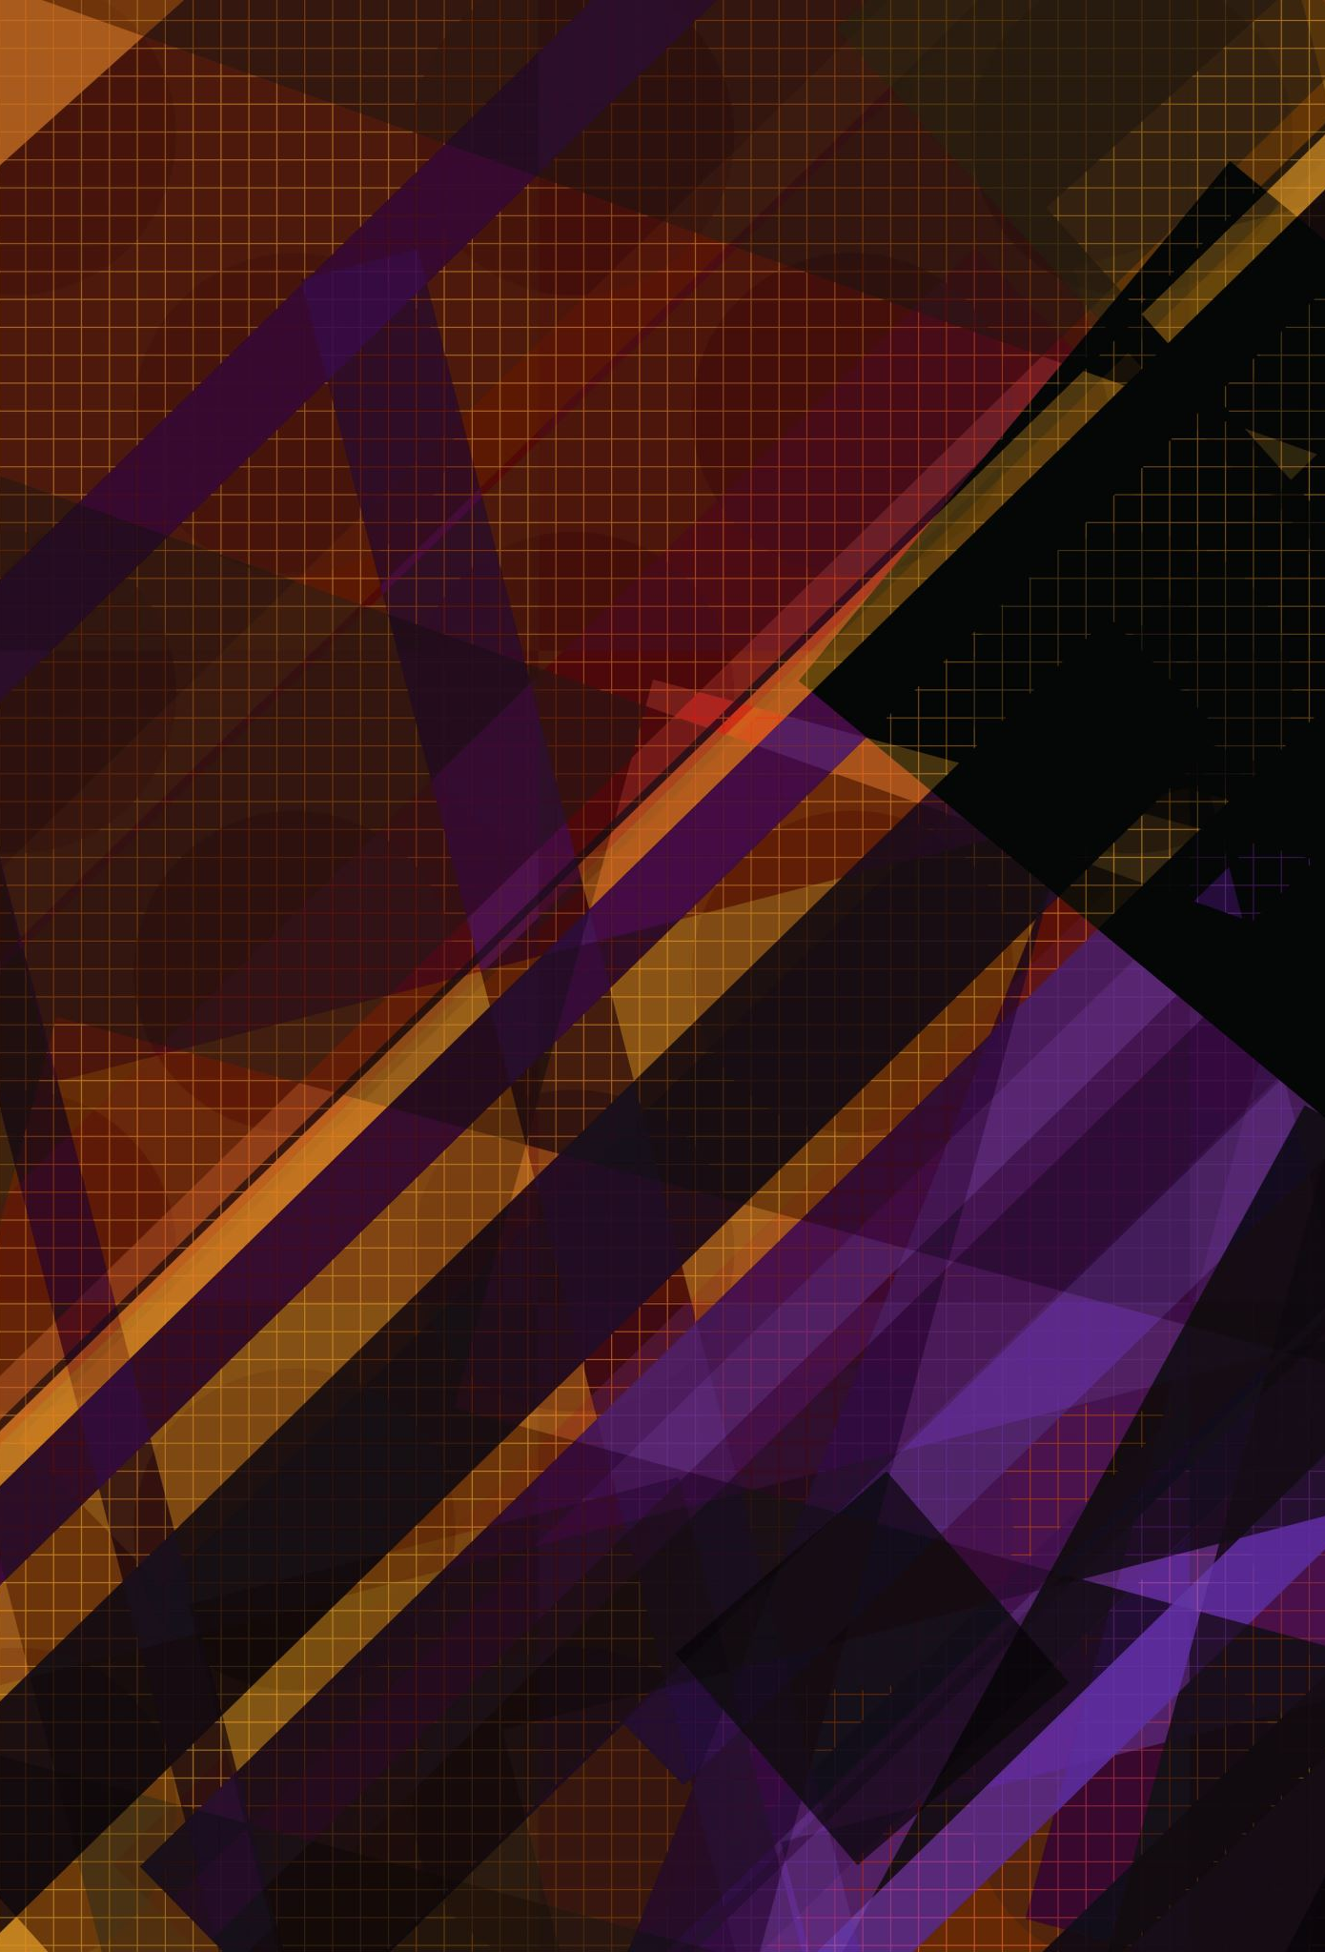
Operating Systems Attacks

Slide 2
Intentional Attacks

Slide 3
Intentional Attacks
Denial-of-Service (DoS) Attack
Wiretapping
Viruses
Worms
Trojans

Slide 4
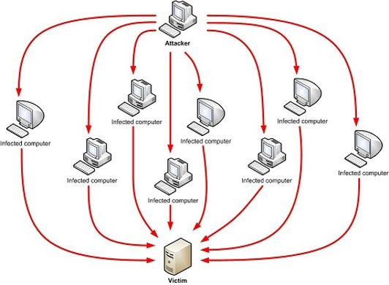
Denial-of-Service (DoS) Attack
Makes the “victim” computer unavailable to its users.
Typically used on computers that act as Web Servers.

Slide 5
Denial-of-Service (DoS) Attack
Works by making the “victim” computer perform a task repeatedly, thus preventing it from doing other jobs.
DoS attacks have a huge attack surface, and the attacker can carry out this attack in the following two ways:
Deny a service using a programming flaw.
Deny a service
The motivation behind carrying out a denial-of-service attack might include competitive advantage, extortion, entertainment, or manipulation using resource exhaustion.

Slide 6
Distributed Denial-of-Service (DDoS) Attack
In a Distributed Denial-of-Service (DDoS) attack, a hacker tries to flood the targeted machine with requests until all the resources are used up and the service becomes unavailable.
The attack is made more effective when multiple compromised computer systems carry out the attacks.
Before a DDoS attack can be carried out, the hacker needs to gain access to multiple computers. This can be achieved by installing malware on the victim’s computer.
This malware turns each machine into a bot, which gives the hacker control over the botnet. The hacker can then direct the bots to carry out targeted attacks on a machine.

Slide 7
Denial-of-Service (DoS) Attack
How does it work?
There are a variety of approaches that can work. We’ll look at a HTTP POST DoS attack.

Slide 8
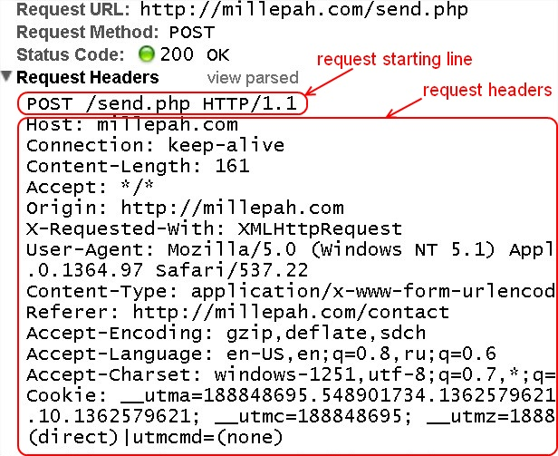

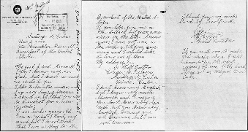
Denial-of-Service (DoS) Attack
HTTP
POST
Attack
<HTTP Message>
HEAD
BODY

Slide 9
Denial-of-Service (DoS) Attack
HTTP
POST
Attack
A legitimate HTTP POST header, which includes a 'Content-Length' field to specify the size of the message body to follow. However, the attacker then proceeds to send the actual message body at an extremely slow rate (e.g., 1 byte/110 seconds).
The target server will attempt to obey the 'Content-Length' field in the header and wait for the entire body of the message to be transmitted, which can take a very long time.

Slide 10
Denial-of-Service (DoS) Attack
HTTP
POST
Attack
The attacker establishes hundreds or even thousands of such connections, until all resources for incoming connections on the server (the victim) are used up, hence making any further (including legitimate) connections impossible until all data has been sent.

Slide 11
Prevent slow HTTP Post Attacks
HTTP
POST
Attack
It is hard to differentiate these attacks from genuine slow connections, so they are difficult to prevent completely.
However, certain steps can be taken to avoid these attacks:
Set an absolute connection timeout based on the median of request lengths. This should handle most cases of legitimate requests.
Establish a minimum incoming data rate and drop any connections that have a rate slower than that.

Slide 12
Common DDos Attacks
The following are some common DDoS attacks:
UDP Flood
Ping Flood
Syn Flood

Slide 13
UDP Flood
A UDP flood is any DDoS attack that floods a target with User Datagram Protocol (UDP) packets.
The goal of the attack is to flood random ports on a remote host that then looks for an application listening on the port.
When the host discovers that there is no such application, it sends back a ‘destination unreachable’ packet.
This entire cycle consumes network resources and limits connectivity to actual users.

Slide 14
Ping Flood
Just like a UDP Flood attack, an ICMP flood attack overwhelms the target resource with ICMP Echo Request (ping) packets.
These are sent as fast as possible without waiting for replies, thus, they overload the server.

Slide 15
SYN Flood
A SYN flood DDoS attack exploits a known weakness in the TCP connection sequence (“three-way handshake”), where an SYN request to initiate a TCP connection with a host must be answered by an SYN-ACK response from that host.
However, in this attack, the attacking systems send multiple SYN requests, often with spoofed IP addresses, and do not respond to the SYN-ACK responses.
This causes the host system to keep waiting on received acknowledgments, which renders it unavailable for other users.

Slide 16
Wiretapping

Slide 17
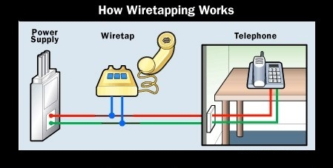
Wiretapping
Wiretapping has been around since the 1890s, it’s simply a matter of gaining access to the transmission media and using a device to intercept the signals.

Slide 18
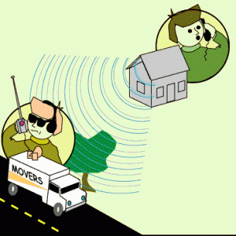
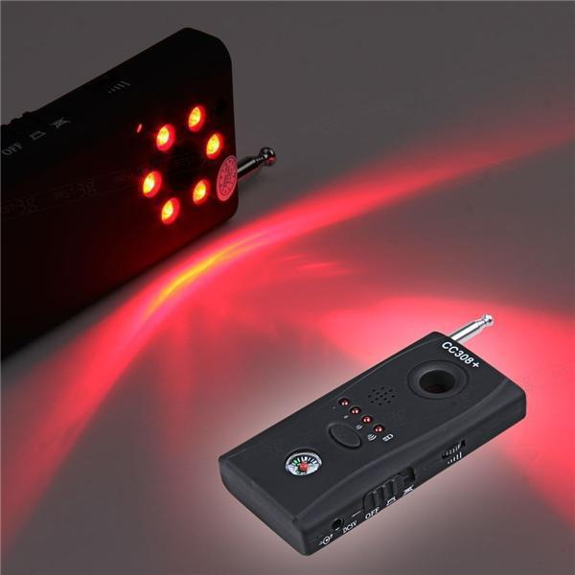
Wiretapping
Wireless wiretapping works in the exact same way, except that there is no need to have physical contact with the transmission media.
This is why we should encrypt wireless transmissions.

Slide 19
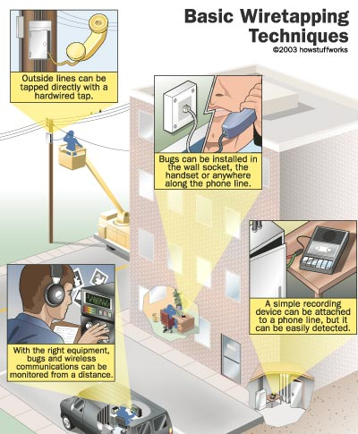
Wiretapping

Slide 20
Wiretapping
There are two forms of wiretapping:
Passive wiretapping - you are recording the data transmitted, but not interfering with it.
Active Wiretapping - you are recording the data and modifying it before it is sent onto the receiver.

Slide 21

Wiretapping Case Study
USA Patriot Act
The USA PATRIOT act
Title II: Enhanced Surveillance Procedures

Slide 22
Wiretapping Case Study
USA Patriot Act
The USA PATRIOT act
Title II: Enhanced Surveillance Procedures
Section 209 made it easier for authorities to gain access to voicemail as they no longer must apply for a wiretap order, and instead just apply for a normal search warrant.
The FBI can secretly conduct a physical search or wiretap on U.S. citizens to obtain evidence of crime without proving probable cause, as the 4th Amendment explicitly requires.

Slide 23
Wiretapping Case Study
USA Patriot Act
What it doesn’t cover
The USA PATRIOT act
On February 9, 2016, the FBI asked Apple Inc. to create a new version of the iOS operating system to be installed and run in the iPhone's RAM to disable certain security features that Apple refers to as "GovtOS".
The FBI had recovered an Apple iPhone 5C owned by the San Bernardino County, California government, issued to its employee Syed Rizwan Farook. Farook was one of the shooters involved in the December 2015 San Bernardino attack. The shooters killed 14 people and seriously injured 22.
https://en.wikipedia.org/wiki/Rizwan_Farook_and_Tashfeen_Malik

Slide 24
Wiretapping Case Study
USA Patriot Act
What it doesn’t cover
The USA PATRIOT act
Apple declined due to its policy to never undermine the security features of its products. The FBI responded by successfully applying to a United States magistrate judge, Sherri Pym, to issue a court order, mandating Apple to create and provide the requested software. The order was not a subpoena, but rather was issued under the All Writs Act of 1789.

Slide 25
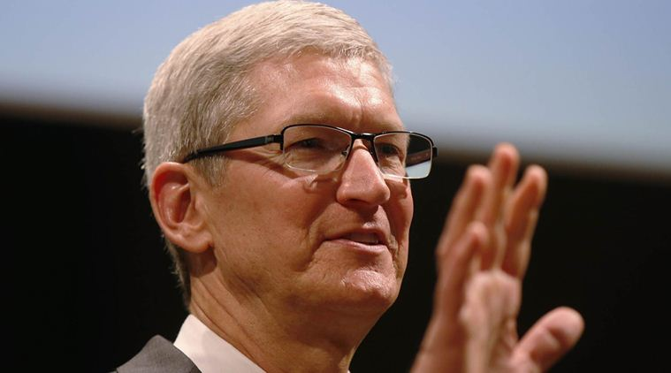
Wiretapping Case Study
USA Patriot Act
What it doesn’t cover
The USA PATRIOT act
On February 16, 2016, Apple chief executive officer Tim Cook released an online statement to Apple customers, explaining the company's motives for opposing the court order. He also stated that while they respect the FBI, the request they made threatens data security by establishing a precedent that the U.S. government could use to force any technology company to create software that could undermine
the security of its products.

Slide 26
Wiretapping Case Study
USA Patriot Act
What it doesn’t cover
The USA PATRIOT act
On March 28, 2016, the FBI said it had unlocked the iPhone with the third party's help, and an anonymous official said that the hack's applications were limited; the Department of Justice vacated the case.

Slide 27
Wiretapping Case Study
USA Patriot Act
What it doesn’t cover
For more details:
In September 2015, Apple released a white paper detailing the security measures in its iOS 9 operating system.
The iPhone 5C model can be protected by a four-digit PIN code. After more than ten incorrect attempts to unlock the phone with the wrong PIN, the contents of the phone will erase the AES encryption key that protects its stored data.

Slide 28
Viruses

Slide 29
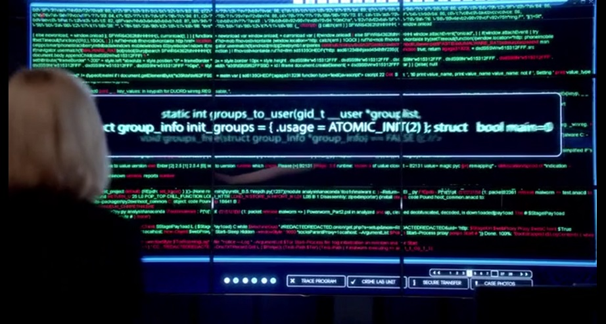
Viruses
A computer virus is a program that alters the way a computer works without permission of the user. It is typically self-executing and self-replicating.

Slide 30
Viruses
A virus is typically written for a specific operating system, so a virus that works on Windows usually won’t work on Linux.
Virus writers exploit vulnerabilities in a specific operating systems.

Slide 31
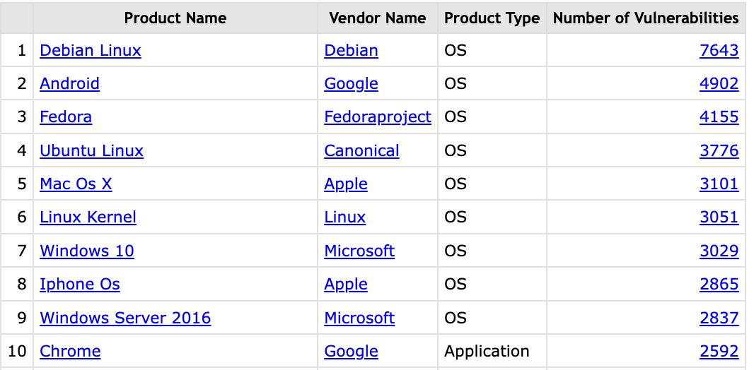
Viruses
Most vulnerable OS & applications in 2022.
https://www.cvedetails.com/top-50-products.php?year=2022

Slide 32
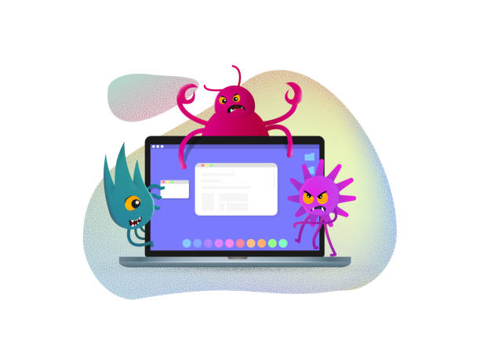
Types of viruses
#1 Boot Sector Virus
#2 File Infector Virus
#3 Macro Virus
#4 Multipartite Virus
#5 Polymorphic Virus

Slide 33
#1 Boot Sector Virus
Infects the boot sector. There are two types of boot sector viruses:
Master Boot Record (MBR): A MBR is the information in the first sector of any hard disk that identifies how and where an OS is located so that it can be boot.
Volume Boot Record (VBR): A VBR can contain code that loads and invokes the operating system.

Slide 34
#2 File Infector Virus
Perhaps the most common type of virus, the file infector takes root in a host file. This type of virus may end up deleting the file that was originally infected, or it may rewrite it or replace it with something else.
Usually infects .COM and .EXE files.

Slide 35
#3 Macro Virus
This is a virus that can be hidden in data files, like Word documents and Spreadsheets.
Disable macros on files that you don’t trust.

Slide 36
#4 Multipartite Virus
A virus of this type may spread in multiple ways, and it may take different actions on an infected computer depending on variables, such as the OS installed or the existence of certain files.
Can infect boot sector and files.

Slide 37
#5 Polymorphic Virus
A polymorphic Virus can mutate over time or after every contaminated file and changes the code that is used to deliver the payload.

Slide 38
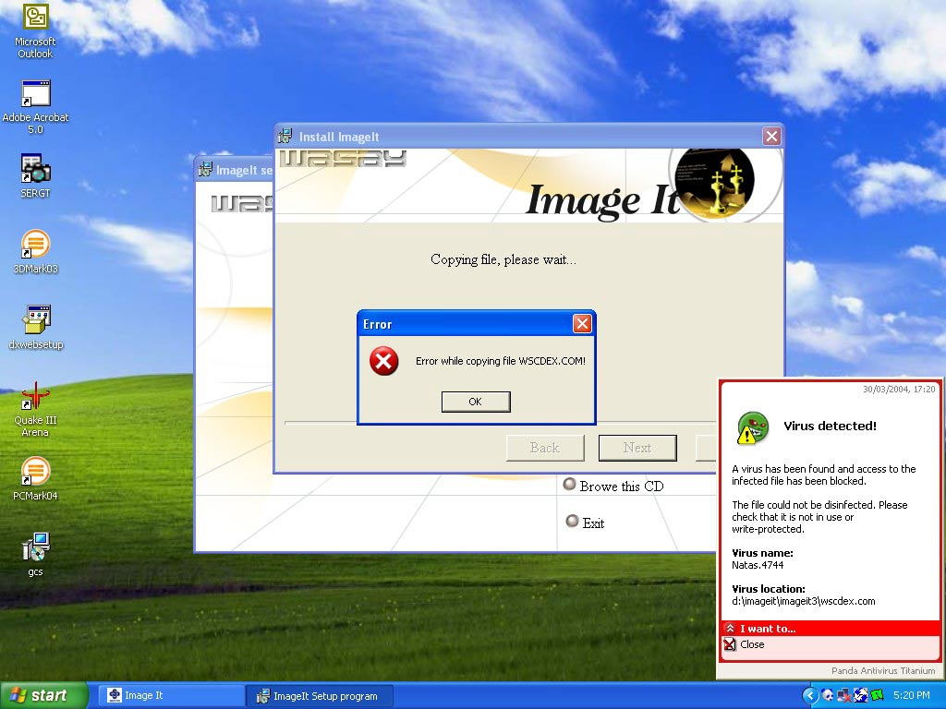
Virus Case Study
Natas
Virus
The Natas Virus

Slide 39
Virus Case Study
Natas
Virus
The Natas Virus
Natas (Satan spelled backwards) is a memory-resident stealth virus which is highly polymorphic, that affects master boot records, boot sectors of diskettes, files .COM and .EXE programs.
https://en.wikipedia.org/wiki/Natas_(computer_virus)

Slide 40
Virus Case Study
Natas
Virus
The Natas Virus
Natas was written in 1992 by James Gentile, a then 18-year-old hacker from San Diego, California who went by the alias of "Little Loc" and later "Priest".
It was made for a Mexican politician who wanted to win the Mexican elections by affecting all the Mexican Federal Electoral Institute (IFE) computers with a floppy disk.

Slide 41
Virus Case Study
Natas
Virus
The Natas Virus
The virus first appeared in Mexico City in May 1992, spread by a consultant using infected floppy disks. It soon became widespread in Mexico and the southwest USA.
The virus also made its way to the other side of the USA, infecting computers at the United States Secret Service, knocking their network offline for approximately 3 days.

Slide 42
Virus Case Study
Natas
Virus
The Natas Virus
When a file infected with Natas is executed, it becomes memory resident, taking up 5,664 bytes in memory and infecting the master boot record and COMMAND.COM.
The virus infects files when they are executed, opened or copied, appending its 4,746 bytes to .COM, .EXE and .OVL files.

Slide 43
Worms

Slide 44
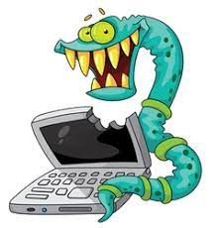
Worms
A computer worm is program that replicates itself in order to spread to other computers (often using a computer network).
Unlike a computer
virus, it does not need
to attach itself to an
existing program.

Slide 45
Worms
Worms usually slow down processor time and take up memory space. They also typically take up network bandwidth.
Some worms that have been designed only to spread, and do not attempt to change the systems they pass through. However, as the Morris worm and Mydoom showed, even these worms can cause major disruption by increasing network traffic.

Slide 46
Helpful Worms
Since the start of computer networks, there have been attempts to create useful worms.
For example, the Nachi family of worms tried to download and install patches from Microsoft's website to fix vulnerabilities in the host system—by exploiting those same vulnerabilities.

Slide 47
Helpful Worms
In practice, although this may have made these systems more secure, it generated considerable network traffic, rebooted the machine while patching it, and did its work without the consent of the computer's owner.
Several worms, like XSS worms, have been written to research how worms spread. For example, the effects of changes in social activity or user behaviour.

Slide 48
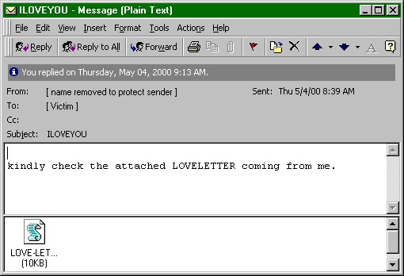
Worm Case Study
"I love you"
Worm
The ILOVEYOU Worm

Slide 49
Worm Case Study
"I love you"
Worm
The ILOVEYOU Worm
ILOVEYOU, sometimes referred to as Love Letter, was a computer worm that attacked tens of millions of Windows PCs on and after May 5th, 2000.
It started spreading as an email message with the subject line "ILOVEYOU" and the attachment "LOVE-LETTER-FOR-YOU.txt.vbs"
https://en.wikipedia.org/wiki/ILOVEYOU

Slide 50
Worm Case Study
"I love you"
Worm
The ILOVEYOU Worm
The worm did damage on the local machine, overwriting random types of files (including Office files, image and audio files).
However, after overwriting MP3 files, the worm hides the file and sends a copy of itself to all addresses in the Windows Address Book used by MS Outlook. This allowed it to spread much faster than any other previous email worm.

Slide 51
Worm Case Study
"I love you"
Worm
The ILOVEYOU Worm
It was created by Onel de Guzman, a college student in Manila, Philippines, who was 24 years old at the time. De Guzman, who was poor and struggling to pay for Internet access at the time, created the ILOVEYOU intending to steal other users' passwords, which he could use to log in to their Internet accounts without needing to pay for the service. He justified his actions on his belief that Internet access is a human right and that he was not actually stealing.

Slide 52
Worm Case Study
"I love you"
Worm
The ILOVEYOU Worm
The worm originated in the Philippines. Thereafter it spread across the world, moving first to Hong Kong, then to Europe, and finally the United States, as employees began their workday that Friday morning.
The outbreak was later estimated to have caused US $5.5-8.7 billion in damages worldwide and estimated to cost the US $15 billion to remove the worm.

Slide 53
Trojans

Slide 54
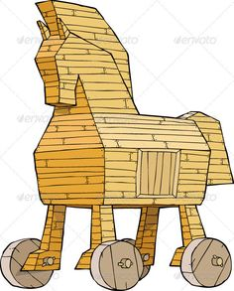
Trojans
A Trojan is a malicious program that misrepresents itself to appear useful, routine, or interesting to persuade a victim to install it.

Slide 55
Trojans
Trojans are generally spread by some form of social engineering.
For example, when a user is duped into executing an e-mail attachment disguised to be unsuspicious, (e.g., a routine form to be filled in), or by downloading.
Unlike computer viruses and worms, Trojans generally do not attempt to inject themselves into other files or otherwise propagate themselves.

Slide 56
Trojans
Types of things Trojans do:
Destructive Behaviour
Use of Resources, or Identity
Money, Theft, or Ransom
Data Theft
Spying, Surveillance, or Stalking

Slide 57
Destructive behaviour
Crashing the computer or device.
Modification or deletion of files.
Data corruption.
Formatting disks, destroying all contents.
Spread malware across the network.
Spy on user activities and access sensitive information.

Slide 58
Use of Resources or Identity
Use of the machine as part of a botnet (e.g., to perform automated spamming)
Using computer resources for mining cryptocurrencies
Using the infected computer as proxy for illegal activities and/or attacks on other computers.
Infecting other connected devices on the network.

Slide 59
Money Theft or Ransom
Electronic money theft
Installing ransomware, such as CryptoLocker

Slide 60
Data Theft
Data theft, including for industrial espionage
User passwords or payment card information
User personally identifiable information
Trade secrets

Slide 61
Spying, Surveillance or Stalking
Keystroke logging
Watching the user's screen
Viewing the user's webcam
Controlling the computer system remotely

Slide 62
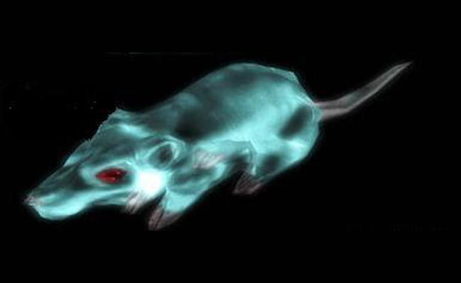
Trojan Case Study
Gh0st RAT Trojan
The Gh0st RAT Trojan

Slide 63
Worm Case Study
Gh0st RAT Trojan
The Gh0st RAT Trojan
Gh0st RAT is a Trojan horse for the Windows platform that was used to hack into some of the most sensitive computer networks on Earth. It is a cyber spying computer program. The RAT part of the name refers to the software's ability to operate as a "Remote Administration Tool".
https://en.wikipedia.org/wiki/Gh0st_RAT

Slide 64
Worm Case Study
Gh0st RAT Trojan
The Gh0st RAT Trojan
It can:
Take full control of the remote screen.
Provide real time as well as offline keystroke logging.
Provide live feed of webcam, and microphone.
Download remote binaries on the infected remote host.
Take control of remote shutdown and reboot of host.
Disable infected computer remote keyboard input.
Enter into shell of remote infected host with full control.
Provide a list of all the active processes.

Slide 65
Worm Case Study
Gh0st RAT Trojan
The Gh0st RAT Trojan
Gh0st Rat was originally made by the C.Rufus Security Team in 2005.
Just as with other well-featured “off-the-shelf” trojans, like Poison Ivy, Hupigon and DarkComet, it has been used by all sorts of people – from script kiddies to resourceful targeted attack actors.

Slide 66
Worm Case Study
Gh0st RAT Trojan
The Gh0st RAT Trojan
In less than two years (2007-2009) Gh0st Rat infiltrated at least 1,295 computers in 103 countries, including many belonging to embassies, foreign ministries and other government offices, as well as the Dalai Lama’s Tibetan exile centres in India, Brussels, London and New York.

Slide 67
Unintentional Attacks

Slide 68
Unintentional Attacks
An unintentional attack is any breach of security that was not as a result of a planned intrusion.
For example, if two processes are updating the same record and it results in an incomplete modification of the record, that is an unintentional attack.
The Year 2000 problem (aka the Millennium or Y2K bug) was caused by programmers who reduced the four-digit year to two digits. This made the year 2000 indistinguishable from 1900.

Slide 69
Unintentional Attacks Case Study
Unintentional Denial-of-Service
When Michael Jackson died in 2009, websites such as Google and Twitter slowed down or even crashed. Many sites' server managers thought the requests were from a virus or spyware trying to cause a DoS attack, warning users that their queries looked like "automated requests from a computer virus
or spyware application".
Michael Jackson
UA

