Slide 1
Operating Systems - Protections

Slide 2
System protection
System protection is multifaceted. The main four protection methods include:
Antivirus software
Firewalls
Patch management
Authentication

Slide 3
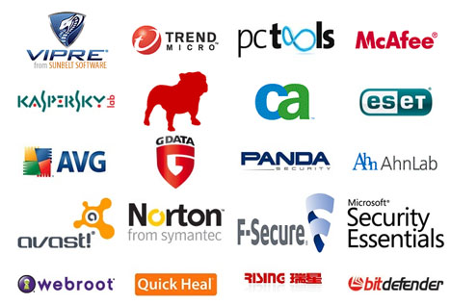
Antivirus software
An antivirus software is used to protect systems from attacks by malicious
software.

Slide 4
Antivirus software
It can be preventative, diagnostic, or a combination of both.
As new viruses are identified, security vendors and government agencies provide information and updates about them.
Antivirus software usually can repair files infected by a virus, but it generally cannot repair the damages done by worms, Trojans, and blended approaches. This is because viruses usually add code to an existing file, whereas worms, Trojans, and blended approaches usually fully replace files.

Slide 5
Antivirus software
Examples of antivirus software include:
Bitdefender Antivirus Plus
Kaspersky Anti-Virus
Webroot SecureAnywhere AntiVirus
Emsisoft Anti-Malware
F-Secure Anti-Virus 2015
Malwarebytes Anti-Exploit
McAfee AntiVirus Plus
Panda Antivirus Pro
Trend Micro Antivirus+ Security
VoodooSoft VoodooShield

Slide 6
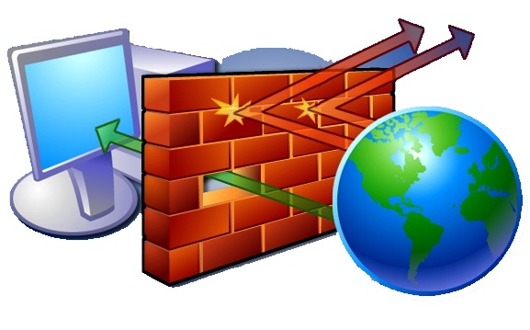
Firewalls
A firewall is a network security system that monitors and controls the incoming and outgoing network
traffic based on predetermined
security rules.

Slide 7
Firewalls
Network firewalls can be software programs running on general purpose hardware, or hardware-based firewall computer appliances, that filter traffic between two or more networks.
Firewall appliances may also offer other functionality to the internal network they protect, such as acting as a DHCP or VPN server for that network.
Notes:
DHCP (Dynamic Host Configuration Protocol) is a protocol that provides a central and automatic management for the distribution of IP addresses to the devices in a network. In other words, DHCP is the protocol that assigns a device its IP address. DHCP is also used to configure other parameters such as the subnet mask, default gateway, and the DNS server information on connected devices.
A Virtual Private Network (or VPN) is an online service that creates a secure connection to another network over the Internet, hides your IP address, and encrypts your traffic to effectively shield you from your ISP and government. VPNs are frequently utilized by corporations to secure sensitive information. However, utilizing a personal VPN is progressively getting more mainstream as communications transition from up close and personal to the Internet.

Slide 8
Firewalls
Firewalls typically:
Log activities that access the internet
Maintain access control based on the senders’ and receivers’ IP addresses
Maintain access control based on the services being requested
Hide the internal network from unauthorized users
Verify that virus protection is installed and running
Perform authentication based on the source of a request from the Internet

Slide 9
Firewalls
Firewalls use a combination of packet filtering and proxy servers.
Packet Filtering means that the firewall reviews all the header information of each packet coming into the computer and going out to make sure there is nothing suspicious present.
Proxy Servers sit in between the local computer and network. They intercept all requests to the local computer from the network and verify them before passing them onto the local computer.

Slide 10
Firewall software
Examples of firewalls include:
Bullguard
ZoneAlarm
McAfee
Norton
AVG Anti-virus
Bitdefender
Avira
Kaspersky Lab

Slide 11
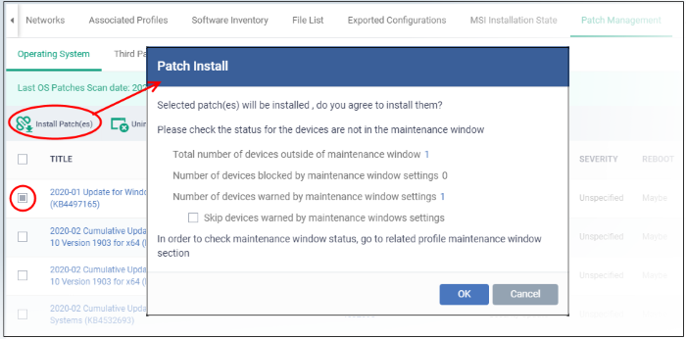
Patch Management
A patch is a piece of software that can be applied to an operating system (or any other software) to correct an issue with that software.

Slide 12
Patch Management
Most operating systems will have several patches after their initial release and usually update the version of the program when successfully installed.
Software patches can be found through the software developer's website or are automatically downloaded after each system restart.

Slide 13
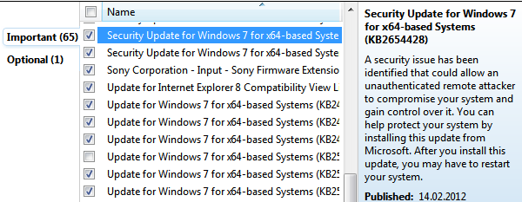
Patch Management
A security patch is a change applied to an operating system to correct a discovered vulnerability.
This corrective action will prevent successful exploitation and remove or mitigate a threat’s capability to exploit a specific vulnerability in that operating system.

Slide 14
Patch Management
Security patches are the primary method of fixing security vulnerabilities in operating systems.
Currently Microsoft releases its security patches once a month, and other operating systems and software projects have security teams dedicated to releasing the most reliable software patches as soon after a vulnerability announcement as possible.

Slide 15
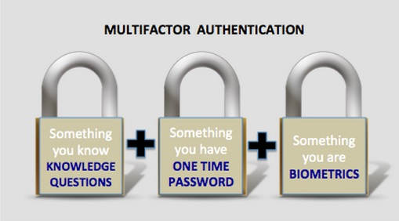
Authentication
Authentication is verification that an individual trying to access the system is authorised to do so.

Slide 16
Authentication
Let’s consider passwords, they should be:
Easy to remember
Hard to guess
Changed often
Never written down
Never part of an automated login
Passwords are stored in the operating system in an encrypted format. When you type in your password, it is encrypted using the same algorithm, and the two encryptions are compared to verify its correctness.

Slide 17
Authentication
The longer the password, the better.
A password of eight (8) letters, just using lowercase letters has 26⁸ (208,827,064,576) possible combinations.
A password of ten (10) letters, just using lowercase letters has 26¹⁰ (141,167,100,000,000) possible combinations.
A password of eight (8) letters, using all letters and numbers has 95⁸ (6,634,204,300,000,000) possible combinations.
A password of ten (10) letters, using all letters and numbers has 95¹⁰ (59,873,694,000,000,000,000) possible combinations.

Slide 18
Authentication
Where are the passwords stored?
Operating System | Path
Windows | c:\windows\system32\config\SAM
Linux | /etc/shadow
Unix and (some) Apple | /etc/passwd

Slide 19
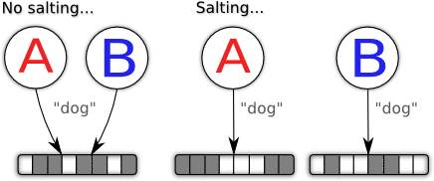
Authentication
Salting
Some operating systems (not Windows) make the passwords even harder to guess by adding in a few extra random bits into the encrypted password. So even if two people have the same password, they will be stored differently.

Slide 20
Authentication
Alternatives to passwords:
CAPTCHAs
reCAPTCHAs
Smart Cards
Biometrics

Slide 21

CAPTCHAs
CAPTCHA ("Completely Automated Public Turing test to tell Computers and Humans Apart") is a type of challenge-response test.
The term was coined in 2003 by Luis von Ahn, Manuel Blum, Nicholas J. Hopper, and John Langford.
This form of CAPTCHA requires that the user type the letters of a distorted image, sometimes with the addition of an obscured sequence of letters or digits that appears on the screen.

Slide 22
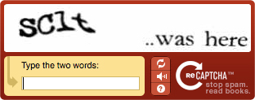

reCAPTCHAs
The reCAPTCHA service supplies subscribing websites with images of words that are hard to read for Optical Character Recognition (OCR) software.
The text is obscured with horizontal lines and warped.

Slide 23
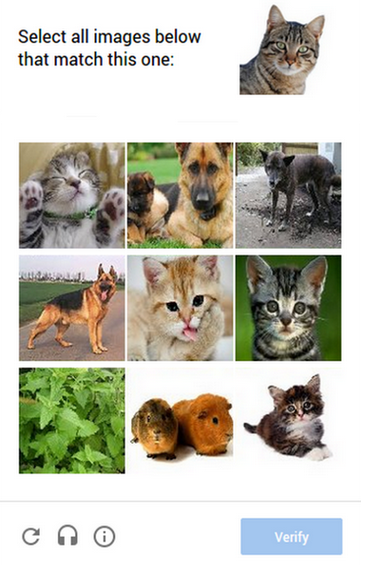
Image reCAPTCHAs
In 2014, reCAPTCHA implemented another system in which users are asked to select one or more images from a selection of nine images.

Slide 24
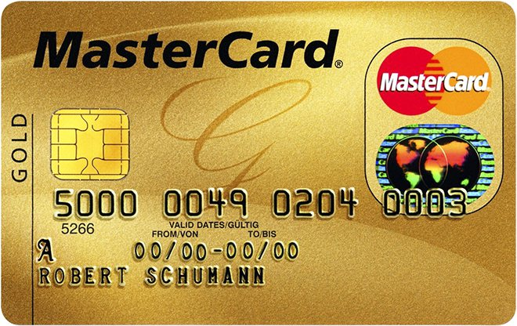
Smart Cards
A smart card, chip card, or integrated circuit card (ICC) is any pocket-sized card that has embedded integrated circuits.
Smart cards can be either contact or contactless smart card. Smart cards can provide personal identification, authentication, data storage, and application processing.
Smart cards may provide strong security authentication for single sign-on (SSO) within large organizations.

Slide 25

Biometrics
Biometrics authentication (or realistic authentication) is used as a form of identification and access control.
Examples include, but are not limited to fingerprint, palm veins, face recognition, DNA, palm print, hand geometry, iris recognition, retina and odour/scent.
Smart cards may provide strong security authentication for single sign-on (SSO) within large organizations.

Slide 26

Cryptography
Encryption is a method which converts particulars into confidential codes that cloak the information’s exact meaning.
In computing, unencrypted data is also named ‘plaintext’, and encrypted data is called ‘ciphertext’.
Encryption falls under cryptography.
The formulas used to encrypt and decrypt messages are known as ciphers

Slide 27
Ciphers
To be effective, a cipher comprises a variable as a segment of the algorithm.
The variable, also known as a key, assembles a cipher’s output individual.
When an encrypted message is snatched by an unofficial entity, the trespasser has to estimate which cipher the sender used to encode the message as well as the keys that were utilized as variables.
The time and difficulty of estimating these particulars are what make encryption such a beneficial security tool.

Slide 28
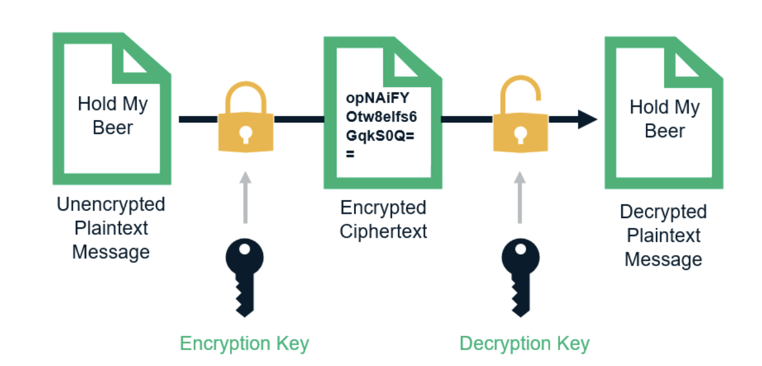
How does encryption work?

Slide 29
What is Ethical Hacking?

Slide 30
What is Ethical Hacking?
An ethical hacker is an expert in information security who systematically tries to penetrate a network or computer system or network to locate security vulnerabilities that a malicious hacker could misuse. This job requires a similar set of skills as a malicious hacker, such as:
Send phishing emails
Brute-force password attacks
Breach perimeters
Exploit system misconfigurations
Ethical hackers are usually hired before a new system goes live, and often times, organizations will use a bounty scheme: a financial reward is provided to ethical hackers who demonstrate evidence of a system’s flaw.

Slide 31
What is Penetration Testing?
Penetration testing is a specific type of ethical hacking that involves hiring a certified professional to asses the strengths of a preexisting system. Usually, pen testers are given privileged information and use it to find exploitable flaws. These tests include:
Web application tests
Wireless network tests
External/internal network tests
These pen tests are typically more systematic and implemented at regular, preset times, i.e. before a major change to application is released.

