Slide 1
Computer Security - Summary

Slide 2
Operating
System
Memory
Manager
File
Manager
Process
Manager
Device
Manager
Network
Manager
Security
Manager

Slide 3
Operating System Security
The Operating System uses several different ways to protect the system:
Your credentials (e.g. username and password)
Your authorisation (e.g. drwxr-x-r--)
Your location (e.g. inside/outside the LAN)
Your behaviour (e.g. deleting lots of files)
The firewall

Slide 4
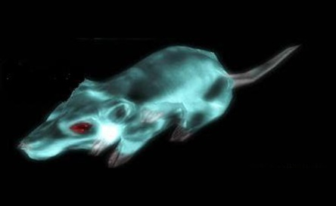
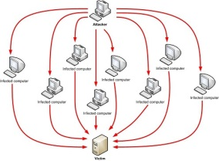
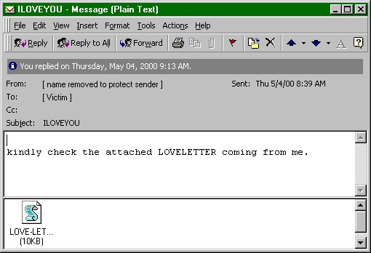

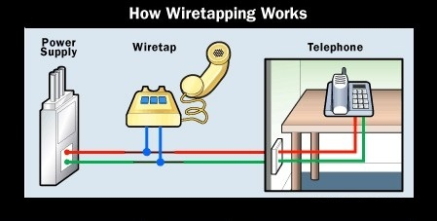
Operating Systems Attacks
Intentional Attacks
Denial-of-Service (DoS) Attack
Wiretapping
Viruses
Worms
Trojans
Unintentional Attacks
Parallel writes
Unintentional Denial-of-Service (DoS)

Slide 5
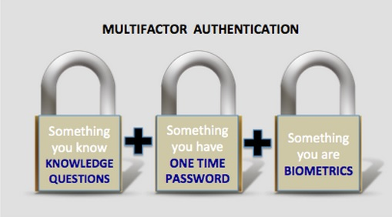


System Protection
System protection is multifaceted, four protection methods include:
Antivirus Software
Firewalls
Patch Management
Authentication
CAPTCHAs
reCAPTCHAs
Smart Cards
Biometrics

