Slide 1


Zod

Slide 2
What is Zod?
Zod is a TypeScript-first schema declaration and validation library
Allows developers to define data structures and validate data at runtime

Slide 3
Zod aspects
Ensures type safety by inferring TypeScript types directly from schemas.
Ideal for front-end projects that heavily rely on TypeScript.
Zero dependencies
Tiny: 8kb minified + zipped
Immutable: methods (e.g. .optional()) return a new instance
Functional approach: parse, don't validate
Works with plain JavaScript too

Slide 4
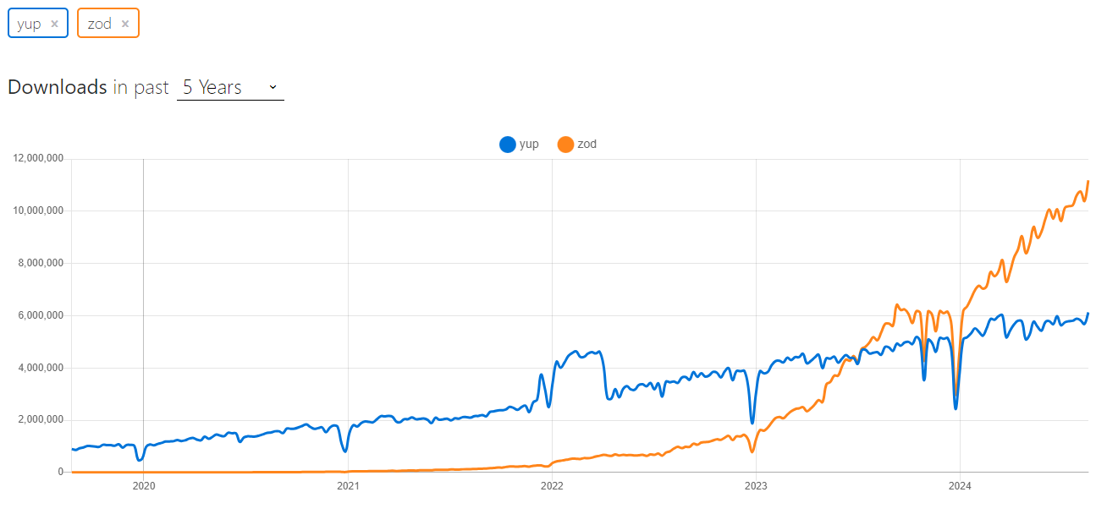
Zod vs Yup (1)

Slide 5
Zod vs Yup (2)
Feature | ZOD | YUP
TS support | Excellent | Limited (no support for generic union, intersection, promise and function types)
Eco system | Integration with React Hook Form | Integration with Formik
Community | ~300 contributors | ~160 contributors
Error messages | Detailed and customizable, nested errors | Standard customizable
Validation syntax | Declarative | Declarative

Slide 6
Demo Time!

