Slide 1
June 29, 2026
Central Utility Plant (CUP) — Co-Generation Project
Mammoth Hill · Central City, Colorado
Notes:
Consolidated Co-Gen CUP presentation. Source memo: 'Goals and Timeline — USGPD as Developer and Operator of the Central Utility Plant', prepared by Bill Hibbard, 6/5/26, plus the Aaron Equipment Caterpillar CG170-16 quote.

Slide 2
Project Overview
USGPD as Developer & Operator of the Central Utility Plant (CUP)
The Co-Gen Special Project Group as well as PDG have considered the recent delivery options as well as progress completed to date. Development of construction documents for the CUP is critical to completing the application and approval for the Xcel gas use application. We provide the following points for consideration by ownership to continue on our current path to include the CUP as part of the overall delivery of the Casino project.

Slide 3
Advantages of Developing, Owning & Operating the CUP
Seven reasons to keep the CUP inside the Casino project delivery
Primary Focus
Application Timeline
CUP Location
Alternate Delivery Sources
Utility Cost Control
Long-Term Economic Payback
Central City Mini-District Constraints

Slide 4
Primary Focus
The CUP is essential to the overall project delivery
Our primary focus is the construction and operation of the Casino.
The CUP is an essential part of the overall project delivery and long-term operation.
Being one user in a larger district would transfer timely delivery and key decision-making to a separate entity.

Slide 5
Application Timeline
IMEG selected (May) to deliver the Feasibility Study; Xcel approval path
A Co-Gen consultant was identified in early April for a Feasibility Study; the bid process completed in May and IMEG was selected.
IMEG Phase I — ROM & Schedule: 6/5/26 → 6/19/26
IMEG Phase II — Equipment Selection, P&ID, Floor Plan, Economic Payback Analysis: 6/19/26 → 8/3/26
Energy Modeling (IMEG or Group 14): 7/15/26 → 9/15/26
Prepare Construction Documents for the CUP: 8/3/26 → 10/30/26
Submit CDs & Application to Xcel for approval: 11/2/26

Slide 6
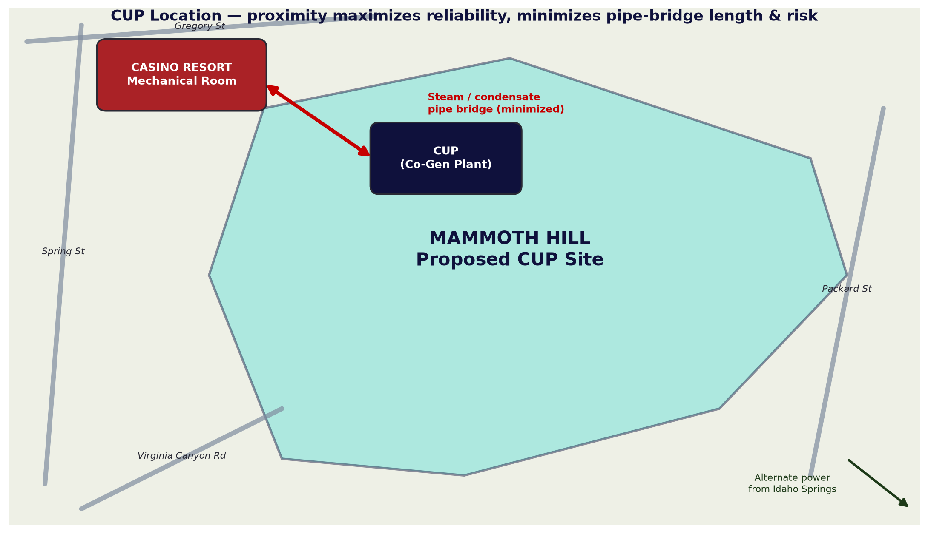
CUP Location
Mammoth Hill — proximity is key to reliability and cost
Proximity of the CUP to the Casino site maximizes reliability and minimizes risk.
A steam / condensate pipe bridge delivers superheated steam to the Casino Mechanical Room and returns condensate to the CUP.
Minimizing pipe-bridge length (pump transfer stations, traps, etc.) reduces maintenance, shutdown risk, service interruption and cost.
Mammoth Hill is the primary location for the CUP site selection process.
Schematic site context — Mammoth Hill CUP relative to the Casino

Slide 7
Alternate Delivery Sources
Grid-only delivery adds maintenance, risk and a ~5-year Xcel timeline
Special Projects met with Xcel on options for delivering electricity to the Casino project.
Current connected load ≈ 8.5 MW; regular operating load ≈ 5–6.5 MW.
Xcel can provide 2.5 MW without improvements to the current grid infrastructure.
Additional power could be run from Idaho Springs (underground or overhead) — adding maintenance, reliability concerns and outage risk.
Xcel reported installation would require 5 years from application.

Slide 8
Utility Cost Control
Internal cost management vs. payments to a District in perpetuity
Cost control of the generated electricity will be managed by USGPD.
Market rate for electricity ≈ $0.07/kWh (region-dependent, excludes transmission); natural gas ≈ $4.50/DTH.
The CUP cost per kWh will be a cost-of-operation figure set by the economic payback analysis.
Internal management of this cost — versus payments to a District in perpetuity — is an important factor in the decision.

Slide 9
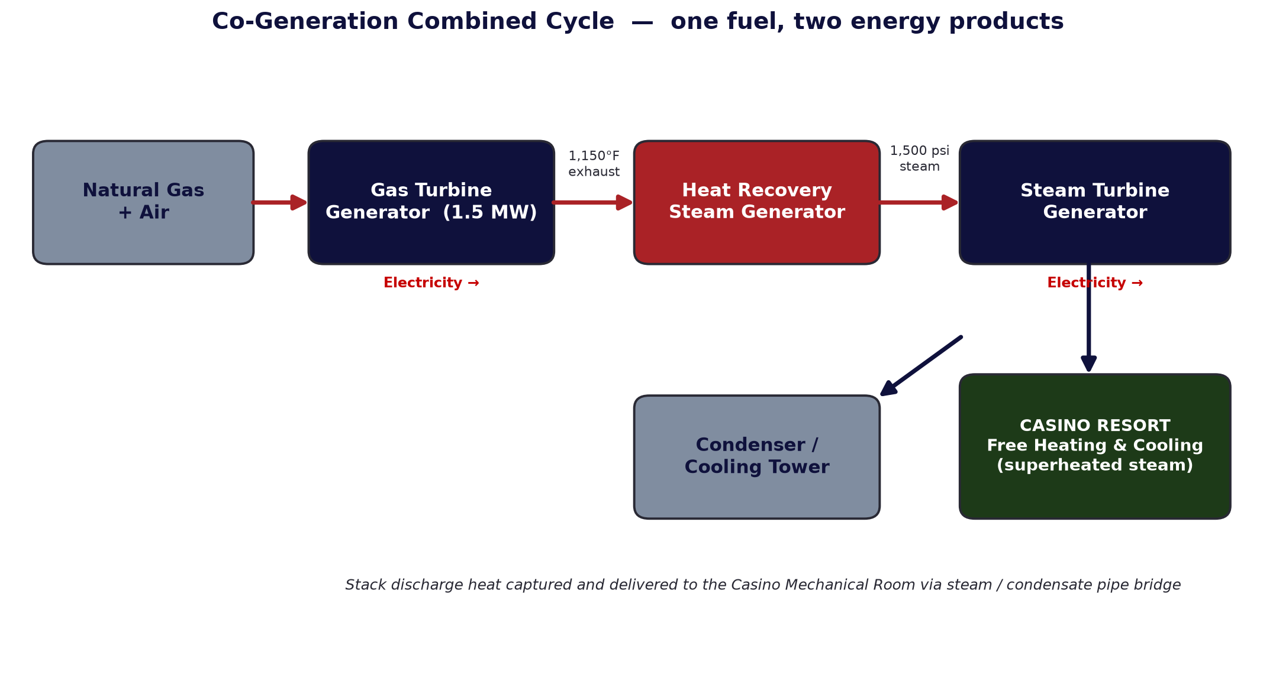
Long-Term Economic Payback
‘Free heating & cooling’ from turbine stack discharge
The Casino will be the primary, if not sole, user of the thermal energy (superheated steam) generated by the CUP.
This provides 'free heating and cooling' for the Resort by optimizing the turbine generators' high-temperature stack discharge.
Overall cost of energy to operate the Casino will be determined in the IMEG Feasibility Study and Economic Payback Analysis.
Combined-cycle co-generation: one fuel, electricity + thermal

Slide 10
Central City Mini-District Constraints
A third-party district adds delay, perpetual cost and distance risk
Central City would most likely hire a third-party Developer/Operator.
This would delay the construction-document and gas-application process.
It would lead to negotiation of utility costs in perpetuity.
A district plant farther from the Casino adds substantial cost (pipe-bridge length) and raises reliability and disruption risk.

Slide 11
Disadvantage to Consider
The principal trade-off of owning and operating the CUP
Time Value of Money

Slide 12
Time Value of Money
A $24M–$30M CUP carries capital and interest before full operation
The CUP is estimated to cost between $24M and $30M.
An independent owner/operator could reduce the total funds USGPD raises through syndication and the interest due on funds prior to full operation and economic return of the CUP.
The economic payback analysis (IMEG) is part of the overall feasibility analysis.

Slide 13
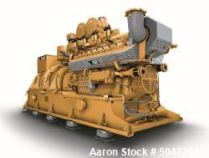
Proposed Equipment — Caterpillar CG170-16
Unused 1.5 MW natural-gas cogeneration generator set — $599,000
Unused Caterpillar Cogeneration Natural Gas Generator System, 1.5 MW.
CG170-16 engine rated 1,556 kW, 4160 V, 3-phase, 60 Hz at 0.8 PF.
Pritchard Brown enclosure, Cannon boiler, Boulden radiator, WHR system, Stueler SCR system (outside enclosure), Caterpillar ISO aux cabinet.
Built 2017; 80 hours of engineering support to site. U.S.A. only.
Item price: $599,000.00 USD
Aaron Equipment — Stock #50477001 (Caterpillar CG170-16)

Slide 14
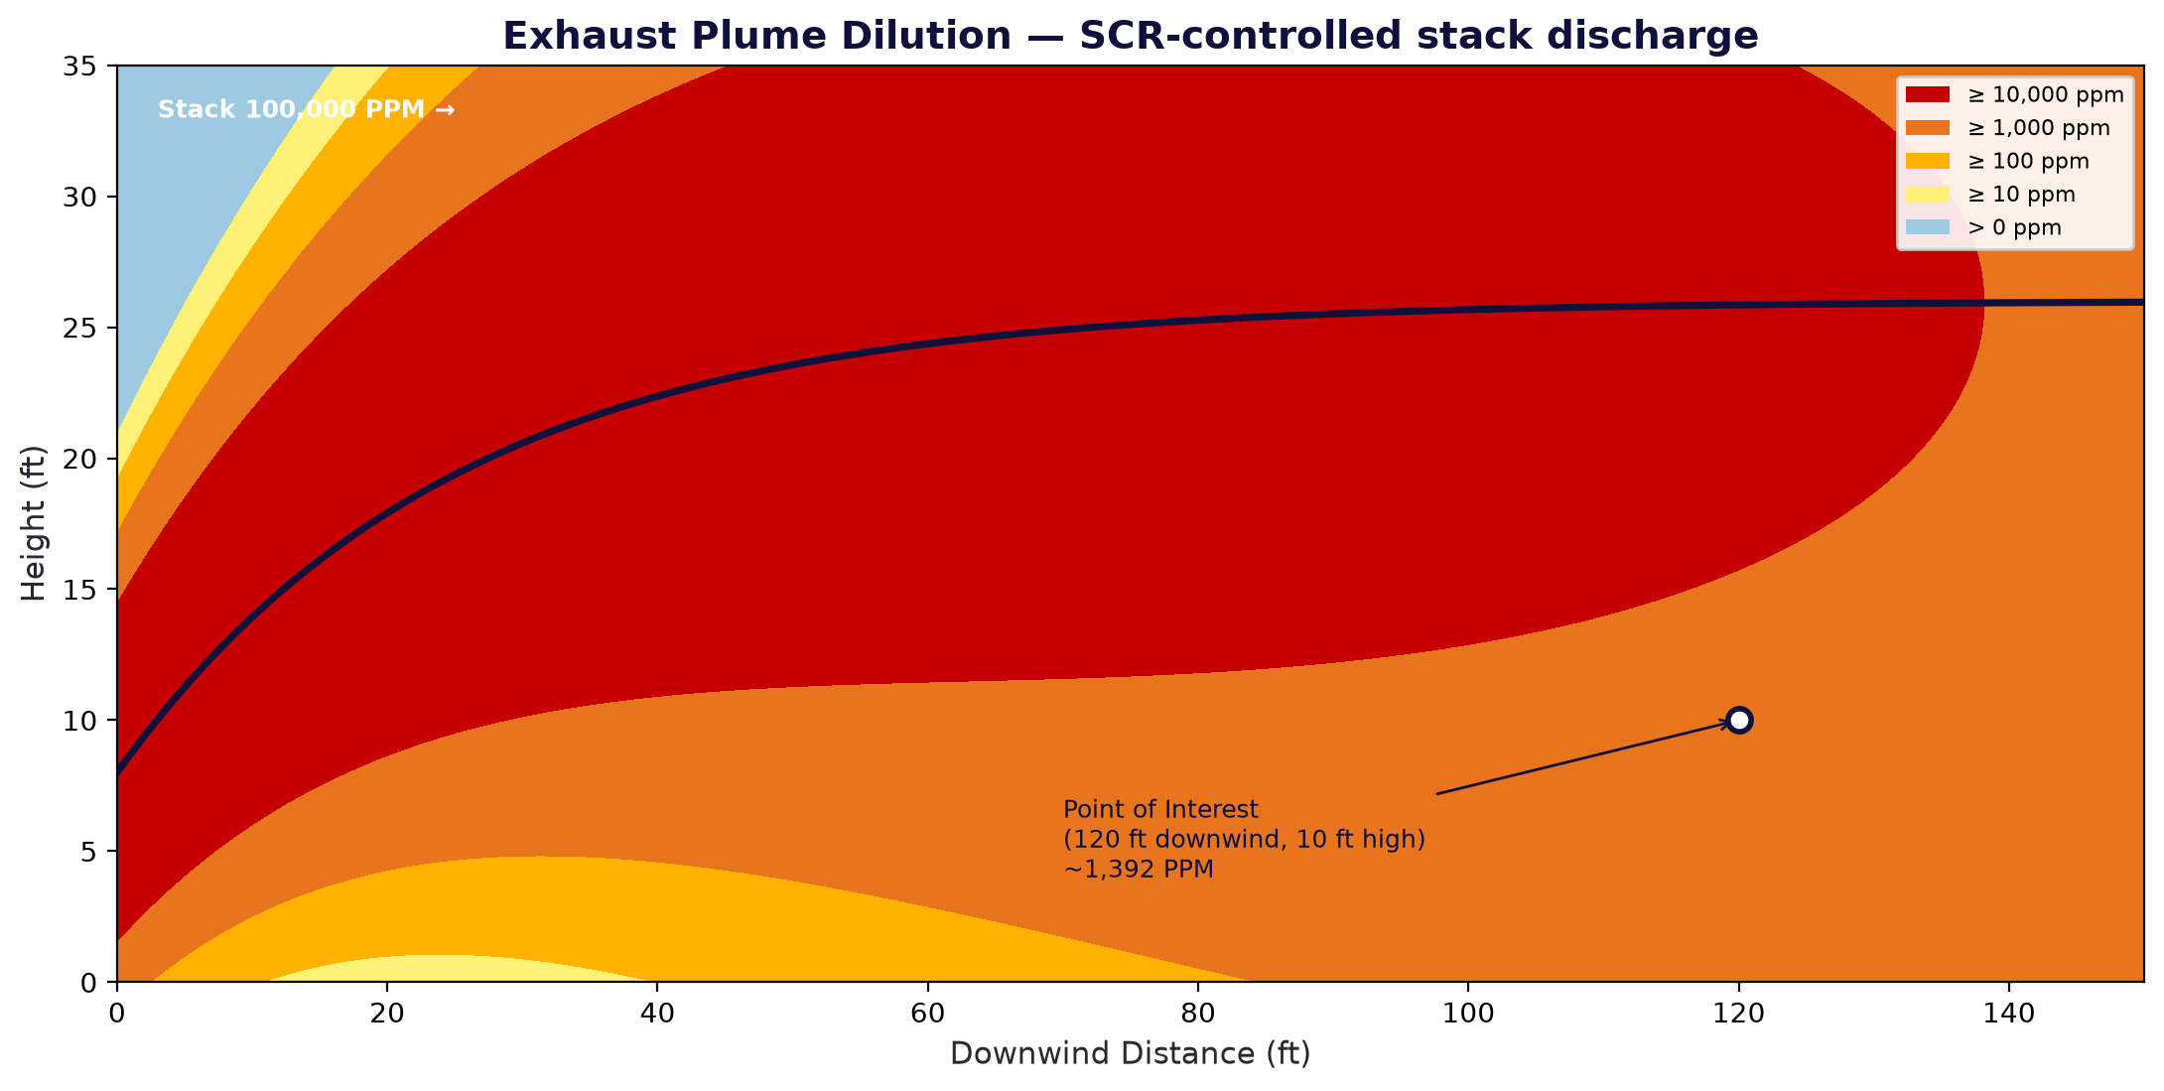
Emissions Control & Exhaust Dilution
SCR-controlled stack discharge — plume dilution with downwind distance
The Stueler SCR system controls exhaust emissions from the gas engine.
Stack discharge is the high-temperature heat source captured for the Casino's thermal load.
Plume-concentration modeling (e.g., Greenheck CAPS-style analysis) confirms concentrations fall rapidly with downwind distance and height.
Point of interest at 120 ft downwind / 10 ft high ≈ 1,392 PPM — used to site the stack and intakes.
Illustrative exhaust-plume dilution (concentration bands)

Slide 15
Project Update & Status to Date
Xcel confirms gas and 2.5 MW available without infrastructure upgrades
USGPD and the design team (Martin & Martin, OS, RTM) have been in discussions with Xcel to apply for gas and electric service.
Xcel has communicated that 9 million cubic feet of gas and 2.5 MW of electricity are available for the Casino project (see Meeting Minutes).
These quantities may be provided without improvements to area utility infrastructure.

Slide 16
RFP & Consultant Selection
Fast-track strategy: complete CDs required before Xcel approval
On April 7th, USGPD issued an RFP to four Co-Gen specialist consultants for a Feasibility Study and Economic Payback Analysis.
Proposals were received April 22nd.
NOTE — Applications for electric and gas service have been submitted to Xcel. Xcel requires a complete set of Construction Documents before approving service and quantities — driving a 'fast-track' strategy.

Slide 17
Recommendation
Include the CUP as part of the overall Casino project
Central City and independent developers have expressed interest in owning and operating a Utility Mini-District to serve the Casino and future development.
Due to the factors above — control, timeline, reliability, cost control and long-term thermal payback — the current recommendation is to develop, own and operate the CUP within the Casino project.
Prepared by Bill Hibbard · USGPD Special Projects · 6/5/26

Slide 18
Internal Comparison Agent
A dependency-free agent (embedded in this file) scores the three CUP delivery options against weighted criteria.
Criterion | Weight | Self-Develop (USGPD) | Mini-District (3rd party) | Grid-Only (Xcel)
Control & Decision-Making | 20% | 5 | 2 | 1
Delivery Timeline / Schedule Certainty | 20% | 5 | 2 | 1
Reliability & Risk | 20% | 5 | 3 | 2
Utility Cost Control | 15% | 5 | 2 | 2
Capital / Time Value of Money | 15% | 2 | 4 | 5
Long-Term Economic Payback (thermal) | 10% | 5 | 3 | 1
WEIGHTED SCORE (1–5, higher = better) | 100% | 4.55 | 2.60 | 1.95
▶ Recommend: USGPD develops, owns & operates the CUP (Mammoth Hill) (weighted 4.55/5.0). Include the CUP as part of the overall Casino project.
Notes:
This deck embeds a runnable agent: deal_agent/agents/cogen_comparison_agent.py is also stored inside this .pptx package under /agent/. Run it for the live matrix:
python cogen_comparison_agent.py # formatted table + recommendation
python cogen_comparison_agent.py --json # machine-readable scoring matrix
Criteria weights: Control 20, Timeline 20, Reliability 20, Cost Control 15, Capital 15, Thermal Payback 10. Scores are 1-5 from USGPD's goal perspective.

