Slide 1
A method for parcellation
Yichen
2024/07/04

Slide 2
Overview
Tasks: Parcellate scans into multiple components.
Challenges:
Many components
It can make it hard for AI.
Thoughts: Use anatomical knowledge and basic computer vision methods

Slide 3
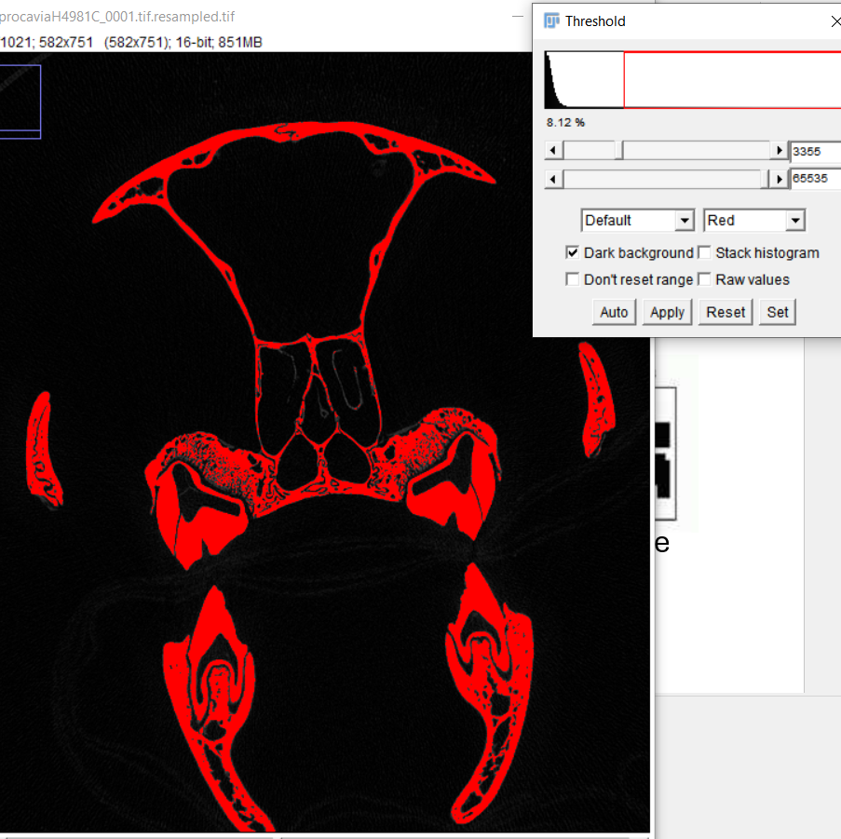
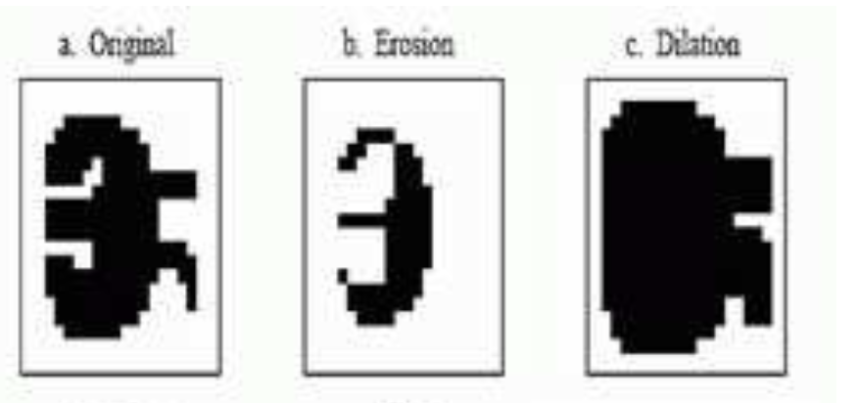

Basic methods behind
Thresholding
Morphological erosion
Morphological dilation
Disconnect components
The idea is using Disconnect Components to detect and create parcellated segmentation
Notes:
Add examples of these operations

Slide 4
Steps
Goal: Split scans into target components
Data and Methods: The methods (calculations) are all done in 3D images (image stack).
Steps:
Create seeds (segmentation)
Find and create a good seed
Grow seeds to make the final results
Check results

Slide 5
1. Create seeds
Idea: Erosion to break attached comps.
Input: Images or Binary Segmentation
Input Arguments:
Number of erosion
The maximum number of comps
Thresholds if input is images. (Use to create binary segmentation for erosion)
Output: Segmentation with values from 0 to x. 0 as background. From 1 to x is the comps with maximum volume to min volume.

Slide 6
1. Create seeds
High erosion or High thresholds
Pro: Could create more separations.
Cons: Less like the original scan, and could completely erode small parts
Low erosion or Low thresholds
Vice versa

Slide 7
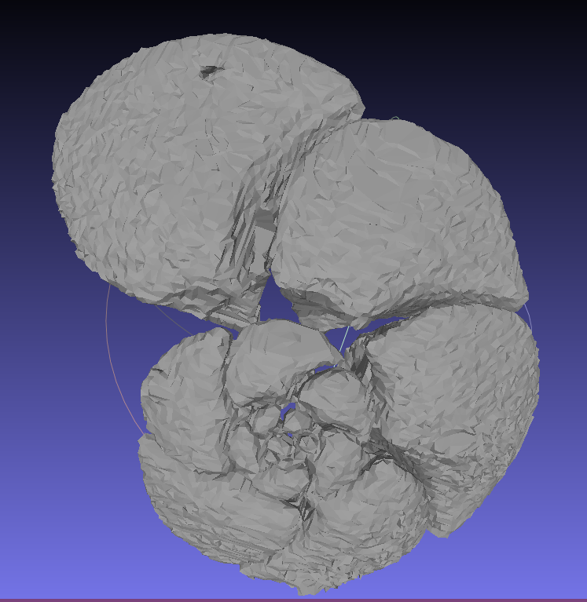
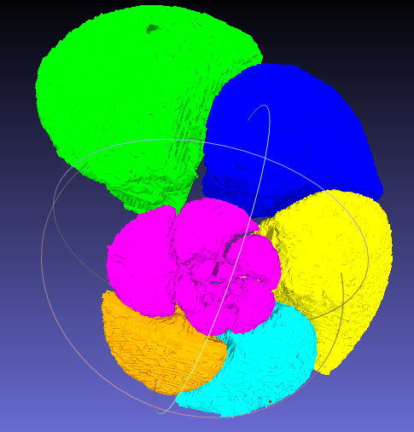
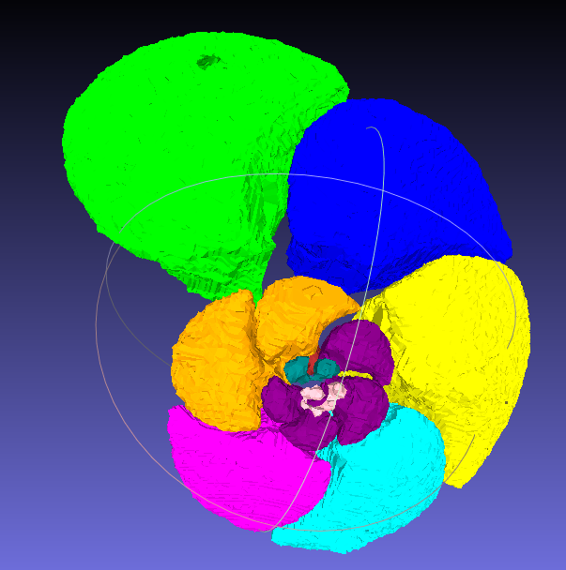
Results
Original scan
No erosion
1 erosion

Slide 8
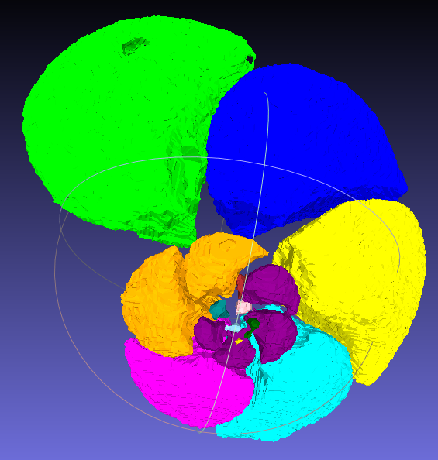
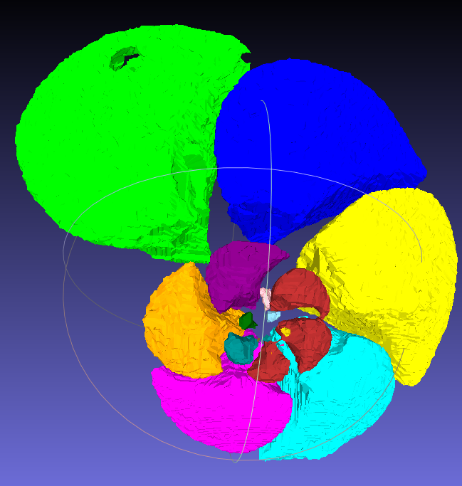
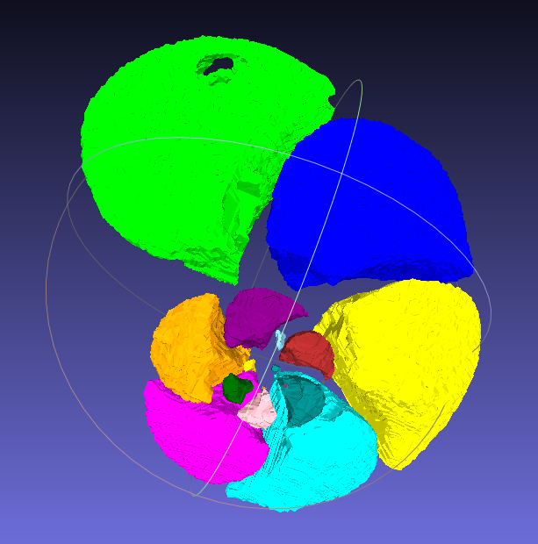
Results
2 erosion
3 erosion
4 erosion

Slide 9
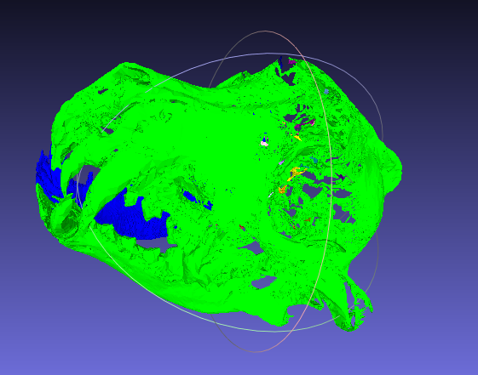
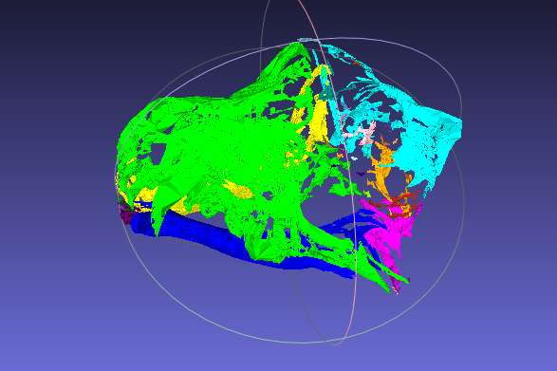
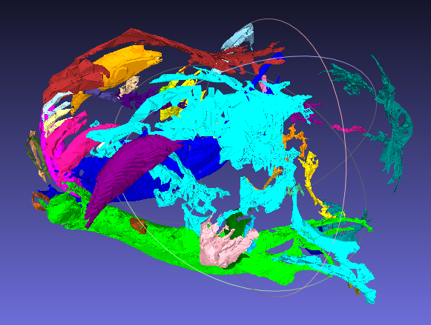
Results
2100 threshold
1 erosion
1800 threshold
2 erosions
2100 threshold
2 erosions
Notes:
Add examples of skulls

Slide 10
2. Find a good or multiple good seeds
Generate many seeds with different input args.
Visualise seeds, and check them manually.
Create meshes from seeds, view them in meshlab
Or open in avizo (or other softwares)
Use some knowledge to filter seeds
The size (volume) of different comps. E.g., the first largest comp should not be much larger than the second largest one
Notes:
Add figures of plot ?

Slide 11
2. Find a good or multiple good seeds
If there isn’t a good seed that can be used.
Example 1
Connected jaw bones, separated parietal frontal
Separated jaw bones, eroded parietal frontal
Example 2
Connected large chambers, separated small chambers
Separated large chambers, eroded small chambers
Merge separated comps from multiple seeds.

Slide 12
2. Find a good or multiple good seeds
Auto select and merge for forams:
Compare comps ith erosion to comps from the origin.
Detect separation: If a comp_origin has been split into multiple comps_i_ero, swap the comp_origin to the comps_i_ero.
Detect disappearance: If a comp_origin hasn’t appeared in comps_i_ero, do not remove the comp_origin

Slide 13
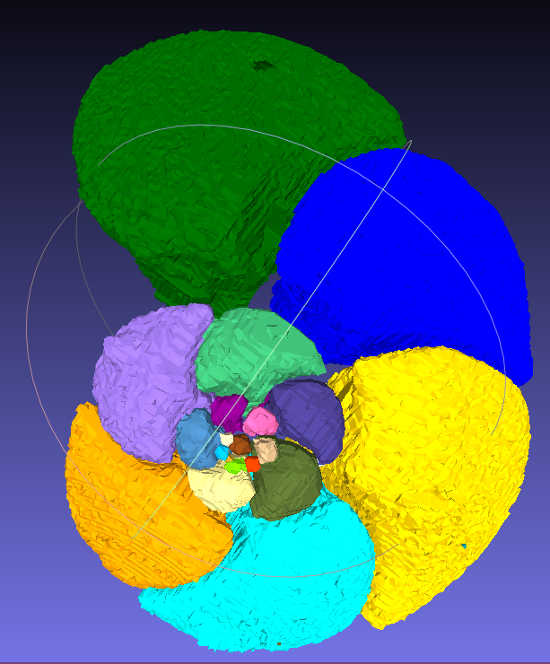
3. Grow seeds to make the final results
Idea: Dilate, grow back to the original scan (segmentation)
Input: (1) Images or Binary Segmentation (2) a seed
Input Arguments:
Number of dilation
Thresholds if using images. (Use to create binary segmentation for erosion), this threshold doesn’t need to match the one in seed generation, it just the threshold you want the seed to grow to.
Output: Segmentation with values from 0 to x. 0 as background. From 1 to x is the comps with maximum volume to min volume.

Slide 14
4. Check results
Visualised Results, and check manually.
Create meshes from seeds, plot or view them in meshlab
Or open in avizo (or other softwares)
Note: if the used seed is good, the result tend to be good.

Slide 15
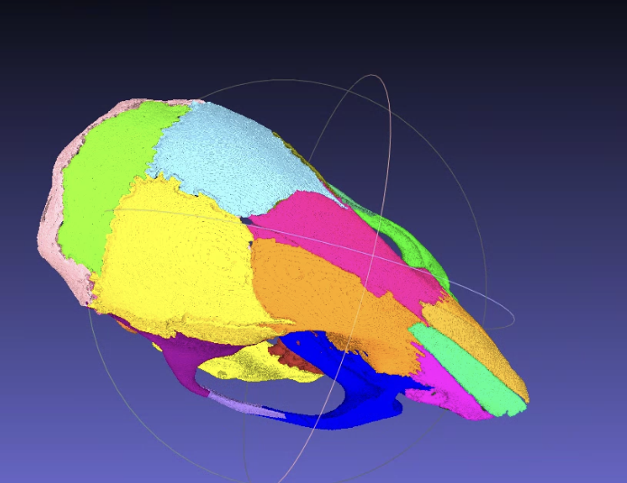
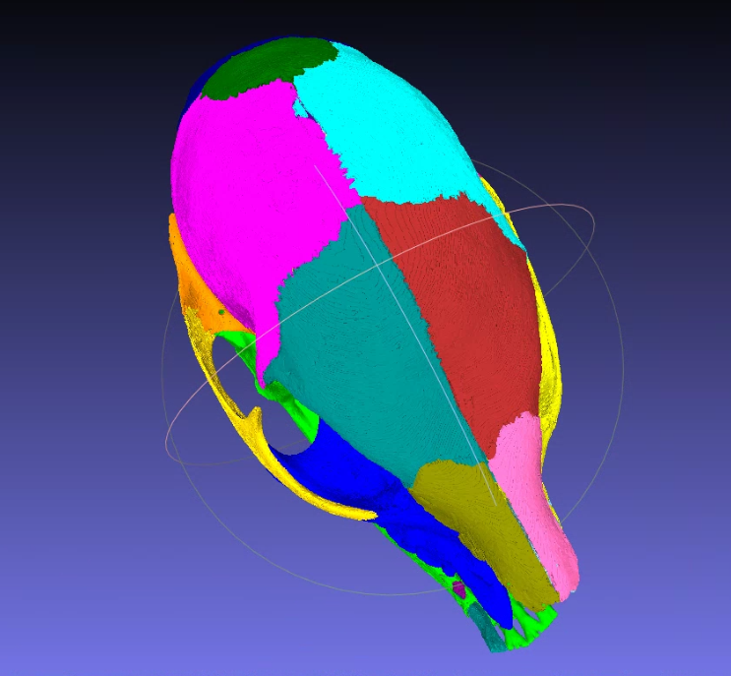
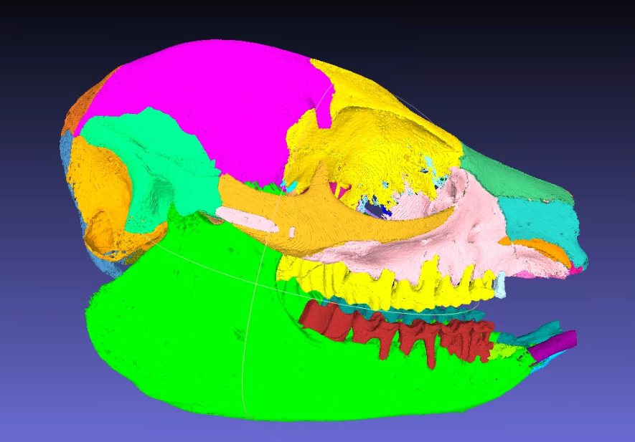
Results

Slide 16
Pros & Cons
The running speed is reasonable fast and can run parallel.
No training set needed.
Simple and white box design.
Can generate many candidate seeds/results first, faster than generation->tune->generation
Need human input
Checking seeds and results
Assign correct id.

