Slide 1
Fantasy Football
Cameron Grande
MD Hossain
Evan Cheney
CompSci 445

Slide 2
What is our model?
Our goal was to design a model that would take in data and be able to make predictions about
We used Python and the Optuna library in complement with a in house model we designed to create and measure predictions.

Slide 3
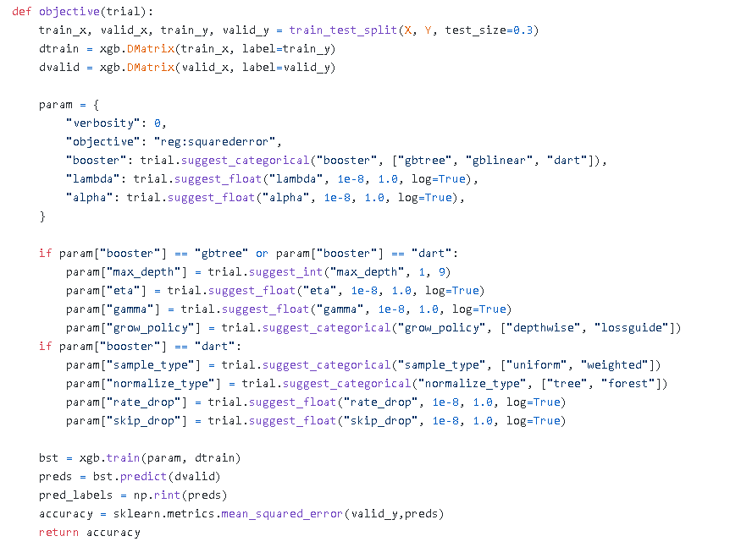

Slide 4
Results:
Our model ended up with a relatively high accuracy, ranging in the 93-97% error range!

Slide 5
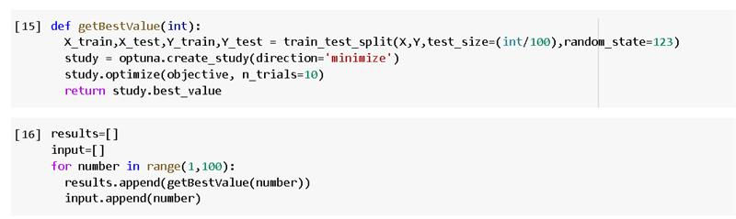
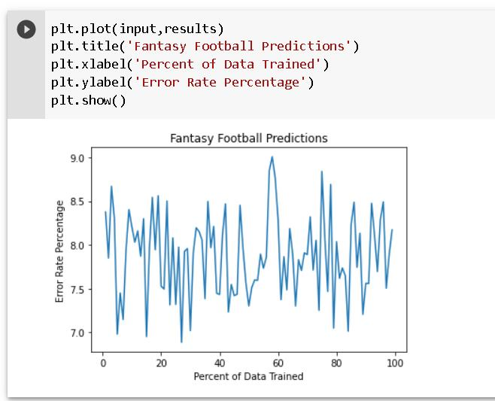

Slide 6
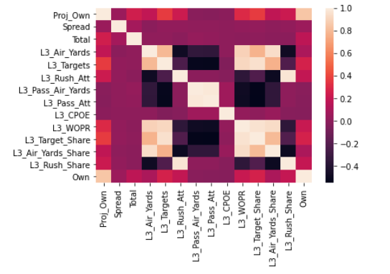
Here is a heatmap to see some of the importance of the features:

Slide 7
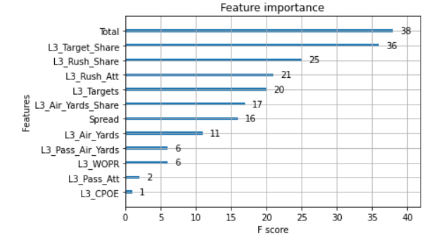
Further feature importance:

Slide 8
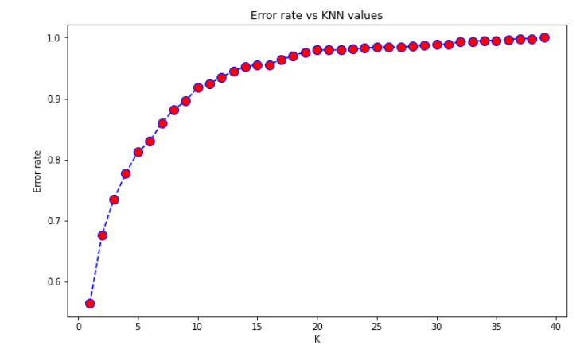
MD also used a KNN algorithm to do additional predicting. The results based on a different K value selected are as follows:

