Slide 1
PivotPoint 实时协同看板
PivotPoint — Real-time Collaborative Dashboard
第五组 — 软件工程实训
Group 3 — Software Engineering Training
React 19 · Supabase · Vite 8 · Tailwind CSS 4 · @dnd-kit
@goanarbolkong · @MemerZxZ · @Echeq
July 2026
1
Notes:
Good morning everyone. Today we present PivotPoint, a real-time collaborative Kanban dashboard built with React 19 and Supabase. We are Group 5 from the Software Engineering Training program.

Slide 2
会议议程
Agenda
01
项目概览
02
核心业务流程
03
核心功能：任务管理
Project Overview
Core Business Process
Core Features: Task Management
04
核心功能：实时协作
05
核心功能：视图与导出
06
架构与技术栈
Core Features: Real-time Collaboration
Core Features: Views & Export
Architecture & Tech Stack
07
挑战与解决方案
08
技术亮点
09
个人贡献
Challenges & Solutions
Technical Highlights
Individual Contributions
10
经验与收获
11
现场演示
Lessons Learned
Live Demo
2
Notes:
We have 11 topics today, from project overview through the live demo. The presentation is bilingual — Chinese and English — for our international audience.

Slide 3
项目概览
Project Overview
面向需要轻量级 Jira 替代方案的小团队
For small teams needing a lightweight Jira alternative
✕ 痛点 Problems
✓ PivotPoint 解决方案
Pain Points
Our Solution
• 工具碎片化，信息分散在不同平台
• Fragmented tools, scattered information
• 统一看板：任务、项目、标签一体化
• All-in-one Kanban: tasks, projects, labels
• 缺乏实时同步，进度更新延迟
• No real-time sync, delayed progress updates
• 毫秒级实时同步，基于 Supabase Realtime
• Millisecond real-time sync via Realtime
• 部署复杂，基础设施成本高昂
• Complex deployment, high infrastructure costs
• 零服务器运维，完全 Serverless 架构
• Zero server ops, fully serverless
• 工作流僵化，难以定制适配
• Rigid workflows, hard to customize
• 5种视图、5种语言、RBAC 权限
• 5 views, 5 languages, RBAC permissions
• 按席位收费，团队扩展成本高
• Per-seat licensing, expensive at scale
• 面向团队协作优化，开箱即用
• Team-optimized, out-of-the-box experience
轻量 · 实时 · 可定制 — 重新定义团队协作
3
Notes:
Many project management tools are fragmented, lack real-time sync, are complex to deploy, expensive, and rigid. PivotPoint solves all this with a unified, real-time, serverless approach. It's designed for small teams who need a lightweight alternative to tools like Jira.

Slide 4
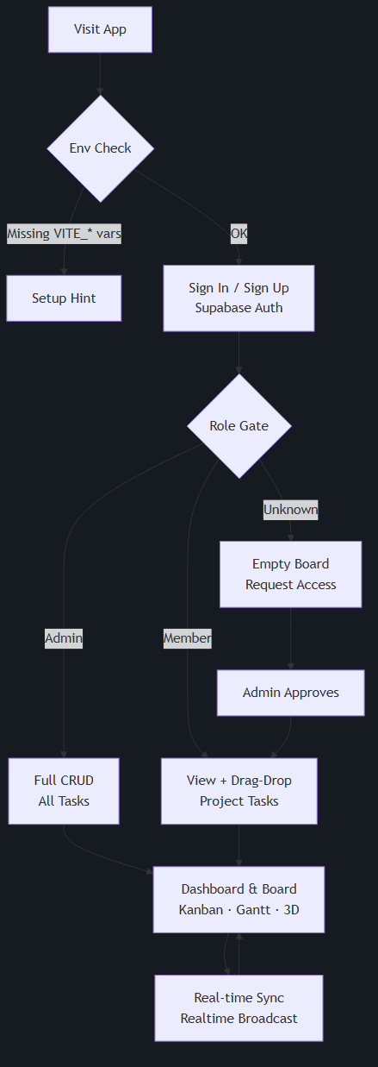
核心业务流程
Core Business Process
角色规则 Role Rules
第一个注册 → 管理员
1st signup → Admin
完全权限 Full CRUD
受邀 → 成员
Invited → Member
查看 + 拖拽 View + Drag
默认 → 未知用户
Default → Unknown
申请访问 Request access
RLS 行级安全
Row-Level Security
管理员：全部可见 Members：项目+共享看板 Unknown：无权限
Admin: all tasks Member: project + shared Unknown: no access
4
Notes:
The user journey starts with environment validation, then authentication via Supabase Auth. A role gate determines access. The first user becomes admin. Invited users become members. Everyone else is unknown and must request access.

Slide 5
核心功能：任务管理
Core Features: Task Management
功能 Feature 功能 Feature | 实现 Implementation 实现 Implementation | 优势 Benefit 优势 Benefit
增删改查 CRUD Create, read, update, delete | 通过 Supabase 实现 Via Supabase PostgREST | 完整任务生命周期 Full task lifecycle
拖拽排序 Drag & Drop 跨列拖拽 | @dnd-kit 集成 @dnd-kit cross-column | 直观操作，零学习成本 Intuitive, no learning curve
定位算法 Positioning float8 positionBetween | 中点重排，max+1024 插入 Midpoint reorder, no re-index | O(1) 重排，无需索引重建 O(1) reorder, unlimited scale
优先级 Priority P0(紧急) – P3(低) | 颜色编码 + 数据库 CHECK Color-coded, DB CHECK | 快速识别关键任务 Focus on critical tasks
智能视图 Smart Views 我的·即将到期·逾期 | 客户端过滤器 Client-side filters | 即时过滤，无需查询 Instant filtering
分配与依赖 Assign + Dependencies | 用户选择器 + 循环检测 Assignee + circular guard | 明确责任，防止误完成 Clear accountability
标签 Labels 自定义彩色标签 | 按项目管理 Per-project labels | 灵活分类 Flexible categorization
IMAGEN DE TASK MANAGEMENT UI
(Screenshot of TASK MANAGEMENT UI)
5
Notes:
Task management is the core module. It supports full CRUD, drag-and-drop with @dnd-kit, a float8 positioning algorithm that avoids re-indexing, P0-P3 priorities, smart views, assignments with dependencies and circular detection, and custom labels per project.

Slide 6
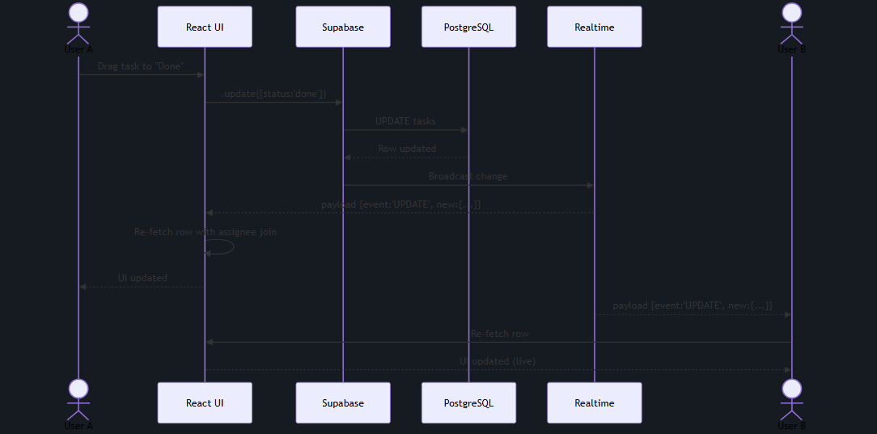
核心功能：实时协作
Core Features: Real-time Collaboration
协作功能 Collaboration
实时同步 Live Sync
Broadcasts every change to all connected clients
在线状态 Presence
See who's online in real time
编辑互斥 Edit Mutex
See who's editing which task
智能通知 Notifications
DB triggers: due_soon, overdue, assignment, mention
IMAGEN DE REAL-TIME COLLABORATION
(Screenshot of REAL-TIME COLLABORATION)
6
Notes:
Real-time collaboration is powered by Supabase Realtime. Every change broadcasts instantly. We track online presence, active editors, and send database-triggered notifications. A sequence diagram on the left shows the full data flow from user action to UI update.

Slide 7
核心功能：视图与导出
Core Features: Views & Export
📋
看板 Kanban
📊
甘特图 Gantt
🌐
3D 球体 3D Sphere
默认视图，@dnd-kit 拖拽
frappe-gantt 时间线
Three.js 空间可视化
Default, drag-and-drop
Timeline visualization
Spatial visualization
📈
仪表盘 Dashboard
📑
列表视图 List
统计与活动概览
可排序表格 + 高级筛选
Stats & activity overview
Sortable table + filters
导出 Export · 国际化 i18n · 主题 Theme
▸ 导出：XLSX (exceljs) · PDF (jspdf) · CSV
▸ Export: XLSX (exceljs) · PDF (jspdf) · CSV
▸ 国际化：EN · ES · ZH · ID · AR (RTL)
▸ i18n: EN · ES · ZH · ID · AR (RTL)
IMAGEN DE VIEWS INTERFACE
▸ 主题：亮/暗切换，localStorage 持久化
▸ Theme: Light/Dark toggle, persisted
(Screenshot of VIEWS INTERFACE)
▸ 快捷键：Ctrl/Cmd+N 新建 · Ctrl/Cmd+F 搜索
▸ Shortcuts: Ctrl/Cmd+N new, Ctrl/Cmd+F search
7
Notes:
PivotPoint offers 5 view modes: Kanban, Gantt chart, 3D Sphere, Dashboard, and List view. Users can export to XLSX, PDF, or CSV. The interface supports 5 languages including Arabic RTL. Light/dark themes and keyboard shortcuts complete the experience.

Slide 8
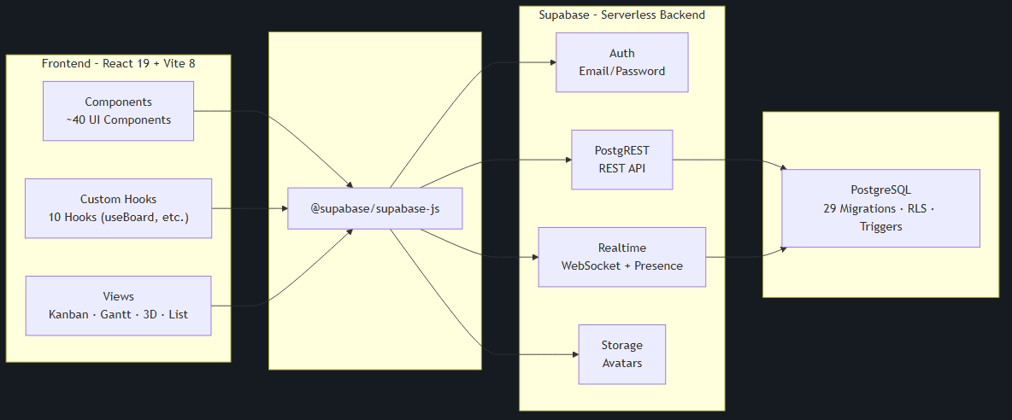
架构与技术栈
Architecture & Tech Stack
层级 Layer 层级 Layer | 技术 Technology 技术 Technology | 用途 Purpose 用途 Purpose
前端 Frontend Frontend | React 19 + Vite 8 + Tailwind 4 React 19 + Vite 8 + Tailwind 4 | UI 框架 + 构建 + 样式 UI + build + styling
拖拽 DnD DnD | @dnd-kit (core@6, sortable@10) @dnd-kit | 看板卡片拖拽 Kanban card DnD
后端 Backend Backend | Supabase (Auth·PostgREST·Realtime) Supabase | 全托管 Serverless Managed serverless
数据库 DB DB | PostgreSQL + 29 迁移 PostgreSQL + 29 migrations | RLS + 触发器 + RPC RLS + triggers + RPCs
测试 Testing Testing | Vitest 4 + Testing Library Vitest 4 + Testing Library | 30+ 测试文件 30+ test files
CI/CD CI/CD | GitHub Actions GitHub Actions | 推送到 main 自动测试构建 Auto test+build on push
无自定义服务器 — JAMstack + Serverless 架构
No custom server — JAMstack + Serverless Architecture
8
Notes:
The architecture diagram shows the full stack. React 19 on the frontend communicates with Supabase via the supabase-js SDK. Supabase provides Auth, PostgREST API, Realtime, and Storage. The database is PostgreSQL with 29 versioned migrations. Vitest powers testing and GitHub Actions CI.

Slide 9
挑战与解决方案
Challenges & Solutions
问题 Problem 问题 Problem | 解决方案 Solution 解决方案 Solution
@dnd-kit 版本不兼容 (core@6, sortable@10) @dnd-kit version mismatch | 按主版本精确导入路径，不升级 Careful import paths per major
MCP 远程迁移导致本地文件不同步 MCP migrations drift locally | 远程变更后手动执行 supabase db pull Manual supabase db pull to sync
Priority 列在迁移外添加，破坏列级权限 Priority added out-of-band, broke grants | 迁移 20260630120000 重新声明完整授权 Reconciliation migration re-stated grants
Realtime 负载缺少联表字段 Realtime payloads lack joins | 每次变更重新抓取单行 + join Re-fetch single row with join
RLS 经历 6 次迭代才最终锁定 RLS took 6 iterations to finalize | enforce_member_task_edit 触发器限制拖拽 Trigger limits members to drag-only
Rolldown 对 JSX 缩进敏感，生产构建失败 Rolldown strict JSX indentation | Code review 强制执行一致格式 Consistent formatting in code review
9
Notes:
We faced 6 major challenges. The @dnd-kit version mismatch required careful import paths. MCP migrations caused local drift. A priority column added outside migrations broke column grants. Realtime payloads lacked join data. RLS took 6 iterations. And Rolldown's strict formatting required consistent code style enforcement.

Slide 10
技术亮点
Technical Highlights
算法 Algorithm
数据库 Database
positionBetween() — Float8 定位 Float8 Positioning
29 次 SQL 迁移 + 行级安全 RLS
重排时取中点，插入时 max+1024
版本化模式，RLS 覆盖所有表
Midpoint on reorder, max+1024 on insert
29 versioned SQL migrations, RLS on every table
零索引重建 — O(1) 重排，无限扩展
列级权限确保 created_by 不可变
Zero re-indexing, O(1) reorder, unlimited scale
Column-level grants enforce immutable created_by
实时技术 Real-time
测试 Testing
Supabase Realtime + Presence
Vitest 4 · 30+ 测试文件 · CI
channel('board') 订阅所有任务变更
组件测试 + Hook 测试 + API 集成测试
Channel subscribes to all task changes
Component + hook + API integration tests
每次变更重新抓取 + 联表
15 秒超时，全局启用，模拟 Supabase
Row re-fetch with join on every change
15s timeout, globals enabled, mock Supabase
10
Notes:
Four technical highlights. First, the float8 positioning algorithm. Second, 29 versioned SQL migrations with Row-Level Security. Third, Supabase Realtime with re-fetch pattern. Fourth, comprehensive testing with Vitest and mocked Supabase client.

Slide 11
个人贡献
Individual Contributions
孔
周
陈
@goanarbolkong
@MemerZxZ
@Echeq
(孔刚)
(周奕龙)
(陈昌发)
前端负责人 Frontend Lead
后端负责人 Backend Lead
项目经理与质量保证 PM & QA
📷 FOTO / PHOTO
📷 FOTO / PHOTO
📷 FOTO / PHOTO
(Pon tu foto aquí / Place photo here)
(Pon tu foto aquí / Place photo here)
(Pon tu foto aquí / Place photo here)
✓ 拖拽集成 @dnd-kit
✓ 全部 29 个数据库迁移
✓ AGENTS.md + 文档管理
Drag-and-drop with @dnd-kit
All 29 database migrations
AGENTS.md + documentation
✓ 甘特图 + 3D 球体可视化
✓ RPC: admin_set_role, check_blocked_tasks 等
✓ ErrorBoundary + EmptyState 组件
Gantt chart + 3D Sphere
RPCs: admin_set_role, etc.
ErrorBoundary + EmptyState
✓ 导出菜单 XLSX/PDF/CSV
✓ RLS 策略 + 触发器
✓ 30+ 测试文件
ExportMenu
RLS policies + triggers
30+ test files
✓ 标签管理 LabelManager
✓ 任务依赖 + 通知系统
✓ CI/CD GitHub Actions 流水线
LabelManager
Task dependencies + notifications
CI/CD pipeline
✓ 列表视图 + 优先级选择器
✓ 系统日志 + 审计
✓ 演示文稿 + 用户手册
ListView + Priority selectors
System logs + audit
Presentation + user manual
11
Notes:
Three team members. @goanarbolkong led frontend development, including drag-and-drop, visualizations, and exports. @MemerZxZ designed all database migrations, RPCs, and RLS. @Echeq managed documentation, testing, CI/CD, and presentation.

Slide 12
经验与收获
Lessons Learned
1
Serverless 架构行之有效
2
实时同步看似简单实则复杂
Serverless Architecture Works
Real-time is Deceptively Hard
Supabase 消除了所有后端运维，零服务器维护，开发完全专注于产品功能。
广播变更很容易，真正的挑战是合并逻辑：每次变更重新抓取联表数据，处理并发编辑。
Supabase eliminated all backend ops. Zero servers to maintain — pure product focus.
Broadcasting is easy. The real challenge is merge logic: re-fetching joins on every change.
3
Float8 定位算法优雅高效
4
团队协作是成功的关键
Float8 Positioning is Elegant
Teamwork is the Key
中点算法完全避免索引重建。positionBetween() 一个函数处理插入、重排、边界情况。
三个人各司其职（前端、后端、QA），清晰分工 + 每日同步 = 高效交付。
No re-indexing. One function handles insert, reorder, and edge cases.
Three roles, clear分工, daily syncs = efficient delivery.
5
SQL 迁移作为唯一真相源
6
自动化测试回报巨大
Migrations as Source of Truth
Testing Pays Off
29 个版本化 SQL 文件提供完整模式历史，可回滚，可审查，如同应用代码。
30+ 测试配合 Mock Supabase 早期捕获回归。Vitest 的 Vite 集成使测试仅需数秒。
29 versioned SQL files: full history, reliable rollback, reviewable like code.
30+ tests with mocked Supabase caught regressions. Suite runs in seconds.
12
Notes:
Six key lessons. Serverless works. Real-time is harder than it looks. The float8 positioning algorithm is elegant. Teamwork with clear roles was essential. Versioned SQL migrations provide reliable schema management. And comprehensive testing pays off.

Slide 13
现场演示
LIVE DEMO
1
登录 / 注册
30s
2
创建项目 + 任务
30s
3
拖拽操作
20s
Sign in / Create account
Create project + tasks
Drag & drop
Supabase Auth
设置优先级、标签、负责人
跨列移动 + 重排序
IMAGEN DE DEMO STEP 1
IMAGEN DE DEMO STEP 2
IMAGEN DE DEMO STEP 3
(Screenshot of DEMO STEP 1)
(Screenshot of DEMO STEP 2)
(Screenshot of DEMO STEP 3)
4
实时同步演示
30s
5
切换视图
20s
6
导出数据
10s
Real-time sync
Switch views
Export data
打开两个浏览器，观察即时同步
看板 → 甘特图 → 3D 球体 → 列表
下载 XLSX / PDF
预计时长：~2 分钟 — 完整流程演示 Expected: ~2 min full walkthrough
13
Notes:
Now for the live demo. We'll walk through 6 steps in about 2 minutes: signing in, creating a project and tasks, drag-and-drop, demonstrating real-time sync across two browsers, switching views, and exporting to PDF.

Slide 14
谢谢
Thank You
谢谢 · Thank You · Gracias · Terima Kasih · شكراً
问答环节 Questions?
React 19 · Supabase · Vite 8 · Tailwind CSS 4 · @dnd-kit
github.com/Echeq/MiniSemesterProject
Star us on GitHub ⭐
@goanarbolkong · @MemerZxZ · @Echeq
14
Notes:
Thank you for your attention. We've demonstrated that React 19 and Supabase can build a production-grade, real-time collaborative application. The source code is on GitHub. Thank you in 5 languages. We're happy to take questions.

