Slide 1

PivotPoint: Real-time Collaboration Dashboard
A Modern Project Management Tool Built with React 19 and Supabase
Tech Stack: React 19 · Supabase · Vite 8 · Tailwind CSS 4
Speaker: [Your Name] | Date: July 2026
Notes:
Hello everyone, and welcome to this project demonstration. Today, I will introduce you to a real-time collaboration dashboard called "PivotPoint". This is a modern project management tool built with cutting-edge web technologies such as React 19 and Supabase. It is designed to address many of the pain points in current team collaboration, providing an out-of-the-box, efficient, and real-time solution.

Slide 2

Agenda
01
Project Background & Pain Points (The Problem)
Discuss the common issues and industry pain points of current project management tools in collaboration efficiency, information synchronization, and process control.
04
Key Features Deep Dive
Showcase core functional modules such as full-lifecycle task management, real-time team collaboration dashboards, and multi-dimensional data views in detail.
02
The Solution: PivotPoint Overview
Introduce PivotPoint's core value proposition and explain how it addresses the core bottlenecks of traditional tools through innovative design.
05
Development Workflow
Outline the complete engineering practice process from requirement iteration, agile development, automated testing to CI/CD pipeline deployment.
03
System Architecture & Tech Stack
Deep dive into the project's front-end and back-end layered architecture, database selection strategy, and core technical components supporting high availability.
06
Demo & Conclusion
Visually present the functional effects through a live product demo, and summarize the project achievements, application prospects, and future plans.
Notes:
This presentation will cover six core sections. First, we'll analyze the common challenges in current project management. Next, I'll introduce our solution, PivotPoint, including its core features and value. Then, we'll delve into its system architecture, tech stack, and the implementation details of key features. Finally, we'll walk through the development workflow and conclude the project.

Slide 3

01 Project Background & Pain Points
Tool Fragmentation & Silos
Lack of Real-time Collaboration
Teams use different tools for collaboration, scattering information across platforms. Integration is hard, making a unified project view impossible and efficiency plummeting.
Relying on manual refreshes or delayed sync, information flow lags. It fails to meet the need for instant progress sharing and problem communication.
Complex Deployment & High Cost
Rigid & Non-customizable
Local deployment needs professional ops, and commercial licenses charge per seat. Costs for hardware, software and labor surge as teams scale.
Tool workflows are preset and can't adapt to unique team processes. Redundant and missing features coexist, failing to fit real business needs.
Traditional project management tools often rely on complex local deployments and heavy infrastructure maintenance, like tangled server lines. They not only have high setup barriers but also bring exorbitant operational costs and management burdens.
The Core Need:A lightweight, real-time, cost-effective, and highly customizable project management solution.
Notes:
First, let's look at the project background. We found that despite the abundance of project management tools on the market, they all share common issues. For example, tools are fragmented, creating information silos; they lack true real-time collaboration; deployment is complex with high operational costs; and they are expensive with poor customizability. These pain points are the starting point of our project. What teams really need is a lightweight, real-time, cost-effective, and customizable solution.

Slide 4
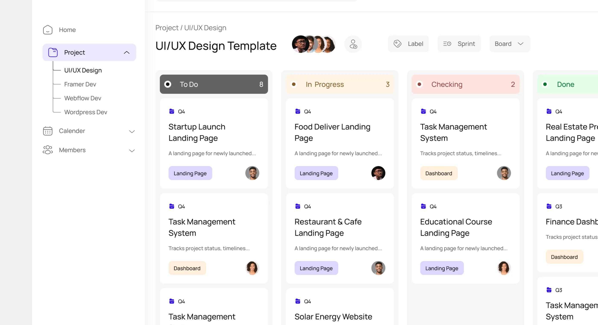
02 The Solution: PivotPoint Overview
PivotPoint is built to solve collaboration pain points. It is a fully-featured real-time collaboration dashboard that eliminates complex configurations, aiming to provide teams with an extremely smooth user experience and powerful project management capabilities, redefining efficient collaboration.
Core Value Proposition:An "out-of-the-box" real-time collaboration dashboard that frees teams from tedious setup and focuses on high-impact output.
Drag-and-Drop Board Management
Granular RBAC Permissions
Visualize the entire task workflow. Update statuses with a simple drag-and-drop. Intuitive operation, zero learning curve for the team.
Assign data access based on roles. Strictly control information flow to ensure project data security and collaboration order.
Millisecond Real-Time Sync
Global & Cross-Scenario Fit
All changes are instantly broadcast to Web, desktop, and mobile, ensuring all collaborators have consistent information.
Supports boards, Gantt charts, etc.; one-click Excel/PDF export; 5 languages & RTL layout ready.
Notes:
To solve these pain points, we introduce PivotPoint. Its core value proposition is to provide an "out-of-the-box" real-time collaboration dashboard. PivotPoint not only offers an intuitive drag-and-drop board but also powerful real-time data sync, role-based access control (RBAC), multiple views and export options, and even internationalization support to meet the needs of global teams.

Slide 5



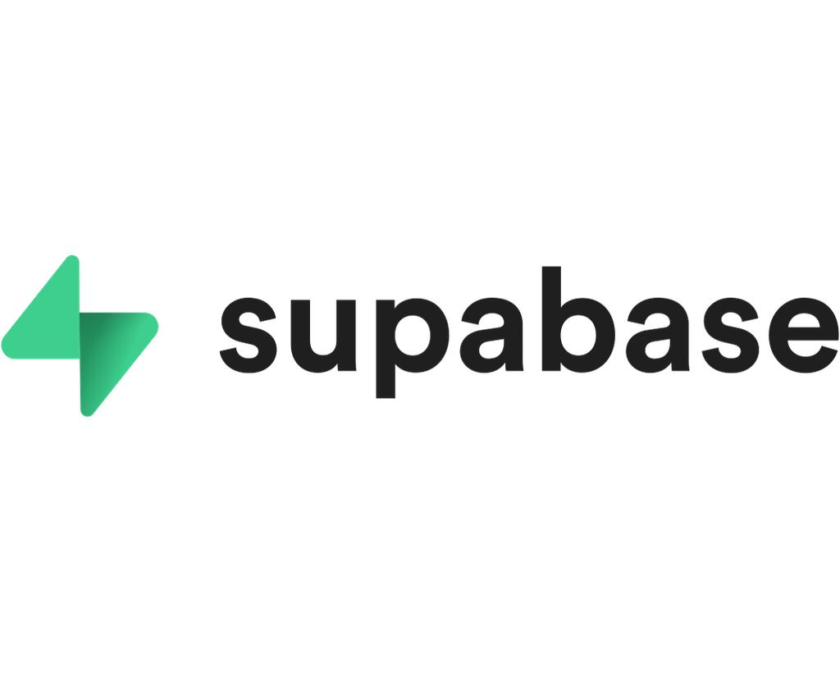
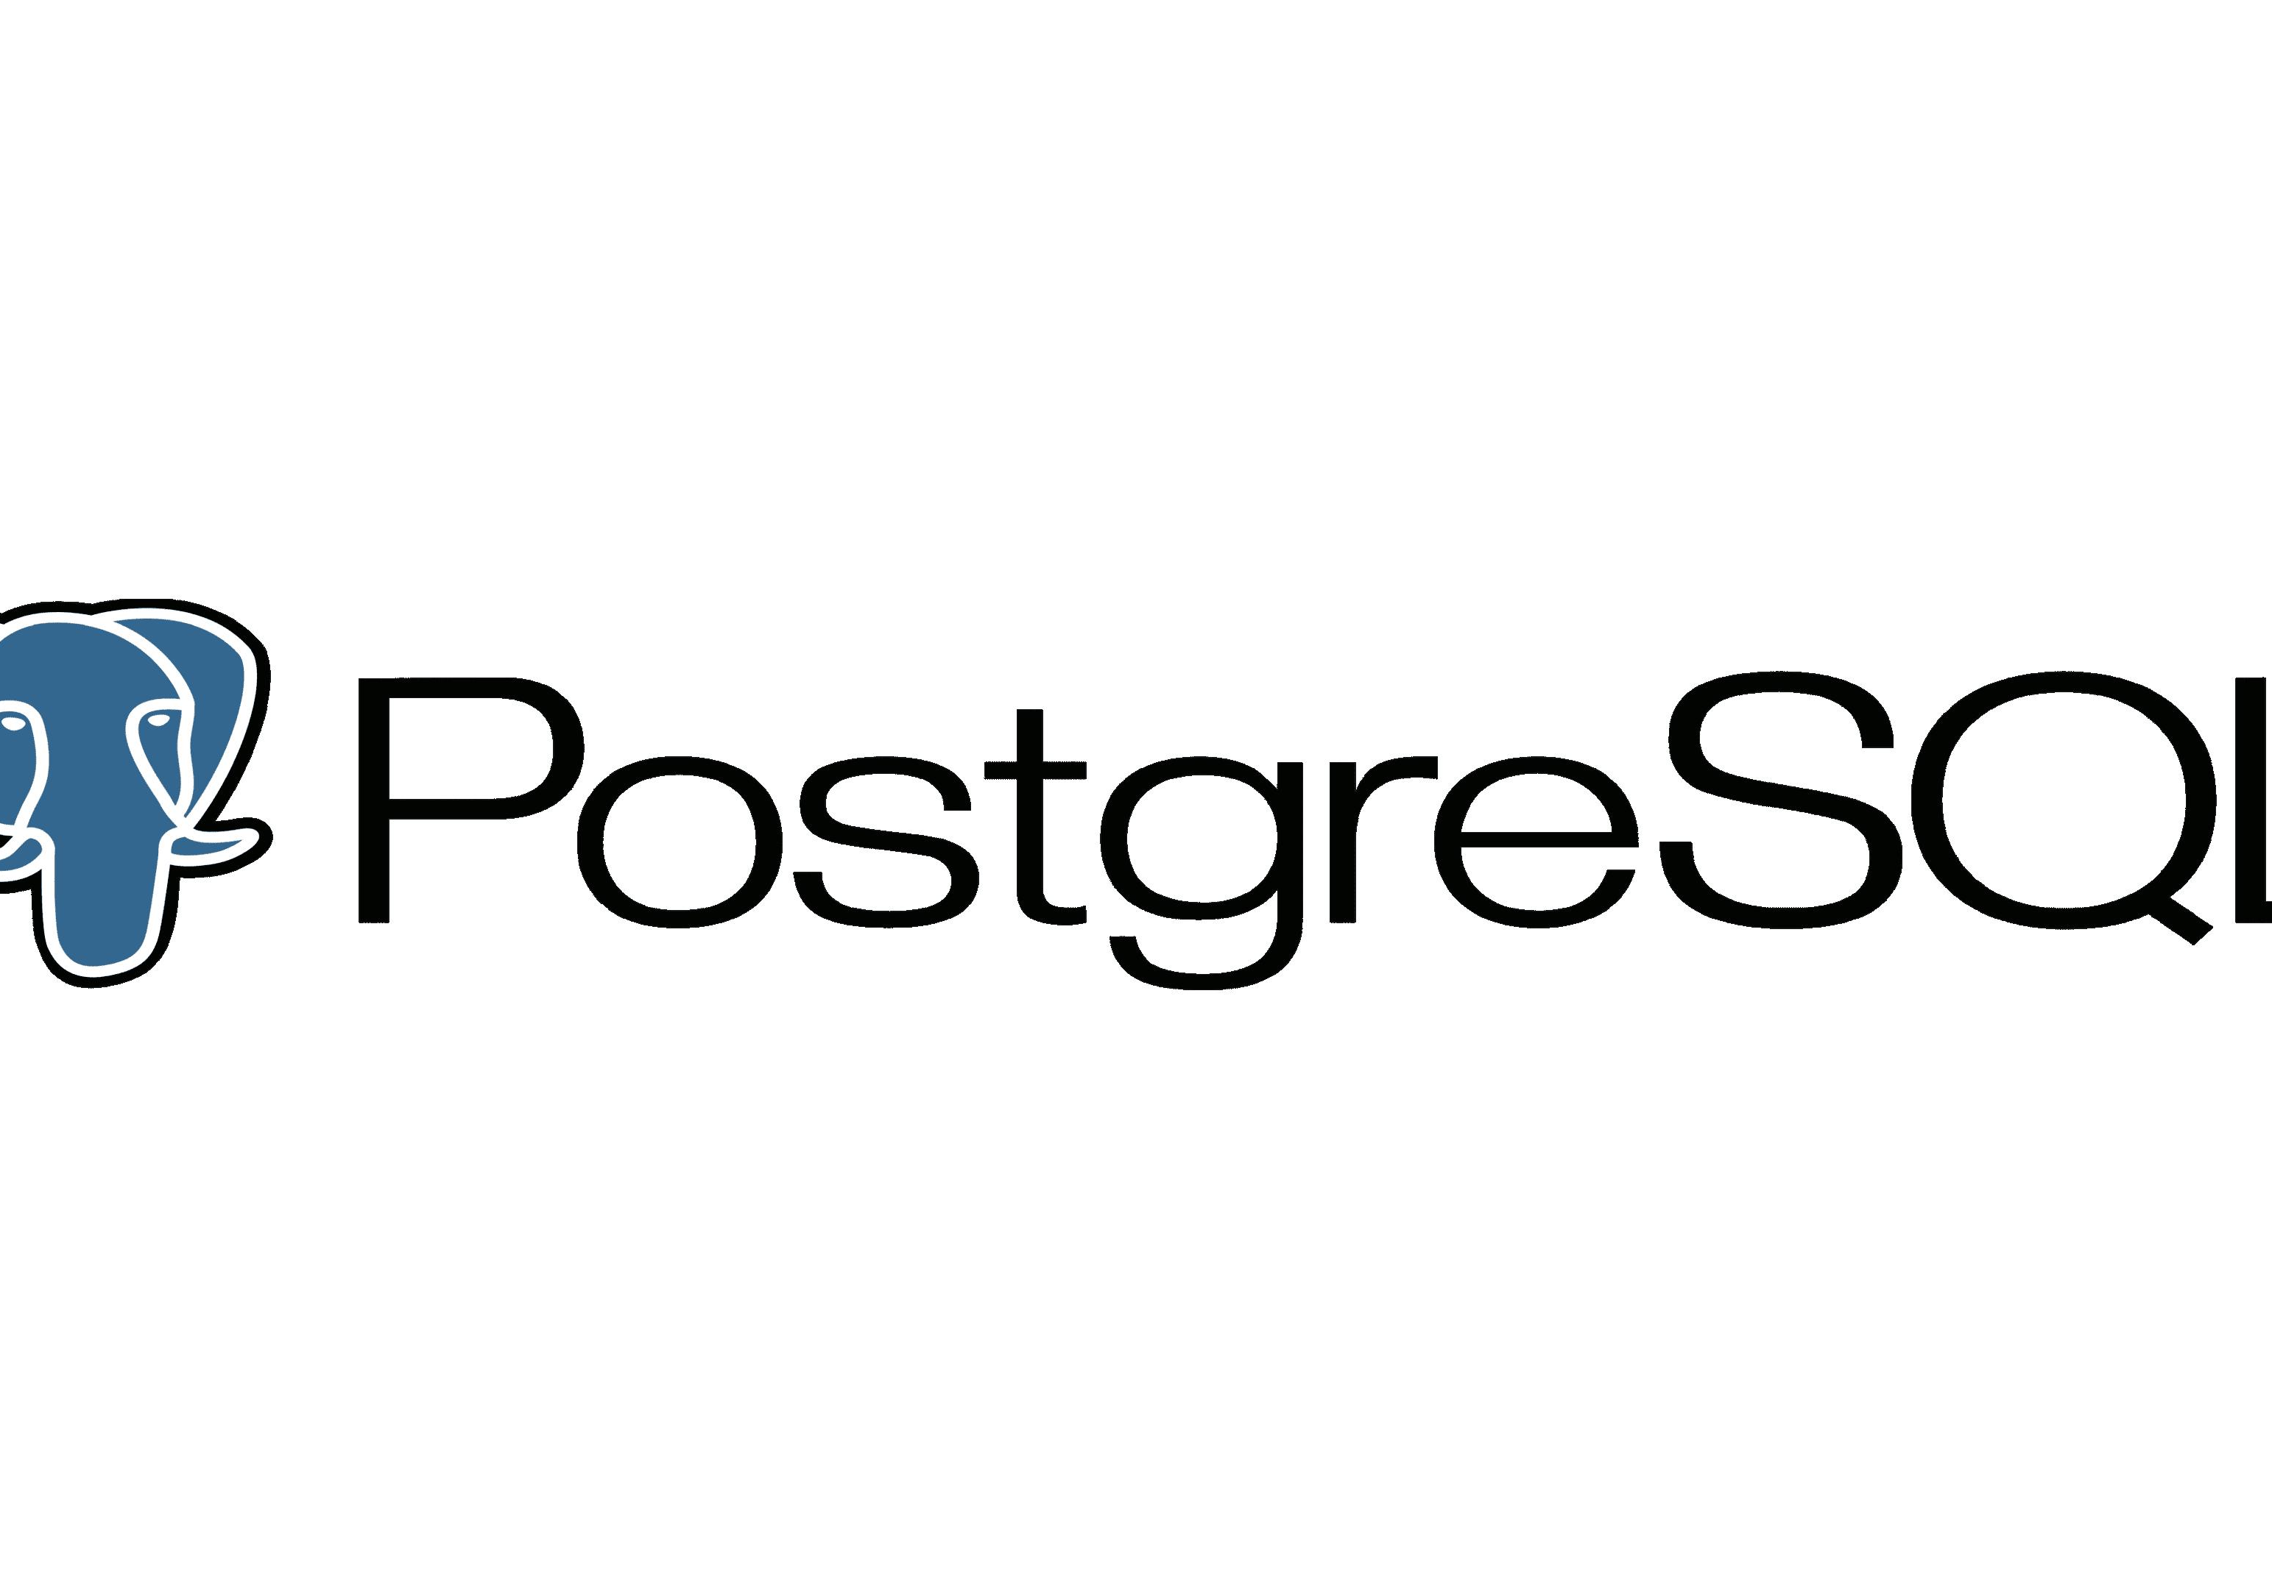
03 System Architecture & Tech Stack
PivotPoint adopts a modern JAMstack architecture, achieving complete separation of front-end and back-end. This not only enhances development iteration efficiency but also ensures high performance and easy deployability in production environments.
Frontend Core: Ultimate Development Experience & Performance
Backend Architecture: Fully Managed Serverless
Supabase Integrated Backend Service
Integrates Auth, auto-generated PostgREST APIs, Realtime data sync, and Storage, building a complete backend with zero operational overhead.
React 19
The latest core framework, paired with 10 custom Hooks for efficient state and logic reuse.
Vite 8 & Rolldown
Uses Rolldown for production builds, delivering lightning-fast hot updates and extreme bundling performance.
Tailwind CSS 4
An atomic CSS solution that enables write-and-use styling, maintaining UI consistency while accelerating development.
PostgreSQL: Powerful Underlying DB
An open-source object-relational database. Its architecture evolution is managed via 24 SQL migration files, ensuring data integrity and scalability.
Core Advantage: A modern architecture with low maintenance costs. The combination of JAMstack and Serverless achieves a perfect balance between development efficiency and system stability.
Notes:
Next, we'll dive into PivotPoint's system architecture and tech stack. On the frontend, we use modern technologies like React 19, Vite 8, and Tailwind CSS 4 to ensure development efficiency and application performance. The backend is entirely built on Supabase, a serverless architecture that provides a full suite of services including authentication, database, real-time communication, etc., greatly simplifying the development and deployment process. The underlying database is the powerful PostgreSQL.

Slide 6
Core Business Flow
PivotPoint's user journey is clear and intuitive, from environment configuration to real-time collaboration, every step is carefully designed to ensure a smooth, secure, and efficient operational experience.
01 Environment Check
02 User Authentication
Automatically validates environment variables and core configurations for system operation, ensuring basic services are ready and avoiding runtime dependency issues.
Implements secure registration & login via Supabase Auth, supporting unified multi-device account management to ensure identity authenticity and security.
03 Role Authorization
04 Dashboard & Collaboration
Assigns differentiated permissions by role (Unknown/Member/Admin), enabling data isolation and operational control for hierarchical system access security.
Access the visual dashboard for real-time collaborative editing, with support for view switching and data export to boost team efficiency.
A visual business flow architecture diagram illustrating the system's full-link logic from authentication to collaboration. Modules are decoupled with clear interactions, ensuring scalability and stability.
Notes:
This is the core business flow diagram of PivotPoint. Users first go through environment checks, then login authentication. The system assigns different permissions based on user roles—Admin, Member, or Unknown. After authentication, users can access the dashboard for real-time collaboration, switch views, or export data. The entire process is clear and intuitive.

Slide 7
System Architecture Overview
PivotPoint adopts a modern JAMstack architecture. Through the separation of front-end and back-end, it not only decouples the development process but also achieves an efficient and scalable deployment solution, providing users with a smooth interactive experience.
Frontend Interaction Layer (Frontend)
Built on the core framework ofReact 19, constructed with Vite 8, and paired with Tailwind CSS 4 for atomic style management, balancing flexibility and development efficiency.
Encapsulates over 10 custom Hooks for state management and abstracts 5 generic view-layer components, greatly improving code reusability and maintainability.
Backend Service Layer (Backend)
Adopts a serverless architecture withSupabase, integrating core services like Auth, Realtime, and Storage to quickly build secure and reliable backend capabilities.
Underpinned by thePostgreSQLdatabase, it automatically generates RESTful APIs via PostgREST for efficient data reading, writing, and real-time synchronization.
Notes:
This diagram provides a more detailed view of our system architecture. The frontend is a typical React application built with Vite and styled with Tailwind CSS. All business logic is encapsulated in custom Hooks. The backend is fully powered by Supabase, a BaaS (Backend as a Service) that automatically exposes the PostgreSQL database as an API via PostgREST and enables real-time communication through its Realtime service.

Slide 8
04 Key Features Deep Dive: Task Management
Task Management is the core module of PivotPoint. With its flexible architectural design, it provides comprehensive support from basic operations to complex logic, empowering teams to collaborate efficiently.
Basic CRUD Operations
It provides standardized task lifecycle management, supporting easy creation, real-time reading, flexible updating, and secure deletion of tasks to ensure the integrity of data flow.
Multi-Level Priority Management
It has a built-in four-level priority system from P0 (Urgent) to P3 (Low), helping teams quickly identify critical tasks, allocate resources rationally, and focus on high-value outputs.
Smooth Drag-and-Drop Sorting
Deeply integrated with the @dnd-kit library, it supports free sorting of tasks within columns and cross-column dragging between different task columns, with fast operation response and smooth interaction experience.
Deadline & Progress Tracking
It supports task deadline setting, and together with smart views, it automatically displays progress status, intuitively presents task delay risks, and ensures on-time project delivery.
High-Performance Intelligent Positioning
It uses the float8 type to store position information and leverages the positionBetween() algorithm to calculate midpoints, avoiding full reindexing and significantly improving reordering performance.
Responsibility Assignment & Dependency Relationships
Tasks can be accurately assigned to members to clarify responsibilities, and it also supports configuring task prerequisites to ensure the rigor and orderliness of complex project execution logic.
Notes:
Now let's take a deep dive into the core features. First is Task Management. We've implemented complete CRUD operations and achieved smooth drag-and-drop sorting through the @dnd-kit library. Notably, we've adopted an intelligent positioning algorithm to optimize reordering performance. In addition, tasks support rich attributes such as priority, deadlines, assignments, dependencies, and tags, fully meeting the needs of project management.

Slide 9
Key Features Deep Dive: Real-time Collaboration
01. Real-time Data Flow Loop
User Interaction Trigger
UI drag-and-drop and editing are instantly captured via custom Hooks.
Cloud DB Sync
The supabase-js library writes changes to PostgreSQL in real time.
Global State Broadcast
Realtime service detects changes and broadcasts to all subscribed clients.
02. Enhanced Collaboration Experience
Real-time collaboration is a core advantage of PivotPoint. Powered by the Supabase Realtime engine, it ensures millisecond-level synchronization of team members' actions, keeping all collaborators on the same page and eliminating version conflicts and information lag.
Online Status
See active members in real time.
Edit Mutex
Avoid concurrent edit conflicts.
Smart Notifications
Triggers send alerts for key updates.
Notes:
Real-time collaboration is the essence of PivotPoint. This slide illustrates the real-time data flow: user actions update the database via the Supabase client library, Supabase Realtime captures changes and broadcasts them to all clients, which then update their interfaces. We've also implemented features like online status, edit mutex, and smart notifications, greatly enhancing team collaboration efficiency and experience.

Slide 10
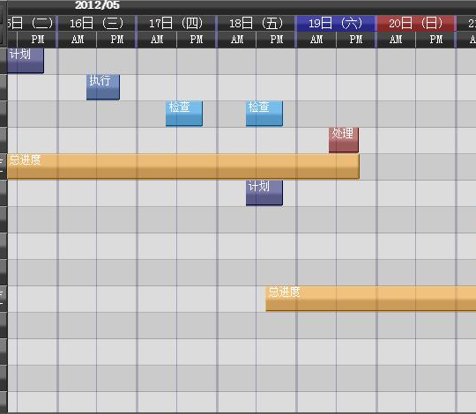
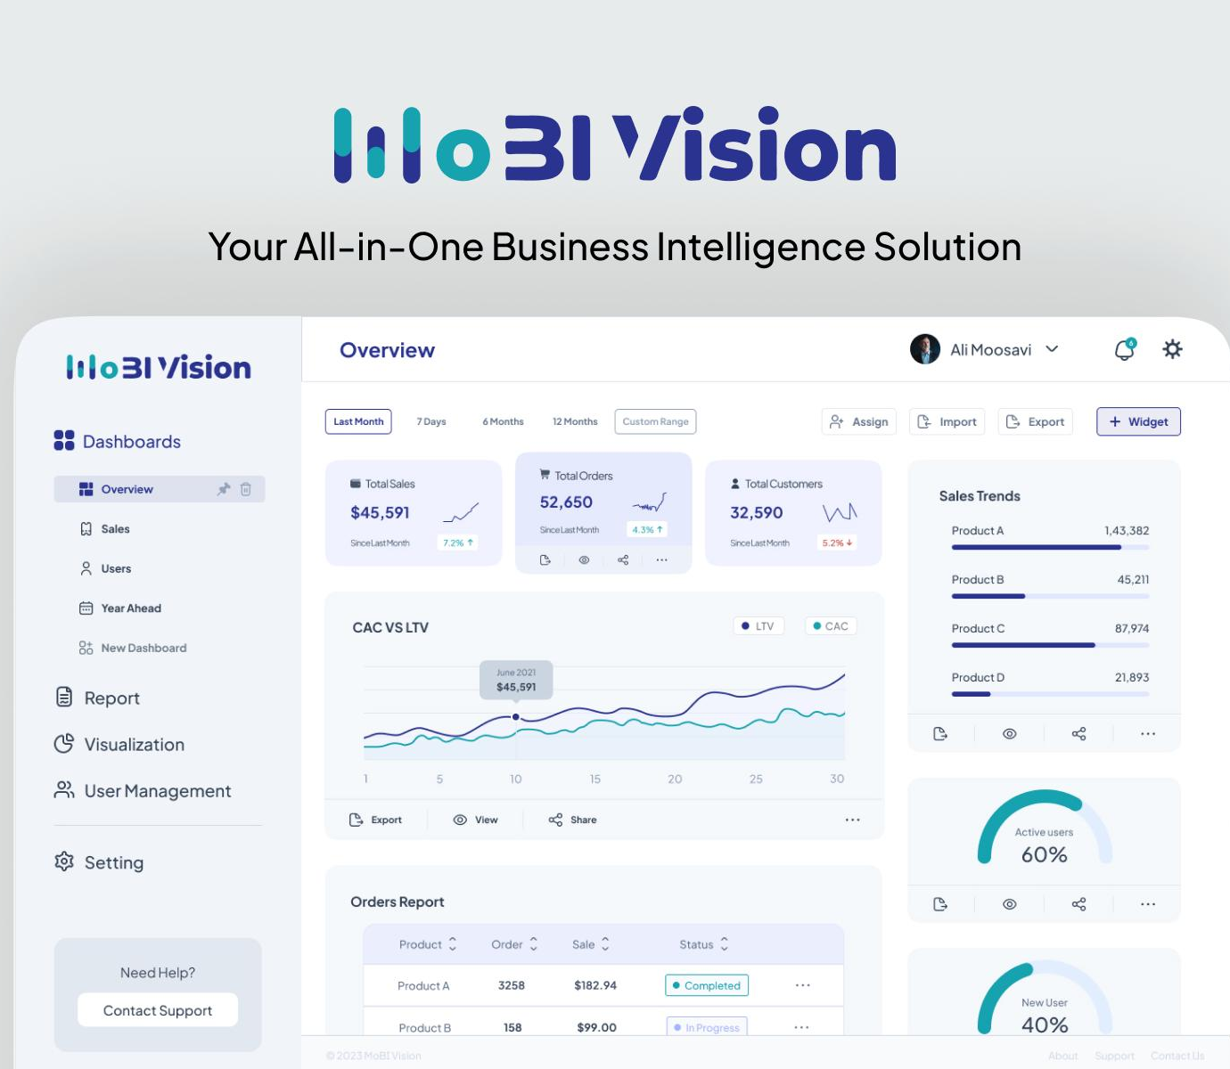

Key Features Deep Dive: Multiple Views & Export
01 Multi-dimensional Views, Flexible Management
02 Multi-format Export, Data Interoperability
03 Global Adaptation, Seamless Experience
Supports one-click export of data to mainstream formats such as XLSX, PDF, CSV, etc., meeting the needs of archiving, sharing, and secondary analysis to achieve seamless data flow.
The interface fully supports5 languages, including English, Spanish, Chinese, Indonesian, and Arabic, reaching global users.
In addition to intuitive Gantt charts and data dashboards, it also supports Kanban, 3D sphere spatial visualization, and list views, covering full scenarios of task scheduling, data overview, and batch operations to adapt to the collaboration habits of different teams.
Specially adapted for right-to-left (RTL) reading habits such as Arabic, optimizing layout and interaction logic to provide a consistent and smooth operation experience for cross-border teams.
Built on mature libraries such as exceljs and jspdf, it ensures standardized file formats and accurate data for compatibility with various office software.
Notes:
To meet different work habits and scenarios, PivotPoint offers a variety of views, including classic Kanban, Gantt charts for planning, unique 3D sphere views, data dashboards for overview, and list views. Additionally, we support one-click export of data to Excel, PDF, or CSV formats. Furthermore, our product supports 5 languages and provides RTL layout for languages like Arabic, truly achieving internationalization.

Slide 11
Role-Based Access Control (RBAC)
PivotPoint adopts the Role-Based Access Control (RBAC) model and deeply integrates with PostgreSQL's Row-Level Security (RLS) policies. It builds a dual security defense from the application logic layer to the database bottom layer, realizing a fine-grained, zero-trust full-link permission management system.
Row-Level Security (RLS) Underlying Safeguard
Strict RLS policies are configured for all core business tables to ensure users can only query and operate data rows within their permission scope, completely eliminating the risk of illegal unauthorized access from the database's lowest level.
Admin
Has full CRUD permissions, responsible for team member management, project configuration and overall control of all task data.
Member
Has read-only access to tasks, can only edit assigned items, focuses on execution and collaboration, and cannot tamper with others' data.
Unknown (Unauthorized)
Blocked by the system, cannot access any task data, and is uniformly redirected to the access application page to strictly enforce security boundaries.
Flexible Dynamic Permission Management
Administrators can call the `admin_set_role` RPC function to adjust user role hierarchies in real time, supporting instant granting, demotion or revocation of permissions to quickly adapt to the dynamic changes of team collaboration.
Notes:
Security is the cornerstone of enterprise applications. PivotPoint ensures data security through Role-Based Access Control (RBAC) and database Row-Level Security (RLS). We define three roles: Administrators, Members, and Unknown users, each with different permissions. All database tables are configured with RLS policies, fundamentally ensuring that users can only access data they are authorized for.

Slide 12
05 Tech Stack Deep Dive
Frontend Framework · React 19
Adopts an efficient component-based development model and virtual DOM mechanism, ensuring rendering performance while greatly enhancing code maintainability and reusability.
Interaction Core · @dnd-kit
A powerful yet lightweight drag-and-drop library with flexible APIs and gesture support, perfectly fitting kanban task dragging and sorting.
Core Data · PostgreSQL
A powerful open-source object-relational DB with native support for JSON, triggers, RLS, etc. It provides a stable, secure, and scalable foundation, perfectly fitting Supabase's ecosystem and ensuring data integrity.
Build Tool · Vite 8
Achieves blazing-fast cold start and HMR. Optimizes bundle size with Rolldown in production, balancing dev experience and performance.
Testing Assurance · Vitest 4
Deeply integrated with Vite, sharing config and pre-bundling. Supports snapshot and component testing, shortening test cycles.
Styling Solution · Tailwind CSS 4
Based on atomic CSS, quickly build UI with utility classes, reduce redundant code, support theme customization, and boost dev efficiency.
Backend Service · Supabase
An all-in-one BaaS solution with auth, realtime DB, storage, etc. No server setup needed, cutting backend dev and ops costs.
Tech Stack Summary
This full-stack combination balances dev efficiency, runtime performance, and deployment ease, laying a solid foundation for rapid iteration and long-term maintenance.
Notes:
This is the detailed list of our tech stack. On the frontend, we've chosen the golden trio of React 19, Vite 8, and Tailwind CSS 4, with Vitest for testing. On the backend, we rely entirely on Supabase and PostgreSQL. These choices are all aimed at achieving efficient development, exceptional performance, and simple deployment.

Slide 13
Database Design
Core Entities
With `profiles`, `tasks`, and `projects` as the three core tables, they carry basic info of users, tasks, and projects, serving as the cornerstone of the entire data model.
Relationships & Collaboration
Many-to-many relationships via junction tables. `project_members` manages permissions, `task_dependencies` organizes workflows, and `notifications` & `invitations` complete collaboration.
Field Length Control
Titles: 1-200 chars, Descriptions: up to 5000 chars, optimizing storage efficiency.
Immutable Creator
`created_by` is locked after writing, ensuring traceability and clear accountability.
The system adopts a standardized relational database structure, with clear table associations and foreign key constraints, building a solid data foundation. The design fully considers data consistency, integrity, and scalability, providing reliable underlying support for business functions.
Standardized Priority Enums
Limited to P0-P3, standardizing task priority definitions for unified collaboration.
Integrity & Consistency
Foreign keys and non-null constraints enforce data validity and eliminate dirty data.
Notes:
This is our database ER diagram. As you can see, the design is very standardized. The core tables include the profiles table for user info, tasks table for tasks, project tables, member tables, etc. We ensure data consistency and integrity through foreign keys and constraints, e.g., limiting the length of titles and descriptions, and specifying priority value ranges.

Slide 14
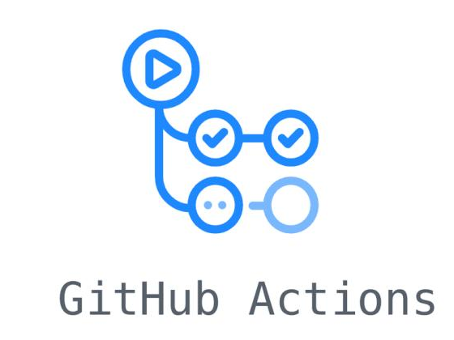
Development & Deployment Workflow
PivotPoint's development workflow adheres to the best practices of modern frontend projects. Through standardized steps and a clear project architecture, it achieves an efficient iteration and easy-to-maintain code management system, ensuring a balance between delivery quality and development efficiency.
Standardized Development Workflow
Clear Modular Architecture
Automated CI/CD System
Environment & Database:Install dependencies, configure environment variables, start a local Supabase instance and run database migrations to quickly set up the development environment.
Testing & Building:Run full automated tests with Vitest for stability; build the production version and preview locally to avoid online risks.
Frontend Layer (frontend/):Centrally manage React core code, split into hooks, components, locales and other modules for single responsibility and high reusability.
Data Layer (supabase/):Independently maintain database migration scripts and seed data, decoupling application code from database logic for easier version control.
IntegrateGitHub Actionsfor pipeline automation. On code push or pull requests, it automatically triggers testing and building processes, ensuring code compliance upon submission and improving iteration efficiency and delivery stability.
Core Value:Full-link standardization from local development to cloud deployment, achieving an efficient delivery loop of "write once, run anywhere".
Notes:
In terms of development and deployment, we follow the best practices of modern frontend development. Developers can prepare the environment, start the local database, run tests and build the project with just a few simple commands. We use GitHub Actions to implement CI/CD, ensuring code quality. The project structure is also very clear, with frontend and database code separated and high modularity, making it easy to maintain and extend.

Slide 15
06 Project Demo & Conclusion
User Registration/Login
Task Drag-and-Drop Flow
Data Export & Sharing
Demonstrate user identity authentication via email and password, ensuring system access security and user data isolation.
Easily switch tasks between statuses like "To Do/In Progress/Done" with simple drag-and-drop operations, visualizing the workflow.
Support exporting project kanban data to Excel or PDF formats for easy archiving, reporting, and sharing with external teams.
Create Project Space
Member Task Assignment
Real-Time Multi-Device Sync
Show the process of creating a new project, supporting customization of project name, description, and permission scope to quickly start team collaboration.
Assign specific tasks to team members with one click, clarify responsibility ownership, and the system sends notifications synchronously to improve collaboration efficiency.
Real-time data synchronization across devices and browsers, with operations taking effect instantly to ensure team members see identical information.
Quick Task Addition
Flexible Multi-View Switching
Admin Permission Management
Intuitively create new tasks in the kanban view, supporting the setting of priority, deadline, and detailed description for clear entry.
Support switching between multiple views such as kanban, list, and calendar to meet project progress viewing and management needs in different scenarios.
Demonstrate the admin's role configuration, permission allocation, and project access control for team members to ensure system data security.
Notes:
Next is the project demo session. Through practical operations, I will showcase the core features of PivotPoint to everyone, including user authentication, project and task creation, drag-and-drop sorting, member assignment, view switching, data export, and the most critical real-time synchronization feature. Additionally, I will also demonstrate the admin's backend management functions.

Slide 16
Conclusion & Thanks
PivotPoint has successfully demonstrated that a modern web tech stack combining React and Supabase can efficiently build a fully functional, real-time collaboration-enabled, and minimally deployable enterprise project management tool, offering a lightweight, high-quality solution for team collaboration scenarios.
Modern Tech Stack
Serverless Architecture
Real-Time Collaboration
Built with React 19, Vite 8, and Tailwind CSS 4, balancing development experience with high performance and maintainability.
Based on Supabase's fully managed platform, eliminating server config & maintenance, and reducing operational costs.
Built-in real-time DB listening & sync ensures instant updates for all members, eliminating information lag.
Flexible Customization
Robust Security
Rich configurations and multi-view switching (Kanban, List, Calendar) perfectly adapt to diverse workflows.
Leverages PostgreSQL RLS and Supabase Auth to strictly control data access and ensure core information security.
Notes:
In conclusion, PivotPoint proves that modern tech stacks like React and Supabase can build powerful, easy-to-deploy enterprise applications. Our highlights include a modern tech stack, serverless architecture, real-time collaboration, high customizability, and robust security. Thank you for your attention! The source code is available on GitHub.

Slide 17

THANK YOU
Thank you for your attention
Project Address: https://github.com/Echeq/MiniSemesterProject
Notes:
Thank you again for your time. If you are interested in our project, feel free to visit our GitHub repository to check out the source code or leave your valuable feedback. Thank you!

