Slide 1
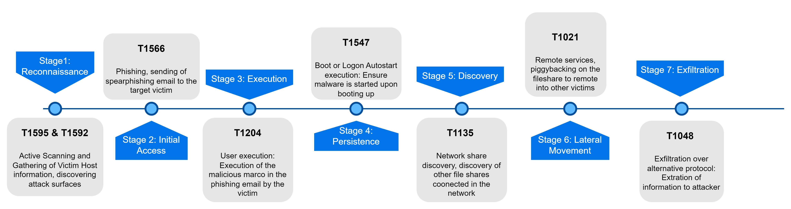
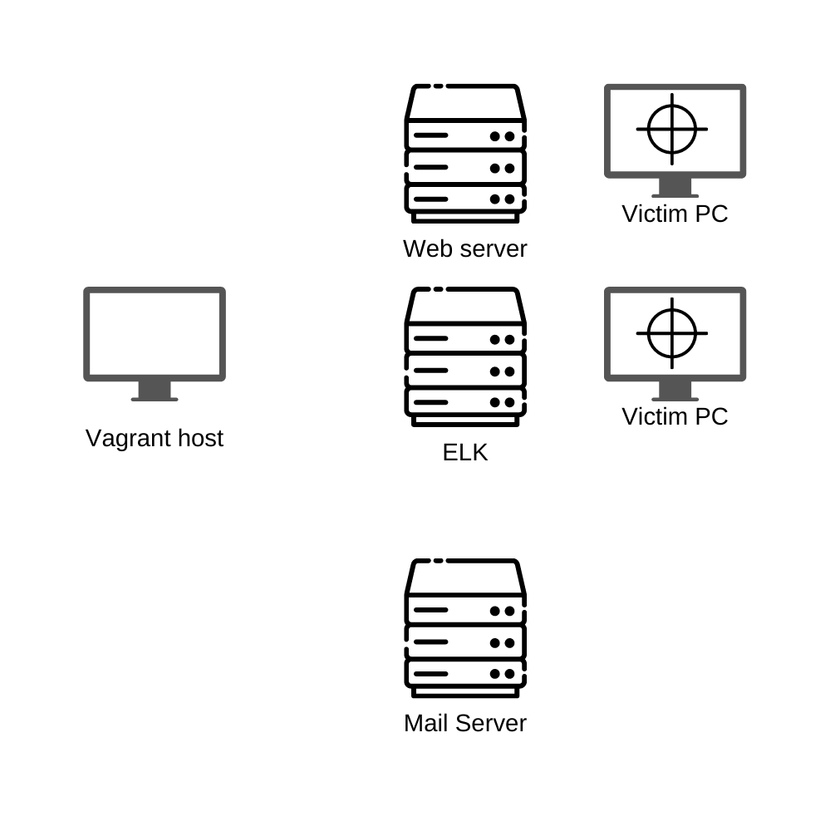
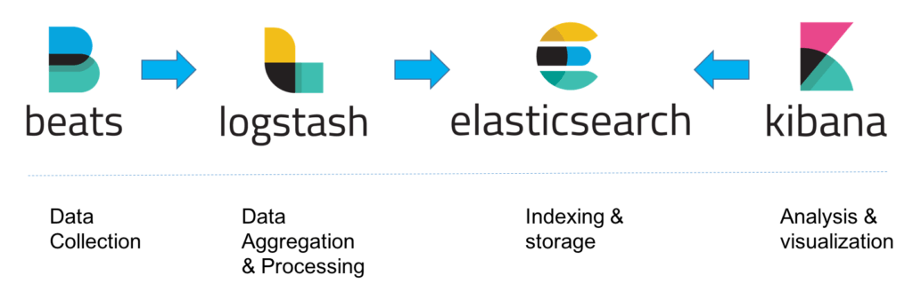





STUDENTS: Eugene Chew, How Shun Han, Lim Jun Rui, Zames Li, Teng Ming Hui, Law Shui Yuan
ICT3204 – Group 14 Coursework 1
Project Scope
For this project, each team member will be simulating 1 MITRE ATT&CK technique on a simulated network using open-source tools and/or self developed scripts, capture the logs generated by each attack and do cleaning on the logs for future analysis. Each phase of the attack and log gathering/cleaning should be automated as much as possible.
Attacker scans the web server for email addresses
Attacker sends email with malicious payload to victim
Victim executes the payload when opening the malicious document
Attacker gain foothold of the victim’s machine
Move laterally throughout the network
Employ persistency techniques
Attacker exfiltrates data
Description
The network architecture used for the simulated attack consists of a web server (scanning), a mail server (initial access), 2 x victim machines (exploitation & post exploitation), log server (for aggregating logs & monitoring system health).
Scenario
Simulated Infrastructure
The diagram on the right shows the set up of the simulated network architecture. Vagrant will be used to automate the setting up of the machines within the network. The servers are running docker containers while the victim machines are running VMware instances. Logs generated on the servers and victim machines are extracted, cleaned then piped into the central logging server for analysis. The logging server also checks each individual machine for its uptime status, displaying their status on a dashboard.
Vagrant Network
Logs collection
Logs Cleaning

