Slide 1
Multi-Threaded Client-Server Chat Application with Encryption
--- presentation given by Chen Jingguo 2024150171

Slide 2
Project Structure
ChatSystem/ ├── common/ │ ├── Message.java │ ├── Protocol.java │ ├── server/ │ ├── ChatServer.java │ ├── ClientHandler.java │ ├── MessageRouter.java │ ├── ExtensionManager.java │ ├── OnlineUserManager.java
├── security/ │ ├── UserManager.java │ ├── AuthService.java │ ├── AuthResult.java │ ├── PasswordUtil.java │ ├── SecurityBootstrap.java │ ├── SSLContextBuilder.java │ ├── client/ │ ├── ChatClient.java │ ├── RegisterDialog.java │ ├── ChatWindow.java │ ├── PrivateChatWindow.java │ ├── ClientGUI.java │ ├── ClientConnection.java │ ├── LoginFrame.java
├── file/ │ ├── FileHttpServer.java │ ├── FileClient.java │ ├── udp/ │ ├── UDPBroadcastServer.java │ ├── log/ │ ├── Logger.java │ └── admin/ ├── AdminCommandHandler.java

Slide 3
Design our protocol:
public static final String LOGIN = "LOGIN";
public static final String REGISTER = "REGISTER";
public static final String LOGOUT = "LOGOUT";
public static final String PRIVATE = "PRIVATE";
public static final String BROADCAST = "BROADCAST";
public static final String SUCCESS = "SUCCESS";
public static final String FAIL = "FAIL";

Slide 4
Design our message:
type | | | sender | | | receiver | | | content
private final String type;
private final String sender;
private final String receiver;
private final String content;
public static Message decode (String line) {}
public String encode () {}

Slide 5
Type of message:
LOGIN
LOGOUT
BROADCAST
FILE
PRIVATE
REGISTER
FILE_UPLOAD

Slide 6
Administrator’s account and password:
admin
123456
Admin commands:
/ban
/help
/list
/kick
/unban
/download
/tell
/shutdown

Slide 7
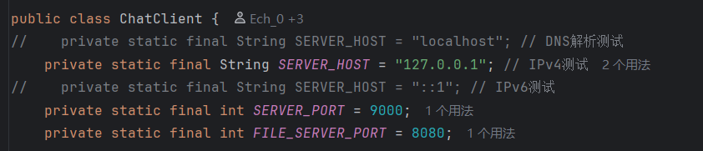
Support test:
DNS TEST
IPv4 TEST
IPv6 TEST

Slide 8

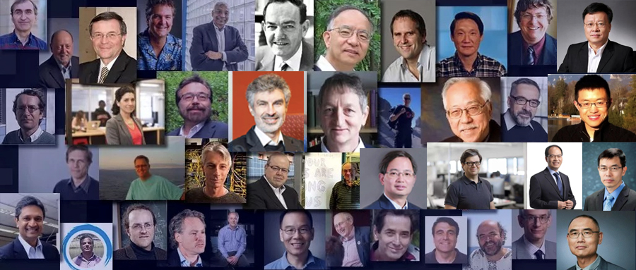
Video Demonstration

Slide 9
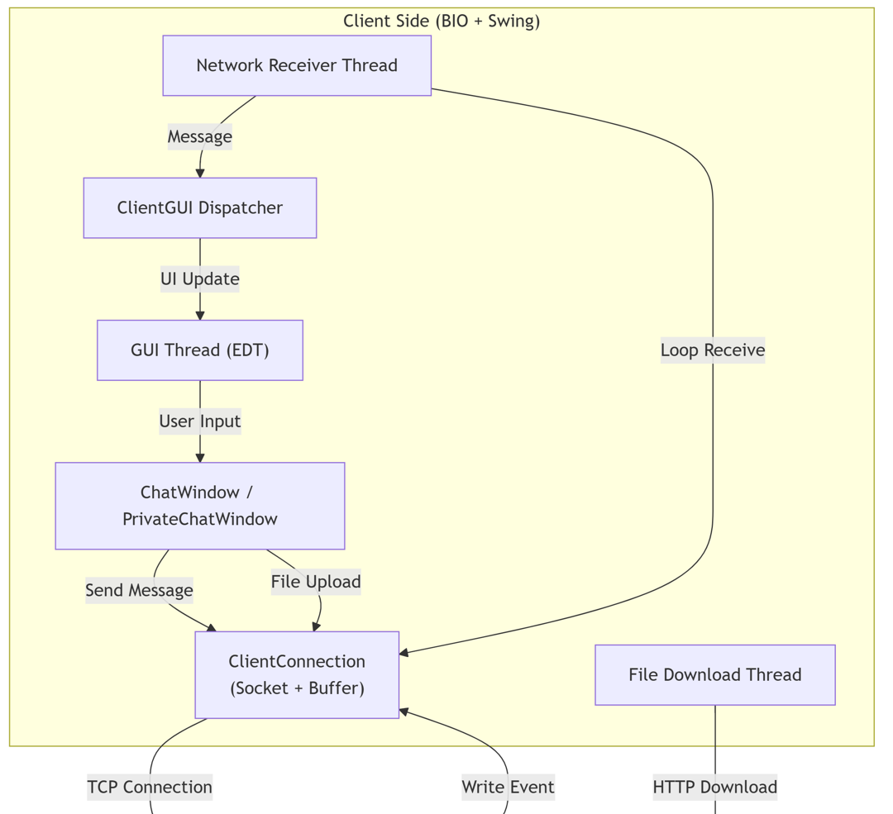
Our chat system architecture follows a clear flow from client to server to storage.
On the client side, the GUI thread handles user input, the network receiver thread listens for incoming messages, and separate threads manage file downloads.

Slide 10
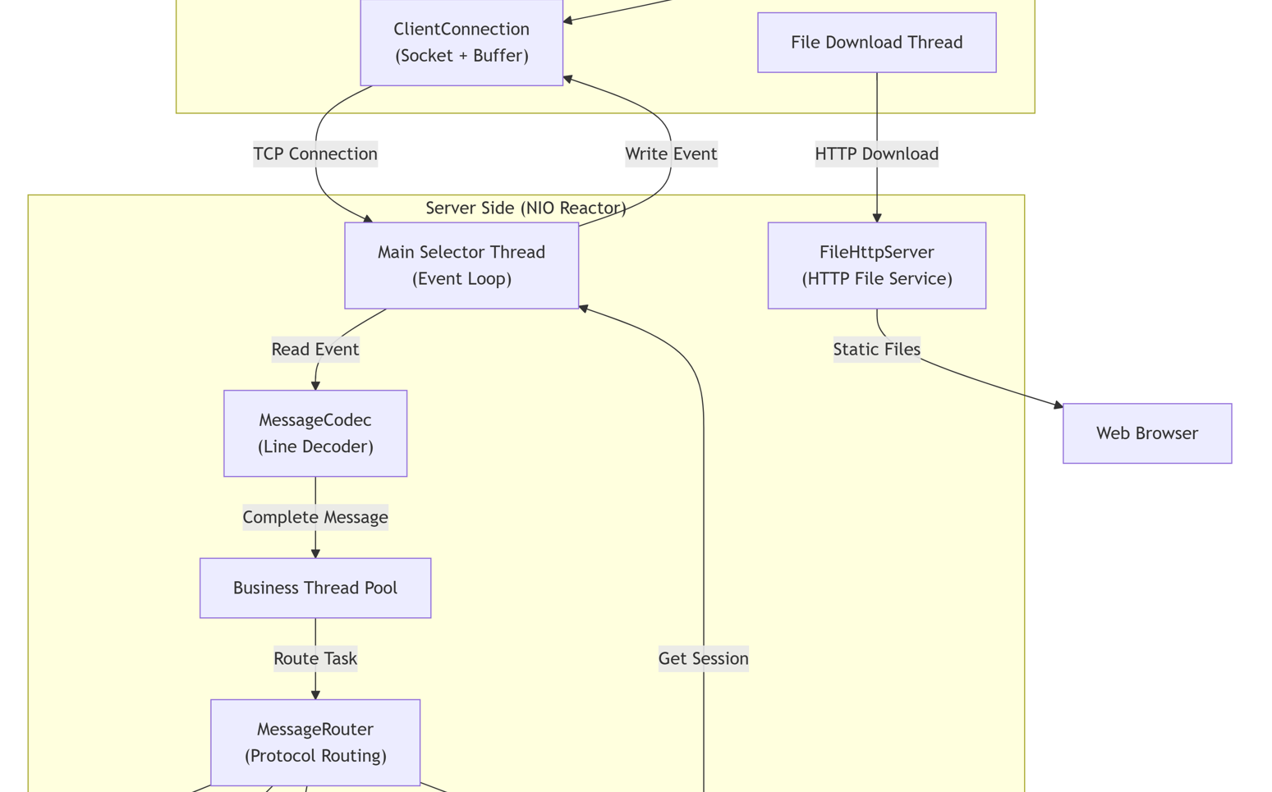
The client communicates with the server over a TCP connection using a text protocol: TYPE|sender|receiver|content.
The server uses an NIO reactor: a single selector thread monitors all I/O events, while a business thread pool processes the actual work.

Slide 11
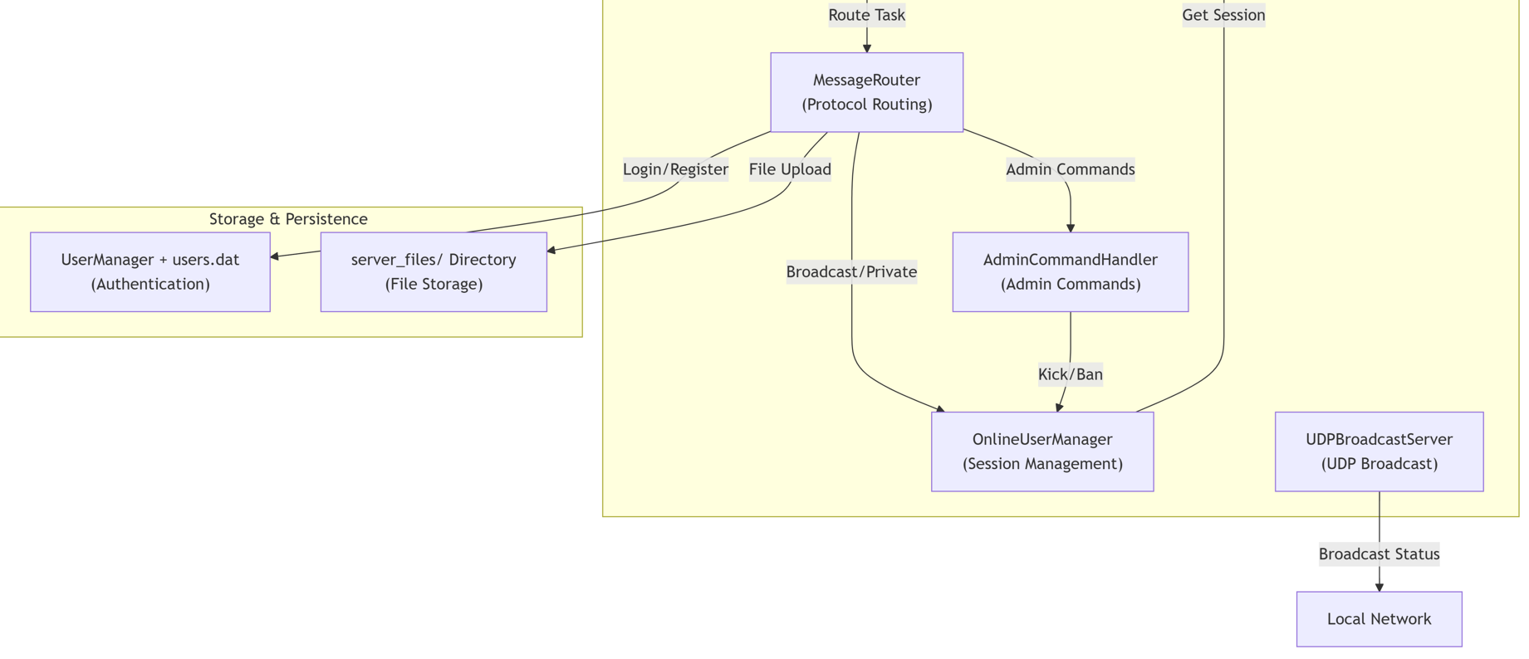
The MessageRouter parses the type and routes it to the appropriate handler — login/register to UserManager,
After processing, responses are enqueued and sent back through the selector.
broadcast/private to OnlineUserManager for delivery, file upload to disk storage, and admin commands to AdminCommandHandler.
Two extension services run alongside: FileHttpServer serves downloaded files, and UDPBroadcastServer enables LAN discovery.

Slide 12
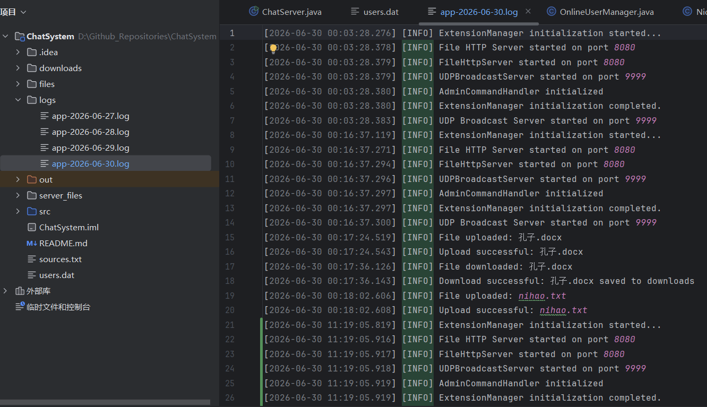
client_downloads
logs
server_files

Slide 13
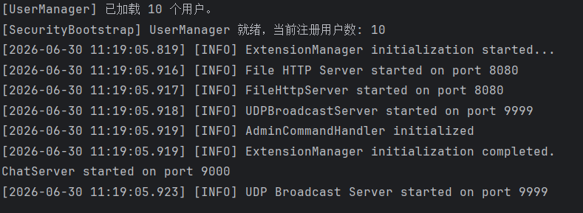
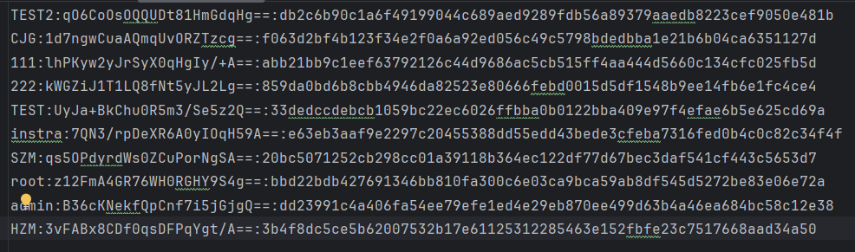
Terminal Info
users.dat
All user data is persisted in users.dat, and uploaded files are saved to server_files/.

Slide 14
Thanks for listening!

