Slide 1
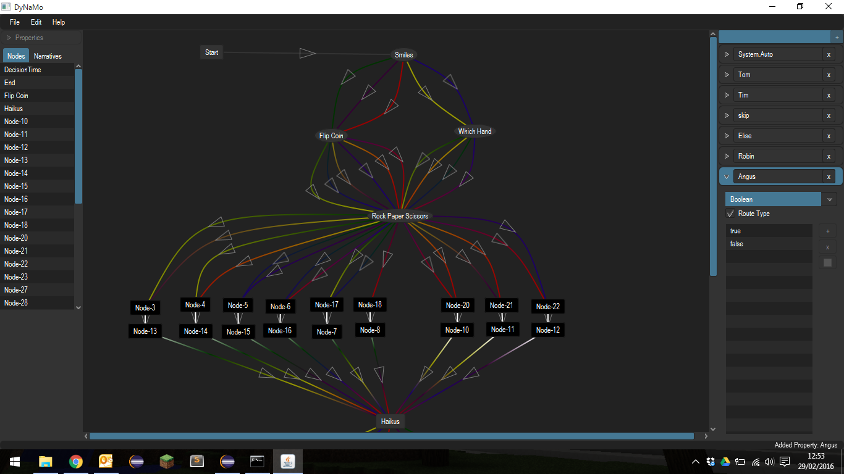

Slide 2
Export
Start Game
Narrative Instance
Narrative
Design
Level Template
Narrative Instance

Slide 3
