Slide 1
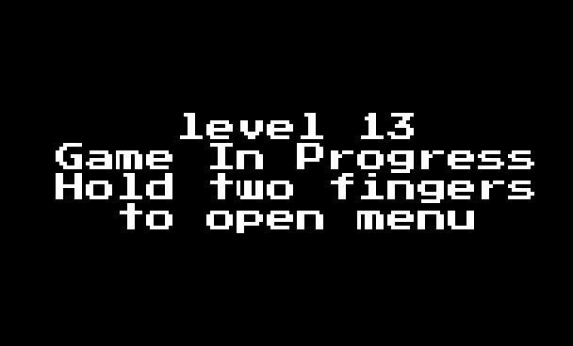
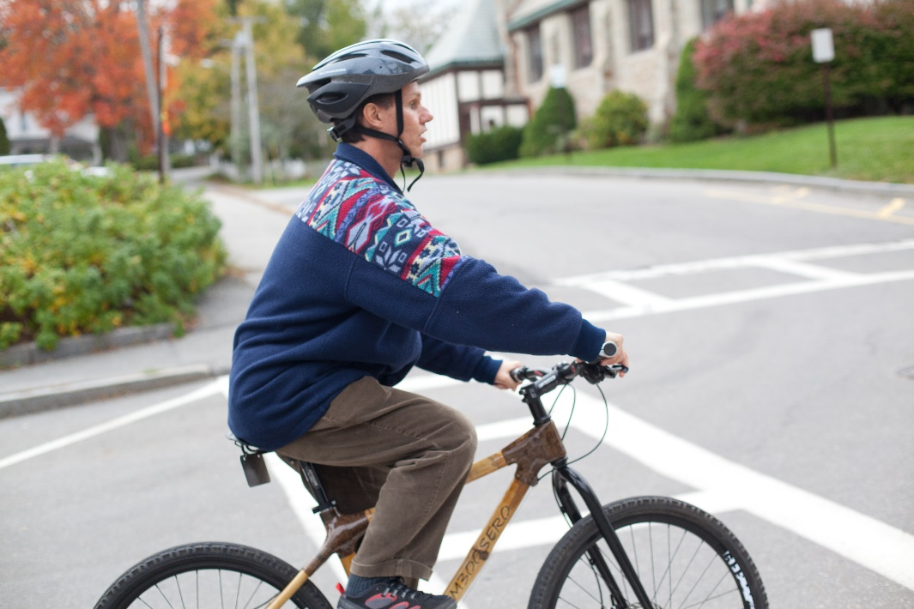
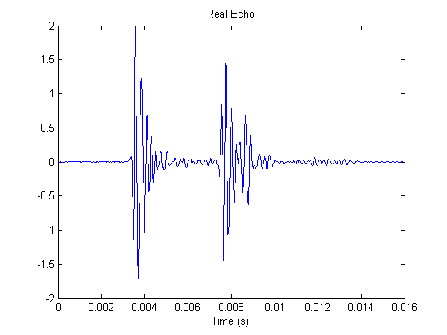
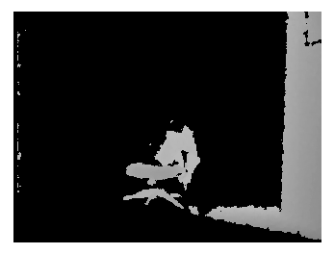
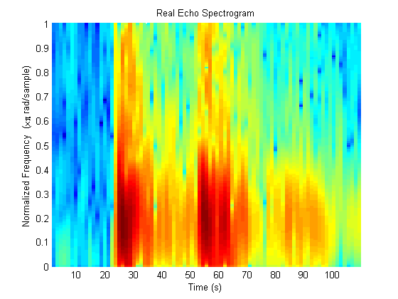

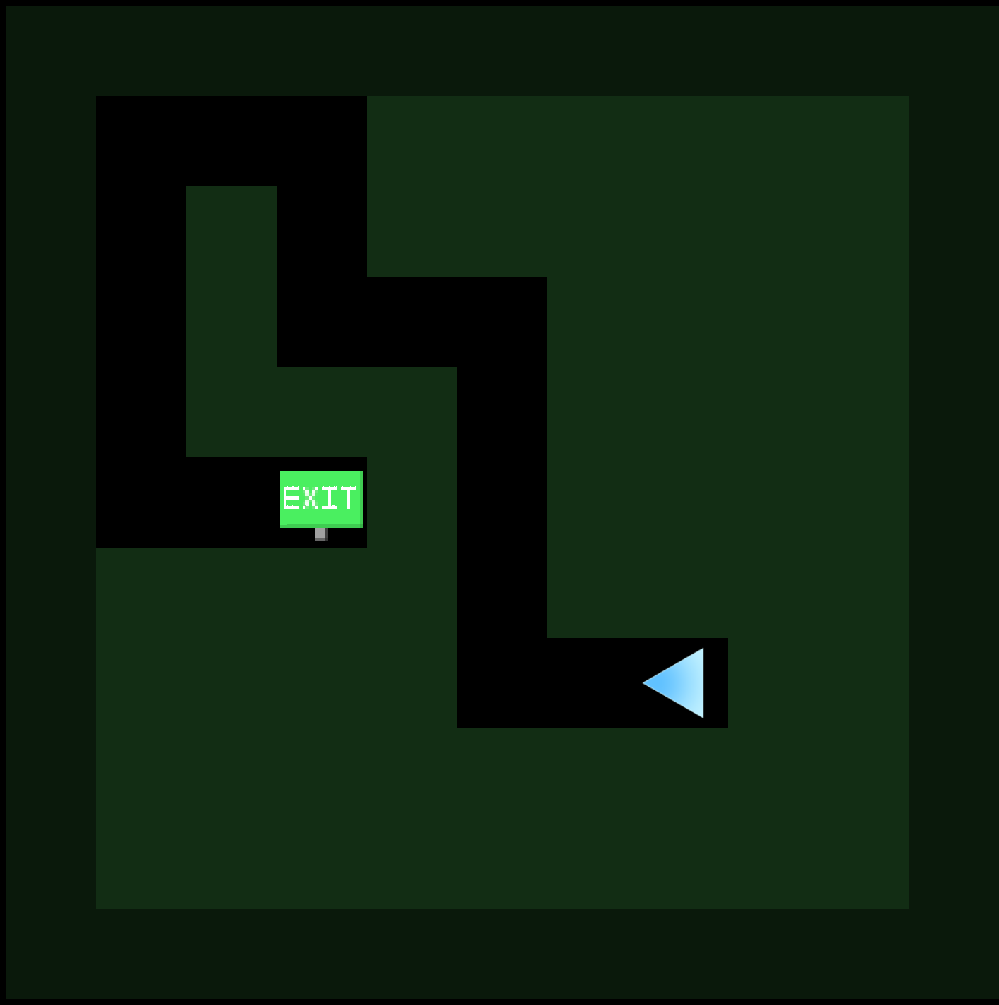
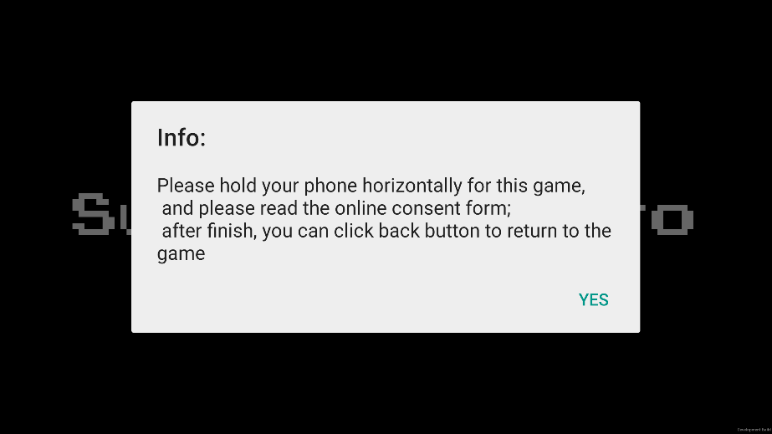
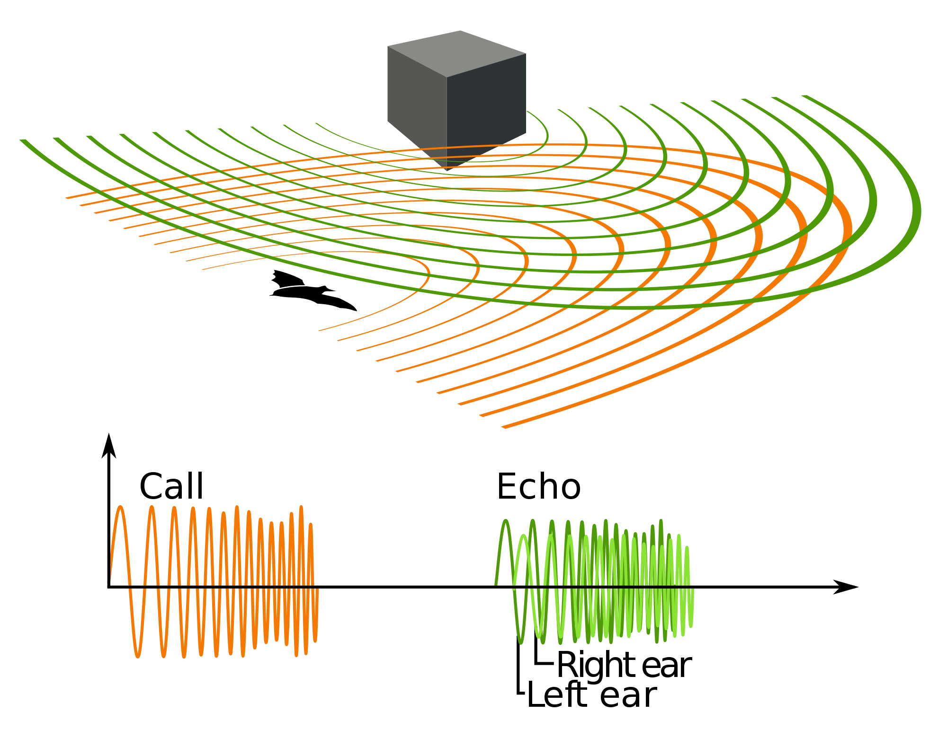

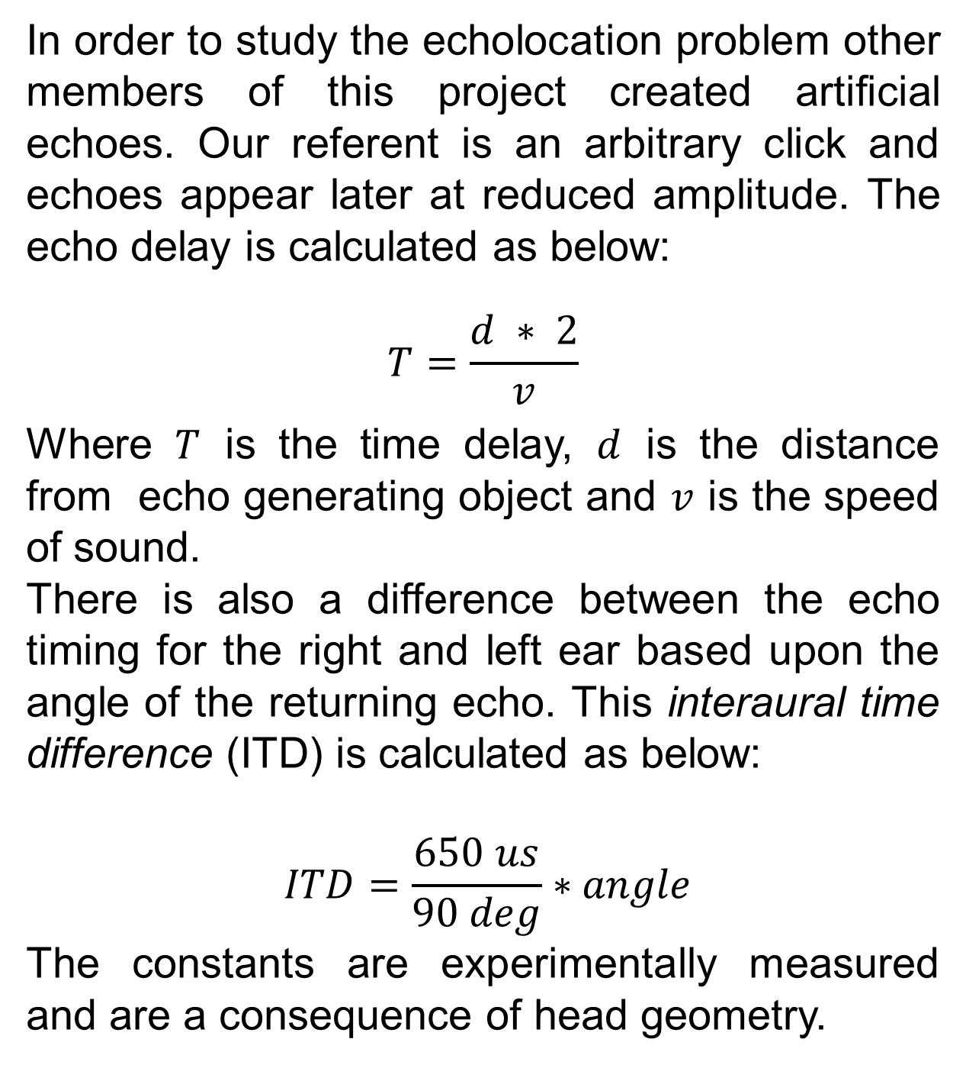
Echo Explorer
Spencer Barton, Rudina Morina, Brandon Perez and Arley Schenker
Overview
Human Echolocation
Structure Sensor
Accessibility
Echolocation is no longer just for the bats. Humans have the ability to learn this skill too, and for a number of blind people, echolocation has already proven itself as a useful navigation tool. However in order for this ability to be useful to the blind community the training process needs to become more accessible. Our work will begin with the creation of realistic artificial echoes which we will use to build a curriculum. We will encompass this curriculum in a mobile application which will be made public.
Daniel Kish and a few others have demonstrated the practical use of human echolocation for the blind. With a simple set of clicks and years of training and experience, a blind person can develop the means to navigate independently. Currently, skilled echolocators teach this skill to other blind individuals through one-on-one intensive training. We hope to improve this teaching process with a training application that could be run on a mobile device.
Since real echoes generated by clicks are extremely difficult to understand without training we will continue to use artificially generated echoes. The artificial echoes will mimic the real echoes but will be simplified and amplified so that the subject can hopefully hear enough echo features to begin learning. In order to make these echoes more dynamic and interactive, the subject can carry a tablet with Structure Sensor attached. The Structure Sensor feeds real time information on objects in proximity so that echoes can be generated to match the space as the subject moves around. Code to generate echoes from depth maps was created but we did not complete the step of having a user walk around with the device. .
The application is also designed to be accessible to blind users without external assistance, which can allow future users to download a public version of the application and train on their own. To facilitate this, text and option menus in the application are narrated and user interactions are made using multi-touch finger gestures as opposed to buttons.
Real Echoes
Daniel Kish using echolocation on a bike.
http://upload.wikimedia.org/wikipedia/commons/1/1a/Daniel_Kish_-_PopTech_2011_-_Camden_Maine_USA.jpg
In order to get a better understanding for how echoes really behave, we made a number of echo recordings.
This depth map comes from an earlier version of the project which uses a Kinect. The Structure Sensor will provide similar results.
Objectives
Realistic echo generation
Validate the generated echoes
Create a training application to teach people basic echolocation
Iterate on the design of the training application
Perform simple experiments to determine people’s baseline echo feature detection abilities
Future Plans
Training Application
There is plenty of work left to be done on this project. Future objectives include:
User studies based on collected data
Iteration on the design and accessibility of the echolocation training app
How Echolocation Works
Citations
Schenkman, Bo N., and Mats E. Nilsson. "Human Echolocation: Blind and Sighted Persons' Ability to Detect Sounds Recorded in the Presence of a Reflecting Object." Perception 39 (2010): 483-501. Web.
Kish, Daniel. "Seeing with Sound." New Scientist (2009): 31-33. Print.
Artificial Echoes
In order to study the echolocation problem other members of this project created artificial echoes. Our referent is an arbitrary click and echoes appear later at reduced amplitude. The echo delay is calculated as below:
$$T=\frac{d ∗ 2}{v}$$
Where $T$ is the time delay, $d$ is the distance from echo generating object and $v$ is the speed of sound.
There is also a difference between the echo timing for the right and left ear based upon the angle of the returning echo. This interaural time difference (ITD) is calculated as below:
$$ITD=\frac{650 us}{90 deg}∗angle$$
The constants are experimentally measured and are a consequence of head geometry.
In order to teach echolocation we developed an Android app. Currently the app presents the user with a simple game which will challenge the user to navigate through an environment using echolocation. The levels were automatically generated with randomized algorithms and are designed to increase in complexity as the user progresses through the game. Unless visual feedback is explicitly requested, the maze layout is kept hidden and the user can only infer the shape of the maze through auditory cues, mainly by requesting artificial echoes during gameplay.
The application collects user statistics throughout the training process (such as the number of collisions against the walls and the number of echoes requested) with the goal of understanding the effectiveness of our model and the areas in which we can improve.
Project Members
http://en.wikipedia.org/wiki/Animal_echolocation
Thanks to our advisors and other students involved in this project: Professor Pulkit Grover, Professor Laurie Heller, Professor Bruno Sinopolli, Tejal Kudav and Anirudh Mendetta.
Echolocation is a navigation tool used by bats, dolphins and other creatures. The animal emits a specific sound which travels through the air or water. As the sound waves intersect objects, the sound bounces back as an echo. Based upon the timing and strength of these echoes, the animal can sense the location of objects. Additional information about direction can be extracted from the delay between hearing the echo reach the right or left ear.
Sponsored by
SURG Grant

