Slide 1
Machine Learning Algorithms Showcase
Comprehensive Analysis on Energy Datasets
Evan Tobias
AI Final Year Project
December 7, 2025

Slide 2
Presentation Agenda
📋 Introduction & Project Overview
📊 Datasets Description
🔧 Methodology & Preprocessing
🤖 Regression Algorithms (5 models)
🎯 Classification with Logistic Regression
🔍 Clustering with K-means
📈 Results & Performance Comparison
💡 Key Findings & Conclusions

Slide 3
Project Overview
🎯 Objective: Demonstrate 7 ML algorithms on real-world data
📚 Algorithms Implemented:
• Linear & Polynomial Regression
• Decision Trees & Random Forest
• Neural Networks (PyTorch)
• Logistic Regression (Classification)
• K-means Clustering
🔬 Two Energy Datasets: ENB2012 & Energy Consumption
📊 768 & 19,735 samples respectively

Slide 4
Datasets Overview
ENB2012 Dataset
• 768 samples
• 8 features (building design)
• Target: Heating/Cooling Load
• Use: Regression analysis
Features:
• Relative Compactness
• Surface & Wall Area
• Overall Height
• Glazing Area
Energy Consumption Dataset
• 19,735 samples
• 28 features (sensors)
• Target: Appliances energy
• Use: Classification & Clustering
Features:
• Temperature (multiple rooms)
• Humidity (multiple rooms)
• Pressure, Wind Speed
• Energy consumption (Wh)

Slide 5
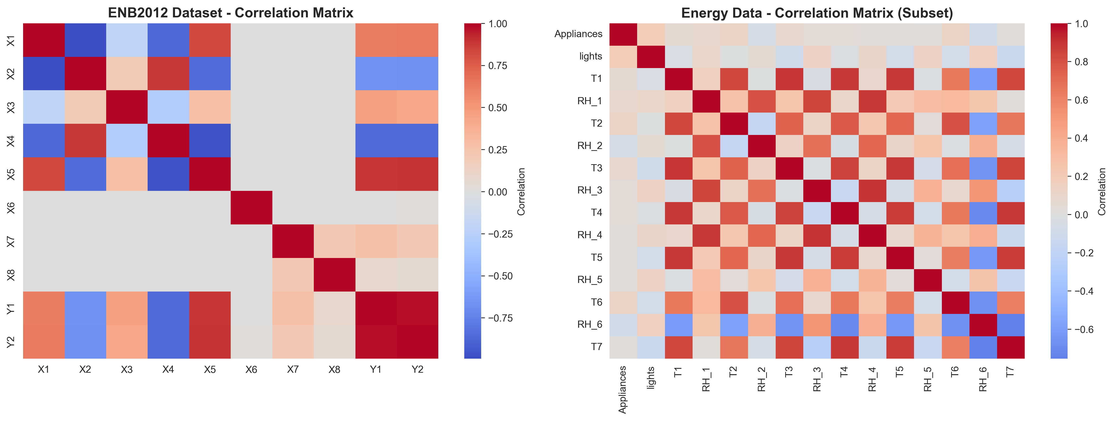
Correlation Analysis

Slide 6
Methodology & Preprocessing
🧹 Data Cleaning: No missing values, no duplicates
📏 Feature Scaling: Z-score normalization (μ=0, σ=1)
🔍 Multicollinearity Check: VIF analysis
✂️ Train-Test Split: 80/20 ratio, stratified for classification
🎯 Feature Engineering: Binary target for classification
🔧 Tools: scikit-learn, PyTorch, pandas, numpy

Slide 7
Linear Regression
📐 Formula: ŷ = β₀ + β₁x₁ + β₂x₂ + ... + βₙxₙ
🎯 Method: Ordinary Least Squares (OLS)
📊 Loss Function: Mean Squared Error (MSE)
✅ Results:
• R² Score: 0.9122 (91.22% variance explained)
• RMSE: 3.0254
• MAE: 2.1821
💡 Strong baseline performance with linear relationships

Slide 8
Polynomial Regression
📐 Extends linear regression with polynomial terms (degree=2)
🔧 Includes interaction terms: x₁x₂, x₁², x₂²
🎯 Captures non-linear relationships
✅ Results:
• R² Score: 0.9938 (99.38% variance explained) 🌟
• RMSE: 0.8030
• MAE: 0.6042
💡 Excellent performance, captures complex patterns

Slide 9
Decision Tree & Random Forest
🌳 Decision Tree
• Recursive partitioning
• Non-parametric
• Interpretable splits
Results:
• R²: 0.9883
• RMSE: 1.1059
• MAE: 0.7561
Top Feature:
Overall Height (58%)
🌲 Random Forest
• Ensemble of 100 trees
• Bootstrap + Feature bagging
• Robust to overfitting
Results:
• R²: 0.9976 🏆 BEST!
• RMSE: 0.4978
• MAE: 0.3584
Near-perfect predictions

Slide 10
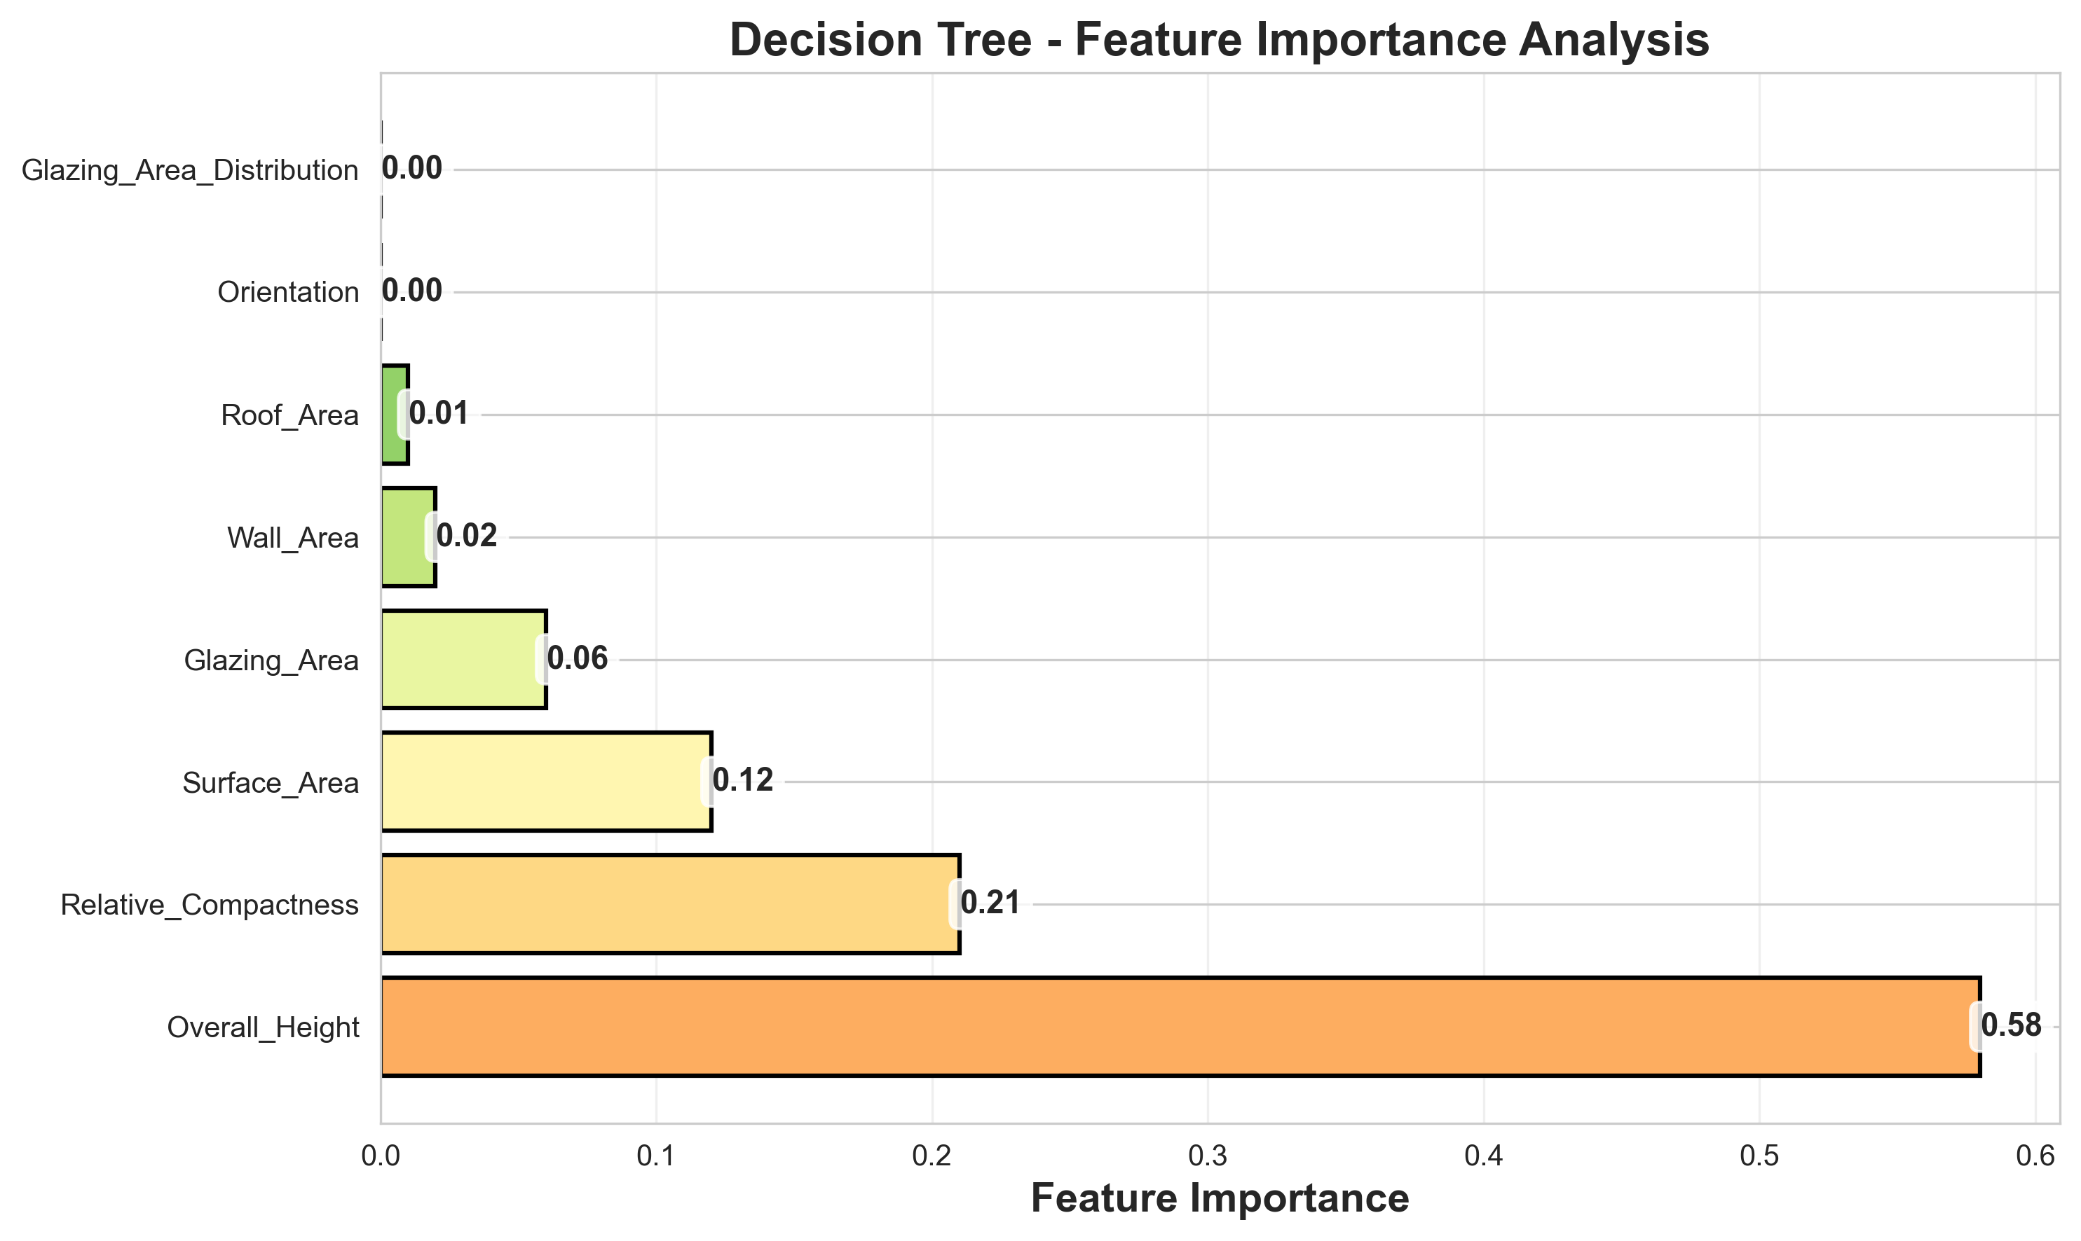
Feature Importance Analysis

Slide 11
Neural Network (PyTorch)
🧠 Architecture: 8 → 64 → 32 → 16 → 1
⚡ Activation: ReLU for hidden layers
🎯 Total Parameters: 3,201
🔧 Optimizer: Adam (lr=0.001)
📈 Training: 200 epochs, MSE Loss
✅ Results:
• R² Score: 0.9683 (96.83%)
• RMSE: 1.8186
• MAE: 1.3031
💡 Strong performance, demonstrates backpropagation

Slide 12
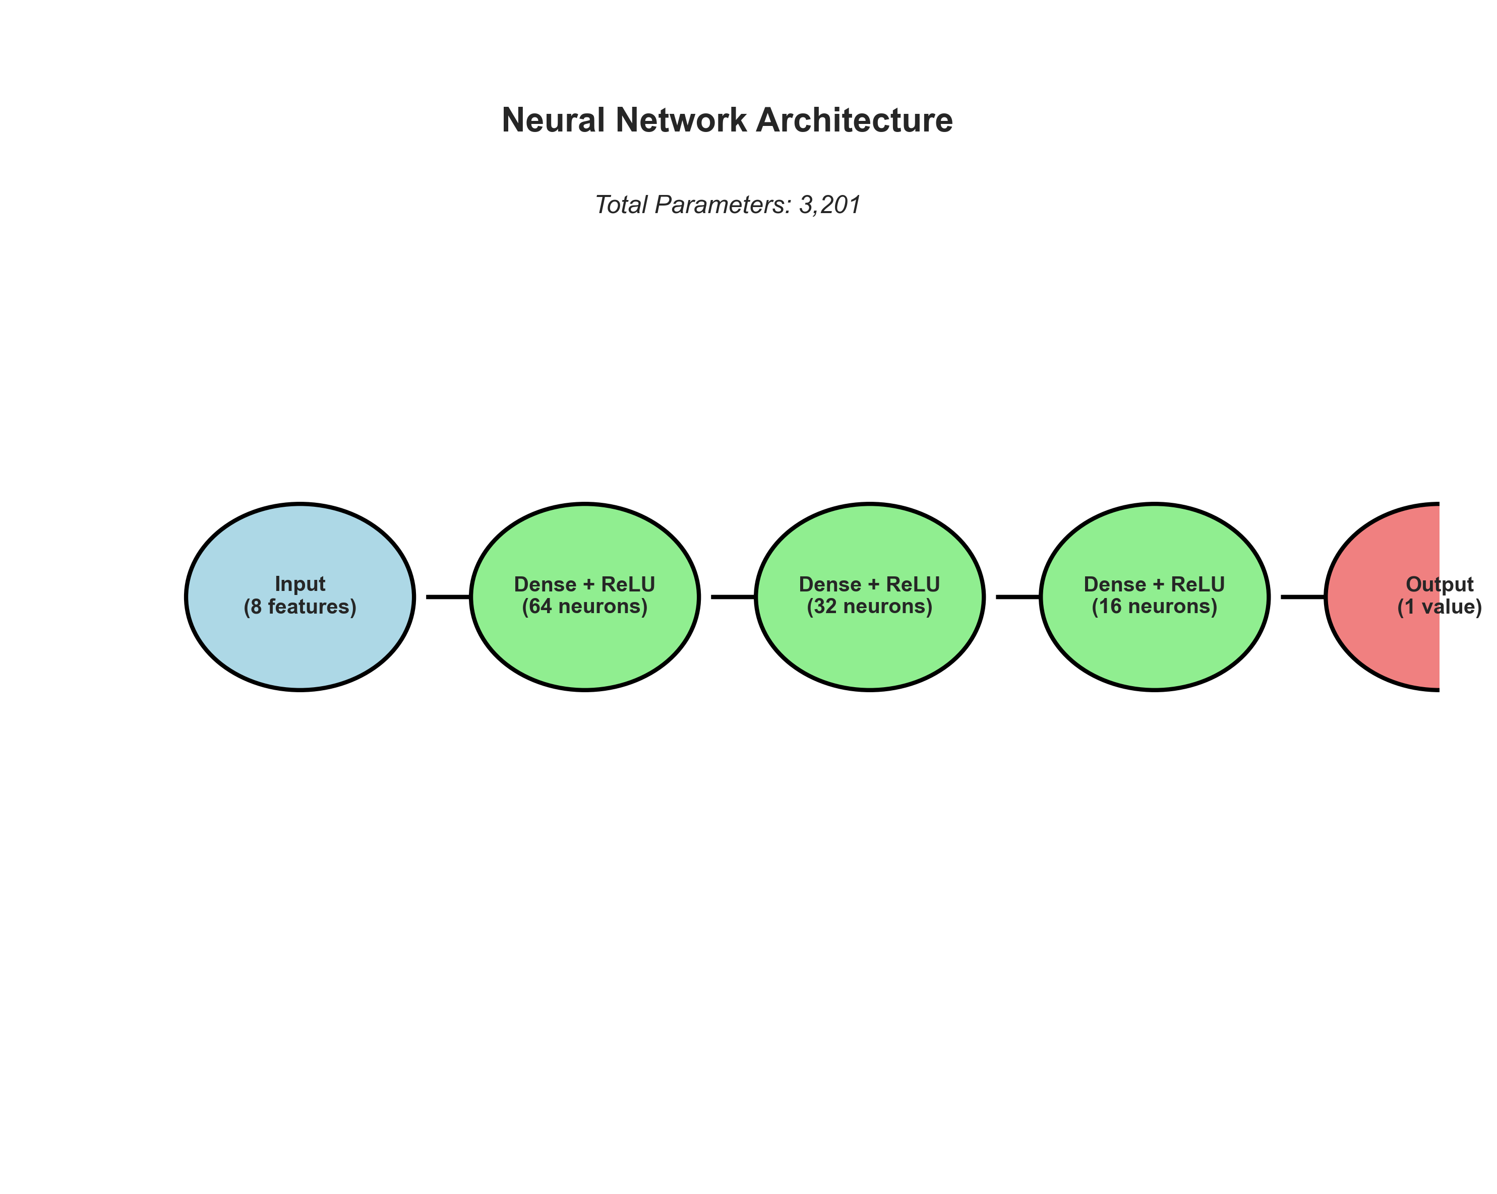
Neural Network Architecture

Slide 13
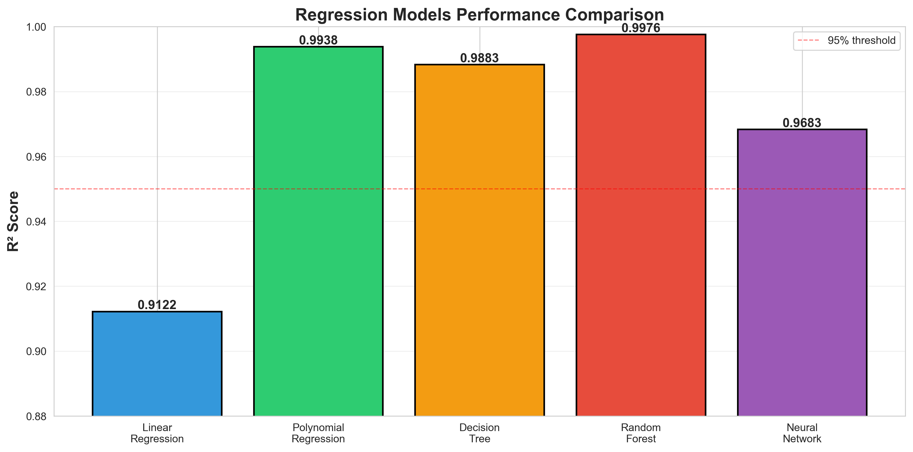
Regression Models Comparison

Slide 14
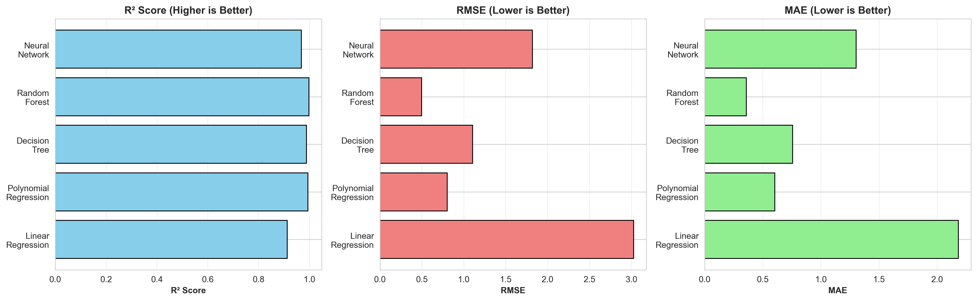
Comprehensive Metrics Comparison

Slide 15
Logistic Regression - Classification
🎯 Task: Classify energy consumption (Low vs High)
📐 Method: Sigmoid function for probability
🔧 Binary threshold at median consumption
✅ Results:
• Accuracy: 75.65%
• Precision: 73.69%
• Recall: 80.21%
• F1-Score: 76.81%
• AUC-ROC: 0.8329 🌟
💡 Good discriminative ability, high recall

Slide 16
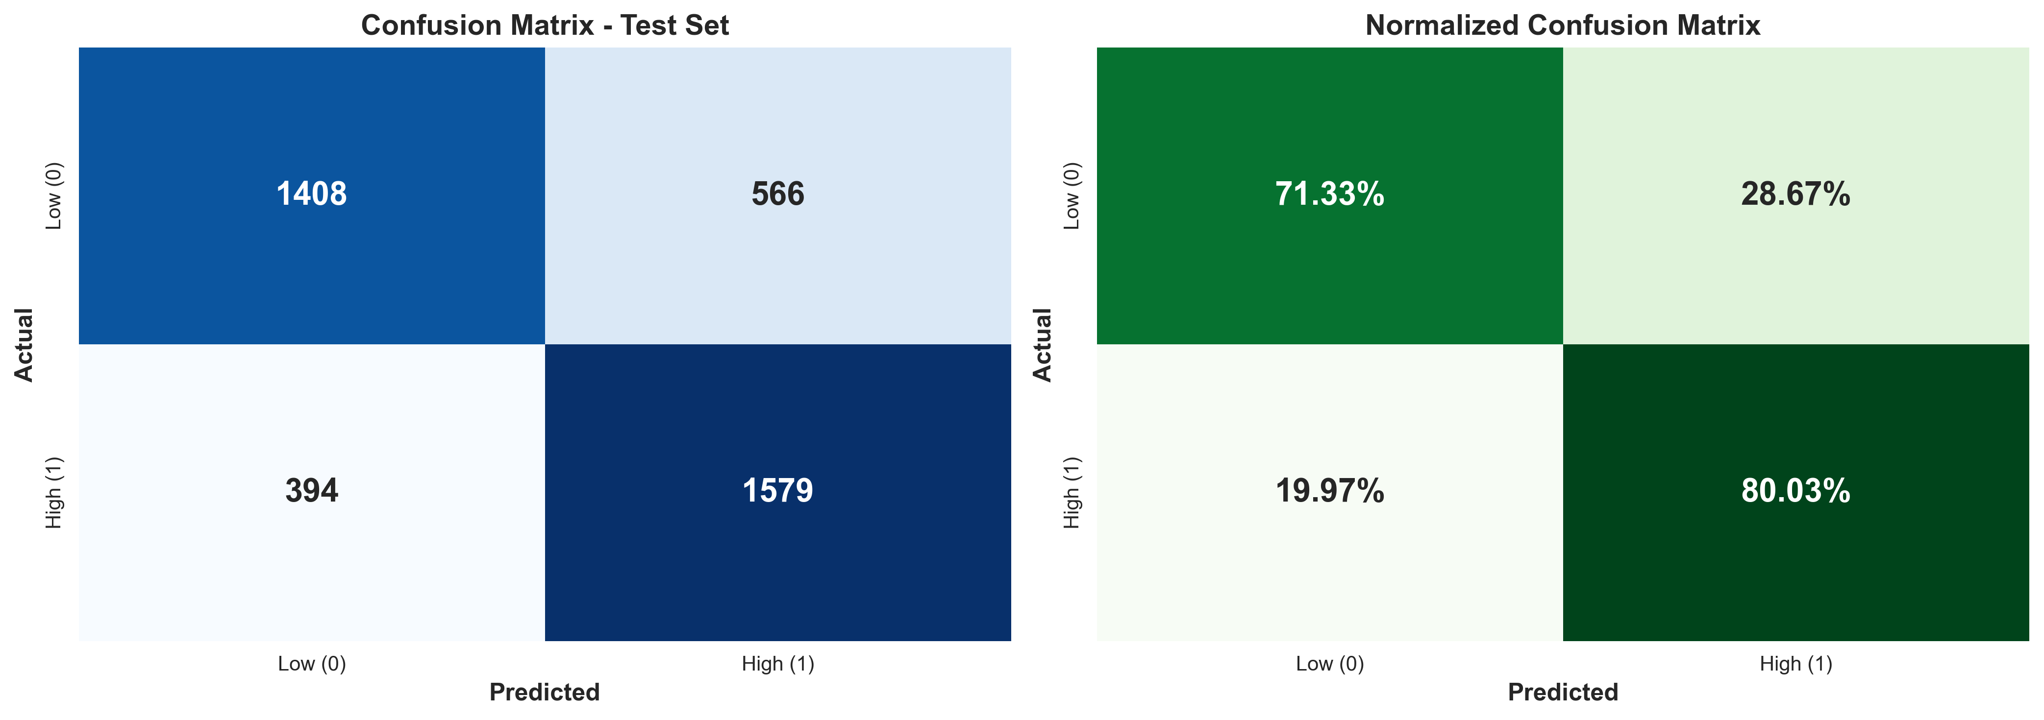
Classification Performance

Slide 17
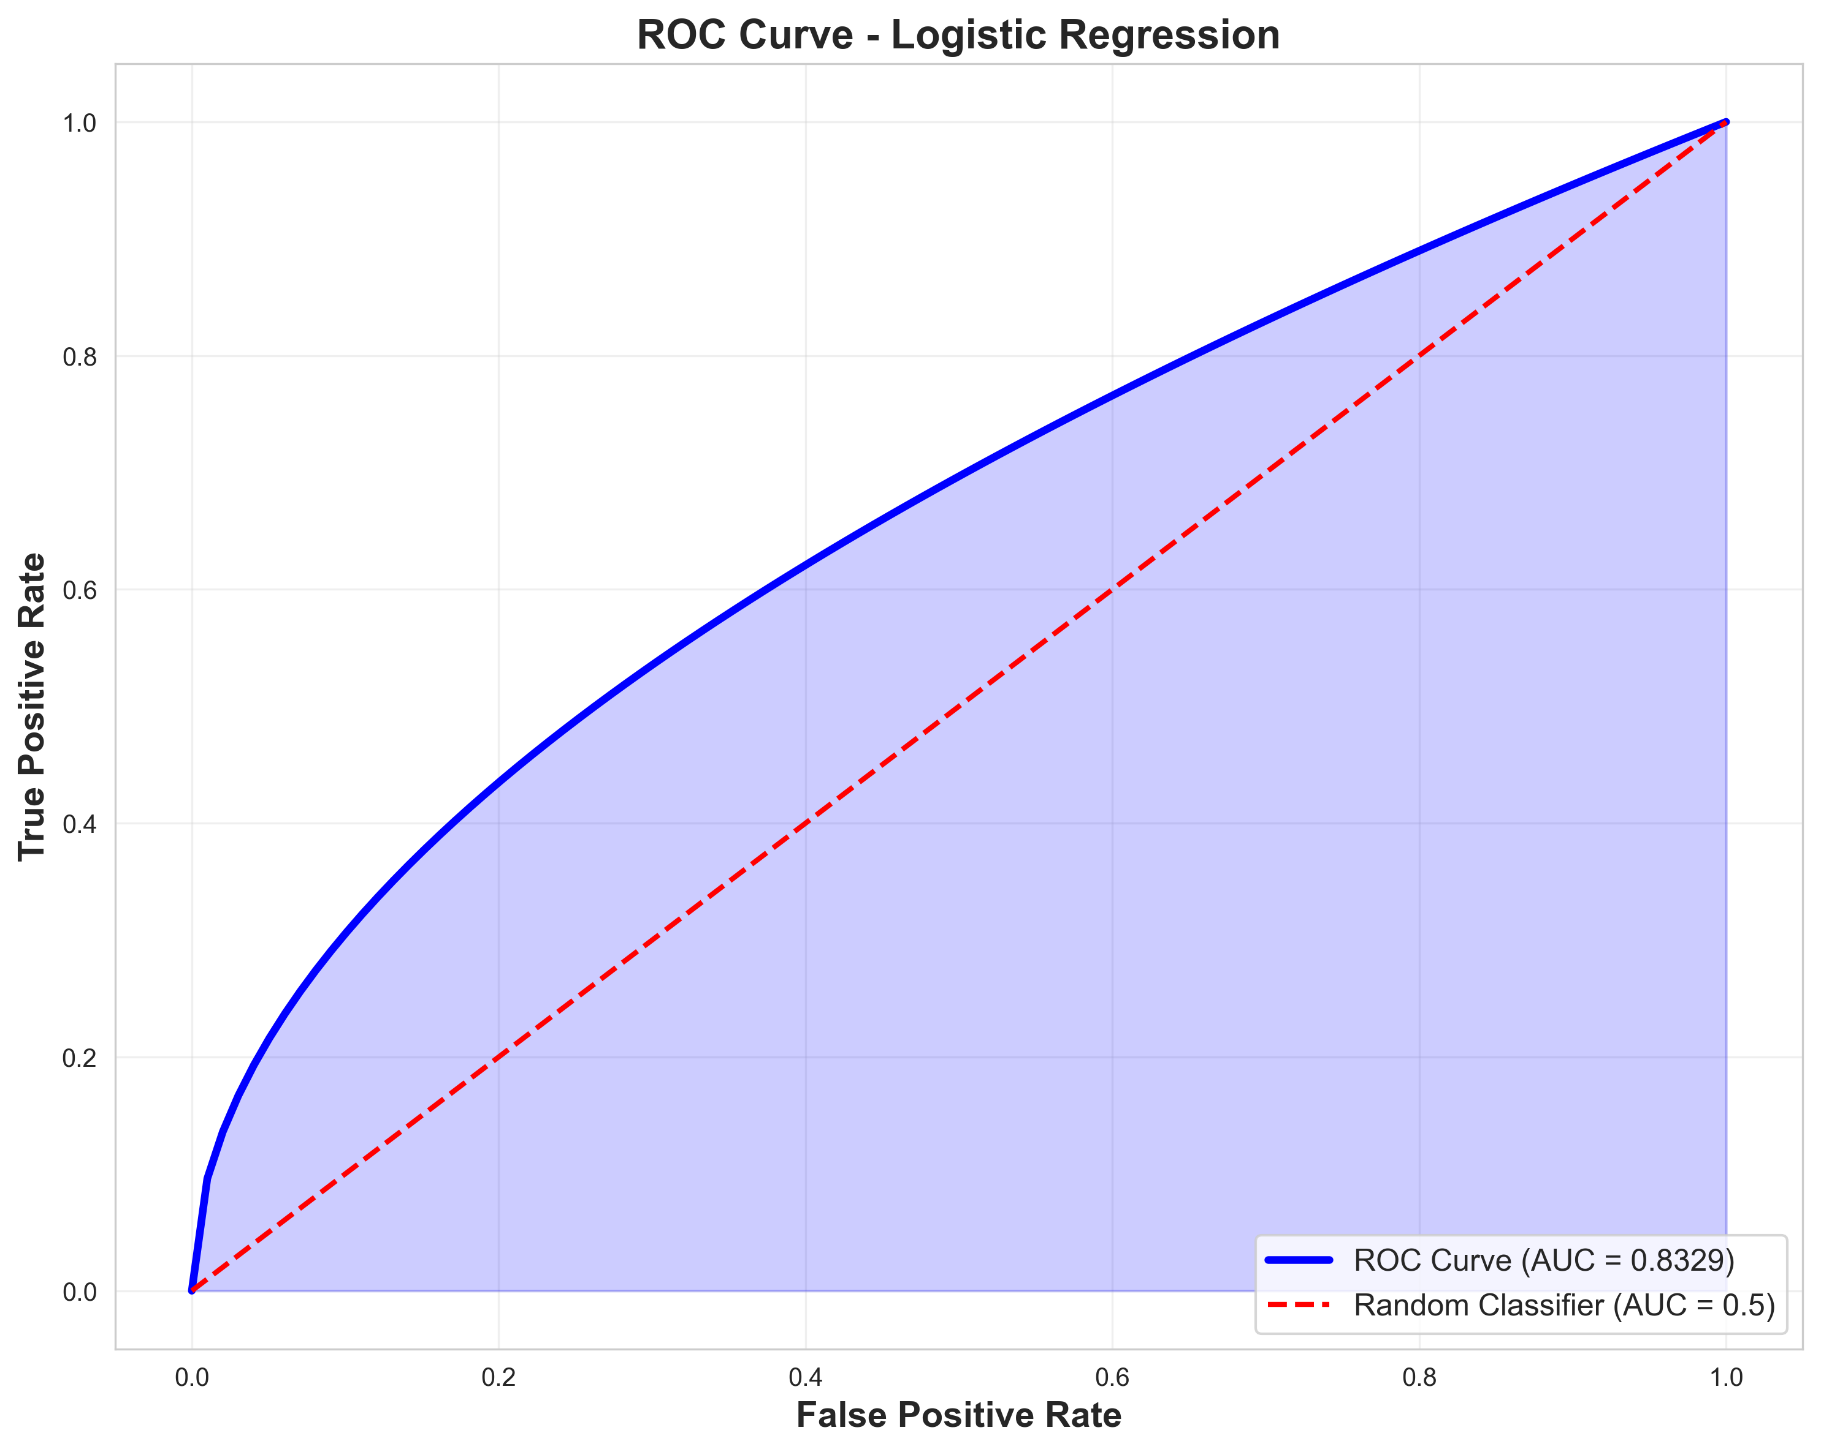
ROC Curve Analysis

Slide 18
K-means Clustering
🔍 Task: Discover consumption patterns
🎯 Method: Partition data into k clusters
📊 Optimal k Selection: Elbow + Silhouette methods
✅ Results:
• Optimal k: 2 clusters
• Silhouette Score: 0.22
• Cluster 0: 9,894 samples (Low usage: 41 Wh)
• Cluster 1: 9,841 samples (High usage: 105 Wh)
💡 Clear separation between usage patterns

Slide 19
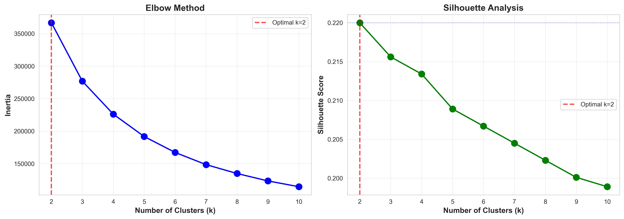
Clustering Analysis: Elbow & Silhouette

Slide 20
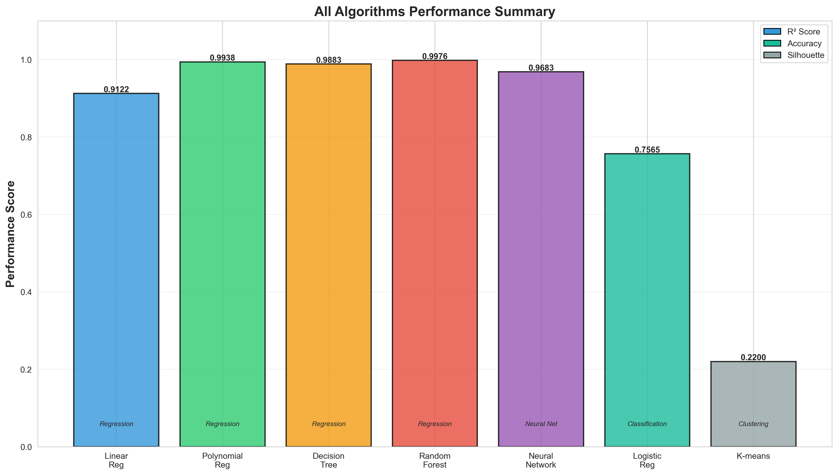
All Algorithms Performance Summary

Slide 21
Key Findings
🏆 Best Regression: Random Forest (R² = 0.9976)
🧠 Neural Network: Excellent performance (R² = 0.9683)
🎯 Classification: Strong results (75.65% accuracy, AUC = 0.83)
🔍 Clustering: Identified 2 clear consumption patterns
📊 All models achieved >91% R² for regression
💡 Ensemble methods (Random Forest) excel
⚡ Deep learning competitive with proper tuning
🔧 Feature importance: Overall Height most critical (58%)

Slide 22
Conclusions & Future Work
✅ Successfully implemented 7 ML algorithms
✅ Comprehensive evaluation across multiple metrics
✅ Real-world energy datasets with practical insights
✅ Demonstrated supervised & unsupervised learning
🔮 Future Work:
• LSTM/GRU for time-series forecasting
• Hyperparameter optimization (Grid/Bayesian search)
• Ensemble stacking for improved performance
• Real-time deployment as web service
• Explainable AI (SHAP/LIME) for interpretability

Slide 23
Thank You!
Questions?
Evan Tobias | AI Final Year Project | December 2025

