Slide 1
Shiny, Part 1
Topics
Final project proposals due next week
Required Shiny homework due next week
Shiny
MUSA 620: Week 12

Slide 2
Shiny
Shiny is a framework for building interactive web apps.
What is the difference between a website and a web app?

Slide 3
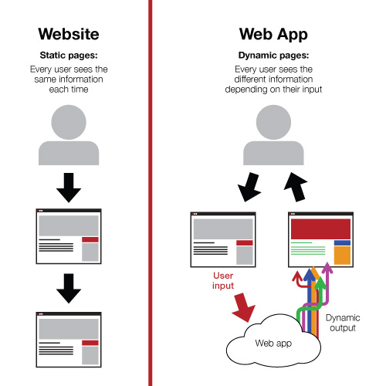
Shiny
What is the difference between a website and a web app?
A website has a single codebase (html, css, and JavaScript). The page is loaded once, and from then on everything runs locally within your browser. (e.g. mapshaper.org)
A web app includes two separate codebases: code that runs locally in the browser and code that runs remotely on a server. As the user interacts with the page, it reacts by fetching new information from the server.

Slide 4
Shiny
A Shiny project contains at least two files
ui.r – the user interface for your app (runs in the browser)
server.r – controls what your app does (runs on the server)
library(shiny)
fluidPage(
titlePanel("My Slider App"),
sidebarLayout(
sidebarPanel(
sliderInput("myinputdata", "Slide me", 0, 100, 0)
),
mainPanel(
h3("Slider Value:"),
textOutput("myoutputdata")
)
)
)
library(shiny)
function(input, output){
output$myoutputdata <- renderText(input$myinputdata)
}

Slide 5
Debugging Shiny
Unlike normal R scripts, which can be run line-by-line, Shiny runs as one comprehensive program. This makes it harder to locate the source of errors.
How NOT to write/debug your Shiny apps
The RIGHT WAY to write/debug your Shiny apps
Write your entire program in one go and then run it to see if it works.
To fix an error, spend the next 30 minutes inspecting each line closely to see if you missed something.
Try to fix an error by: changing something, running the whole program to see if it works. If not, change something else and repeat.
Test your code frequently as you are writing it – ideally after each new line is added. It will save you time in the long run.
Look for common errors - trailing commas after the last element in a vector is an error that I make frequently
If you get stuck, reduce the code to something simple that you know works. Then add the pieces back on one at a time, testing along the way.

