Slide 1
The Influence of all kinds of Computer Technology on Urban Construction
黄晨箬
第四组 6109119066

Slide 2
01
Background
The background or circumstances of a research report
02
Questions And Methods
Objective or research question/hypothesis in the paper
And the methodology used in my research
CONTENTS
03
Findings
The main findings of the paper
04
Other content
The main limitations of previous studies and my further study

Slide 3
The Background of my research
/01
The background or circumstances of a research report

Slide 4
What is Smart city?
Technology
Governance
1
4
Technology fusion and data fusion
Improve urban governance and services
Communication
Industry
2
5
Break the information silos
Build a large consumer industry
Construction
People's life
3
6
Promote the upgrading of urban management services
Improving people's livelihood

Slide 5
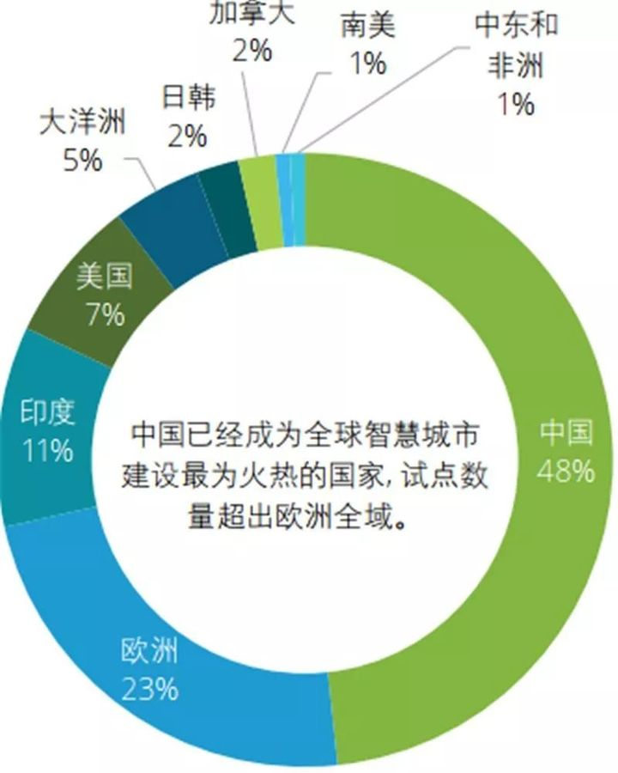
International status of smart city construction

Slide 6
Questions And Methods
/02
Objective or research question/hypothesis in the paper
And the methodology used in my research

Slide 7
Questions And Methods
The research question
In what ways do different computer technologies influence the construction of smart cities?
What benefits can we bring to the construction of smart cities by using these methods?
What technologies do we really need?

Slide 8
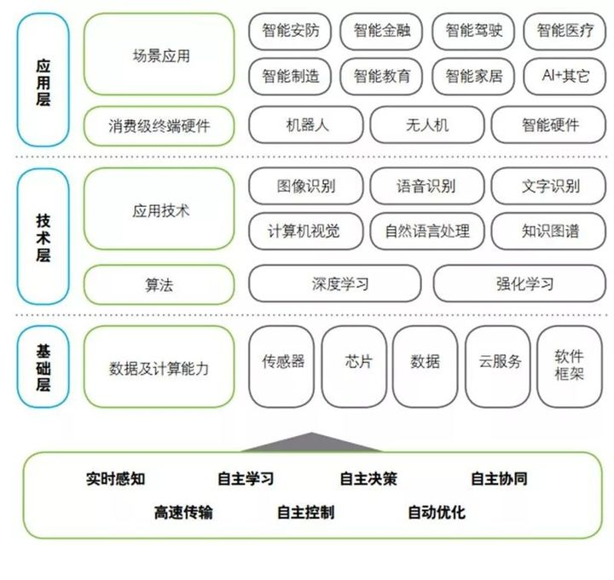
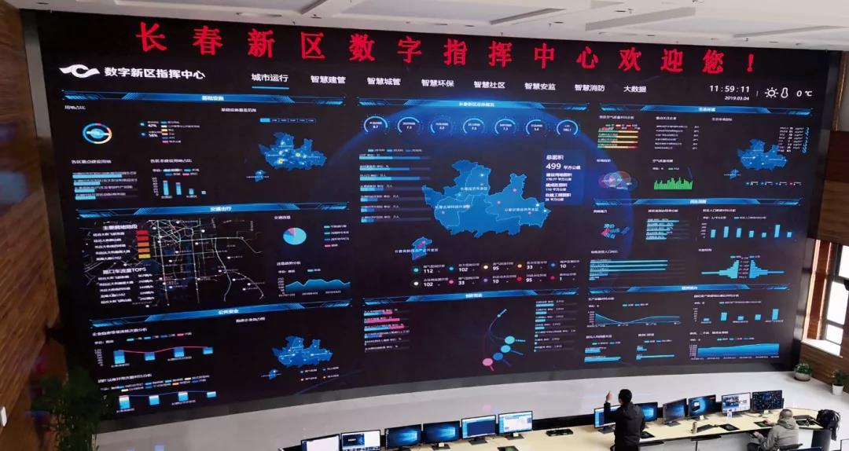
Questions And Methods
Literature analysis
Case study
How to do research

Slide 9
Findings
/03
The main findings of the paper

Slide 10
Findings
Computer vision
To improve the cost overruns that occur in the process of building cities
Improve the loss of income in the process of urban construction
Blockchain Technology
We will make cities smarter and more efficient
We will strengthen the autonomous guarantee of urban data

Slide 11
Other content
/04
The main limitations of previous studies and my further study

Slide 12
Other content
Limitations
Previous studies in this area are lack of comprehensiveness, and most of them only stay in a certain aspect without sublimation of the theme.
The main limitations of previous studies
practicalness
Their professional content is too much, and not too much focus on the real application, but mostly stay in theory.

Slide 13
Other content
Further Study
1
2
3
The literature review
Instance to investigate
Explore the essence
Read about what techniques can be used to collect literature
Use examples to see which techniques work in practice
explore the essential technologies needed for the construction of smart cities.

Slide 14
Thank you for listening
黄晨箬

