Slide 1
604-220 Week 2
Attendance
Pronunciation: –s and –es endings
Simple Present vs. Present Continuous
Reading—Main ideas exercise

Slide 2
Pronouncing –s or –es
Choose the correct pronunciation for the verb endings: /s/, /z/, /iz/
believes
washes
hopes
goes
matches
coughs
robs
kisses
asks
rooms

Slide 3
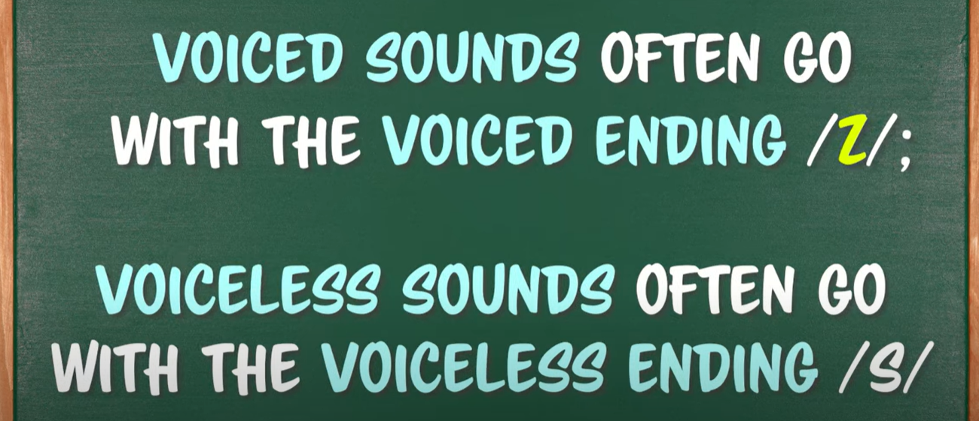
https://www.youtube.com/watch?v=E9bY3iE12yI&t=115s

Slide 4
Rules of pronouncing –s or –es
1. /s/
Nouns and verbs with the sounds /p/, /f/, /k/, /t/, /θ/
For example: hikes
Your examples:______________________________.
2. /iz/
Nouns and verbs with the sounds /s/,/z/,/ks/,-ch, -sh,-dge
For example: misses
Your examples:______________________________.
3. /z/
Nouns and verbs ending in all other sounds
For example: bags
Your examples:______________________________.

Slide 5
Pronunciation practice
Read the following paragraph and pay special attention to the pronunciation of –s and –es endings.
“Inventors in Canada have two primary tools to protect their inventions: the trademark and the patent. They are both useful in certain respects, but which is better? While the patent protects the physical designs and functions of new intellectual property, the trademark is used to protect the brand names, such as Tim Horton’s, McDonald’s, and so on. ”
adapted from Trademark or Patent by Diego Pelaez
Question: What’s your favorite brand for clothing and why?

Slide 6
Grammar Review
What are the names of the present tenses?
__________
__________
__________
__________

Slide 7
The simple present tense is used for two main types of actions:
1. Habits: Actions which happen regularly like every day or every week
2. States: Things which do not often change like facts or
beliefs
Examples:
Joshua_____ (like) chocolate.
Sam _____ (not brush) his teeth every day.
Carla’s uncle _____ (live) in Florida.
Jenny _____ (talk) too much.
I usually_____ (have) a salad for lunch.

Slide 8
The present continuous tense is used for two main types of action:
1. A temporary action happening now:
Something which is going on right now (but it will stop in the future)
2. A definite plan for the future:
Something we intend to do, usually in the near future
See next page for examples.

Slide 9
Present continuous tense examples
A continuous temporary action or a future plan?
I_____ (have) a party this Friday.
Terry _____ (think) about taking a vacation.
It _____ (rain) outside.
Maria _____ (leave) for Toronto soon.
Tom _____ (spend) lots of time on the project.
Helen _____ (go) to see her grandma.

Slide 10
Simple Present or Present Continuous
Many people say that water 1___(be) the oil of the 21st century. As we speak, in many parts of the world, water supplies 2___(drop) dramatically. How much water 3___ (we/have/really)? Some people 4___(say) that Canada 5___(hold) 20% of the world’s freshwater resources. The situation is different in the US. Many parts of the US 6___(run) out of the precious fluid and large corporations 7___(get) ready to import Canadian water. These companies 8___(try) to find cheap ways to transport huge quantities of water. Many Canadians 9___(be) worried and 10___(want) the government to protect their natural resource.
Adapted from Prospect by Jane Petring and Richard Paré

Slide 11
Main Ideas Exercise
Please see the handout.

Slide 12
References
1. Technically Speaking by Susan Drolet & Ann Seguin
2. Goals by Lynne Gaetz
3. http://web2.uvcs.uvic.ca
4. Prospect by Jane Petring
5. https://www.youtube.com/watch?v=E9bY3iE12yI&t=115s
Notes:
usan

