Slide 1
604-220 Week3
Attendance
Review of /s/ and /z/ sounds
Pronouncing –d and –ed endings
Past tenses review
List of irregular verbs
The Alibi game

Slide 2
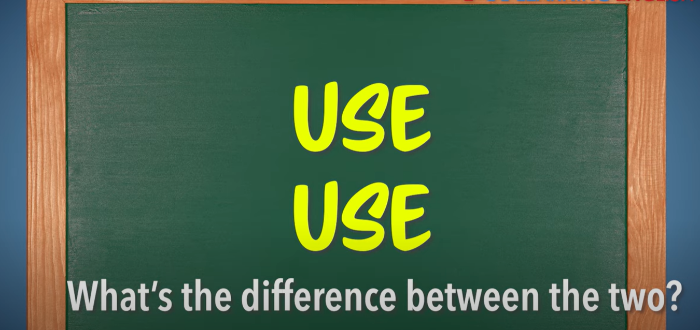
Review of /s/ and /z/
https://www.youtube.com/watch?v=zLGb4dT3vBA&list=PLd9hCvj34W5gxnTUV-wHERehpInsTJgq7&index=45

Slide 3
Pronouncing –d, –ed
Choose the correct pronunciation for the endings: /t/, /d/, /id/
washed
explained
wanted
passed
prepared
needed
laughed
arranged
asked
lived

Slide 4
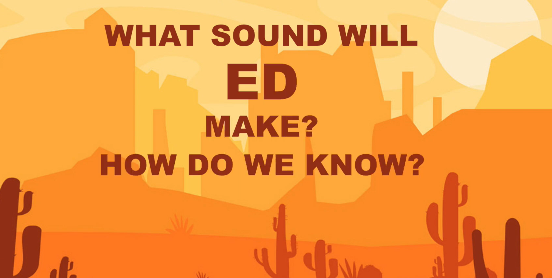
https://www.youtube.com/watch?v=Dsd0eFgU0m8

Slide 5
Pronunciation rules about –d, -ed
1. /t/ Verbs ending with -sh, -ch, /s/,/p/,/ k/,/f/ Example: washed
Your examples:__________________________
2. /id/ Verbs ending with /t/,/d/
Example: wanted
Your examples:___________________________
3. /d/ Verbs ending with all other sounds
Example: explained
Your examples:____________________________

Slide 6
Pronunciation practice: -ed
1. They witnessed a robbery last night.
2. Jackie Robinson played for the Montreal Royals.
3. Johnathan lived in New York with his girlfriend.
4. She borrowed money to open a restaurant.
5. Celine Dion linked a perfume with her name.
6. They wanted to find good jobs but couldn’t.
7. The basketball game lasted for three hours.
8. He changed his name when he was 18.
9. My parents walked in the woods after dinner.
10. Mary finally finished her big project.

Slide 7
Read Aloud
Among the most widely reported experiements in the history of animal behaviour are those psychologist Harry Harlow performed on monkeys. The baby monkeys who preferred soft, huggable dummy mothers to hard, wire surrogates, even when only the wire ones dispensed milk, are famous and have even been used as evidence that psychological studies on animals—really forms of torture—can teach humans about their emotions.
Questions:
Does the writer have a positive or a negative opinion about Harry Harlow’s experiements on monkeys?
Do you think animals have emotions? Why?
Is eating meat the same as eating dead animals? Why?
Source: Moussaieff Masson, Jeffrey and Susan McCarthy. When Elephants Weep: The Emotional Lives of Animals. Delta, 1996, p.102

Slide 8
Grammar Review: Past tenses
What are the names of the past tenses?
_________________
_________________
_________________
_________________

Slide 9
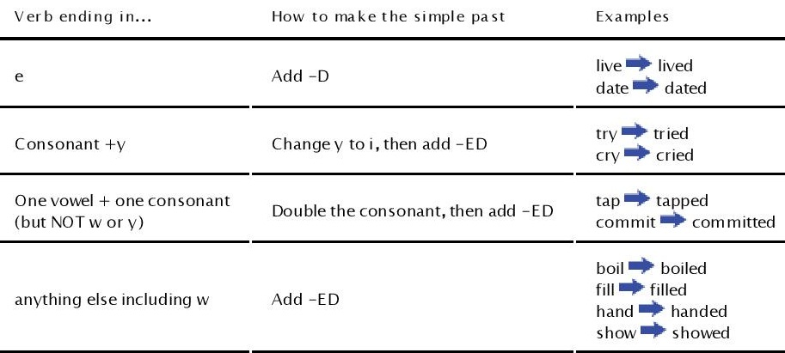
Forming the simple past tense—regular verbs

Slide 10
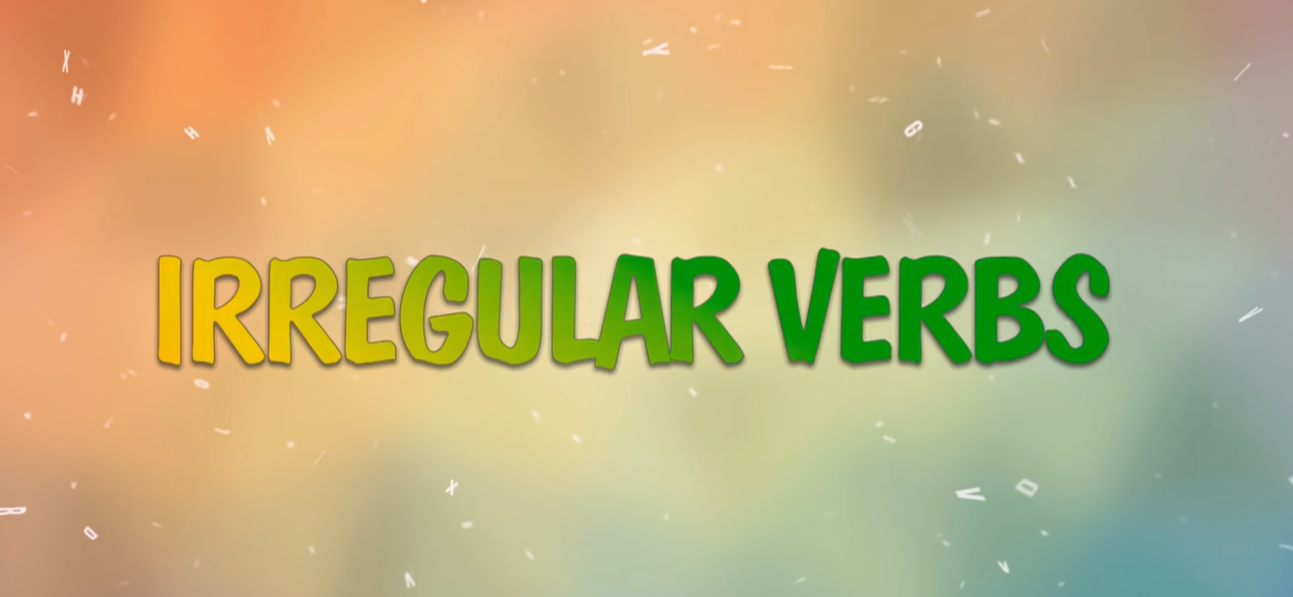
The Irregular Verbs Song https://www.youtube.com/watch?v=MA3NFtLc22k
The Irregular Verb List: see the handout

Slide 11
Use simple past tense to complete the text.
My grandfather _____ a very exciting life. When he _____ young, he _____ on a farm in the country. When he _____ eighteen, he _____ to university, where he _____ Philosophy. He also _____ the trumpet in a jazz band. When the war _____, he _____ to join the Air Force, but he ____ up in the Navy. In the Atlantic, a German torpedo _____ a hole in the side of his ship, and the ship _____. Only five men _____. When he _____back to England, he _____ my grandmother and they _____after only three weeks.

Slide 12
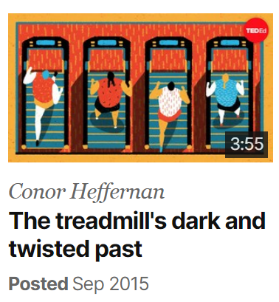
https://www.ted.com/talks/conor_heffernan_the_treadmill_s_dark_and_twisted_past?language=en

Slide 13
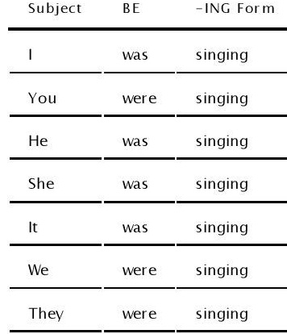
Forming the past continuous tense

Slide 14
Verb+ing Rules
If there is the silent e , remove e and add ing.
Example: like→ liking
Your examples: _________________________________
2. If there is CVC (consonant +vowel+ consonant), double the last consonant and add ing.
Example: sit→ sitting
Your examples: _________________________________
3. For words ending with Y, keep Y and add ing.
Example: carry→ carrying
Your examples:__________________________________

Slide 15
The Alibi game
Please see the handout.

Slide 16
References
1. Technically Speaking by Susan Drolet & Ann Seguin
2. Goals by Lynne Gaetz
3. Avenues series by Lynne Gaetz
4. http://web2.uvcs.uvic.ca
5. http://godfather.wikia.com/wiki/Fredo_Corleone
6.https://www.youtube.com/watch?v=zLGb4dT3vBA&list=PLd9hCvj34W5gxnTUV-wHERehpInsTJgq7&index=44
7. https://www.youtube.com/watch?v=Dsd0eFgU0m8
8. https://www.youtube.com/watch?v=MA3NFtLc22k
Notes:
usan

