Slide 1
604-220 Week 4
Class:
Attendance
Review Ed endings
Pronunciation: word stress
Grammar review: future tenses
Writing: error analysis
How to identify reliable sources and cite them properly

Slide 2
/t/, /d/, or /id/
Snored
Blushed
Clapped
Scribbled
Wounded
Juggled
Combed
Whispered
Sneezed
Plummeted
Tripped
Impeded
Drained
Walked

Slide 3
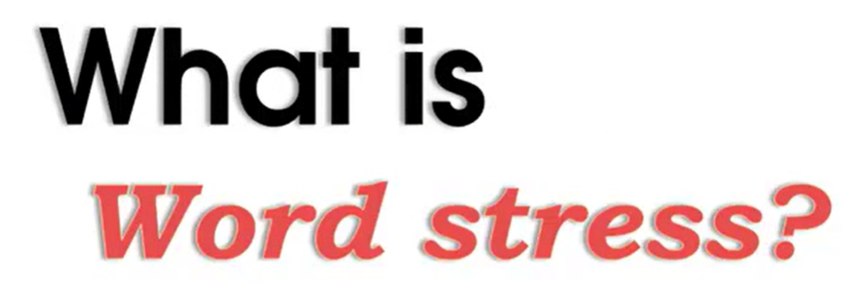
https://www.youtube.com/watch?v=Yb8X7qAByJg

Slide 4
Where is the stress?
Politics political politician
Economy economical economist
Psychology psychological psychologist psycho
Technique technical technician
Photo photograph photographer
photographic

Slide 5

Listen and identify the word stress
Tra-di-tion-al
Psy-chi-a-trist
Se-cre-ta-ry
Po-ten-tial
En-vi-ron-ment
Pu-nish-ment
In-vent
In-ven-to-ry
La-bo-ra-to-ry
Mo-ti-vate
Mo-ti-va-tion
12. Hap-pen-ing
13. Of-fered
14. Pre-ferred
15. Be-gin-ning
16. Me-di-cal
17. Me-di-ca-tion
18. O-pe-rate
19. O-pe-ra-tion
20. De-ve-loped
21. Un-der-stand

Slide 6
Grammar Review: Future Tenses
What are the names of the future tenses?
_________________
_________________
_________________
_________________

Slide 7
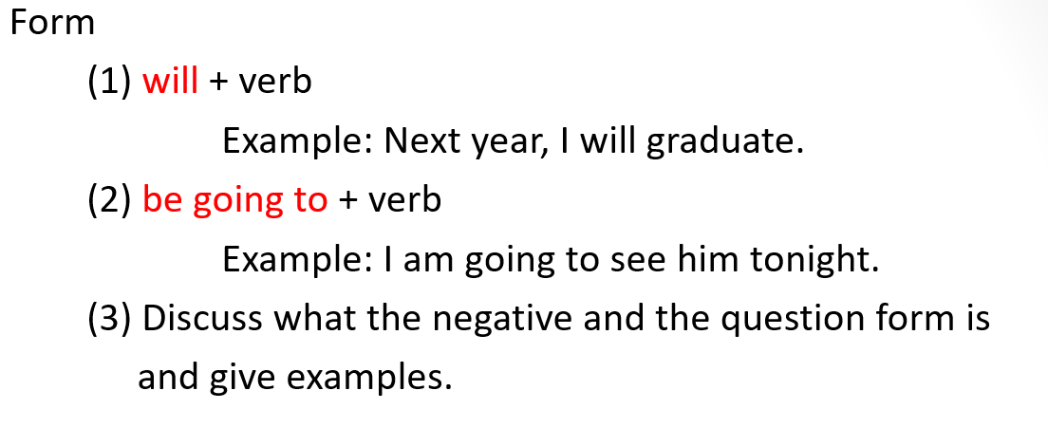
Simple Future Tense

Slide 8
Time clauses
1. Never use the future tense after the following time markers:
After before until as soon as unless when
Example: As soon as I have enough money, I will buy a car.
2. Complete the following sentences:
When she _____ (find) a job, she _____ (be) happy.
He ___ (move out) as soon as he ___ (graduate) from college.
I ___ (drive) unless you ___ (want) to do it this time.
Before I ___ (visit) your place, I ___ (call) you.
We ____ (miss) Peter after he ___ (retire).
3. Make your own sentences with the time markers.

Slide 9
Error analysis
Find and correct 15 errors in the following paragraph.
Scientist predict that major earthquakes will occur on the pacific coast of north America. What is citizens gonna do? How big the next earthquake going to be? When such disasters will occur, will the coastline changes? Where residents are going to live after a catastrophe? Unless engineers and construction companys will work together to build more earthquake-proof structure, many building and bridge will collapse probably.
Adapted from Avenues 3 by Lynn Gaetz

Slide 10
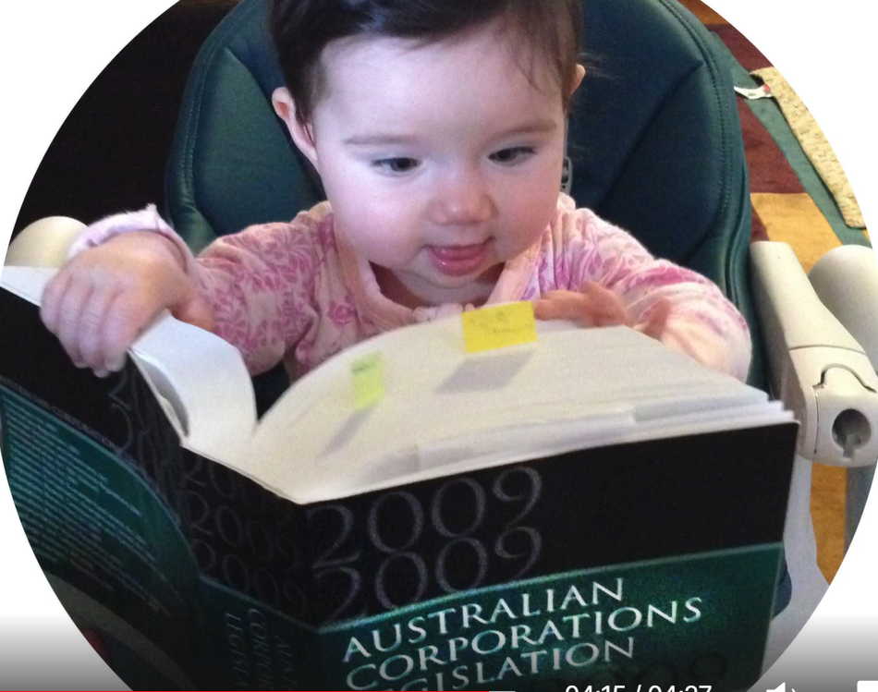
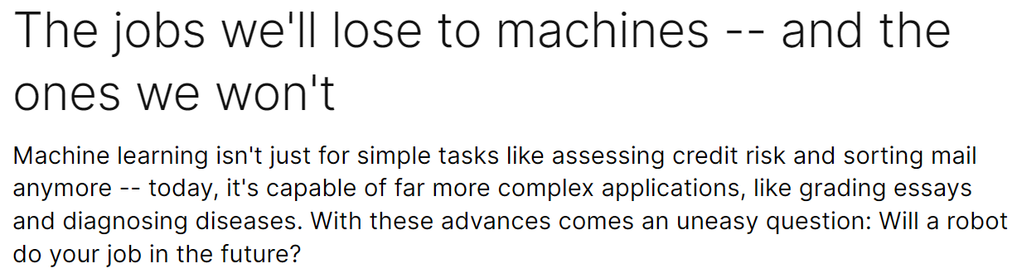
https://www.ted.com/talks/anthony_goldbloom_the_jobs_we_ll_lose_to_machines_and_the_ones_we_won_t?language=en

Slide 11
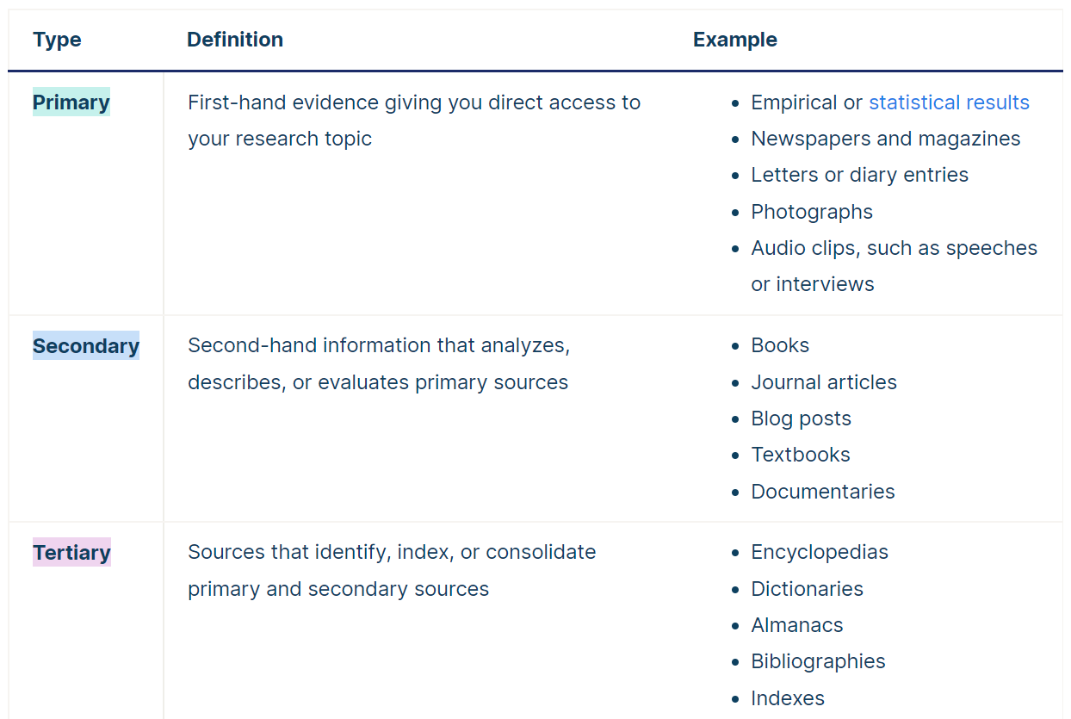
Types of Sources adapted from https://www.scribbr.com/working-with-sources/credible-sources/

Slide 12
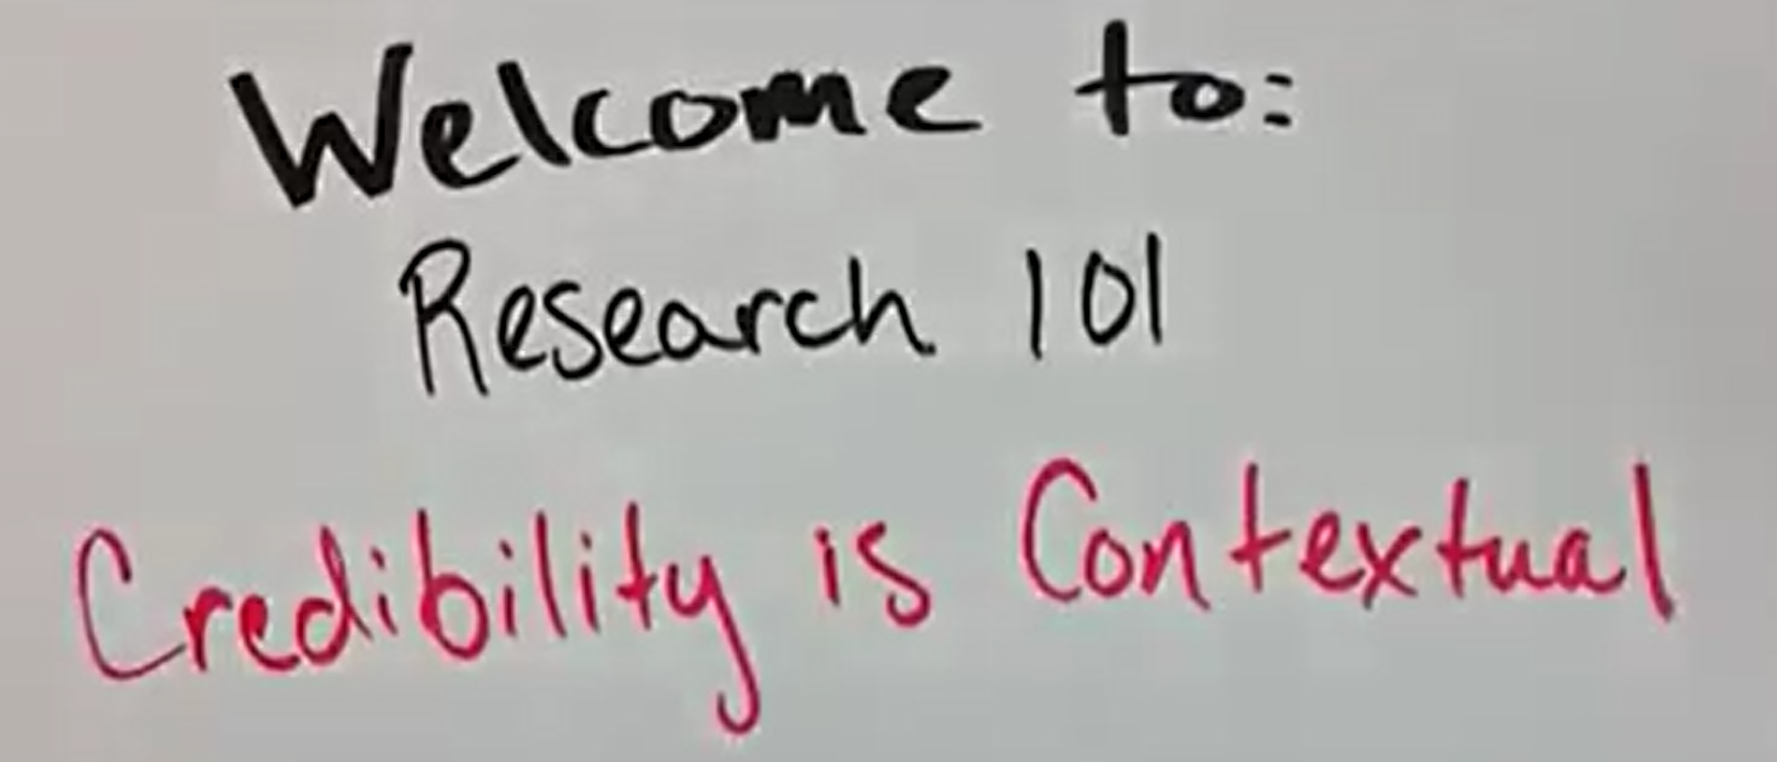
How do I know if my sources are credible/reliable?
https://guides.lib.uw.edu/research/faq/reliable

Slide 13
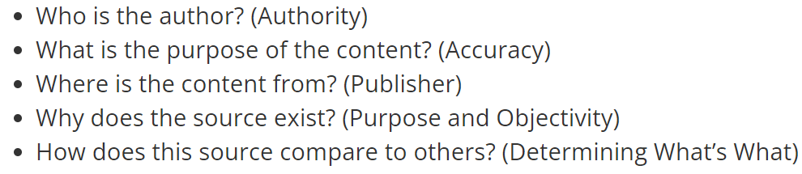
Frameworks Adapted from https://guides.lib.uw.edu/research/faq/reliable
The 5Ws

Slide 14
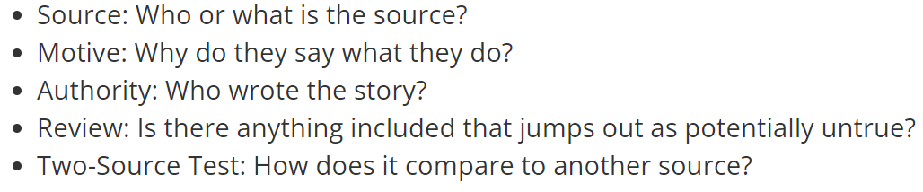
2. The SMART Check

Slide 15
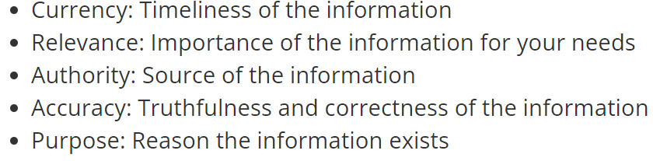
3. The CRAAP Test

Slide 16
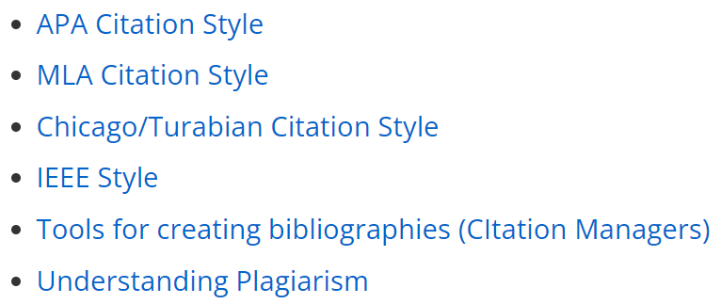
Citing Sources adapted from https://pitt.libguides.com/citationhelp and https://guides.lib.uw.edu/research/citations/citationwhich

Slide 17
Lab
Begin Task I: Field-specific audio/video research
This task counts towards Summative Evaluation 1 Listening 10%.
Due time: at the end of the lab period in Week 5.
Instructions: Individually, research an audio/video clip
approximately three minutes long that highlights the
characteristics of your field.
Evaluation Criteria (10 points):
An audio/video clip of approximately three minutes that highlights the characteristics of a certain field (3 points)
from a reliable/credible source (2 points)
Identify three level-appropriate field-related terms/expressions and write their definitions (3 points): word frequency levels 1-3 OR B2 according to https://www.collinsdictionary.com/dictionary/english
Use a couple of sentences to write about the main ideas. (2 points)
See the model on the next page.

Slide 18
Word Document
Field of study (1 point): English language
Length of the clip (1 point): 3:21
Link to the audio/video clip (1point): https://www.ted.com/talks/emma_bryce_how_to_use_a_semicolon?language=en
Justification of the reliable source (2 points): This video was made by Emma Bryce who is a UK-based journalist. Her work has appeared in publications including The Guardian, WIRED Magazine UK, Audubon, Yale e360, The Atlantic, and Live Science. She works as a writer and editor of animated video scripts for TED Education. Emma has a masters degree in science, health and environmental reporting from New York University.
Level-appropriate Field-related Vocabulary (3 points)
(1) level 2 semicolon: it is a punctuation mark that is used in writing
to separate different parts of a sentence or list.
(2) level 3 clause: it is a group of words containing a verb. A sentence
could contain one or more clauses.
(3)B2 conjunction: it is a word or group of words that joins words or
clauses.
Main ideas (2 points): This short video explains the main functions of a semicolon and how to use it to improve writing.

Slide 19
Bibliography
Insight by Jane Petring
Fields of Opportunity by Caroline Orton
Goals by Lynne Gaetz
Avenues series by Lynne Gaetz
Collins Online English Dictionary

