Slide 1
604-220 Week 8
Class:
Attendance
Review of Summative Speaking Evaluation
Pronouns
Transitional Words and Phrases (handout)
Reading (handout)
Lab: Start Task II: Innovation Reading Research.

Slide 2
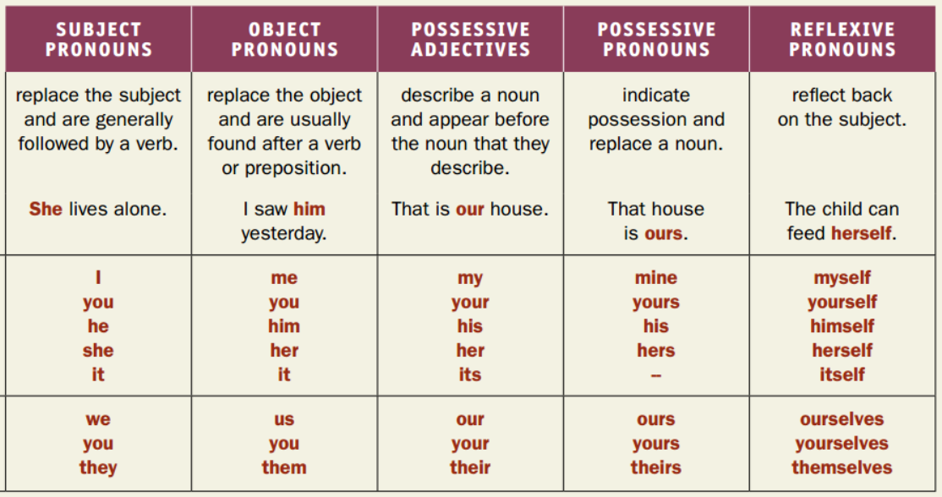
Pronouns (Avenues 1 Grammar P.2)

Slide 3
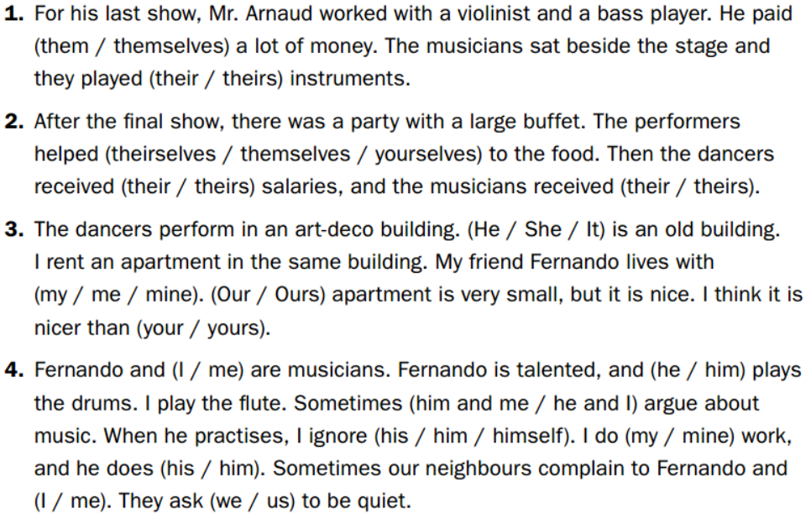
Mixed Pronouns (Avenues 1 Grammar P.10)

Slide 4
Error Analysis (over 20 errors) adapted from Avenues 3 p.78-81
Solomon Asch was a social scientifique. One of its most well-known experiment happenned in 1951. In a small room, he conducts its classic study about conformity. He gathered a group, and they consisted of ten participant. The peoples believed that they are in a experiment for test theirs visual judgment. Each person was lead into a room filled with other people. What the participants didn’t realized were that all the others were actor except for the participants. The actors would gave obviously wrongs answers to some questions, and the participants have to decided whether they agreed or not. Solomon Asch finded out that over one third of the participants gived the wrong answers because them want to conform with the group.

Slide 5
Lab
Begin Task II: Innovation Reading Research
This task counts towards Summative Evaluation 2 Reading 10%.
Due time: at the end of the lab period in Week 9.
Instructions: Individually, research an article of approximately 750 words from a reliable source, which shows recent (less than ten years old) innovation(s) in your field.
Evaluation Criteria (10 points):
Field of study (1 point)
The required number of words (not too long or too short) (0.5 point)
Reference to the source (0.5 point)
Justification of the reliability of the source (2 points)
Three level-appripriate, field-related terms/expressions and their definitions (3 points) Word frequency levels 1-3 or B2 are acceptable.
The main ideas in a couple of sentences (2 points)
The printed ariticle about a recent innovation(s) (1 point)
See the model on the next page.

Slide 6
Word Document
Group:___________ Name:____________
Field of study (1 point):
Number of words (0.5 point):
Reference to the source (0.5 point):
Justification of the source(2 points):
Level-appropriate, field-related vocabulary and definitions (3 points)
(1)
(2)
(3)
Main ideas (2 points):
The printed innovation article (1 point)

Slide 7
Bibliography
Insight by Jane Petring
Fields of Opportunity by Caroline Orton
Goals by Lynne Gaetz
Avenues series by Lynne Gaetz
Collins Online English Dictionary

