Slide 1
604-220 Week 9
Class:
Hello!
Attendance
Review of question formation
Whose fault is it anyway?
Modals
Lab:
Attendance
Continue and finish the innovation research. Hand in your Word document and article by the end of the lab period.

Slide 2
Hello + Attendance
A little bit about me.
Hala Jawlakh Office: 2.470 Office Hours: LEA Email: MIO
What are your expectations for the rest of the semester?
Do you need Accommodations?
Nursing students?
Attendance

Slide 3
Yes/No Questions
How do you form yes/no questions with “be”?
You are happy. Are you happy?
They were walking. Were they walking?
Put “be” before the subject. (Inversion)
How do you form yes/no questions with “do”?
I work out. Do you work out?
I worked out. Did you work out?
Add “do” before the subject.

Slide 4
Open Ended Questions (1)
What is the purpose of open-ended questions?
They ask for information.
Open-ended questions always start with a question word. What are some question words?
Who, What, When, Where, Why, & How
(How old, how many)

Slide 5
Open Ended Questions (2)
QW + Aux or be* +
Question Word | Auxiliary or be | Subject | (Verb) | (…the rest)
What | were | they | thinking | of?
How | is | she?
Where | does | Thomas | work?
 | Did | you | hire | him?
 | Could | Clara | help | me?
 | Is | your boss |  | nice?

Slide 6
Whose fault is it anyway?
Step 1: You will receive a very short admission.
Step 2: Read your admission silently and make up a detailed story of how it happened. Keep the story to yourself.
Step 3: Read the admission to your classmates.
Step 4: Your classmates will ask questions to try and find out what happened. Invent answers to their questions.

Slide 7
Modals
What are modals?
Modals are a type of verb that express modality (a relationship to reality).
What do we use them for?
Ability, requests, advice, obligation, probability, possibility, desire, preference, etc.

Slide 8
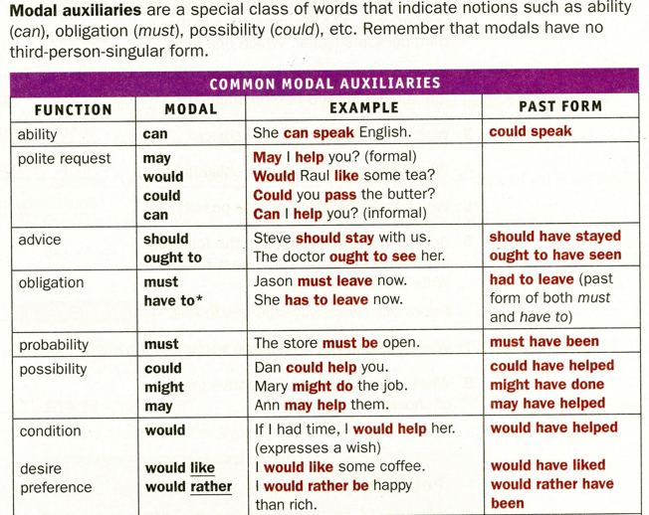

Slide 9
Who’s fault is it anyway?
Step 5: Give your friend some useful advice on how to fix their problem.
Step 6: Present your advice to the rest of the class. .

Slide 10
Our Schedule
Week 9 | Task II Innovation reading research due 10%
Week 11 | Summative evaluation 2: Task II Writing 15%
Week 14 | Certificative evaluation: Task III Writing 25%
Week 15 | Certificative evaluation: Task III Speaking 25%

Slide 11
Instructions for Lab
Begin Task II: Innovation Reading Research
This task counts towards Summative Evaluation 2 Reading 10%.
Due time: at the end of the lab period in Week 9.
Instructions: Individually, research an article of approximately 750 words from a reliable source, which shows recent (less than ten years old) innovation(s) in your field.
Evaluation Criteria (10 points):
Field of study (1 point)
The required number of words (not too long or too short) (0.5 point)
Reference to the source (0.5 point)
Justification of the reliability of the source (2 points)
Three level-appropriate, field-related terms/expressions and their definitions (3 points) Word frequency levels 1-3 or B2 are acceptable.
The main ideas in a couple of sentences (2 points)
The printed ariticle about a recent innovation(s) (1 point)
See the model on the next page.

Slide 12
Break
10 minutes

Slide 13
Lab – Task II
Innovation Reading Research
Summative Evaluation 2 – Reading (10%)
At the end of the lab period today you should submit the following:
A printout of your 750-word article.
A printout of your report on that article.

Slide 14
Word Document
Group:___________ Name:____________
Field of study (1 point):
Number of words (0.5 point):
Reference to the source (0.5 point):
Justification of the source(2 points):
Level-appropriate, field-related vocabulary and definitions (3 points)
(1)
(2)
(3)
Main ideas (2 points):
The printed innovation article (1 point)

Slide 15
Bibliography
Insight by Jane Petring
Fields of Opportunity by Caroline Orton
Goals by Lynne Gaetz
Avenues 2 Unit 6 by Lynne Gaetz
Collins Online English Dictionary
Forward 2 English Communication
http://uvcs.uvic.ca/
https://www.askamanager.org
https://www.reddit.com/r/AmItheAsshole/
https://en.wikipedia.org/wiki/Marianne_Moore
Lotus (Xuelian) Wei

