Slide 1
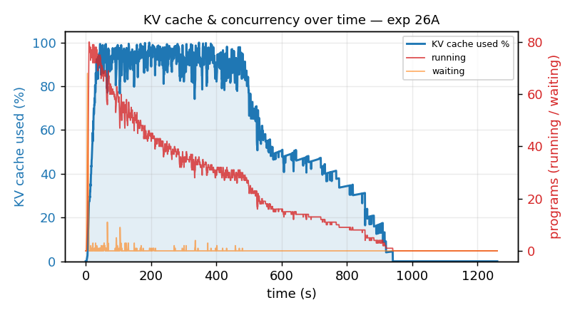
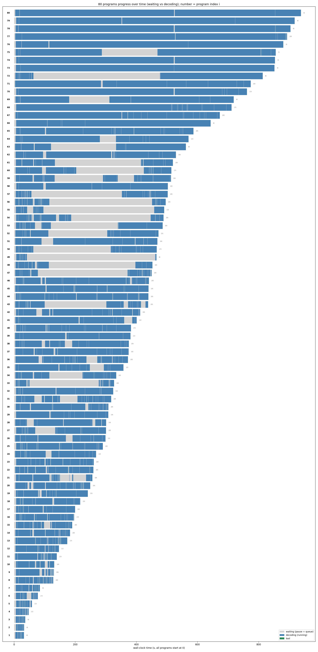
Exp 26A · Coder A/B rep1 — Pass A (size)
policy = size (rep1)
Model: qwen3-coder-30b
Dataset: SWE-bench Verified subset — 80 tasks (sympy/pytest/pylint/requests/flask/seaborn)
Backend: vLLM 0.12.0 · prefix cache ON
Concurrency: 80-way · max turns 20
KV cache curve over time
Gantt — per-program timeline
Avg prefill (prompt tok) | 240.3k
Avg decode length (tok) | 5.8k
Avg task rounds (turns) | 14.6
KV cache util (avg / peak) | 49% / 100%
Prefix cache hit rate | 78.1%
Avg task latency | 428 s
Makespan (wall) | 1258 s
Throughput (gen) | 366.8 tok/s
Preempt / decode calls | 0.7% (8/1167)
Serving: resolved 11 · avg running 21 · max waiting 63 · preemptions 8
result/26_AB_coder_size_vs_hazard · latency = decode + tool + scheduler wait (excl. grading) · makespan = batch wall-clock · preempt/decode calls = vLLM preemptions (last-first) / total LLM calls (sum of turns)

Slide 2
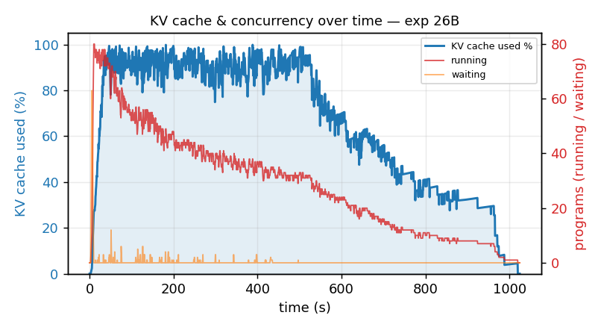
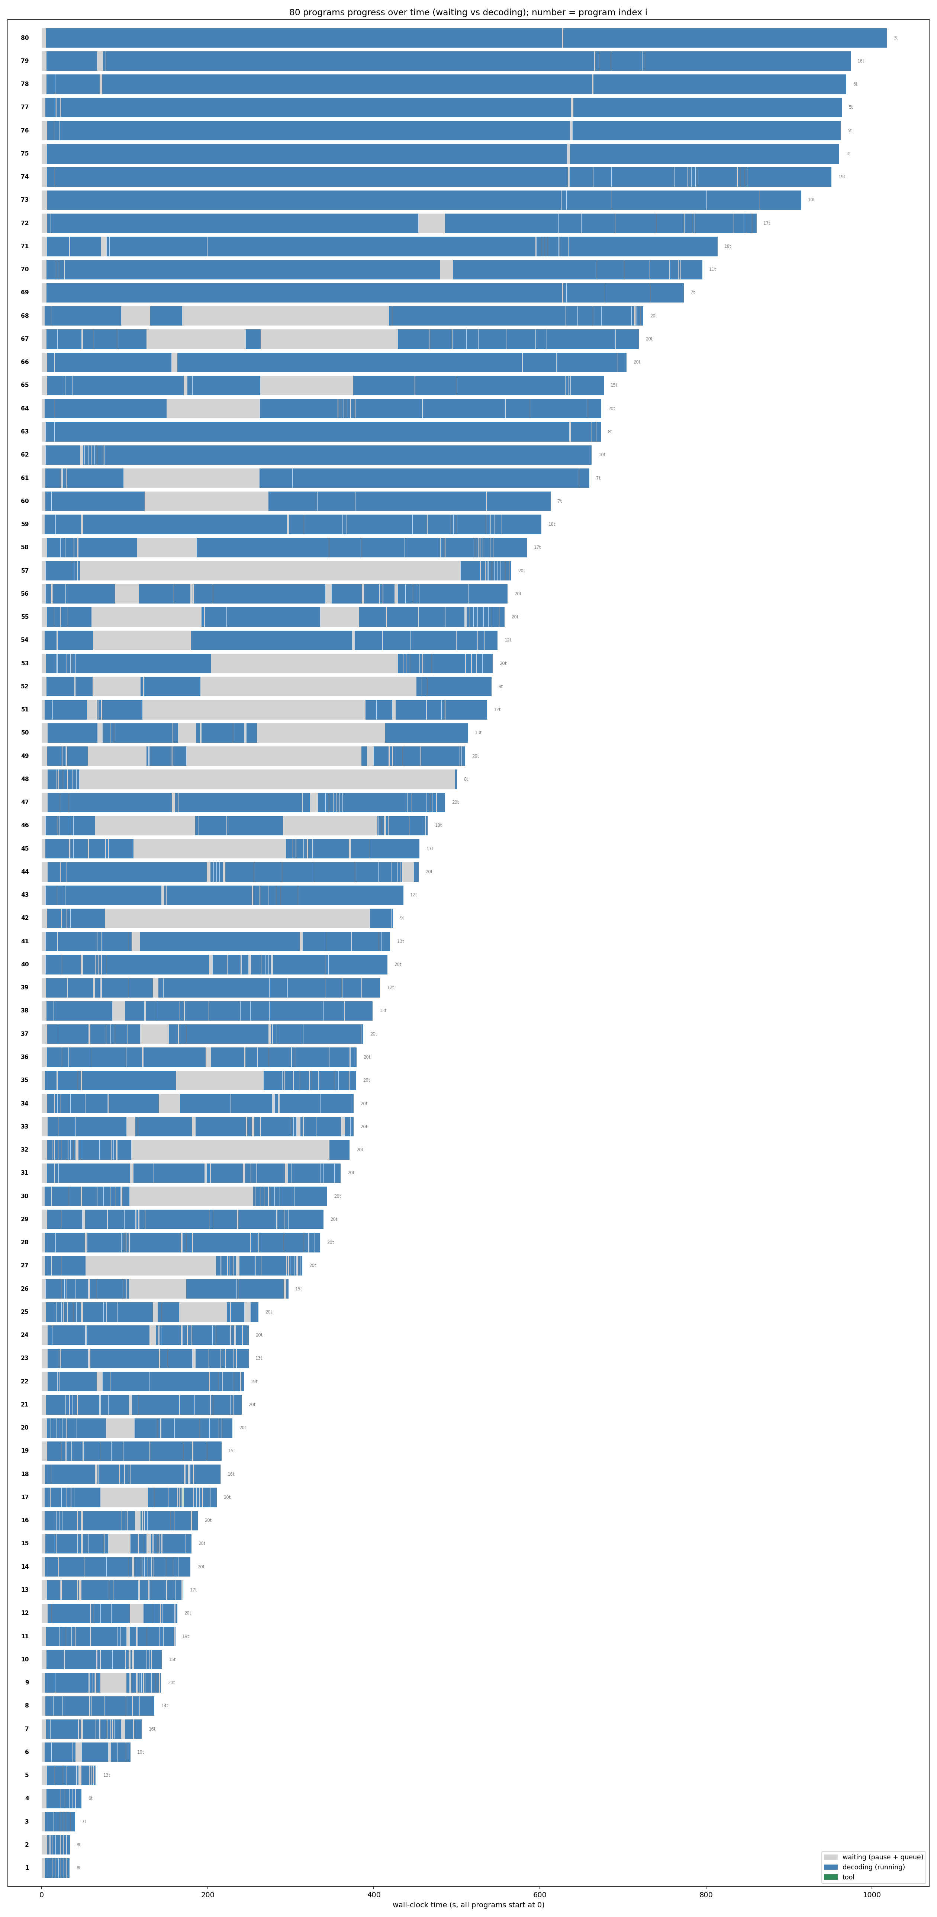
Exp 26B · Coder A/B rep1 — Pass B (hazard_grade)
policy = hazard_grade (rep1)
Model: qwen3-coder-30b
Dataset: SWE-bench Verified subset — 80 tasks (sympy/pytest/pylint/requests/flask/seaborn)
Backend: vLLM 0.12.0 · prefix cache ON
Concurrency: 80-way · max turns 20
KV cache curve over time
Gantt — per-program timeline
Avg prefill (prompt tok) | 248.7k
Avg decode length (tok) | 5.5k
Avg task rounds (turns) | 15.3
KV cache util (avg / peak) | 66% / 100%
Prefix cache hit rate | 77.0%
Avg task latency | 469 s
Makespan (wall) | 1023 s
Throughput (gen) | 430.2 tok/s
Preempt / decode calls | 0.4% (5/1221)
Serving: resolved 14 · avg running 29 · max waiting 63 · preemptions 5
Note: hazard tuned to coder: decode_reserve 1024, coder16 prior; retention knapsack fired only 17x (KV rarely saturated).
result/26_AB_coder_size_vs_hazard · latency = decode + tool + scheduler wait (excl. grading) · makespan = batch wall-clock · preempt/decode calls = vLLM preemptions (last-first) / total LLM calls (sum of turns)

Slide 3
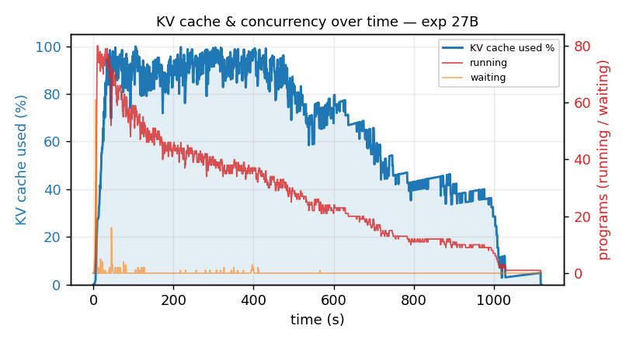
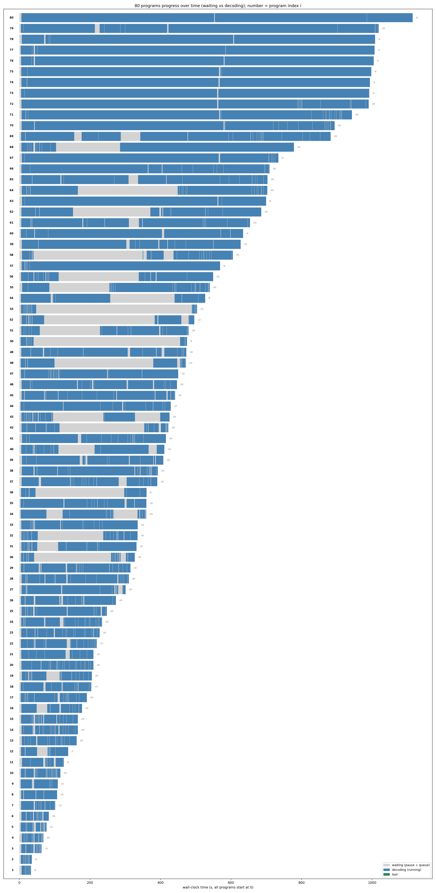
Exp 27B · Coder A/B rep2 — Pass B (hazard_grade)
policy = hazard_grade (rep2)
Model: qwen3-coder-30b
Dataset: SWE-bench Verified subset — 80 tasks (sympy/pytest/pylint/requests/flask/seaborn)
Backend: vLLM 0.12.0 · prefix cache ON
Concurrency: 80-way · max turns 20
KV cache curve over time
Gantt — per-program timeline
Avg prefill (prompt tok) | 251.3k
Avg decode length (tok) | 6.1k
Avg task rounds (turns) | 15.1
KV cache util (avg / peak) | 64% / 100%
Prefix cache hit rate | 80.5%
Avg task latency | 473 s
Makespan (wall) | 1116 s
Throughput (gen) | 435.4 tok/s
Preempt / decode calls | 0.6% (7/1211)
Serving: resolved 16 · avg running 27 · max waiting 61 · preemptions 7
Note: hazard tuned to coder: decode_reserve 1024, coder16 prior; retention knapsack fired only 15x (KV rarely saturated).
result/27_AB_coder_size_vs_hazard · latency = decode + tool + scheduler wait (excl. grading) · makespan = batch wall-clock · preempt/decode calls = vLLM preemptions (last-first) / total LLM calls (sum of turns)

Slide 4
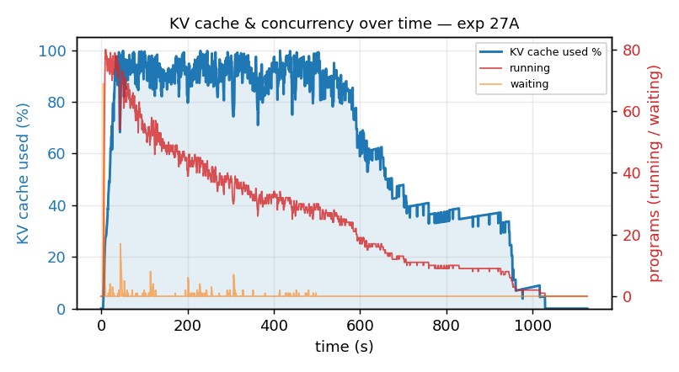
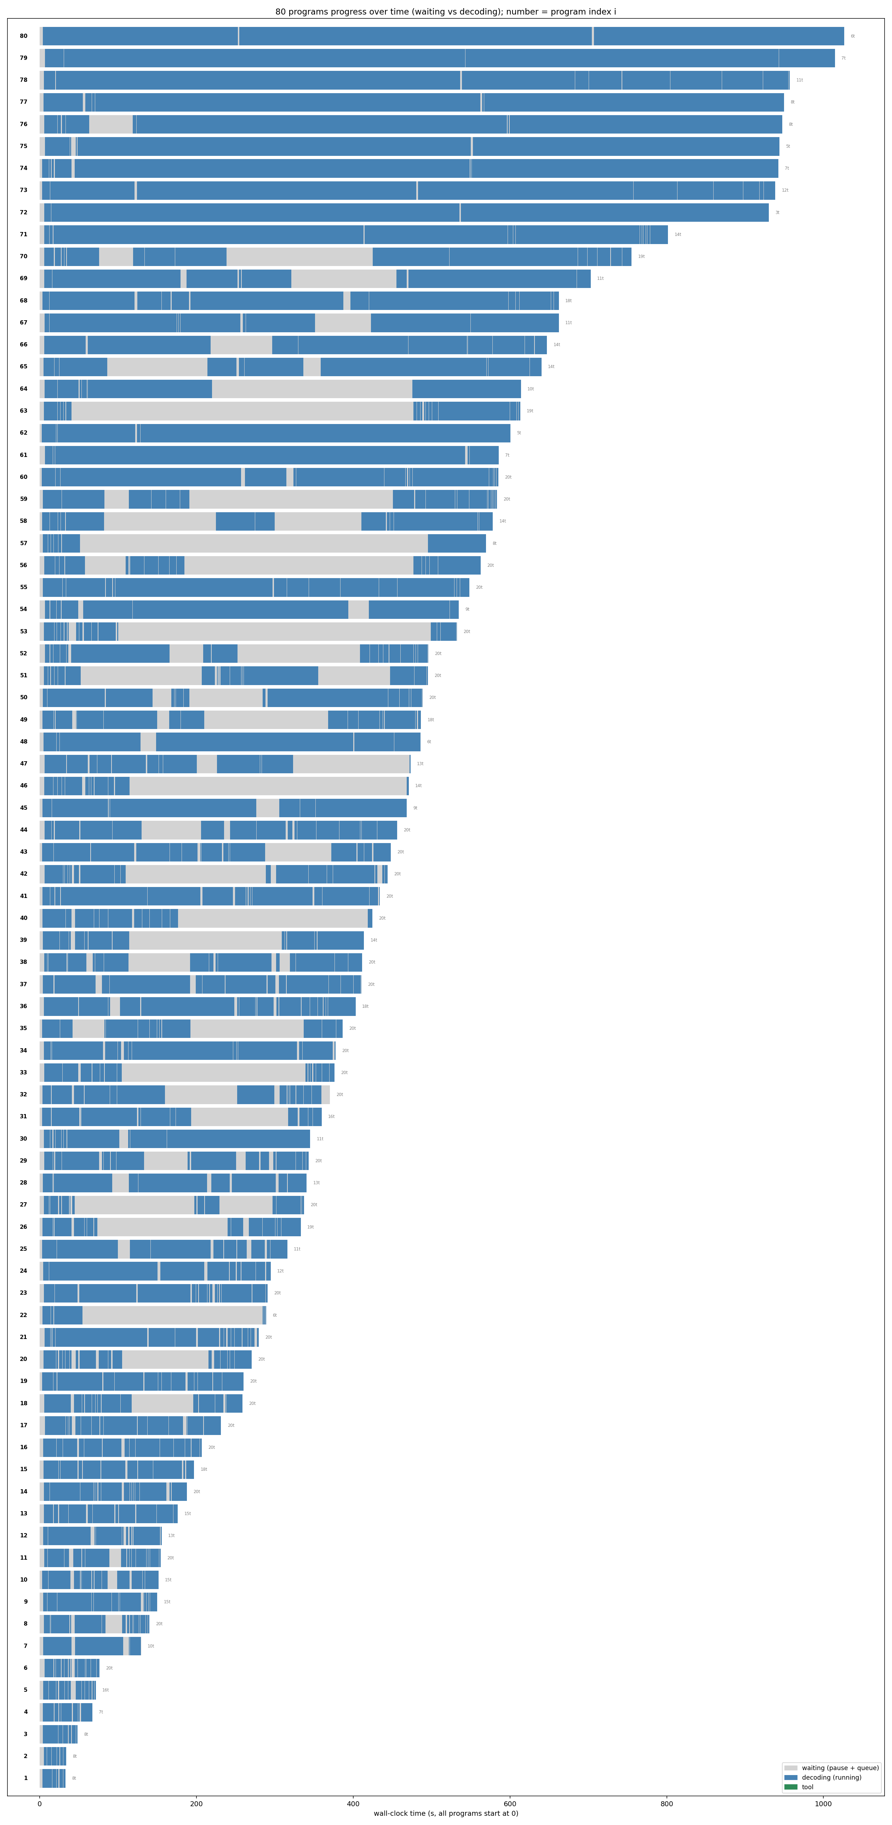
Exp 27A · Coder A/B rep2 — Pass A (size)
policy = size (rep2)
Model: qwen3-coder-30b
Dataset: SWE-bench Verified subset — 80 tasks (sympy/pytest/pylint/requests/flask/seaborn)
Backend: vLLM 0.12.0 · prefix cache ON
Concurrency: 80-way · max turns 20
KV cache curve over time
Gantt — per-program timeline
Avg prefill (prompt tok) | 235.1k
Avg decode length (tok) | 5.9k
Avg task rounds (turns) | 14.9
KV cache util (avg / peak) | 60% / 100%
Prefix cache hit rate | 77.6%
Avg task latency | 467 s
Makespan (wall) | 1124 s
Throughput (gen) | 419.7 tok/s
Preempt / decode calls | 0.6% (7/1193)
Serving: resolved 12 · avg running 25 · max waiting 69 · preemptions 7
result/27_AB_coder_size_vs_hazard · latency = decode + tool + scheduler wait (excl. grading) · makespan = batch wall-clock · preempt/decode calls = vLLM preemptions (last-first) / total LLM calls (sum of turns)

