Slide 1
Variability-based model transformation
Variation-aware rule application and rule merging
Daniel Strüber University of Koblenz and Landau, Germany with Julia Rubin, Marsha Chechik, Gabriele Taentzer, Thorsten Arendt, Jennifer Plöger
FOSD Meeting, Grasellenbach, March 15, 2017

Slide 2
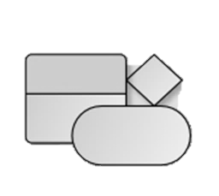

What are these models and why transform them?
Models
Transformations
Manipulation
Refactoring
Simulation
Textual
General purpose
Domain-specific languages
Refinement
Migration
Visual
Reverse Engineering
Refactoring
Analysis
Crypto APIs
Software patches
Business processes
Rendering
Synchronization
Synthesis

Slide 3

And what has variability got do with it?
Product lines of models and model transformations
Models
Transformations
Manipulation
Refactoring
Simulation
Textual
General purpose
Domain-specific languages
Refinement
Migration
Visual
Reverse Engineering
Refactoring
Analysis
Crypto APIs
Software patches
Business processes
Rendering
Synchronization
Synthesis

Slide 4
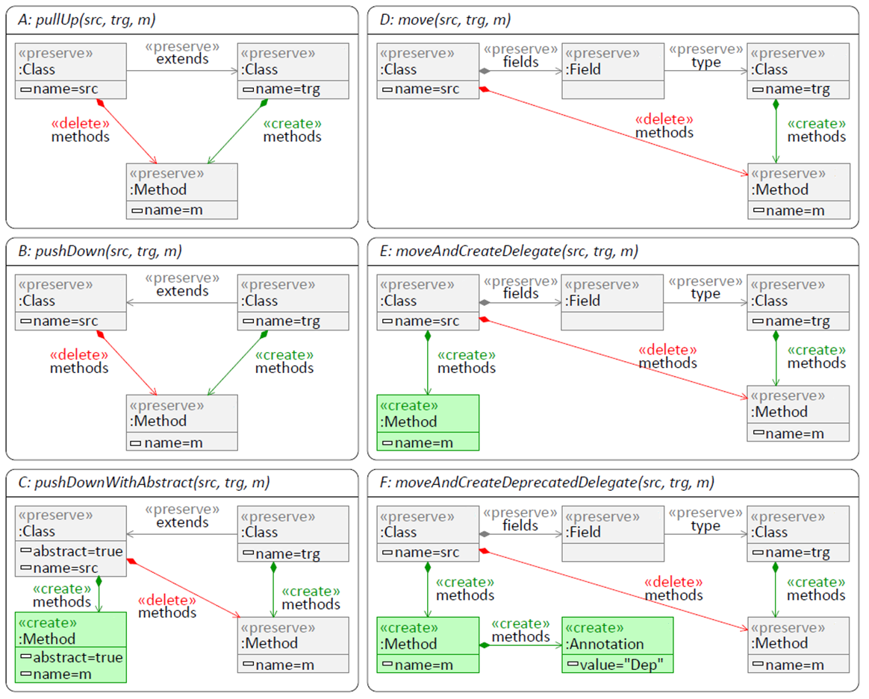
Model transformations rules are prone to cloning
Move method
Model transformations are often specified using rules
Multiple rule variants: Reuse mechanisms rarely available, cloning is a common paradigm
Error-prone
Leads to large rule sets
Performance bottlenecks
Move method
Move method as a graph-based transformation rule with deletions and insertions
Notes:
The context of this work is model-driven software development and its application in global scenarios.
Today, there‘s an ongoing trend of software being developed at many distributed locations, be in the context of open source development or in industrial outsourcing scenarios.
In distributed scenarios, model-driven software development faces significant challenges.
One of these challenges is the great complexity of software projects which leads to models of remarkable size.

Slide 5
From similar to variability-based rules
Diam
Circ
Tri
Merge cloned rules to produce a “150% rule”
Enable compact specification and improved performance
Inspired by SPLE techniques, uses clone detection and clustering
Notes:
The context of this work is model-driven software development and its application in global scenarios.
Today, there‘s an ongoing trend of software being developed at many distributed locations, be in the context of open source development or in industrial outsourcing scenarios.
In distributed scenarios, model-driven software development faces significant challenges.
One of these challenges is the great complexity of software projects which leads to models of remarkable size.

Slide 6
Example: Six highly redundant refactoring rules
Notes:
The context of this work is model-driven software development and its application in global scenarios.
Today, there‘s an ongoing trend of software being developed at many distributed locations, be in the context of open source development or in industrial outsourcing scenarios.
In distributed scenarios, model-driven software development faces significant challenges.
One of these challenges is the great complexity of software projects which leads to models of remarkable size.

Slide 7
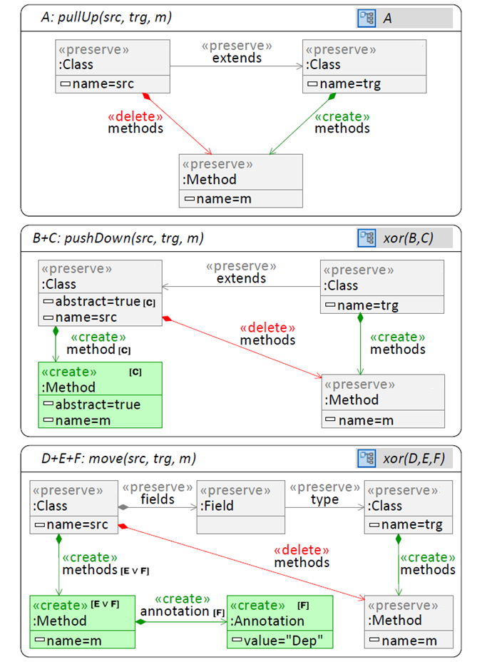
As merge result, we produce variability-based rules
Unify variants, annotate differences with presence conditions
Benefits
Smaller rule set
Less error-prone
Faster execution, based on shared execution
A presence condition
Notes:
The context of this work is model-driven software development and its application in global scenarios.
Today, there‘s an ongoing trend of software being developed at many distributed locations, be in the context of open source development or in industrial outsourcing scenarios.
In distributed scenarios, model-driven software development faces significant challenges.
One of these challenges is the great complexity of software projects which leads to models of remarkable size.

Slide 8
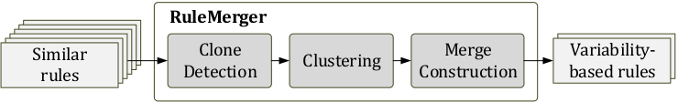
Three-component framework for rule merging
1:
Diam
Circ
Tri
2:
3:
Notes:
The context of this work is model-driven software development and its application in global scenarios.
Today, there‘s an ongoing trend of software being developed at many distributed locations, be in the context of open source development or in industrial outsourcing scenarios.
In distributed scenarios, model-driven software development faces significant challenges.
One of these challenges is the great complexity of software projects which leads to models of remarkable size.

Slide 9
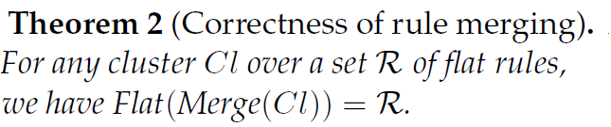
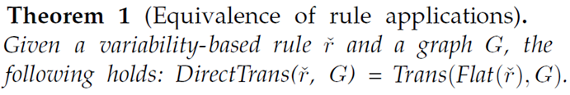
Proving the correctness of rule merging and variability-based rule application
Merge
Variability-based rule
Classic rules
=
Flatten
Input model
Input model
=
Apply individually
Output model
Apply variability-based
Notes:
The context of this work is model-driven software development and its application in global scenarios.
Today, there‘s an ongoing trend of software being developed at many distributed locations, be in the context of open source development or in industrial outsourcing scenarios.
In distributed scenarios, model-driven software development faces significant challenges.
One of these challenges is the great complexity of software projects which leads to models of remarkable size.

Slide 10





Beyond correctness: Quality goals during merging may be in conflict
Execution speed
Editor performance
Readability
Goals
Low number of rules
Low size of individual rules
Meaningful clustering
Low size of left-hand sides
No single perfect merge result ☹
Can derive purpose-specific merge results, all of them equivalent (Thm. 1) ☺
Low number of annotations
Sub-goals
Notes:
The context of this work is model-driven software development and its application in global scenarios.
Today, there‘s an ongoing trend of software being developed at many distributed locations, be in the context of open source development or in industrial outsourcing scenarios.
In distributed scenarios, model-driven software development faces significant challenges.
One of these challenges is the great complexity of software projects which leads to models of remarkable size.

Slide 11

Evaluation using realistic rule sets
3 rule sets from different domains
Edit operation recognition [Bürdek 2015]
Translation of OCL constraints [Arendt 2014]
Transformation benchmark [Varró 2006]
Materials
Measured performance, scalability, and compactness
Input parameters optimized for performance
Set-up
Notes:
The context of this work is model-driven software development and its application in global scenarios.
Today, there‘s an ongoing trend of software being developed at many distributed locations, be in the context of open source development or in industrial outsourcing scenarios.
In distributed scenarios, model-driven software development faces significant challenges.
One of these challenges is the great complexity of software projects which leads to models of remarkable size.

Slide 12
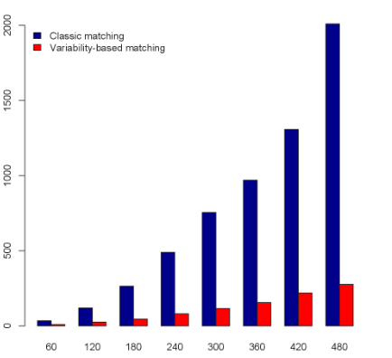



In our evaluation, rule merging allowed producing highly effective rule sets
4-158x as fast as “classic” rules
Caveat: Many matches (0.7x)
y = execution time / sec
Performance
Performance gain was constant for larger input models
Scalability
Removed 29-75% of all elements
Manually merged rules were even more compact
x = sqrt (model size)
Compactness
Notes:
29 vs. 67

Slide 13
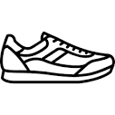
From similar to variability-based rules
Diam
Circ
Tri
Merge cloned rules to produce a “150% rule”
Apply “150% rule” using a variability-based algorithm
Tool support: SNEAKERS4FREE
Future work
Address variability in input models
Formalizing the quality goal readability: can machine learning help?
SNEAKERS4FREE
Notes:
The context of this work is model-driven software development and its application in global scenarios.
Today, there‘s an ongoing trend of software being developed at many distributed locations, be in the context of open source development or in industrial outsourcing scenarios.
In distributed scenarios, model-driven software development faces significant challenges.
One of these challenges is the great complexity of software projects which leads to models of remarkable size.

