Slide 1
CEF 440 | INTERNET & MOBILE PROGRAMMING | UNIVERSITY OF BUEA
EduStream
Adaptive Mobile E-Learning Platform Based on Quality of Experience (QoE)
for Inclusive Online Education in Low-Resource Settings
PRESENTED BY GROUP 21
CHE RANDY FANG
Software
FE23A030
Course Instructor: Dr Nkemeni Valery
ECHUNDIP CARL-LAWRENCE N.
Networking
FE23A040
Faculty of Engineering and Technology
MAKANE THANKS MOSAKA
Software
FE23A085
July 2026
NUMFOR PRECIOUS LUM
Software
FE23A126
TEMFA NKOMBONG FORTUNEE
Software
FE23A168
Final Project Presentation

Slide 2




THE Problem
Online education assumes a network that doesn't exist here
The rapid growth of online learning has expanded access to education, but most e-learning platforms rely on stable internet connectivity and modern devices, which are often unavailable in developing countries such as Cameroon. Students frequently experience buffering, poor audio quality, interrupted live sessions, and disconnections due to unstable networks, while existing platforms rarely consider learners' Quality of Experience (QoE) or adapt to changing network conditions.
6
0
30s
4
existing platforms benchmarked
of them adapt to live network conditions
our QoE engine's monitoring interval
delivery modes: HD, SD, Audio, Text
The real barrier isn't a lack of learning platforms - it's that none of them treat unstable connectivity as the default condition to design for, rather than an edge case to tolerate.
02

Slide 3
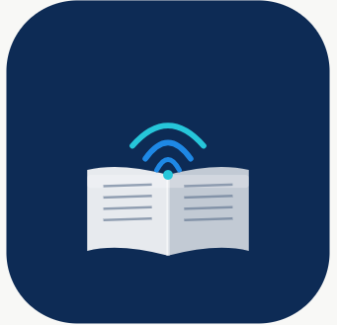
THE SOLUTION
EduStream: one platform, built network-first
EduStream is a cross-platform mobile e-learning app that continuously reads live network conditions and adapts what it delivers - so learning continues through poor connectivity instead of stopping for it.
HOW ADAPTATION WORKS
1
Student opens a lesson
Cross-platform mobile app
React Native + Expo - one codebase, Android and iOS
2
Engine samples bandwidth, latency, packet loss
Unified backend-as-a-service
Supabase: authentication, PostgreSQL, storage, realtime - no fragile custom server
3
Best-fit mode selected: HD / SD / Audio / Text
Adaptive QoE engine
Samples bandwidth, latency & packet loss every 30s, selects HD / SD / Audio-only / Text
4
Content is delivered in that mode
Role-based dashboards
5
Session logged for instructor QoE analytics
Purpose-built views for students, instructors and administrators
6
Loop repeats every 30 seconds
03

Slide 4
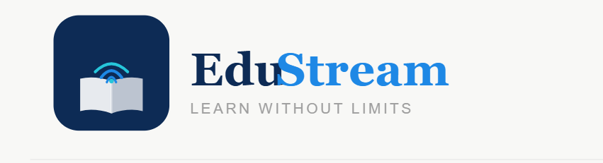

01
Secure, Role-Based Access
THE THINKING
DESIGN & BUILD
WHY IT WINS
Instructors told us course groups on WhatsApp and open Drive links give zero control over who sees what, and zero accountability for who changed it. Any credible learning platform has to start with identity and permission, not features.
Three roles - Student, Instructor, Administrator - each with a distinct dashboard and a distinct, non-overlapping set of permissions baked in from day one.
Built on Supabase Auth (JWT-based sessions) with Row Level Security enforced inside PostgreSQL itself - so access rules live in the database, not just the app's UI.
Permissions in WhatsApp / Drive-based setups are social conventions - easy to break by accident. In EduStream, a student's device literally cannot retrieve another student's records, even if the app's front end were bypassed entirely.
FOUNDATION
04

Slide 5

02
Unified Course & Content Management
THE THINKING
DESIGN & BUILD
WHY IT WINS
Survey data showed lecturers spread materials across WhatsApp, YouTube links and Google Drive - students had no single place to look, and no reliable way to know what was current.
Courses contain ordered lessons (video, audio, text or mixed) inside a normalized schema; content unlocks only after enrollment.
PostgreSQL relational schema (courses -> lessons -> enrollments) with segmented Supabase storage buckets by content type and size limit.
One integrated system replaces a fragmented WhatsApp + Drive + YouTube workflow. Enrollment-gated access also means course material isn't sitting on a public link anyone can forward.
CONTENT LAYER
05

Slide 6
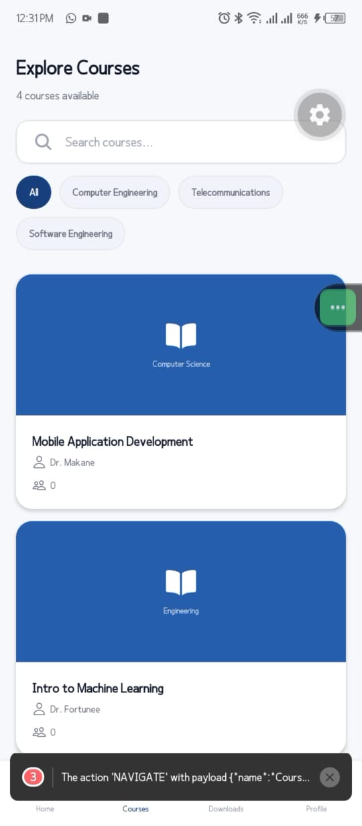
Course Details Screen

Slide 7
03
The QoE Adaptive Engine
THE THINKING
DESIGN & BUILD
WHY IT WINS
Reverse-engineering Zoom, Meet and YouTube showed the same gap in all of them: when a network degrades, the platform just buffers or freezes. None of them make an active decision to protect the learning session.
A monitoring loop samples bandwidth, latency and packet loss every 30 seconds and selects the best-fit delivery mode: HD Video, SD Video, Audio-only, or Text - logged to a QoE table for every session.
Phase 1 (shipped): live network sampling, rule-based mode selection, and full QoE logging for analytics. Phase 2 (roadmap): true multi-bitrate HLS/DASH streaming and WebRTC live adaptation.
EduStream is the only platform of the six we studied that treats degraded connectivity as a signal to act on, not an error to display. We're shipping the decision engine now and scaling it to full adaptive streaming next.
CORE INNOVATION
06

Slide 8

04
Real-Time Messaging & Notifications
THE THINKING
DESIGN & BUILD
WHY IT WINS
Instructors said broadcast-only WhatsApp groups make it impossible to reach a specific student, and students said they miss deadlines buried in group chat noise.
Direct instructor-student messaging plus automatic, targeted notifications for assignments, live classes, quizzes and announcements.
Supabase Realtime (WebSocket channels) pushes updates instantly; database triggers auto-generate notifications the moment an event occurs - no manual broadcasting.
Unlike a WhatsApp group where messages disappear into scroll and everyone sees everything, EduStream delivers targeted, timestamped, auditable communication tied directly to the course record.
ENGAGEMENT
07

Slide 9

05
Analytics & QoE Dashboards
THE THINKING
DESIGN & BUILD
WHY IT WINS
Instructors were candid: they have no idea whether a student who 'attended' a live session actually experienced it well, or sat through a frozen screen for 40 minutes.
Role-specific dashboards: instructors see per-course engagement and QoE summaries; administrators see platform-wide health and adoption trends.
Six SQL analytics views (course completion, average QoE, delivery-mode distribution, and more) queried directly for near real-time dashboard rendering.
Zoom gives you an attendance count. EduStream gives instructors a network-quality-adjusted view of engagement - a metric no platform in our benchmark set exposes today.
VISIBILITY
08

Slide 10
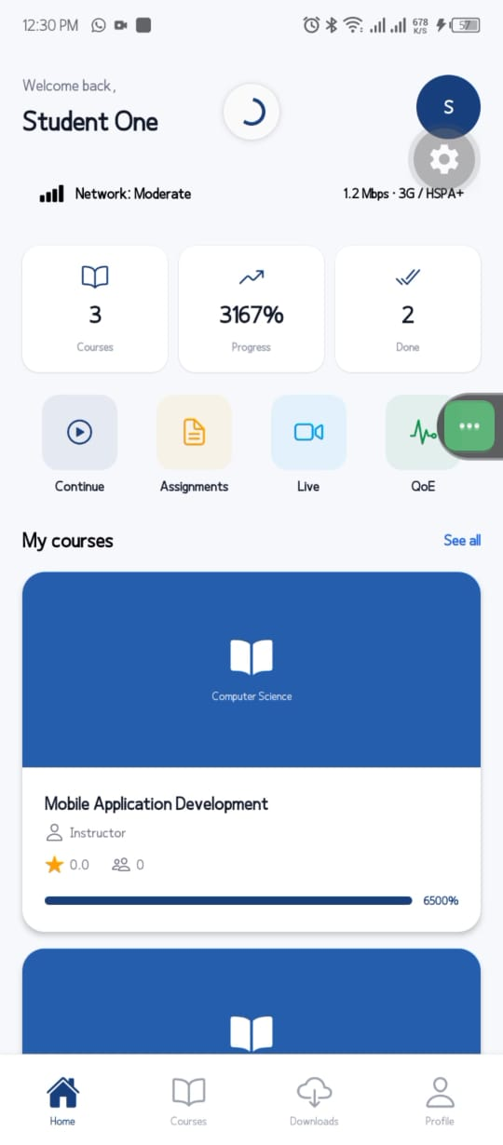
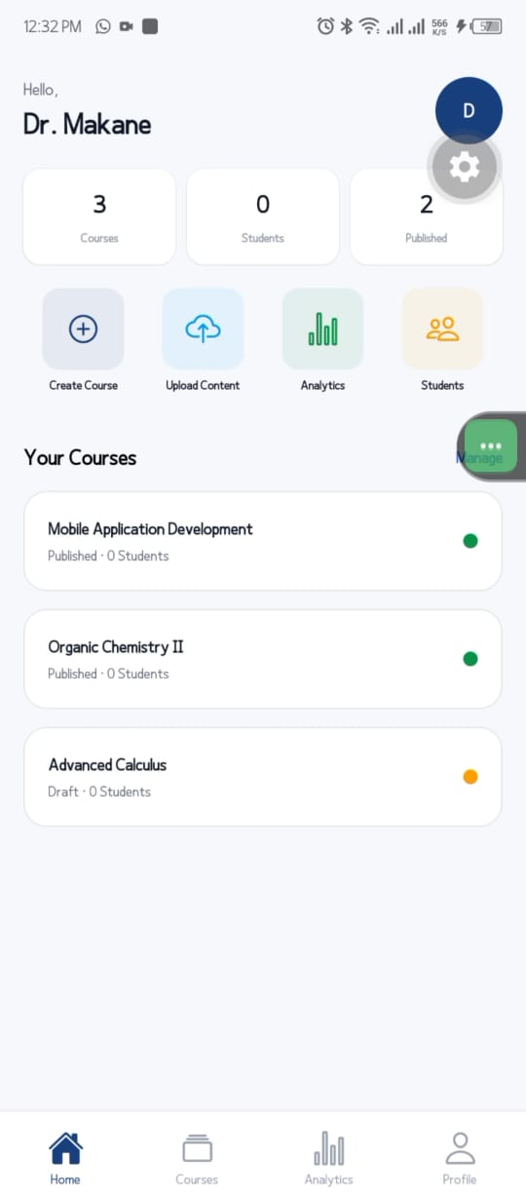
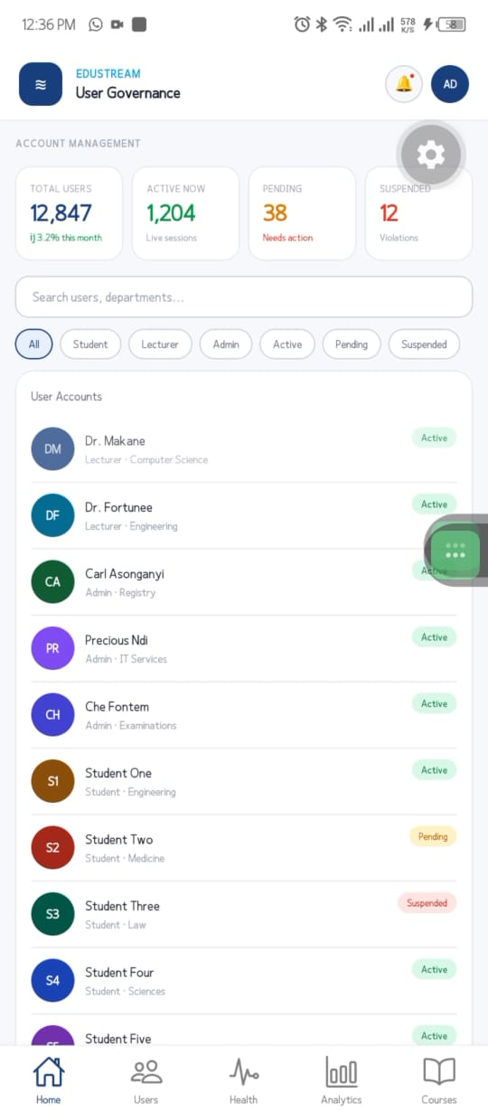
Student Dashboard
Instructor Dashboard
Admin Dashboard

Slide 11

06
Secure, Scalable Cloud Architecture
THE THINKING
DESIGN & BUILD
WHY IT WINS
A single-university deployment still has to scale and stay secure without a rebuild - and institutions are wary of any system that can leak student records.
Fifteen normalized entities with foreign-key-enforced integrity, one relational source of truth instead of scattered spreadsheets and files.
PostgreSQL 15 on Supabase, Row Level Security enabled on every table, and versioned storage buckets segmented by content type and access policy.
A managed BaaS layer replaces what would otherwise be three fragile self-hosted services (auth server, database, file server) - lower infrastructure cost, faster iteration, enterprise-grade security from launch.
INFRASTRUCTURE
09

Slide 12
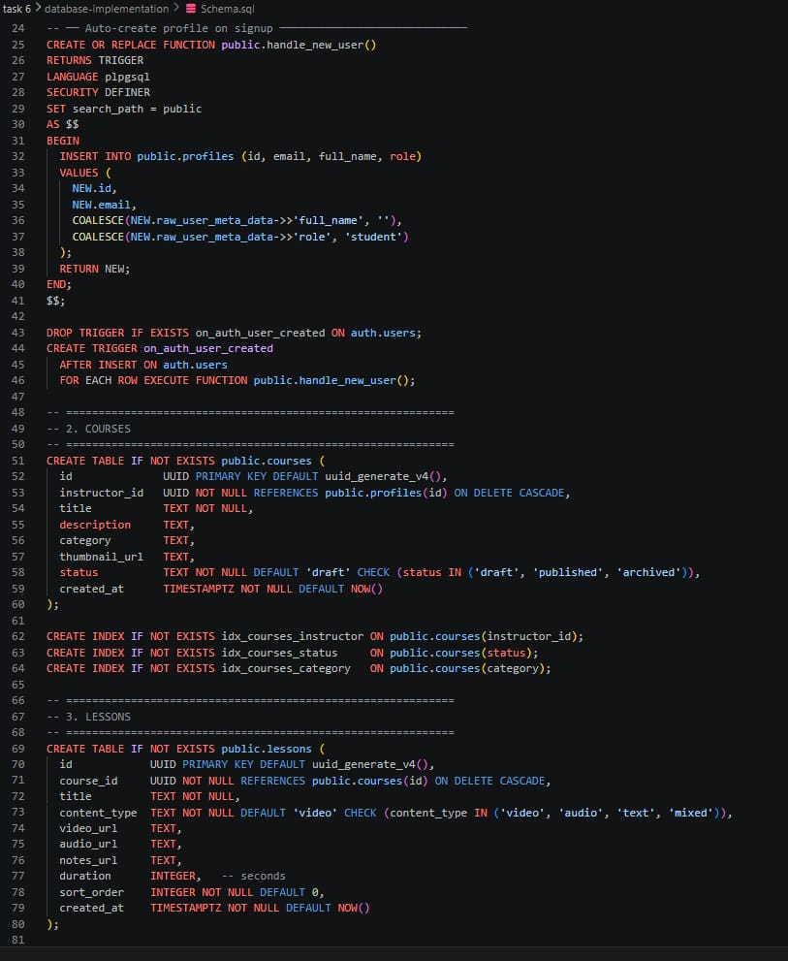

Slide 13




BUILDING A SUSTAINABLE MODEL
How EduStream Sustains and Scales
Institutional SaaS Licensing
Freemium for Educators
Tiered per-active-student pricing for universities - Starter, Growth, Enterprise - covering hosting, analytics and support.
Individual instructors and small schools use core delivery free; paid upgrade unlocks analytics, QoE reporting and admin tooling.
Digital-Inclusion Partnerships
Grants & Development Funding
Anonymized, aggregate network-quality insights licensed to ISPs, regulators and NGOs tracking connectivity and access gaps.
Alignment with World Bank, UNESCO and GPE digital-education inclusion funding streams and government EdTech subsidies.
Near term: land 3-5 partner faculties at University of Buea as a reference deployment, prove QoE-driven retention gains, then license to peer institutions across the region.
10

Slide 14
THANKS FOR YOUR KEEN ATTENTION!!!

