Slide 1
Sick Prior: ν=40, P(noPain)=0.2 Hiddenprior: ν=1, P(Pain|Pain)=0.8, P(NoPain|Pain)=0.2 Sensprior: ν=10, P(Noci|Pain)=0.5, P(Tickle|NoPain)=0.2

Slide 2
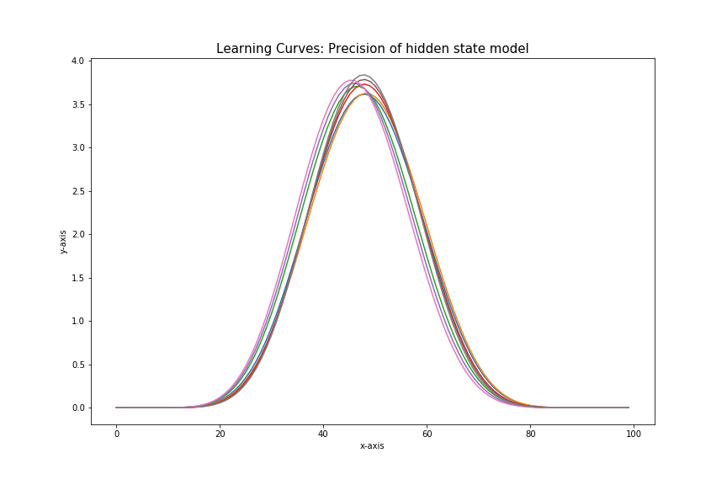
Prior: ν=40, P(noPain)=0.2
Hiddenprior: ν=1, P(Pain|Pain)=0.8, P(NoPain|Pain)=0.2
Sensprior: ν=10, P(Noci|Pain)=0.5, P(Tickle|NoPain)=0.2
Observations: 2x Noci, 2x tickle

Slide 3
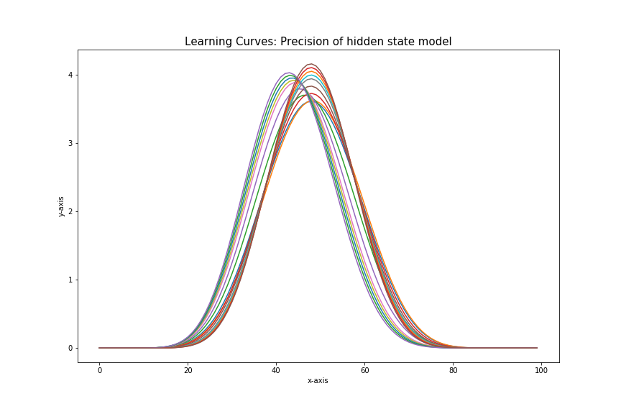
Prior: ν=40, P(noPain)=0.2
Hiddenprior: ν=1, P(Pain|Pain)=0.8, P(NoPain|Pain)=0.2
Sensprior: ν=10, P(Noci|Pain)=0.5, P(Tickle|NoPain)=0.2
Observations: 4x Noci, 4x tickle

Slide 4
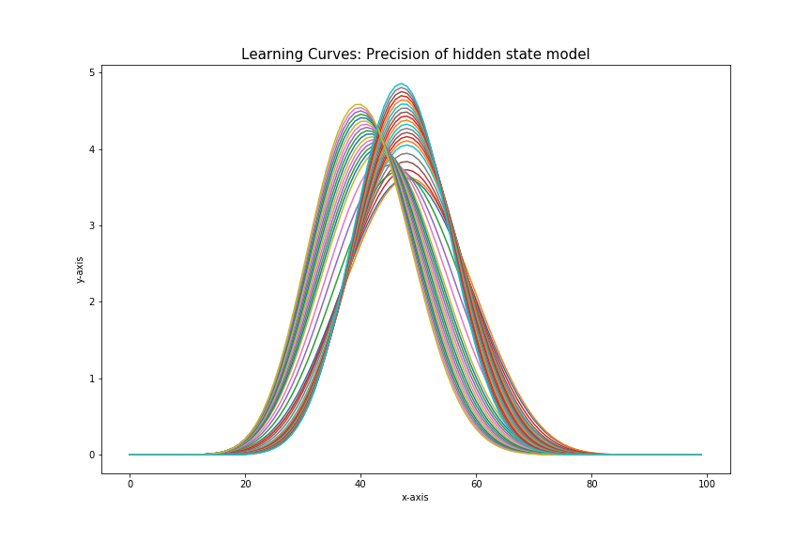
Prior: ν=40, P(noPain)=0.2
Hiddenprior: ν=1, P(Pain|Pain)=0.8, P(NoPain|Pain)=0.2
Sensprior: ν=10, P(Noci|Pain)=0.5, P(Tickle|NoPain)=0.2
Observations: 5x Noci, 15x tickle

Slide 5
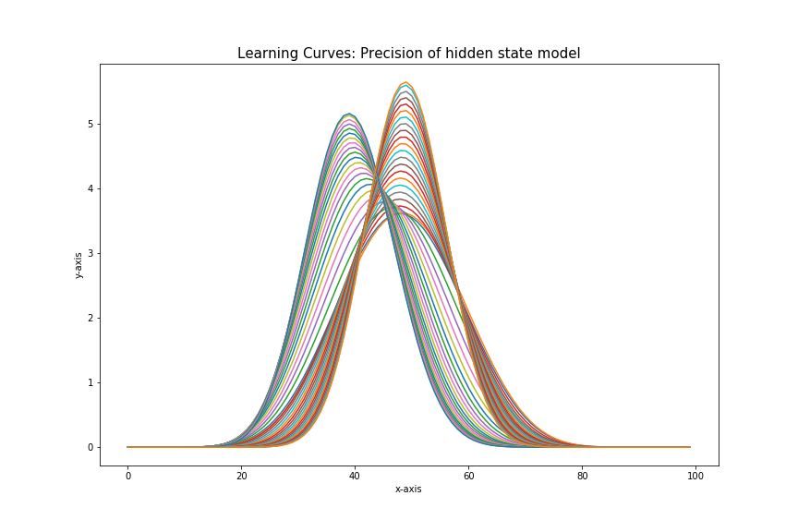
Prior: ν=40, P(noPain)=0.2
Hiddenprior: ν=1, P(Pain|Pain)=0.8, P(NoPain|Pain)=0.2
Sensprior: ν=10, P(Noci|Pain)=0.5, P(Tickle|NoPain)=0.2
Observations: 20x Noci, 1x tickle

Slide 6
Healthy Prior: ν=40, P(noPain)=0.8 Hiddenprior: ν=1, P(Pain|Pain)=0.4, P(NoPain|Pain)=0.1 Sensprior: ν=10, P(Noci|Pain)=0.9, P(Tickle|NoPain)=0.9

Slide 7
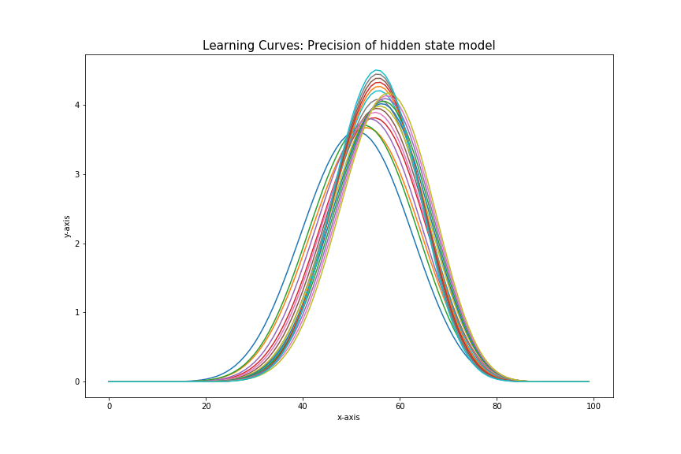
Prior: ν=40, P(noPain)=0.8 Hiddenprior: ν=1, P(Pain|Pain)=0.4, P(NoPain|Pain)=0.1 Sensprior: ν=10, P(Noci|Pain)=0.9, P(Tickle|NoPain)=0.9 Observations: 5x Noci 5 x tickle

Slide 8
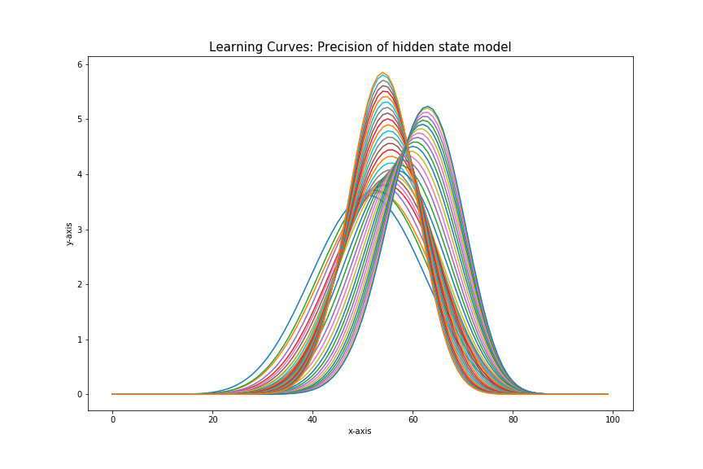
Prior: ν=40, P(noPain)=0.8 Hiddenprior: ν=1, P(Pain|Pain)=0.4, P(NoPain|Pain)=0.1 Sensprior: ν=10, P(Noci|Pain)=0.9, P(Tickle|NoPain)=0.9 Observations: 20x Noci 1x tickle

Slide 9
Precisely healthy Prior: ν=100, P(noPain)=0.8 Hiddenprior: ν=1, P(Pain|Pain)=0.4, P(NoPain|Pain)=0.1 Sensprior: ν=10, P(Noci|Pain)=0.9, P(Tickle|NoPain)=0.9

Slide 10

Prior: ν=100, P(noPain)=0.8 Hiddenprior: ν=1, P(Pain|Pain)=0.4, P(NoPain|Pain)=0.1 Sensprior: ν=10, P(Noci|Pain)=0.9, P(Tickle|NoPain)=0.9 Observations: 20x Noci 1x tickle

Slide 11
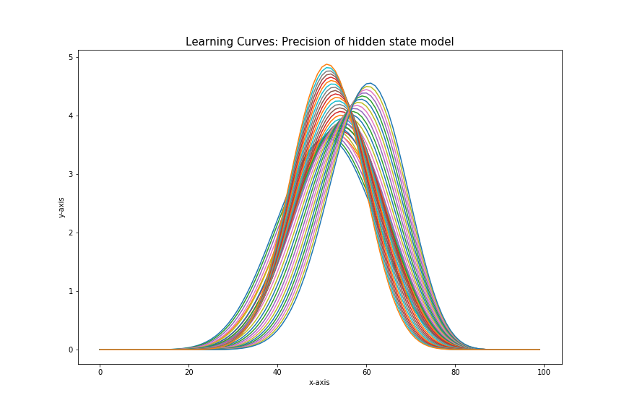
Prior: ν=100, P(noPain)=0.8 Hiddenprior: ν=1, P(Pain|Pain)=0.4, P(NoPain|Pain)=0.1 Sensprior: ν=10, P(Noci|Pain)=0.9, P(Tickle|NoPain)=0.9 Observations: 1x Noci 20x tickle

Slide 12
Precise sensing - healthy Prior: ν=40, P(noPain)=0.8 Hiddenprior: ν=1, P(Pain|Pain)=0.4, P(NoPain|Pain)=0.1 Sensprior: ν=100, P(Noci|Pain)=0.9, P(Tickle|NoPain)=0.9

Slide 13
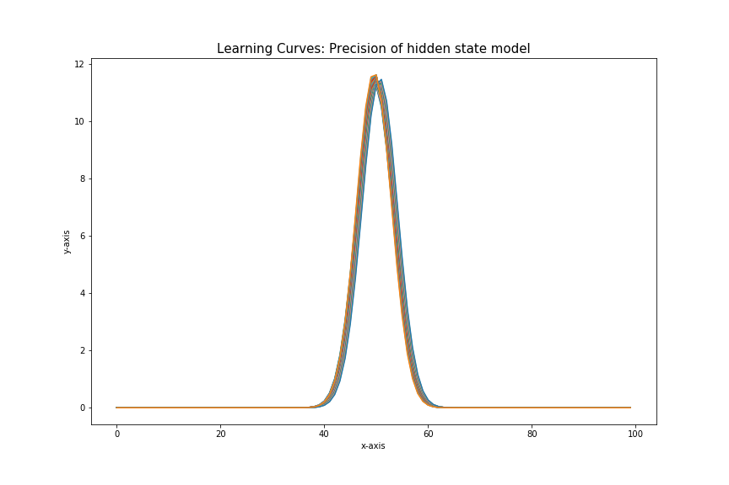
Prior: ν=40, P(noPain)=0.8 Hiddenprior: ν=1, P(Pain|Pain)=0.4, P(NoPain|Pain)=0.1 Sensprior: ν=100, P(Noci|Pain)=0.9, P(Tickle|NoPain)=0.9 Observations: 1x Noci 20x tickle

Slide 14
Imprecise Prior, sick precise sensing Prior: ν=1, P(noPain)=0.5 Hiddenprior: ν=1, P(Pain|Pain)=0.4, P(NoPain|Pain)=0.1 Sensprior: ν=100, P(Noci|Pain)=0.5, P(Tickle|NoPain)=0.2

Slide 15
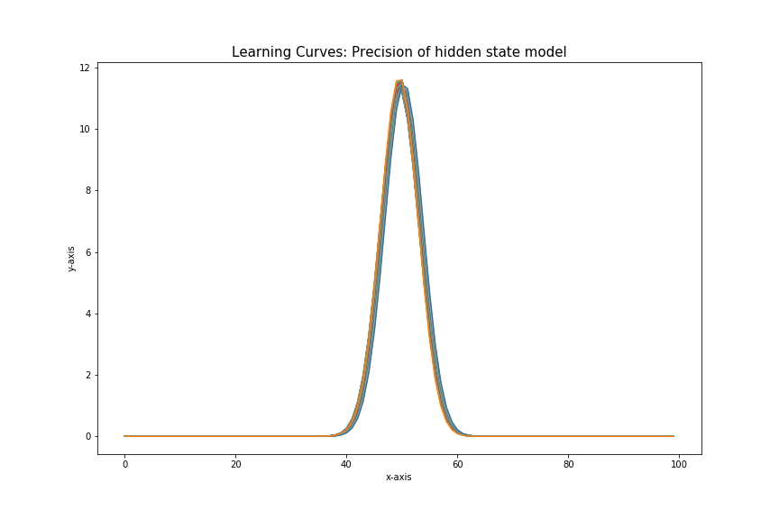
Prior: ν=1, P(noPain)=0.5 Hiddenprior: ν=1, P(Pain|Pain)=0.4, P(NoPain|Pain)=0.1 Sensprior: ν=100, P(Noci|Pain)=0.5, P(Tickle|NoPain)=0.2
Observations: 1xnoci 20xtickle

Slide 16
All imprecise Prior: ν=1, P(noPain)=0.5 Hiddenprior: ν=1, P(Pain|Pain)=0.4, P(NoPain|Pain)=0.1 Sensprior: ν=5, P(Noci|Pain)=0.5, P(Tickle|NoPain)=0.5

Slide 17
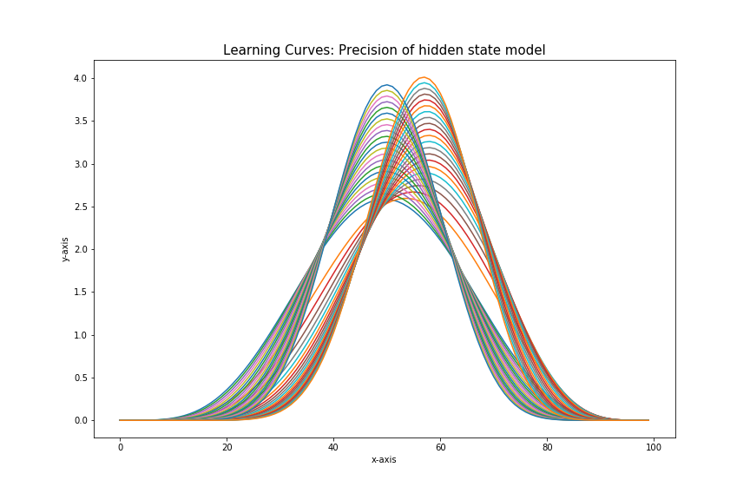
Prior: ν=1, P(noPain)=0.5 Hiddenprior: ν=1, P(Pain|Pain)=0.4, P(NoPain|Pain)=0.1 Sensprior: ν=5, P(Noci|Pain)=0.5, P(Tickle|NoPain)=0.5
Observations: 1x Noci, 20x tickle

