Slide 1
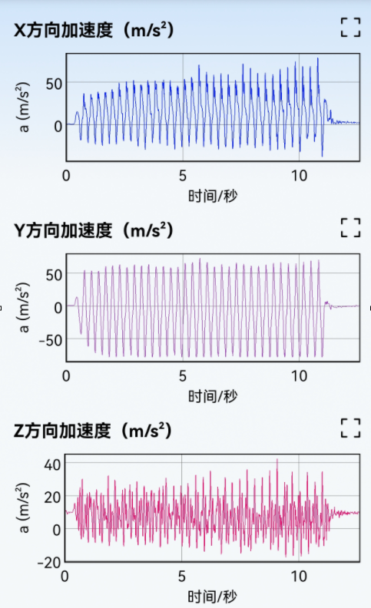
X-axis acceleration
Time: seconds
Y-axis acceleration
Time: seconds
Z-axis acceleration
Time: seconds

