Slide 1
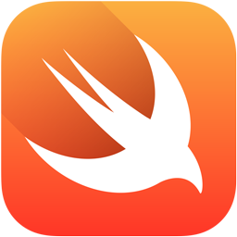
Intro to Mobile Development with Swift
Presented by Erik Andersen

Slide 2
Agenda
What is Swift?
Let’s make an app!
Where can I learn more?

Slide 3
How old is Swift and how is it being accepted by the community?
8
Swift in Android
April 2016
Google considers Swift to replace Java on Android
5
1.0 Release
September 2014
1
It begins…
June 2010
Chris Latner begins as the sole developer
3
6
Swift becomes a major focus at Apple
~ 2013
2.0 Release
September 2015
“Most Loved” language on StackOverflow
2010
2011
2012
2013
2014
2015
2016
2
4
7
Swift In the Cloud
November 2015
PerfectSoft releases server-side support for Swift
The team grows
~ 2011
A few other people began contributing
WWDC - Apple introduces Swift
June 2014
WWDC app first app written in Swift
“The Swift Programming Language” document released
9
WWDC 2016
June 2016
“Most Popular” open source language project
14th most popular language overall
11% of the top 100 apps use “some” Swift
Calculator is the only ”mostly Swift” app from Apple

Slide 4
Why did Apple create Swift?
Objective-C
NSString *text = @"Hello World”
CGRect frame = CGRectMake(0, 0, 50, 50);
UILabel *label = [[UILabel alloc] initWithFrame:frame];
label.text = text;
Proprietary data types
Memory Management
Bulky Syntax
Swift
let text = "Hello World”
let frame = CGRect(x: 0, y: 0, width: 50, height: 50)
let label = UILabel(frame: frame)
label.text = text
Standard data types
Named parameters
Unified constructors
Simplified Syntax
Xamarin (C#)
var text = "Hello World”;
var frame = new CGRect(0, 0, 50, 50);
var label = new UILabel(frame);
label.Text = text;
Notes:
Main reasons:
- Difficulty to learn created a barrier to entry
- Archaic memory management led to very buggy code
- As applications became more complex computationally, graphically, Objective-C was not keeping up

Slide 5
Agenda
What is Swift?
Let’s make an app!
Where can I learn more?

Slide 6
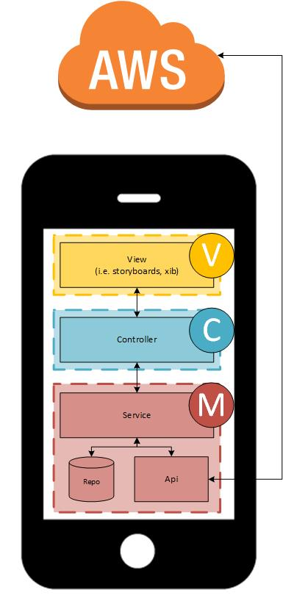
The Dallas internship is following the MVC pattern for architecting the app
1
Use Auto layout to
design our app
2
Create a controller for responding to events
5
Write a service for pulling it all together
4
Use Magical Record
to interact with Core
Data
3
Make asynchronous
requests with AlamoFire

Slide 7
Agenda
What is Swift?
Let’s make an app!
Where can I learn more?

Slide 8
This is really interesting! Where can I learn more?
Podcasts
Tutorials
“More Than Just Code”
Real-world developer focused
“Under the Radar”
Short and focused topics
“iOhYes”
Technically focused
“Release Notes”
Business-side of Mobile Development
“Core Intuition”
Indie software development
iTunes U - Stanford: Developing iOS 9 Apps with Swift (Paul Hagarty)
Ray Wenderlich

Slide 9

Questions

Slide 10
Appendix
2015 “Most Loved” Survey Results
https://stackoverflow.com/research/developer-survey-2015#tech-super2016
2016 “Most Loved” Survey Results
https://stackoverflow.com/research/developer-survey-2016#technology-most-loved-dreaded-and-wanted
Server-side Swift
http://perfect.org/
Swift for Android
http://thenextweb.com/dd/2016/04/07/google-facebook-uber-swift/
Swift is 14th most popular programming language
http://www.tiobe.com/tiobe_index/ (Java is #1)
** The ratings are based on the number of skilled engineers world-wide, courses and third party vendors **
Calculator app as the only Swift app
https://medium.com/ios-os-x-development/is-apple-using-swift-4a6c80f74599#.a3g33pc88
Stable ABI
http://9to5mac.com/2016/01/18/swift-is-quickly-rising-in-popularity-as-a-developer-language-but-how-much-is-apple-using-swift/
A big factor for the lack of update is that the Swift Application Binary Interface (ABI) is not locked down. Until this happens, a goal for Swift 3, it is practically impossible for Apple to make stable Swift frameworks without breaking application compatibility with every release.
Swift still not top ten programming languages on Github
https://github.com/blog/2047-language-trends-on-github
11% of the top apps use “some” Swift
https://medium.com/@ryanolsonk/are-the-top-apps-using-swift-42e880e7727f#.1n2foeisx
Swift, on average, is actually not that much faster than Objective-C
https://yalantis.com/blog/is-swift-faster-than-objective-c/

