Slide 1
COSC 1437.01
PROGRAMMING FUNDAMENTALS II
LECTURE 4. SEARCHING

Slide 2

The Problem
Lecture 4-1 Searching is an everyday occurrence

Slide 3
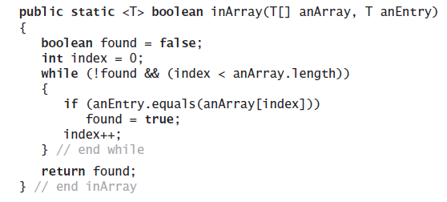
Iterative Sequential Search of an Unsorted Array
Using a loop to search for a specific valued entry.

Slide 4
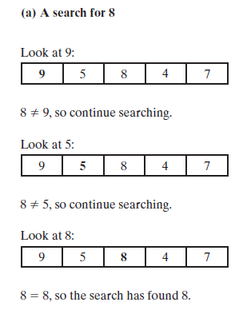
Iterative Sequential Search of an Unsorted Array
Lecture 4-2 An iterative sequential search of an array that
(a) finds its target

Slide 5
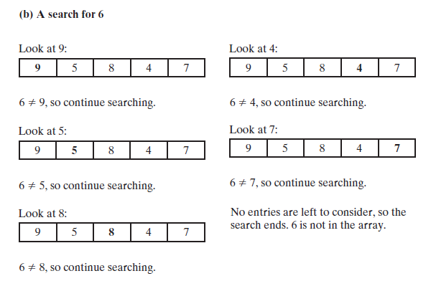
Iterative Sequential Search of an Unsorted Array
Lecture 4-2 An iterative sequential search of an array that
(b) does not find its target

Slide 6
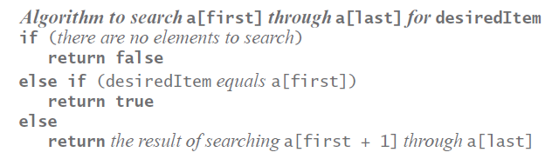
Recursive Sequential Search of an Unsorted Array
Pseudocode of the logic of our recursive algorithm.

Slide 7
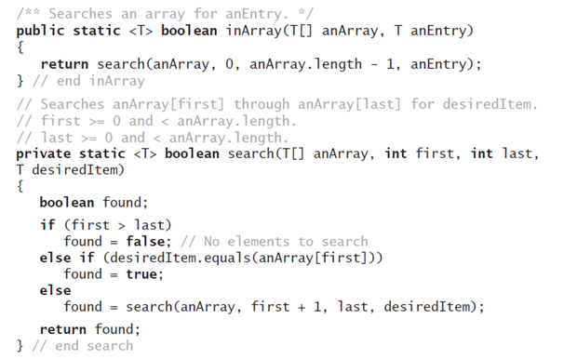
Recursive Sequential Search of an Unsorted Array
Method that implements this algorithm will
need parameters first and last.

Slide 8
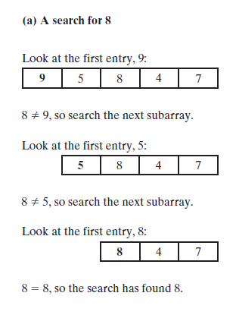
Recursive Sequential Search of an Unsorted Array
Lecture 4-3 A recursive sequential search of an array that (a) finds its target;

Slide 9
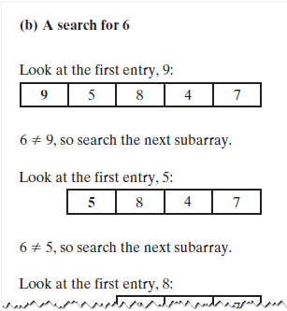
Recursive Sequential Search of an Unsorted Array
Lecture 4-3 A recursive sequential search of an array that (b) does not find its target

Slide 10
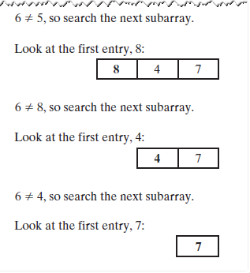
Recursive Sequential Search of an Unsorted Array
Lecture 4-3 A recursive sequential search of an array that (b) does not find its target

Slide 11
Efficiency of a Sequential
Search of an Array
The time efficiency of a sequential search of an array.
Best case O(1)
Worst case: O(n)
Average case: O(n)

Slide 12

Sequential Search of a Sorted Array
Lecture 4-4 Coins sorted by their mint dates
Note: sequential search can be
more efficient if the data is sorted

Slide 13

Binary Search of a Sorted Array
Lecture 4-5 Ignoring one half of the data
when the data is sorted

Slide 14
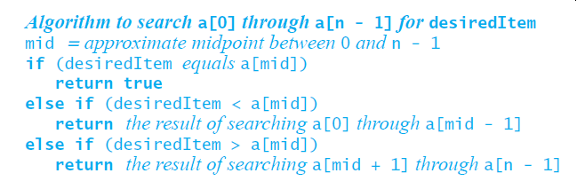
Binary Search of a Sorted Array
First draft of an algorithm for a binary search of an array

Slide 15
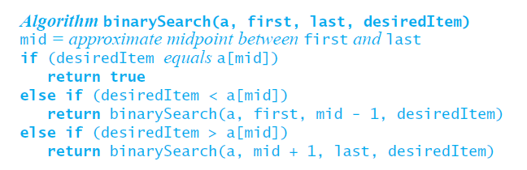
Binary Search of a Sorted Array
Use parameters and make recursive calls look
more like Java

Slide 16
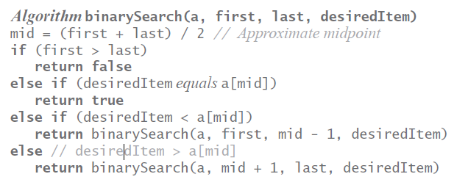
Binary Search of a Sorted Array
Refine the logic a bit, get a more complete algorithm

Slide 17
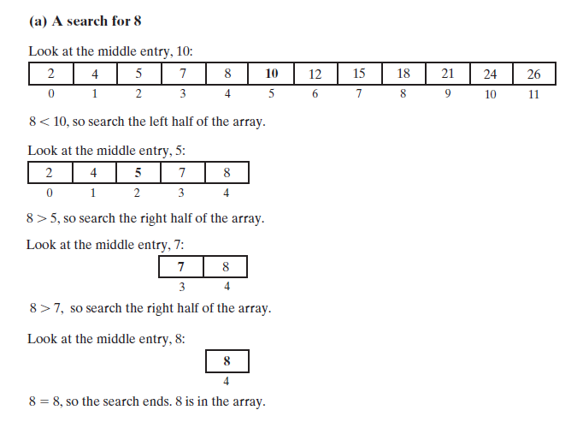
Binary Search of a Sorted Array
FIGURE 18-6 A recursive binary search of a sorted array that (a) finds its target;

Slide 18
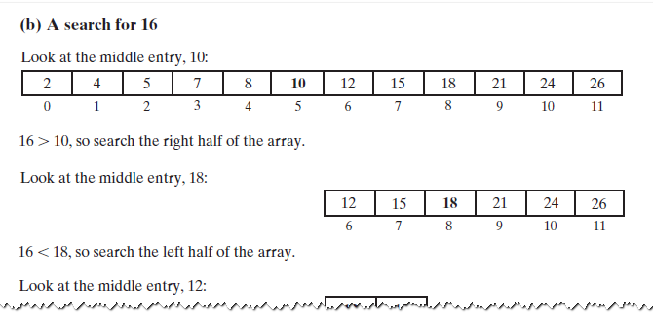
Binary Search of a Sorted Array
Lecture 4 -6 A recursive binary search of a sorted array that (b) does not find its target

Slide 19
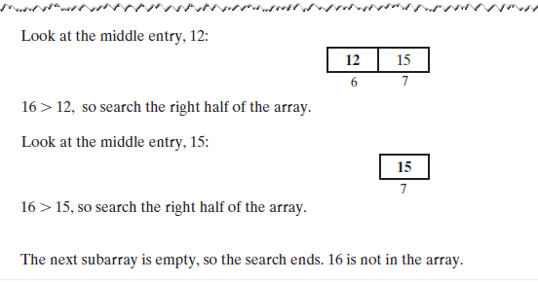
Binary Search of a Sorted Array
Lecture 18-6 A recursive binary search of a sorted array that (b) does not find its target

Slide 20
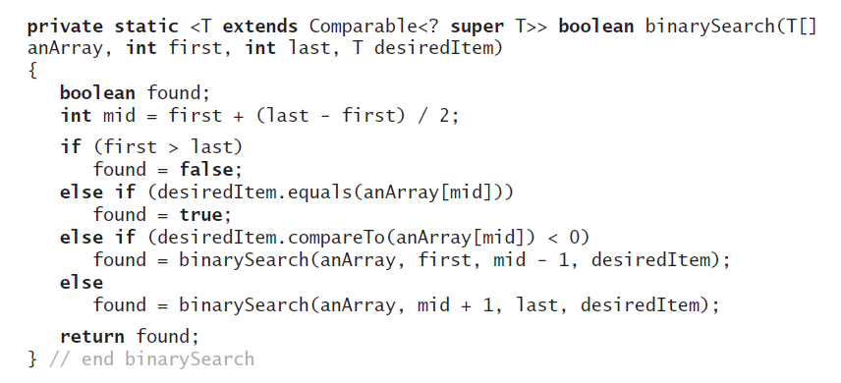
Binary Search of a Sorted Array
Implementation of the method binarySearch

Slide 21
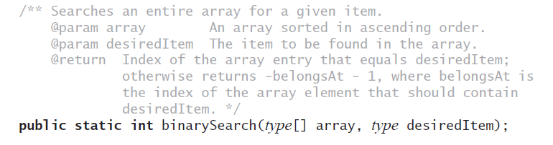
Java Class Library:
The Method binarySearch
Static method binarySearch
with the above specification:

Slide 22
Efficiency of a Binary
Search of an Array
The time efficiency of a binary search of an array
  Best case: O(1)
  Worst case: O(log n)
  Average case: O(log n)

Slide 23
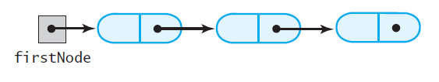
Iterative Sequential Search of an Unsorted Chain
Lecture 4-7 A chain of linked nodes that
contain the entries in a list

Slide 24
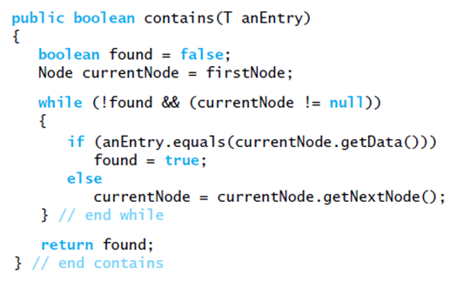
Iterative Sequential Search of an Unsorted Chain
Implementation of iterative search

Slide 25
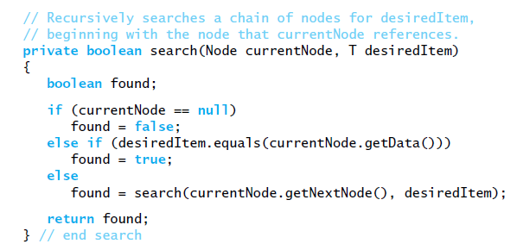
Recursive Sequential Search of an Unsorted Chain
Implementation of the method search

Slide 26
Efficiency of a Sequential
Search of a Chain
The time efficiency of a sequential search of a chain of linked nodes
  Best case: O(1)
  Worst case: O(n)
  Average case: O(n)

Slide 27
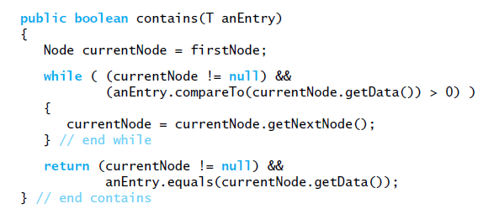
Searching a Sorted Chain
Similar to sequentially searching a sorted array.
Implementation of contains.

Slide 28
Binary Search of a Sorted Chain
To find the middle of the chain you must traverse the whole chain
Then must traverse one of the halves to find the middle of that half
Conclusion
  Hard to implement
  Less efficient than sequential search

Slide 29
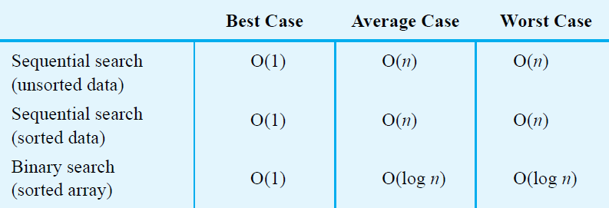
Choosing between Sequential Search and Binary Search
Lecture 4-8 The time efficiency of searching,
expressed in Big Oh notation

Slide 30
Choosing between Iterative
Search and Recursive Search
Can save some time and space by using iterative version of a search
Using recursion will not require much additional space for the recursive calls
Coding binary search recursively is somewhat easier

