Slide 1
COSC 1437.01
PROGRAMMING FUNDAMENTALS II
LECTURE 5. LISTS

Slide 2
Lists
A way to organize data
Examples
  To-do list
  Gift lists
  Grocery Lists
Items in list have position
  May or may not be important
Items may be added anywhere

Slide 3
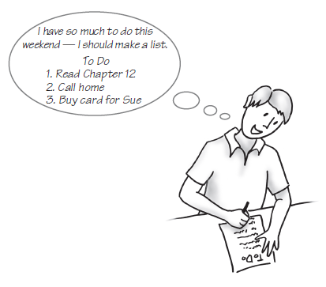
Lists
FIGURE 12-1 A to-do list

Slide 4
Specifications for the ADT List
add (newEntry)
add (newPosition,
newEntry)
remove(givenPosition)
clear()
replace(
givenPosition,
newEntry)
getEntry(
givenPosition)
toArray()
contains(anEntry)
getLength()
isEmpty()

Slide 5
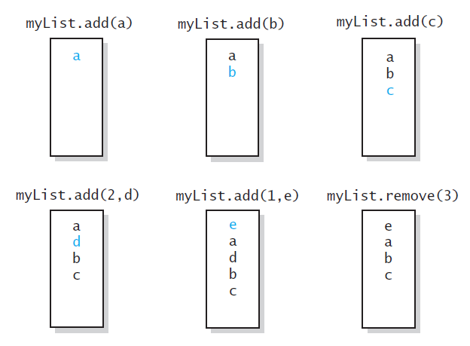
Specifications for the ADT List
FIGURE 12-2 The effect of ADT list operations
on an initially empty list

Slide 6
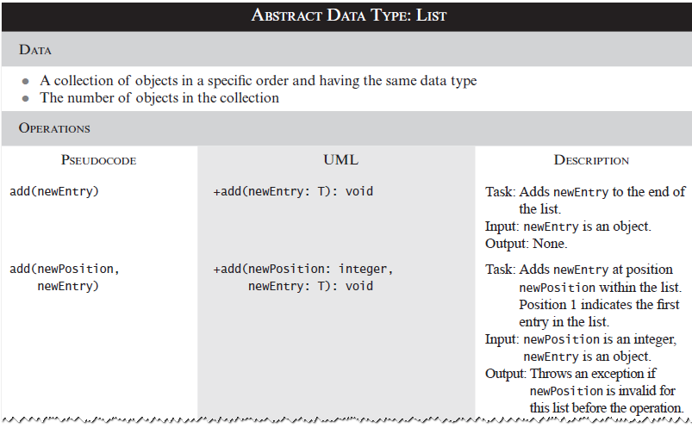
Specifications for the ADT List
Description of ADT List

Slide 7
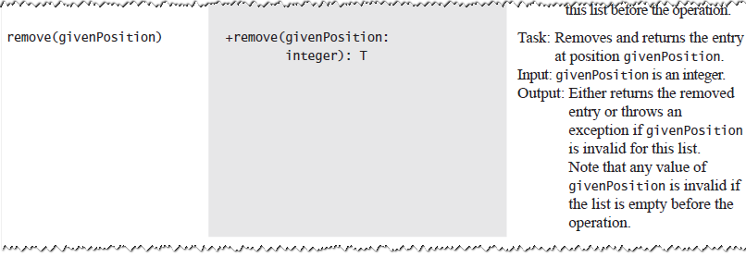
Specifications for the ADT List
Description of ADT List

Slide 8
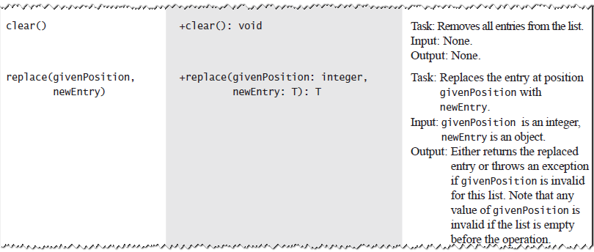
Specifications for the ADT List
Description of ADT List

Slide 9
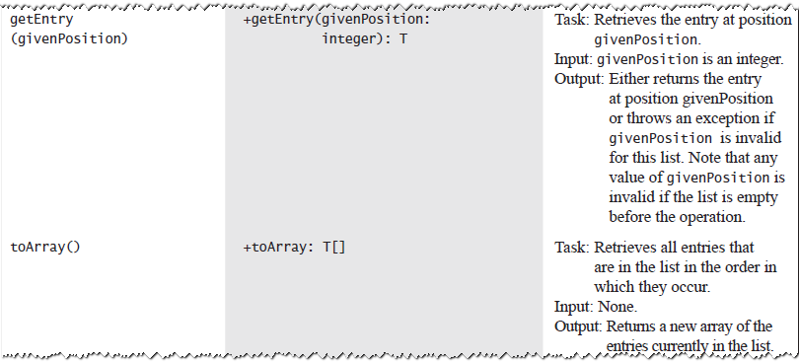
Specifications for the ADT List
Description of ADT List

Slide 10
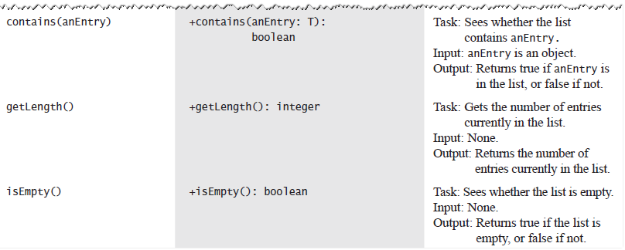
Specifications for the ADT List
Description of ADT List

Slide 11
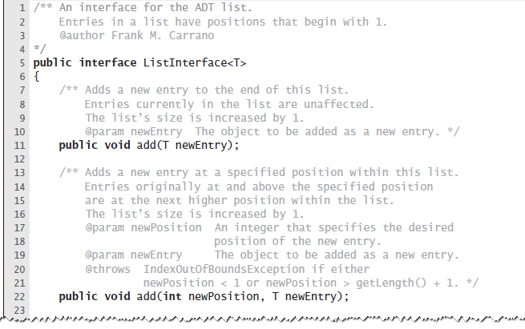
Specifications for the ADT List
LISTING 12-1 The interface ListInterface

Slide 12
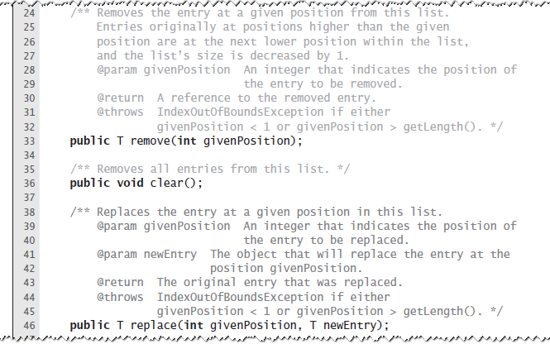
Specifications for the ADT List
LISTING 12-1 The interface ListInterface

Slide 13
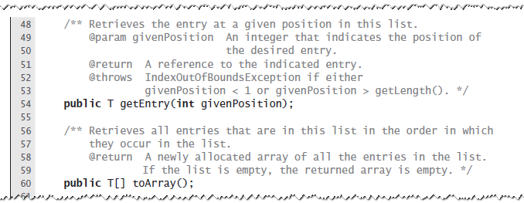
Specifications for the ADT List
LISTING 12-1 The interface ListInterface

Slide 14
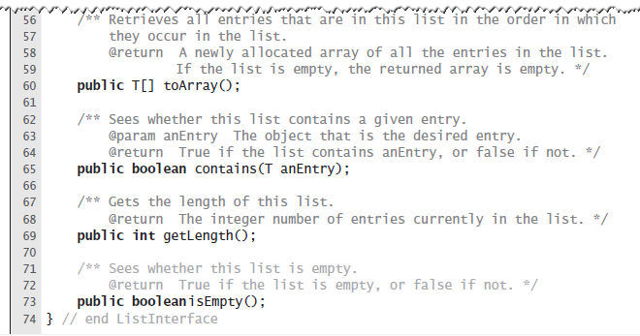
Specifications for the ADT List
LISTING 12-1 The interface ListInterface

Slide 15
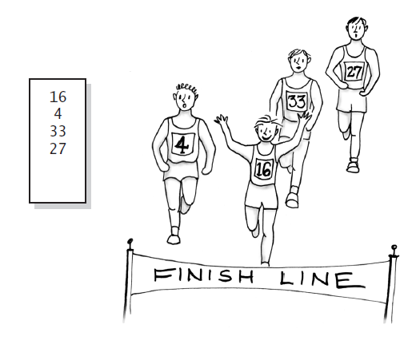
Using the ADT List
FIGURE 12-3 A list of numbers that identify runners in the order in which they finished a race

Slide 16
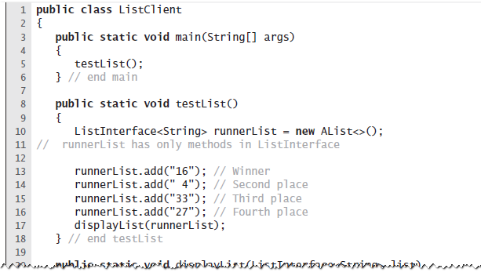
Using the ADT List
LISTING 12-2 A client of a class
that implements ListInterface

Slide 17
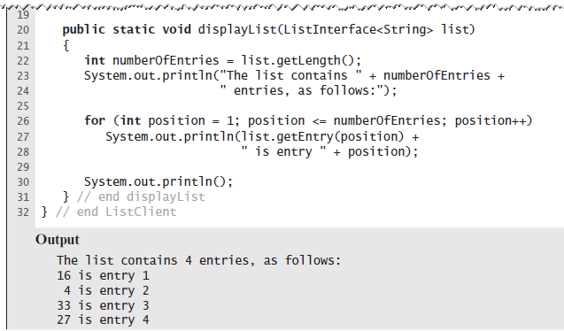
Using the ADT List
LISTING 12-2 A client of a class
that implements ListInterface

Slide 18
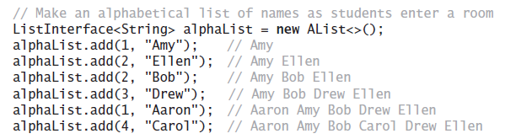
Using the ADT List
Example

Slide 19
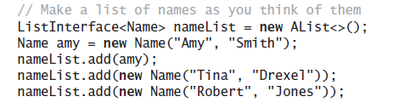
Using the ADT List
A list of Name objects, rather than String

Slide 20
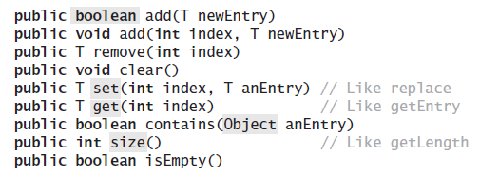
Java Class Library:
The Interface List
Method headers from the interface List

Slide 21
Java Class Library:
The Class ArrayList
Available constructors
  public ArrayList()
  public ArrayList(int
  initialCapacity)
Similar to java.util.vector
  Can use either ArrayList or Vector as an implementation of the interface List.

