Slide 1
COSC 1437.01
PROGRAMMING FUNDAMENTALS II
LECTURE 8. INTRODUCTION TO SORTING
1-<number>

Slide 2
Sorting
We seek algorithms to arrange items, a_{i}
such that
entry 1 ≤ entry 2 ≤ . . . ≤ entry n
Sorting an array is usually easier than sorting a chain of linked nodes
Efficiency of a sorting algorithm is significant

Slide 3
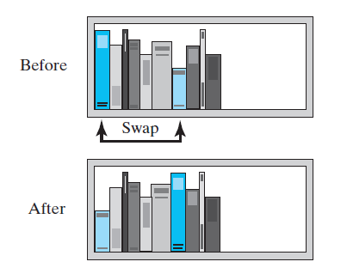
Selection Sort
FIGURE 8-1 Before and after exchanging
the shortest book and the first book

Slide 4
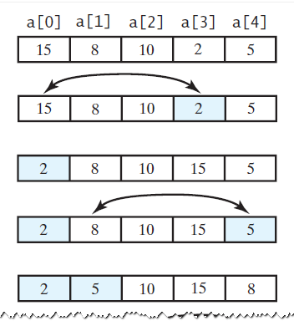
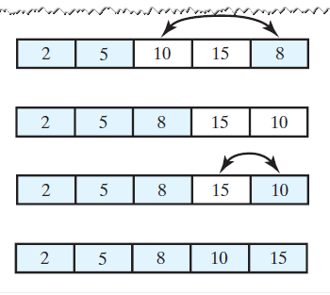
Selection Sort
FIGURE 8-2 A selection sort of an array of integers into ascending order

Slide 5
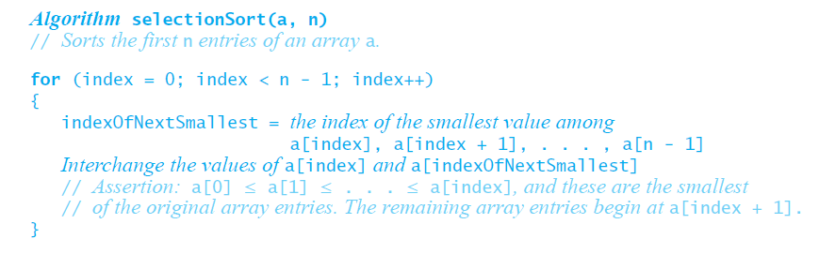
Iterative Selection Sort
This pseudocode describes an
iterative algorithm for the selection sort

Slide 6
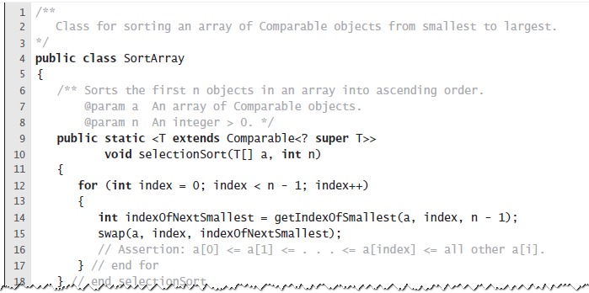
Iterative Selection Sort
LISTING 8-1 A class for sorting an array using selection sort

Slide 7
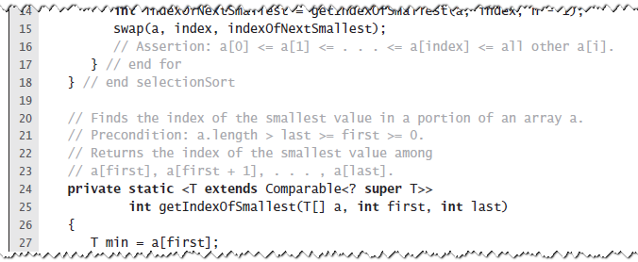
Iterative Selection Sort
LISTING 8-1 A class for sorting an array using selection sort

Slide 8
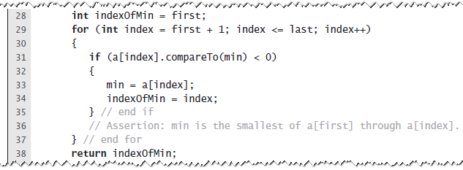
Iterative Selection Sort
LISTING 8-1 A class for sorting an array using selection sort

Slide 9
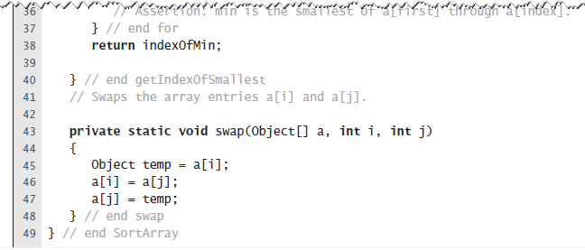
Iterative Selection Sort
LISTING 8-1 A class for sorting an array using selection sort

Slide 10
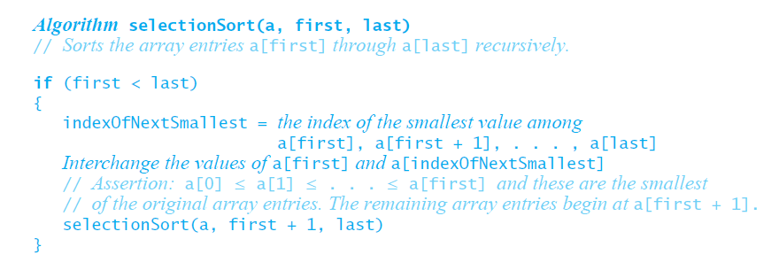
Recursive Selection Sort
?
Recursive selection sort algorithm

Slide 11
Efficiency of Selection Sort
Selection sort is O(n²) regardless of the initial order of the entries.
  Requires O(n²) comparisons
  Does only O(n) swaps

Slide 12
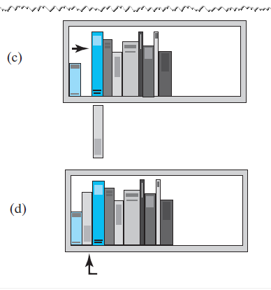
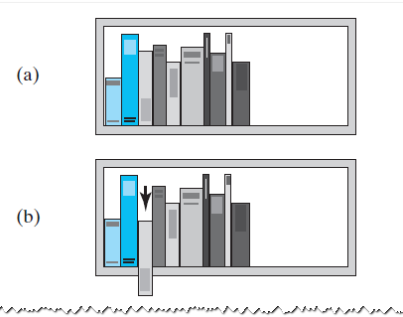
Insertion Sort
FIGURE 8-3 The placement of the
third book during an insertion sort

Slide 13
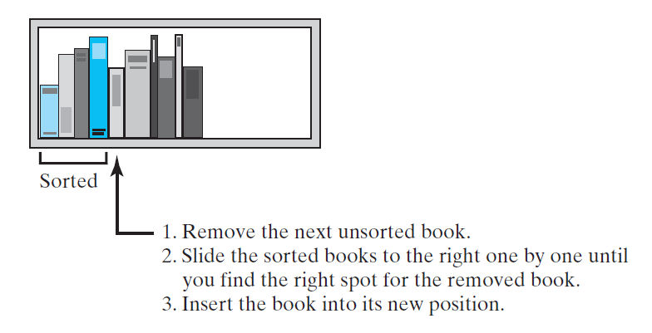
Insertion Sort
FIGURE 8-4 An insertion sort of books

Slide 14
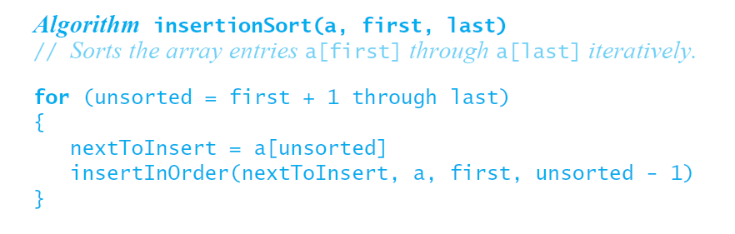
Iterative Insertion Sort
Iterative algorithm describes an insertion sort of the entries at indices first through last of the array a

Slide 15
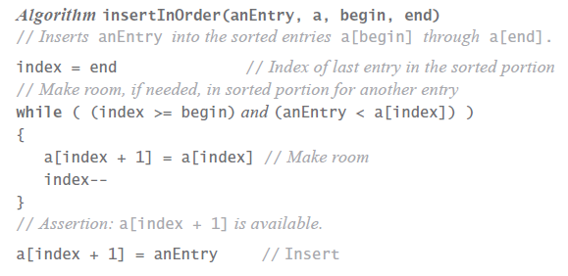
Iterative Insertion Sort
?
?
Pseudocode of method, insertInOrder,
to perform the insertions.

Slide 16
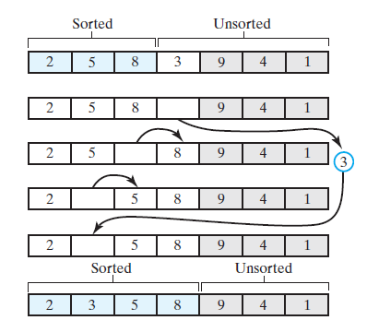
Iterative Insertion Sort
FIGURE 8-5 Inserting the next unsorted entry into its proper location within the sorted portion of an array during an insertion sort

Slide 17
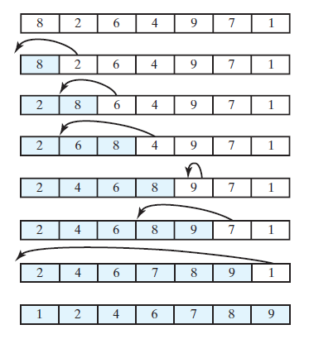
Iterative Insertion Sort
FIGURE 8-6 An insertion sort of an array
of integers into ascending order

Slide 18
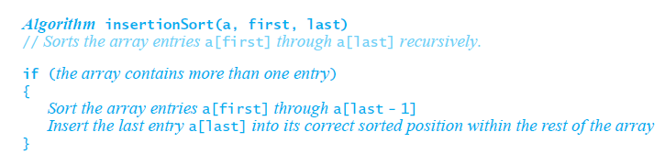
Recursive Insertion Sort
This pseudocode describes a recursive insertion sort.

Slide 19
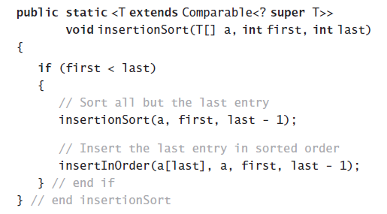
Recursive Insertion Sort
?
?
Implementing the algorithm in Java

Slide 20
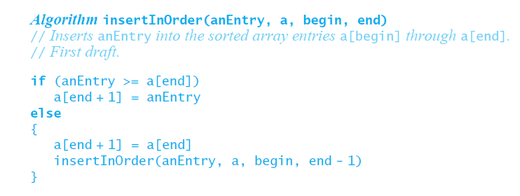
Recursive Insertion Sort
?
?
?
First draft of insertInOrder algorithm.

Slide 21
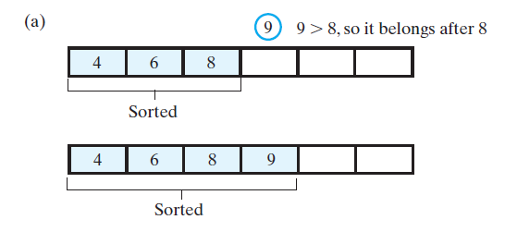
Recursive Insertion Sort
FIGURE 8-8 Inserting the first unsorted entry into the sorted portion of the array. (a) The entry is greater than or equal to the last sorted entry

Slide 22
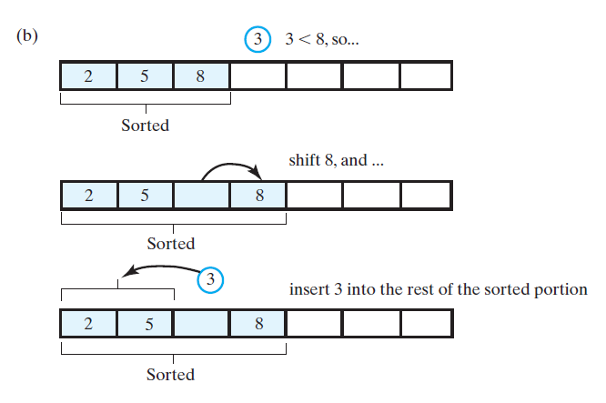
Recursive Insertion Sort
FIGURE 8-8 Inserting the first unsorted entry into the sorted portion of the array. (b) the entry is smaller than the last sorted entry

Slide 23
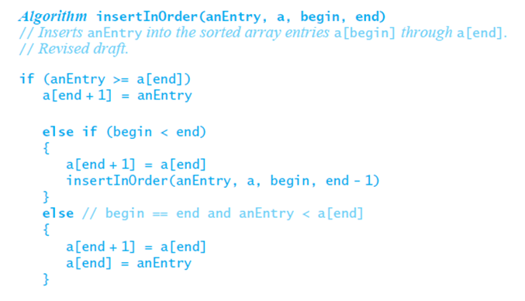
Recursive Insertion Sort
?
?
The algorithm insertInOrder: final draft.
Note: insertion sort efficiency (worst case) is O(n²)

Slide 24
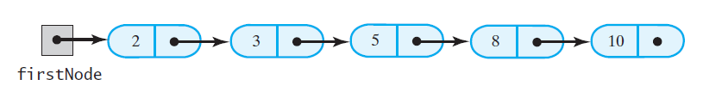
Insertion Sort of a
Chain of Linked Nodes
FIGURE 8-8 A chain of integers sorted into ascending order

Slide 25
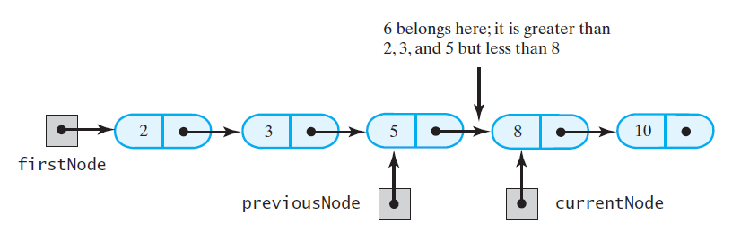
Insertion Sort of a
Chain of Linked Nodes
FIGURE 8-9 During the traversal of a chain to locate the insertion point, save a reference to the node before the current one

Slide 26
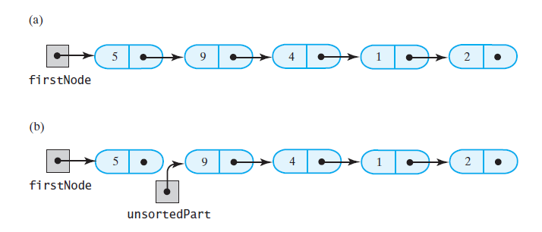
Insertion Sort of a
Chain of Linked Nodes
FIGURE 8-10 Breaking a chain of nodes into two pieces as the first step in an insertion sort: (a) the original chain;
(b) the two pieces

Slide 27
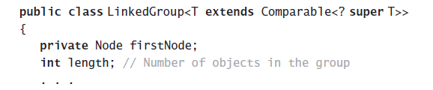
Insertion Sort of a
Chain of Linked Nodes
Add a sort method to a class LinkedGroup
that uses a linked chain to represent a certain collection

Slide 28
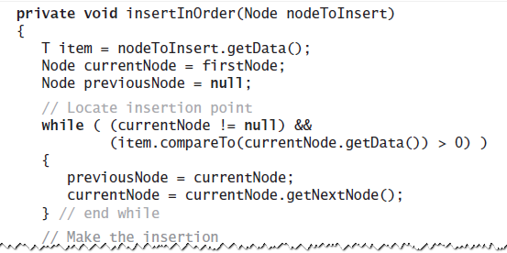
Insertion Sort of a
Chain of Linked Nodes
?
?
This class has an inner class Node that
has set and get methods

Slide 29
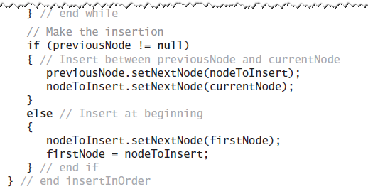
Insertion Sort of a
Chain of Linked Nodes
?
?
?
?
This class has an inner class Node that
has set and get methods

Slide 30
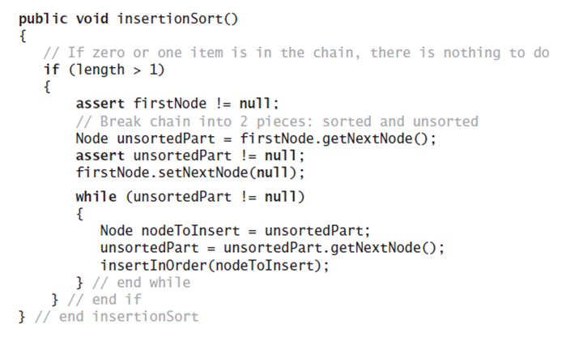
Insertion Sort of a
Chain of Linked Nodes
?
?
The method to perform the insertion sort.

Slide 31
Shell Sort
Algorithms seen so far are simple but inefficient for large arrays at O(n²)
Note, the more sorted an array is, the less work insertInOrder must do
Improved insertion sort developed by Donald Shell

Slide 32
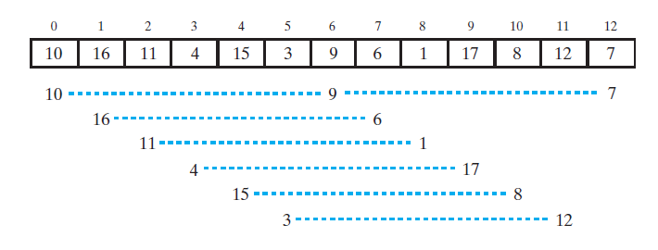
Shell Sort
FIGURE 8-11 An array and the subarrays formed by grouping entries whose indices are 6 apart.

Slide 33
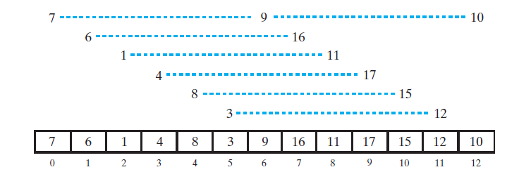
Shell Sort
FIGURE 8-12 The subarrays of Figure 8-11 after each is sorted, and the array that contains them

Slide 34
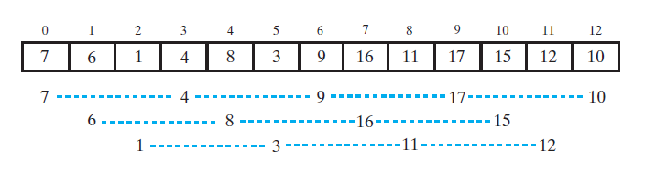
Shell Sort
FIGURE 8-13 The subarrays of the array in Figure 8-12 formed by grouping entries whose indices are 3 apart

Slide 35
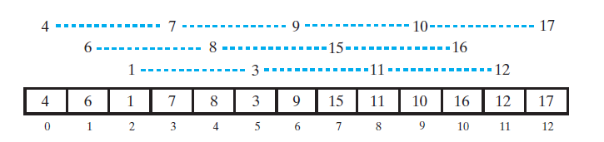
Shell Sort
FIGURE 8-14 The subarrays of Figure 8-13 after each is sorted, and the array that contains them

Slide 36
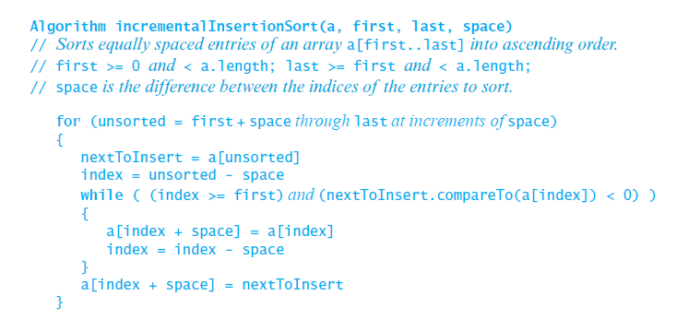
Shell Sort
?
Algorithm that sorts array entries whose indices are separated by an increment of space.

Slide 37
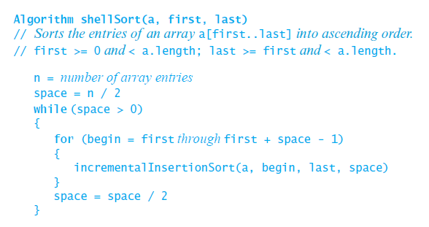
Shell Sort
Algorithm to perform a Shell sort will invoke incrementalInsertionSort and supply any sequence of spacing factors. Efficiency (worst) can be O(n^{1.5})

Slide 38
Analysis of Shell Sort
Intuition:
  Reduces work by moving elements farther earlier
Its general analysis is an open research problem
Performance depends on sequence of gap values
For sequence 2^{k}, performance is O(n²)
Hibbard’s sequence (2^{k}-1), performance is O(n^{3/2})
We start with n/2 and repeatedly divide by 2.2
  Empirical results show this is O(n^{5/4}) or O(n^{7/6})
  No theoretical basis (proof) that this holds

Slide 39
Shell Sort Algorithm
Set gap to n/2
while gap > 0
for each element from gap to end, by gap
Insert element in its gap-separated sub-array
if gap is 2, set it to 1
otherwise set it to gap / 2.2

Slide 40
Shell Sort Algorithm: Inner Loop
3.1 set nextPos to position of element to insert
3.2 set nextVal to value of that element
3.3 while nextPos > gap and
element at nextPos-gap is > nextVal
3.4 Shift element at nextPos-gap to nextPos
3.5 Decrement nextPos by gap
3.6 Insert nextVal at nextPos

Slide 41
Shell Sort Code
public static <T extends <Comparable<T>>
void sort (T[] a) {
int gap = a.length / 2;
while (gap > 0) {
for (int nextPos = gap;
nextPos < a.length; nextPos++)
insert(a, nextPos, gap);
if (gap == 2)
gap = 1;
else
gap = (int)(gap / 2.2);
}
}

Slide 42
Shell Sort Code (2)
private static <T extends Comparable<T>>
void insert(T[] a, int NextPos, int gap){
T val = a[nextPos];
while ((nextPos >= gap) &&
(val.compareTo(a[nextPos-gap])<0)){
a[nextPos] = a[nextPos-gap];
nextPos -= gap;
}
a[nextPos] = val;
}

Slide 43
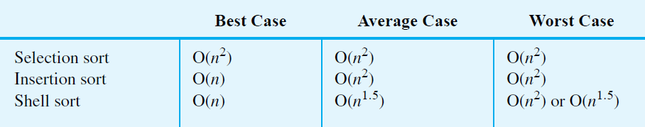
Comparing the Algorithms
FIGURE 8-16 The time efficiencies of three sorting algorithms, expressed in Big Oh notation

Slide 44
Bubble Sort
Compares adjacent array elements
  Exchanges their values if they are out of order
Smaller values bubble up to the top of the array
  Larger values sink to the bottom

Slide 45
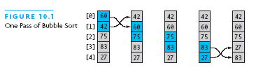
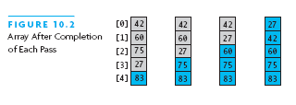
Bubble Sort Example

Slide 46
Bubble Sort Algorithm
do
for each pair of adjacent array elements
if values are out of order
Exchange the values
while the array is not sorted

Slide 47
Bubble Sort Algorithm, Refined
do
Initialize exchanges to false
for each pair of adjacent array elements
if values are out of order
Exchange the values
Set exchanges to true
while exchanges

Slide 48
Analysis of Bubble Sort
Excellent performance in some cases
  But very poor performance in others!
Works best when array is nearly sorted to begin with
Worst case number of comparisons: O(n²)
Worst case number of exchanges: O(n²)
Best case occurs when the array is already sorted:
  O(n) comparisons
  O(1) exchanges (none actually)

Slide 49
Bubble Sort Code
int pass = 1;
boolean exchanges;
do {
exchanges = false;
for(int i=0; i<a.length-pass; i++)
if (a[i].compareTo(a[i+1]) > 0) {
T tmp = a[i];
a[i] = a[i+1];
a[i+1] = tmp;
exchanges = true;
}
pass++;
} while (exchanges);

Slide 50




Shell Sort: The Varying Gap
Before and after sorting with gap = 7
Before and after sorting with gap = 3

Slide 51
Merge Sort
A merge is a common data processing operation:
  Performed on two sequences of data
    Items in both sequences use same compareTo
    Both sequences in ordered of this compareTo
Goal: Combine the two sorted sequences in one larger sorted sequence
Merge sort merges longer and longer sequences

Slide 52
Merge Algorithm (Two Sequences)
Merging two sequences:
  Access the first item from both sequences
  While neither sequence is finished
    Compare the current items of both
    Copy smaller current item to the output
    Access next item from that input sequence
  Copy any remaining from first sequence to output
  Copy any remaining from second to output

Slide 53
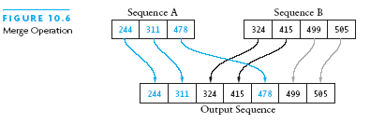
Picture of Merge

Slide 54
Analysis of Merge
Two input sequences, total length n elements
  Must move each element to the output
  Merge time is O(n)
Must store both input and output sequences
  An array cannot be merged in place
  Additional space needed: O(n)

Slide 55
Merge Sort Algorithm
Overview:
Split array into two halves
Sort the left half (recursively)
Sort the right half (recursively)
Merge the two sorted halves

Slide 56
Merge Sort Algorithm (2)
Detailed algorithm:
if tSize ≤ 1, return (no sorting required)
set hSize to tSize / 2
Allocate LTab of size hSize
Allocate RTab of size tSize – hSize
Copy elements 0 .. hSize – 1 to LTab
Copy elements hSize .. tSize – 1 to RTab
Sort LTab recursively
Sort RTab recursively
Merge LTab and RTab into a

Slide 57
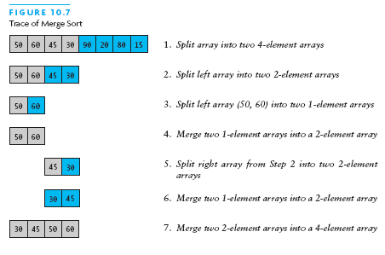
Merge Sort Example

Slide 58
Merge Sort Analysis
Splitting/copying n elements to subarrays: O(n)
Merging back into original array: O(n)
Recursive calls: 2, each of size n/2
  Their total non-recursive work: O(n)
Next level: 4 calls, each of size n/4
  Non-recursive work again O(n)
Size sequence: n, n/2, n/4, ..., 1
  Number of levels = log n
  Total work: O(n log n)

Slide 59
Merge Sort Code
public static <T extends Comparable<T>>
void sort (T[] a) {
if (a.length <= 1) return;
int hSize = a.length / 2;
T[] lTab = (T[])new Comparable[hSize];
T[] rTab =
(T[])new Comparable[a.length-hSize];
System.arraycopy(a, 0, lTab, 0, hSize);
System.arraycopy(a, hSize, rTab, 0,
a.length-hSize);
sort(lTab); sort(rTab);
merge(a, lTab, rTab);
}
arraycopy(Object src, int srcPos, Object dest, int destPos, int length)
src -- This is the source array.
srcPos -- This is the starting position in the source array.
dest -- This is the destination array.
destPos -- This is the starting position in the destination data.
length -- This is the number of array elements to be copied.

Slide 60
Merge Sort Code (2)
private static <T extends Comparable<T>>
void merge (T[] a, T[] l, T[] r) {
int i = 0; // indexes l
int j = 0; // indexes r
int k = 0; // indexes a
while (i < l.length && j < r.length)
if (l[i].compareTo(r[j]) < 0)
a[k++] = l[i++];
else
a[k++] = r[j++];
while (i < l.length) a[k++] = l[i++];
while (j < r.length) a[k++] = r[j++];
}

Slide 61
Heapsort
Merge sort time is O(n log n)
  But requires (temporarily) n extra storage items
Heapsort
  Works in place: no additional storage
  Offers same O(n log n) performance
Idea (not quite in-place):
  Insert each element into a priority queue
  Repeatedly remove from priority queue to array
    Array slots go from 0 to n-1

Slide 62
A Data Structure Heap
A heap is an array object that can be viewed as a nearly complete binary tree.
1
6
2
3
5
3
6
5
3
2
4
1
4
5
6
2
4
1

Slide 63
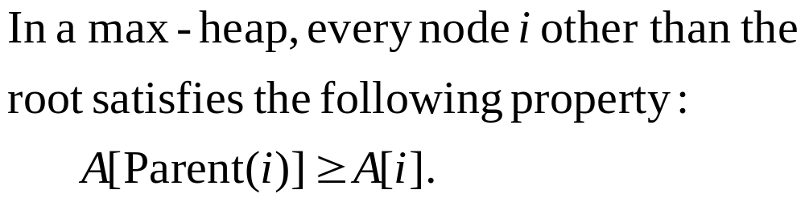
Max-Heap

Slide 64
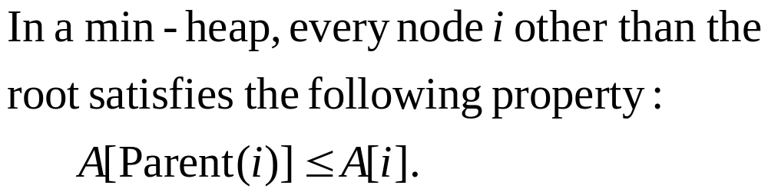
Min-Heap

Slide 65
Max-Heapify
Max-Heapify(A,i) is a subroutine.
When it is called, two subtrees rooted at Left(i) and Right(i) are max-heaps, but A[i] may not satisfy the max-heap property.
Max-Heapify(A,i) makes the subtree rooted at A[i] become a max-heap by letting A[i] “float down”.

Slide 66
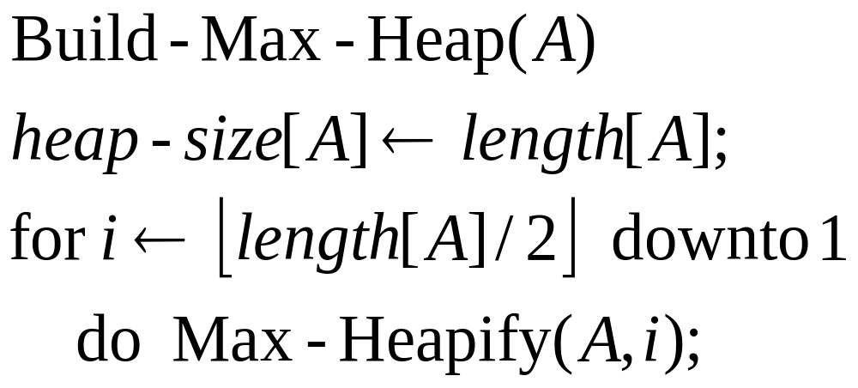
Building a Max-Heap
e.g., 4, 1, 3, 2, 16, 9, 10, 14, 8, 7.

Slide 67
4
1
3
2
16
9
10
14
8
7

Slide 68
4
1
3
2
16
9
10
14
8
7

Slide 69
4
1
3
16
9
10
14
2
8
7

Slide 70
4
1
3
14
16
9
10
2
8
7

Slide 71
4
1
10
14
16
9
3
2
8
7

Slide 72
4
1
10
14
16
9
3
2
8
7

Slide 73
4
16
10
14
1
9
3
2
8
7

Slide 74
4
16
10
14
7
9
3
2
8
1

Slide 75
16
4
10
14
7
9
3
2
8
1

Slide 76
16
14
10
4
7
9
3
2
8
1

Slide 77
16
14
10
7
9
3
8
2
4
1

Slide 78
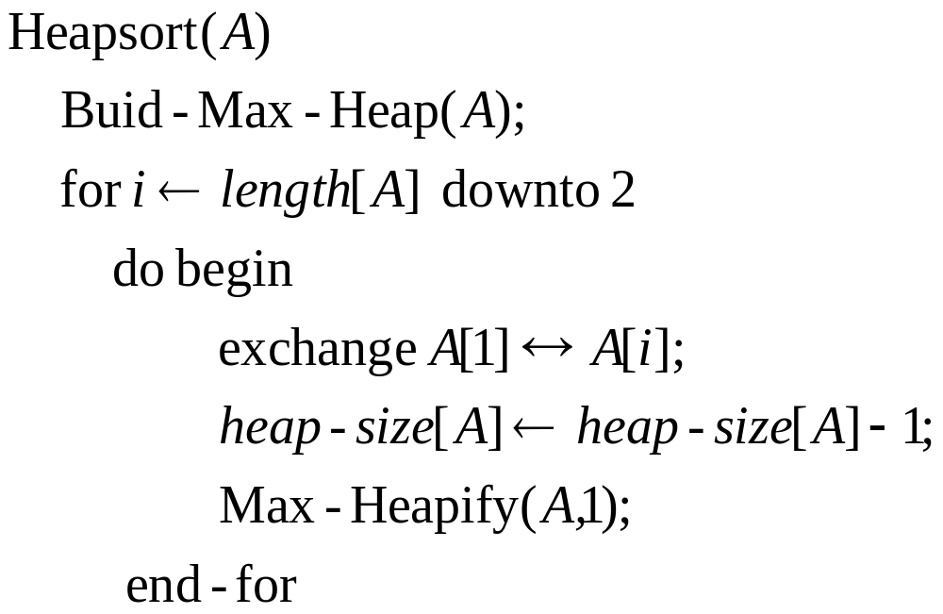
Heapsort

Slide 79
Input: 4, 1, 3, 2, 16, 9, 10, 14, 8, 7.
Build a max-heap
16
14
10
7
9
3
8
2
4
1
16, 14, 10, 8, 7, 9, 3, 2, 4, 1.

Slide 80
1
14
10
7
9
3
8
2
4
16

Slide 81
1
14
10
7
9
3
8
2
4
16
1, 14, 10, 8, 7, 9, 3, 2, 4, 16.

Slide 82
14
8
10
7
9
3
4
2
1
16

Slide 83
14
8
10
7
9
3
4
2
1
16
14, 8, 10, 4, 7, 9, 3, 2, 1, 16.

Slide 84
1
8
10
7
9
3
4
2
14
16

Slide 85
1
8
10
7
9
3
4
2
14
16
1, 8, 10, 4, 7, 9, 3, 2, 14, 16.

Slide 86
10
8
9
7
1
3
4
2
14
16

Slide 87
10
8
9
7
1
3
4
2
14
16
10, 8, 9, 4, 7, 1, 3, 2, 14, 16.

Slide 88
2
8
9
7
1
3
4
10
14
16

Slide 89
2
8
9
7
1
3
4
10
14
16
2, 8, 9, 4, 7, 1, 3, 10, 14, 16.

Slide 90
9
8
3
7
1
2
4
10
14
16

Slide 91
9
8
3
7
1
2
4
10
14
16
9, 8, 3, 4, 7, 1, 2, 10, 14, 16.

Slide 92
2
8
3
7
1
9
4
10
14
16

Slide 93
8
7
3
2
1
9
4
10
14
16

Slide 94
1
7
3
2
8
9
4
10
14
16

Slide 95
7
4
3
2
8
9
1
10
14
16

Slide 96
2
4
3
7
8
9
1
10
14
16

Slide 97
4
2
3
7
8
9
1
10
14
16

Slide 98
1
2
3
4
7
8
9
10
14
16

Slide 99
3
2
1
4
7
8
9
10
14
16

Slide 100
1
2
3
4
7
8
9
10
14
16

Slide 101
2
1
3
4
7
8
9
10
14
16

Slide 102
1
2
3
4
7
8
9
10
14
16

Slide 103
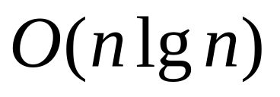
Running Time
O(n)
O(lg n)

Slide 104
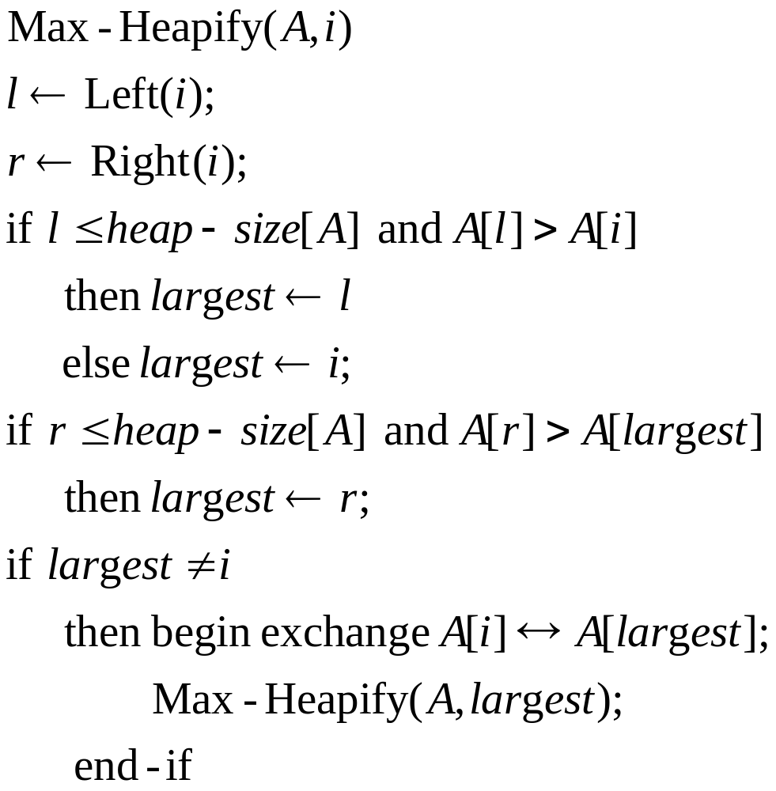

Slide 105
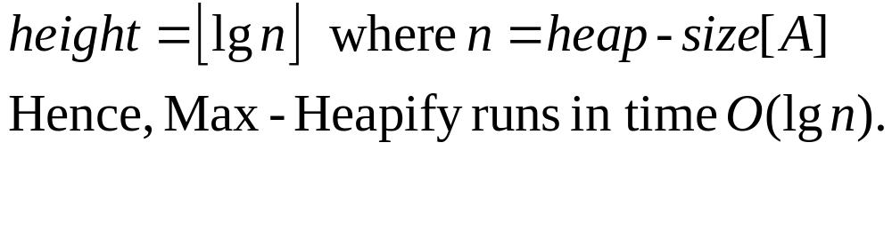
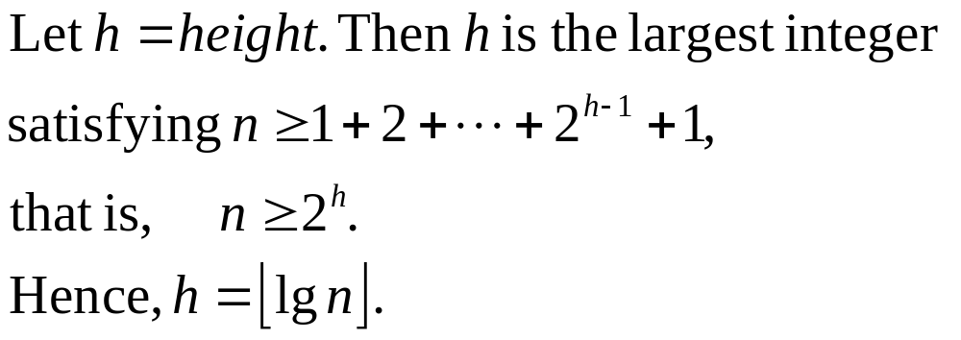
Running time

Slide 106
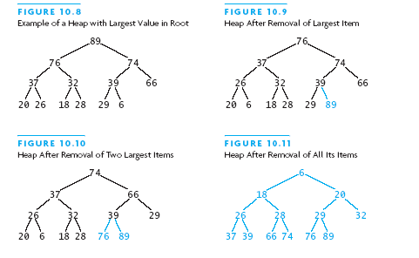
Heapsort Picture

Slide 107
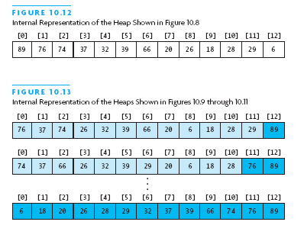
Heapsort Picture (2)

Slide 108
Algorithm for In-Place Heapsort
Build heap starting from unsorted array
While the heap is not empty
  Remove the first item from the heap:
    Swap it with the last item
  Restore the heap property

Slide 109
Heapsort Code
public static <T extends Comparable<T>>
void sort (T[] a) {
buildHp(a);
shrinkHp(a);
}
private static ... void buildHp (T[] a) {
for (int n = 2; n <= a.length; n++) {
in t chld = n-1; // add item and reheap
int prnt = (chld-1) / 2;
while (prnt >= 0 &&
a[prnt].compareTo(a[chld])<0) {
swap(a, prnt, chld);
chld = prnt; prnt = (chld-1)/2
} } }

Slide 110
Heapsort Code (2)
private static ... void shrinkHp (T[] a){
int n = a.length;
for (int n = a.length-1; n > 0; --n){
swap(a, 0, n); // max -> next posn
int prnt = 0;
while (true) {
int lc = 2 * prnt + 1;
if (lc >= n) break;
int rc = lc + 1;
int maxc = lc;
if (rc < n &&
a[lc].compareTo(a[rc]) < 0)
maxc = rc;
....

Slide 111
Heapsort Code (3)
if (a[prnt].compareTo(a[maxc])<0){
swap(a, prnt, maxc);
prnt = maxc;
} else {
break;
}
}
}
}
private static ... void swap
(T[] a, int i, int j) {
T tmp = a[i]; a[i] = a[j]; a[j] = tmp;
}

Slide 112
Heapsort Analysis
Insertion cost is log i for heap of size i
  Total insertion cost = log(n)+log(n-1)+...+log(1)
  This is O(n log n)
Removal cost is also log i for heap of size i
  Total removal cost = O(n log n)
Total cost is O(n log n)

Slide 113
Quicksort
Developed in 1962 by C. A. R. Hoare
Given a pivot value:
  Rearranges array into two parts:
    Left part ≤ pivot value
    Right part > pivot value
Average case for Quicksort is O(n log n)
  Worst case is O(n²)

Slide 114
Quicksort Algorithm
Given an array of n elements (e.g., integers):
If array only contains one element, return
Else
  pick one element to use as pivot.
  Partition elements into two sub-arrays:
    Elements less than or equal to pivot
    Elements greater than pivot
  Quicksort two sub-arrays
  Return results

Slide 115
Example
We are given array of n integers to sort:
40
20
10
80
60
50
7
30
100

Slide 116
Pick Pivot Element
There are a number of ways to pick the pivot element. In this example, we will use the first element in the array:
40
20
10
80
60
50
7
30
100

Slide 117
Partitioning Array
Given a pivot, partition the elements of the array such that the resulting array consists of:
  One sub-array that contains elements >= pivot
  Another sub-array that contains elements < pivot
The sub-arrays are stored in the original data array.
Partitioning loops through, swapping elements below/above pivot.

Slide 118
pivot_index = 0
40
20
10
80
60
50
7
30
100
[0] [1] [2] [3] [4] [5] [6] [7] [8]
too_big_index
too_small_index

Slide 119
While data[too_big_index] <= data[pivot]
++too_big_index
pivot_index = 0
40
20
10
80
60
50
7
30
100
[0] [1] [2] [3] [4] [5] [6] [7] [8]
too_big_index
too_small_index

Slide 120
While data[too_big_index] <= data[pivot]
++too_big_index
pivot_index = 0
40
20
10
80
60
50
7
30
100
[0] [1] [2] [3] [4] [5] [6] [7] [8]
too_big_index
too_small_index

Slide 121
While data[too_big_index] <= data[pivot]
++too_big_index
pivot_index = 0
40
20
10
80
60
50
7
30
100
[0] [1] [2] [3] [4] [5] [6] [7] [8]
too_big_index
too_small_index

Slide 122
While data[too_big_index] <= data[pivot]
  ++too_big_index
While data[too_small_index] > data[pivot]
  --too_small_index
pivot_index = 0
40
20
10
80
60
50
7
30
100
[0] [1] [2] [3] [4] [5] [6] [7] [8]
too_big_index
too_small_index

Slide 123
While data[too_big_index] <= data[pivot]
  ++too_big_index
While data[too_small_index] > data[pivot]
  --too_small_index
pivot_index = 0
40
20
10
80
60
50
7
30
100
[0] [1] [2] [3] [4] [5] [6] [7] [8]
too_big_index
too_small_index

Slide 124
While data[too_big_index] <= data[pivot]
  ++too_big_index
While data[too_small_index] > data[pivot]
  --too_small_index
If too_big_index < too_small_index
  swap data[too_big_index] and data[too_small_index]
pivot_index = 0
40
20
10
80
60
50
7
30
100
[0] [1] [2] [3] [4] [5] [6] [7] [8]
too_big_index
too_small_index

Slide 125
While data[too_big_index] <= data[pivot]
  ++too_big_index
While data[too_small_index] > data[pivot]
  --too_small_index
If too_big_index < too_small_index
  swap data[too_big_index] and data[too_small_index]
pivot_index = 0
40
20
10
30
60
50
7
80
100
[0] [1] [2] [3] [4] [5] [6] [7] [8]
too_big_index
too_small_index

Slide 126
While data[too_big_index] <= data[pivot]
  ++too_big_index
While data[too_small_index] > data[pivot]
  --too_small_index
If too_big_index < too_small_index
  swap data[too_big_index] and data[too_small_index]
While too_small_index > too_big_index, go to 1.
pivot_index = 0
40
20
10
30
60
50
7
80
100
[0] [1] [2] [3] [4] [5] [6] [7] [8]
too_big_index
too_small_index

Slide 127
While data[too_big_index] <= data[pivot]
  ++too_big_index
While data[too_small_index] > data[pivot]
  --too_small_index
If too_big_index < too_small_index
  swap data[too_big_index] and data[too_small_index]
While too_small_index > too_big_index, go to 1.
pivot_index = 0
40
20
10
30
60
50
7
80
100
[0] [1] [2] [3] [4] [5] [6] [7] [8]
too_big_index
too_small_index

Slide 128
While data[too_big_index] <= data[pivot]
  ++too_big_index
While data[too_small_index] > data[pivot]
  --too_small_index
If too_big_index < too_small_index
  swap data[too_big_index] and data[too_small_index]
While too_small_index > too_big_index, go to 1.
pivot_index = 0
40
20
10
30
60
50
7
80
100
[0] [1] [2] [3] [4] [5] [6] [7] [8]
too_big_index
too_small_index

Slide 129
While data[too_big_index] <= data[pivot]
  ++too_big_index
While data[too_small_index] > data[pivot]
  --too_small_index
If too_big_index < too_small_index
  swap data[too_big_index] and data[too_small_index]
While too_small_index > too_big_index, go to 1.
pivot_index = 0
40
20
10
30
60
50
7
80
100
[0] [1] [2] [3] [4] [5] [6] [7] [8]
too_big_index
too_small_index

Slide 130
While data[too_big_index] <= data[pivot]
  ++too_big_index
While data[too_small_index] > data[pivot]
  --too_small_index
If too_big_index < too_small_index
  swap data[too_big_index] and data[too_small_index]
While too_small_index > too_big_index, go to 1.
pivot_index = 0
40
20
10
30
60
50
7
80
100
[0] [1] [2] [3] [4] [5] [6] [7] [8]
too_big_index
too_small_index

Slide 131
While data[too_big_index] <= data[pivot]
  ++too_big_index
While data[too_small_index] > data[pivot]
  --too_small_index
If too_big_index < too_small_index
  swap data[too_big_index] and data[too_small_index]
While too_small_index > too_big_index, go to 1.
pivot_index = 0
40
20
10
30
60
50
7
80
100
[0] [1] [2] [3] [4] [5] [6] [7] [8]
too_big_index
too_small_index

Slide 132
While data[too_big_index] <= data[pivot]
  ++too_big_index
While data[too_small_index] > data[pivot]
  --too_small_index
If too_big_index < too_small_index
  swap data[too_big_index] and data[too_small_index]
While too_small_index > too_big_index, go to 1.
pivot_index = 0
40
20
10
30
7
50
60
80
100
[0] [1] [2] [3] [4] [5] [6] [7] [8]
too_big_index
too_small_index

Slide 133
While data[too_big_index] <= data[pivot]
  ++too_big_index
While data[too_small_index] > data[pivot]
  --too_small_index
If too_big_index < too_small_index
  swap data[too_big_index] and data[too_small_index]
While too_small_index > too_big_index, go to 1.
pivot_index = 0
40
20
10
30
7
50
60
80
100
[0] [1] [2] [3] [4] [5] [6] [7] [8]
too_big_index
too_small_index

Slide 134
While data[too_big_index] <= data[pivot]
  ++too_big_index
While data[too_small_index] > data[pivot]
  --too_small_index
If too_big_index < too_small_index
  swap data[too_big_index] and data[too_small_index]
While too_small_index > too_big_index, go to 1.
pivot_index = 0
40
20
10
30
7
50
60
80
100
[0] [1] [2] [3] [4] [5] [6] [7] [8]
too_big_index
too_small_index

Slide 135
While data[too_big_index] <= data[pivot]
  ++too_big_index
While data[too_small_index] > data[pivot]
  --too_small_index
If too_big_index < too_small_index
  swap data[too_big_index] and data[too_small_index]
While too_small_index > too_big_index, go to 1.
pivot_index = 0
40
20
10
30
7
50
60
80
100
[0] [1] [2] [3] [4] [5] [6] [7] [8]
too_big_index
too_small_index

Slide 136
While data[too_big_index] <= data[pivot]
  ++too_big_index
While data[too_small_index] > data[pivot]
  --too_small_index
If too_big_index < too_small_index
  swap data[too_big_index] and data[too_small_index]
While too_small_index > too_big_index, go to 1.
pivot_index = 0
40
20
10
30
7
50
60
80
100
[0] [1] [2] [3] [4] [5] [6] [7] [8]
too_big_index
too_small_index

Slide 137
While data[too_big_index] <= data[pivot]
  ++too_big_index
While data[too_small_index] > data[pivot]
  --too_small_index
If too_big_index < too_small_index
  swap data[too_big_index] and data[too_small_index]
While too_small_index > too_big_index, go to 1.
pivot_index = 0
40
20
10
30
7
50
60
80
100
[0] [1] [2] [3] [4] [5] [6] [7] [8]
too_big_index
too_small_index

Slide 138
While data[too_big_index] <= data[pivot]
  ++too_big_index
While data[too_small_index] > data[pivot]
  --too_small_index
If too_big_index < too_small_index
  swap data[too_big_index] and data[too_small_index]
While too_small_index > too_big_index, go to 1.
pivot_index = 0
40
20
10
30
7
50
60
80
100
[0] [1] [2] [3] [4] [5] [6] [7] [8]
too_big_index
too_small_index

Slide 139
While data[too_big_index] <= data[pivot]
  ++too_big_index
While data[too_small_index] > data[pivot]
  --too_small_index
If too_big_index < too_small_index
  swap data[too_big_index] and data[too_small_index]
While too_small_index > too_big_index, go to 1.
pivot_index = 0
40
20
10
30
7
50
60
80
100
[0] [1] [2] [3] [4] [5] [6] [7] [8]
too_big_index
too_small_index

Slide 140
While data[too_big_index] <= data[pivot]
  ++too_big_index
While data[too_small_index] > data[pivot]
  --too_small_index
If too_big_index < too_small_index
  swap data[too_big_index] and data[too_small_index]
While too_small_index > too_big_index, go to 1.
pivot_index = 0
40
20
10
30
7
50
60
80
100
[0] [1] [2] [3] [4] [5] [6] [7] [8]
too_big_index
too_small_index

Slide 141
While data[too_big_index] <= data[pivot]
  ++too_big_index
While data[too_small_index] > data[pivot]
  --too_small_index
If too_big_index < too_small_index
  swap data[too_big_index] and data[too_small_index]
While too_small_index > too_big_index, go to 1.
Swap data[too_small_index] and data[pivot_index]
pivot_index = 0
40
20
10
30
7
50
60
80
100
[0] [1] [2] [3] [4] [5] [6] [7] [8]
too_big_index
too_small_index

Slide 142
While data[too_big_index] <= data[pivot]
  ++too_big_index
While data[too_small_index] > data[pivot]
  --too_small_index
If too_big_index < too_small_index
  swap data[too_big_index] and data[too_small_index]
While too_small_index > too_big_index, go to 1.
Swap data[too_small_index] and data[pivot_index]
7
20
10
30
40
50
60
80
100
pivot_index = 4
[0] [1] [2] [3] [4] [5] [6] [7] [8]
too_big_index
too_small_index

Slide 143
Partition Result
7
20
10
30
40
50
60
80
100
[0] [1] [2] [3] [4] [5] [6] [7] [8]
<= data[pivot]
> data[pivot]

Slide 144
Recursion: Quicksort Sub-arrays
7
20
10
30
40
50
60
80
100
[0] [1] [2] [3] [4] [5] [6] [7] [8]
<= data[pivot]
> data[pivot]

Slide 145
Quicksort Analysis
Assume that keys are random, uniformly distributed.
What is best case running time?

Slide 146
Quicksort Analysis
Assume that keys are random, uniformly distributed.
What is best case running time?
  Recursion:
    Partition splits array in two sub-arrays of size n/2
    Quicksort each sub-array

Slide 147
Quicksort Analysis
Assume that keys are random, uniformly distributed.
What is best case running time?
  Recursion:
    Partition splits array in two sub-arrays of size n/2
    Quicksort each sub-array
  Depth of recursion tree?

Slide 148
Quicksort Analysis
Assume that keys are random, uniformly distributed.
What is best case running time?
  Recursion:
    Partition splits array in two sub-arrays of size n/2
    Quicksort each sub-array
  Depth of recursion tree? O(log₂n)

Slide 149
Quicksort Analysis
Assume that keys are random, uniformly distributed.
What is best case running time?
  Recursion:
    Partition splits array in two sub-arrays of size n/2
    Quicksort each sub-array
  Depth of recursion tree? O(log₂n)
  Number of accesses in partition?

Slide 150
Quicksort Analysis
Assume that keys are random, uniformly distributed.
What is best case running time?
  Recursion:
    Partition splits array in two sub-arrays of size n/2
    Quicksort each sub-array
  Depth of recursion tree? O(log₂n)
  Number of accesses in partition? O(n)

Slide 151
Quicksort Analysis
Assume that keys are random, uniformly distributed.
Best case running time: O(n log₂n)

Slide 152
Quicksort Analysis
Assume that keys are random, uniformly distributed.
Best case running time: O(n log₂n)
Worst case running time?

Slide 153
Quicksort: Worst Case
Assume first element is chosen as pivot.
Assume we get array that is already in order:
pivot_index = 0
2
4
10
12
13
50
57
63
100
[0] [1] [2] [3] [4] [5] [6] [7] [8]
too_big_index
too_small_index

Slide 154
While data[too_big_index] <= data[pivot]
  ++too_big_index
While data[too_small_index] > data[pivot]
  --too_small_index
If too_big_index < too_small_index
  swap data[too_big_index] and data[too_small_index]
While too_small_index > too_big_index, go to 1.
Swap data[too_small_index] and data[pivot_index]
pivot_index = 0
2
4
10
12
13
50
57
63
100
[0] [1] [2] [3] [4] [5] [6] [7] [8]
too_big_index
too_small_index

Slide 155
While data[too_big_index] <= data[pivot]
  ++too_big_index
While data[too_small_index] > data[pivot]
  --too_small_index
If too_big_index < too_small_index
  swap data[too_big_index] and data[too_small_index]
While too_small_index > too_big_index, go to 1.
Swap data[too_small_index] and data[pivot_index]
pivot_index = 0
2
4
10
12
13
50
57
63
100
[0] [1] [2] [3] [4] [5] [6] [7] [8]
too_big_index
too_small_index

Slide 156
While data[too_big_index] <= data[pivot]
  ++too_big_index
While data[too_small_index] > data[pivot]
  --too_small_index
If too_big_index < too_small_index
  swap data[too_big_index] and data[too_small_index]
While too_small_index > too_big_index, go to 1.
Swap data[too_small_index] and data[pivot_index]
pivot_index = 0
2
4
10
12
13
50
57
63
100
[0] [1] [2] [3] [4] [5] [6] [7] [8]
too_big_index
too_small_index

Slide 157
While data[too_big_index] <= data[pivot]
  ++too_big_index
While data[too_small_index] > data[pivot]
  --too_small_index
If too_big_index < too_small_index
  swap data[too_big_index] and data[too_small_index]
While too_small_index > too_big_index, go to 1.
Swap data[too_small_index] and data[pivot_index]
pivot_index = 0
2
4
10
12
13
50
57
63
100
[0] [1] [2] [3] [4] [5] [6] [7] [8]
too_big_index
too_small_index

Slide 158
While data[too_big_index] <= data[pivot]
  ++too_big_index
While data[too_small_index] > data[pivot]
  --too_small_index
If too_big_index < too_small_index
  swap data[too_big_index] and data[too_small_index]
While too_small_index > too_big_index, go to 1.
Swap data[too_small_index] and data[pivot_index]
pivot_index = 0
2
4
10
12
13
50
57
63
100
[0] [1] [2] [3] [4] [5] [6] [7] [8]
too_big_index
too_small_index

Slide 159
While data[too_big_index] <= data[pivot]
  ++too_big_index
While data[too_small_index] > data[pivot]
  --too_small_index
If too_big_index < too_small_index
  swap data[too_big_index] and data[too_small_index]
While too_small_index > too_big_index, go to 1.
Swap data[too_small_index] and data[pivot_index]
pivot_index = 0
2
4
10
12
13
50
57
63
100
[0] [1] [2] [3] [4] [5] [6] [7] [8]
too_big_index
too_small_index

Slide 160
While data[too_big_index] <= data[pivot]
  ++too_big_index
While data[too_small_index] > data[pivot]
  --too_small_index
If too_big_index < too_small_index
  swap data[too_big_index] and data[too_small_index]
While too_small_index > too_big_index, go to 1.
Swap data[too_small_index] and data[pivot_index]
pivot_index = 0
2
4
10
12
13
50
57
63
100
[0] [1] [2] [3] [4] [5] [6] [7] [8]
<= data[pivot]
> data[pivot]

Slide 161
Quicksort Analysis
Assume that keys are random, uniformly distributed.
Best case running time: O(n log₂n)
Worst case running time?
  Recursion:
    Partition splits array in two sub-arrays:
      one sub-array of size 0
      the other sub-array of size n-1
    Quicksort each sub-array
  Depth of recursion tree?

Slide 162
Quicksort Analysis
Assume that keys are random, uniformly distributed.
Best case running time: O(n log₂n)
Worst case running time?
  Recursion:
    Partition splits array in two sub-arrays:
      one sub-array of size 0
      the other sub-array of size n-1
    Quicksort each sub-array
  Depth of recursion tree? O(n)

Slide 163
Quicksort Analysis
Assume that keys are random, uniformly distributed.
Best case running time: O(n log₂n)
Worst case running time?
  Recursion:
    Partition splits array in two sub-arrays:
      one sub-array of size 0
      the other sub-array of size n-1
    Quicksort each sub-array
  Depth of recursion tree? O(n)
  Number of accesses per partition?

Slide 164
Quicksort Analysis
Assume that keys are random, uniformly distributed.
Best case running time: O(n log₂n)
Worst case running time?
  Recursion:
    Partition splits array in two sub-arrays:
      one sub-array of size 0
      the other sub-array of size n-1
    Quicksort each sub-array
  Depth of recursion tree? O(n)
  Number of accesses per partition? O(n)

Slide 165
Quicksort Analysis
Assume that keys are random, uniformly distributed.
Best case running time: O(n log₂n)
Worst case running time: O(n²)!!!

Slide 166
Quicksort Analysis
Assume that keys are random, uniformly distributed.
Best case running time: O(n log₂n)
Worst case running time: O(n²)!!!
What can we do to avoid worst case?

Slide 167
Improved Pivot Selection
Pick median value of three elements from data array:
data[0], data[n/2], and data[n-1].
Use this median value as pivot.

Slide 168
Improving Performance of Quicksort
Improved selection of pivot.
For sub-arrays of size 3 or less, apply brute force search:
  Sub-array of size 1: trivial
  Sub-array of size 2:
    if(data[first] > data[second]) swap them
  Sub-array of size 3: left as an exercise.

Slide 169




Quicksort Example

Slide 170
Algorithm for Quicksort
first and last are end points of region to sort
if first < last
Partition using pivot, which ends in pivIndex
Apply Quicksort recursively to left subarray
Apply Quicksort recursively to right subarray
Performance: O(n log n) provide pivIndex not always too close to the end
Performance O(n²) when pivIndex always near end

Slide 171
Quicksort Code
public static <T extends Comparable<T>>
void sort (T[] a) {
qSort(a, 0, a.length-1);
}
private static <T extends Comparable<T>>
void qSort (T[] a, int fst, int lst){
if (fst < lst) {
int pivIndex=partition(a, fst, lst);
qSort(a, fst, pivIndex-1);
qSort(a, pivIndex+1, lst);
}
}

Slide 172
Algorithm for Partitioning
Set pivot value to a[fst]
Set up to fst and down to lst
do
Increment up until a[up] > pivot or up = lst
Decrement down until a[down] <= pivot or
  down = fst
if up < down, swap a[up] and a[down]
while up is to the left of down
swap a[fst] and a[down]
return down as pivIndex

Slide 173

Trace of Algorithm for Partitioning

Slide 174
Partitioning Code
private static <T extends Comparable<T>>
int partition
(T[] a, int fst, int lst) {
T pivot = a[fst];
int u = fst;
int d = lst;
do {
while ((u < lst) &&
(pivot.compareTo(a[u]) >= 0))
u++;
while (pivot.compareTo(a[d]) < 0)
d++;
if (u < d) swap(a, u, d);
} while (u < d);

Slide 175
Partitioning Code (2)
swap(a, fst, d);
return d;
}

Slide 176

Revised Partitioning Algorithm
Quicksort is O(n²) when each split gives 1 empty array
This happens when the array is already sorted
Solution approach: pick better pivot values
Use three “marker” elements: first, middle, last
Let pivot be one whose value is between the others

Slide 177
Chapter Summary
Three quadratic sorting algorithms:
  Selection sort, bubble sort, insertion sort
Shell sort: good performance for up to 5000 elements
Quicksort: average-case O(n log n)
  If the pivot is picked poorly, get worst case: O(n²)
Merge sort and heapsort: guaranteed O(n log n)
  Merge sort: space overhead is O(n)
Java API has good implementations

Slide 178

Chapter Summary (2)

