Slide 1


Chapter 3 Transport Layer
Computer Networking: A Top Down Approach 6th edition Jim Kurose, Keith Ross Addison-Wesley March 2012
A note on the use of these ppt slides:
We’re making these slides freely available to all (faculty, students, readers). They’re in PowerPoint form so you see the animations; and can add, modify, and delete slides (including this one) and slide content to suit your needs. They obviously represent a lot of work on our part. In return for use, we only ask the following:
If you use these slides (e.g., in a class) that you mention their source (after all, we’d like people to use our book!)
If you post any slides on a www site, that you note that they are adapted from (or perhaps identical to) our slides, and note our copyright of this material.
Thanks and enjoy! JFK/KWR
All material copyright 1996-2012
J.F Kurose and K.W. Ross, All Rights Reserved

Slide 2
Goals of COSC 2327
Gain factual knowledge on transport layer.
Get to know the principles of multiplexing/demultiplexing, reliable data transfer, congestion control, and flow control.

Slide 3
Chapter 3: Transport Layer
our goals:
understand principles behind transport layer services:
multiplexing, demultiplexing
reliable data transfer
flow control
congestion control
learn about Internet transport layer protocols:
UDP: connectionless transport
TCP: connection-oriented reliable transport
TCP congestion control

Slide 4
Chapter 3 outline
3.1 transport-layer services
3.2 multiplexing and demultiplexing
3.3 connectionless transport: UDP
3.4 principles of reliable data transfer
3.5 connection-oriented transport: TCP
segment structure
reliable data transfer
flow control
connection management
3.6 principles of congestion control
3.7 TCP congestion control

Slide 5


















Transport services and protocols
application
transport
network
data link
physical
provide logical communication between app processes running on different hosts
transport protocols run in end systems
send side: breaks app messages into segments, passes to network layer
rcv side: reassembles segments into messages, passes to app layer
more than one transport protocol available to apps
Internet: TCP and UDP
logical end-end transport
application
transport
network
data link
physical

Slide 6
Transport vs. network layer
network layer: logical communication between hosts
transport layer: logical communication between processes
relies on, enhances, network layer services
household analogy:
12 kids in Ann’s house sending letters to 12 kids in Bill’s house:
hosts = houses
processes = kids
app messages = letters in envelopes
transport protocol = Ann and Bill who demux to in-house siblings
network-layer protocol = postal service

Slide 7
Internet transport-layer protocols
reliable, in-order delivery (TCP)
congestion control
flow control
connection setup
unreliable, unordered delivery: UDP
no-frills extension of “best-effort” IP
services not available:
delay guarantees
bandwidth guarantees
application
transport
network
data link
physical
network
data link
physical
network
data link
physical
network
data link
physical
logical end-end transport
network
data link
physical
network
data link
physical
network
data link
physical
network
data link
physical
application
transport
network
data link
physical

Slide 8
Chapter 3 outline
3.1 transport-layer services
3.2 multiplexing and demultiplexing
3.3 connectionless transport: UDP
3.4 principles of reliable data transfer
3.5 connection-oriented transport: TCP
segment structure
reliable data transfer
flow control
connection management
3.6 principles of congestion control
3.7 TCP congestion control

Slide 9

Multiplexing/demultiplexing
multiplexing at sender:
handle data from multiple
sockets, add transport header (later used for demultiplexing)
demultiplexing at receiver:
use header info to deliver
received segments to correct
socket
application
application
P1
P2
application
socket
P3
transport
P4
process
transport
network
transport
network
link
network
link
physical
link
physical
physical

Slide 10
How demultiplexing works
host receives IP datagrams
each datagram has source IP address, destination IP address
each datagram carries one transport-layer segment
each segment has source, destination port numbers
host uses IP addresses & port numbers to direct segment to appropriate socket
32 bits
source port #
dest port #
other header fields
application
data
(payload)
TCP/UDP segment format

Slide 11
Connectionless demultiplexing
recall: when creating datagram to send into UDP socket, must specify
destination IP address
destination port #
recall: created socket has host-local port #:
DatagramSocket mySocket1 = new DatagramSocket(12534);
when host receives UDP segment:
checks destination port # in segment
directs UDP segment to socket with that port #
IP datagrams with same dest. port #, but different source IP addresses and/or source port numbers will be directed to same socket at dest

Slide 12
Connectionless demux: example
UDP socket identified by 2-tuple:
dest IP address
dest port number
Q. What is the purpose of the source port number in the UDP segment?
Port#6428
Port#9157
Port#5775
application
application
P1
application
P3
P4
transport
transport
network
transport
network
link
network
link
physical
link
physical
physical
source port: 6428
dest port: 9157
source port: ?
dest port: ?
source port: 9157
dest port: 6428
source port: ?
dest port: ?

Slide 13
Connection-oriented demux
TCP socket identified by 4-tuple:
source IP address
source port number
dest IP address
dest port number
demux: receiver uses all four values to direct segment to appropriate socket
server host may support many simultaneous TCP sockets:
each socket identified by its own 4-tuple
web servers have different sockets for each connecting client
non-persistent HTTP will have different socket for each request

Slide 14
Connection-oriented demux: example
application
application
P4
P5
P6
application
P3
P2
P3
transport
transport
network
transport
network
link
network
link
physical
link
physical
server: IP address B
physical
host: IP address A
source IP,port: B,80
dest IP,port: A,9157
host: IP address C
source IP,port: C,5775
dest IP,port: B,80
source IP,port: A,9157
dest IP, port: B,80
source IP,port: C,9157
dest IP,port: B,80
three segments, all destined to IP address: B,
dest port: 80 are demultiplexed to different sockets

Slide 15
Connection-oriented demux: example
threaded server
application
application
application
P4
P3
P3
P2
transport
transport
network
transport
network
link
network
link
physical
link
physical
server: IP address B
physical
host: IP address A
source IP,port: B,80
dest IP,port: A,9157
host: IP address C
source IP,port: C,5775
dest IP,port: B,80
source IP,port: A,9157
dest IP, port: B,80
source IP,port: C,9157
dest IP,port: B,80

Slide 16
(Sec 3.1-3.2) Review Questions
Q1. A UDP socket is fully identified by:
A. destination IP
B. destination port number
C. source IP
D. source port number

Slide 17
(Sec 3.1-3.2) Review Questions
Q2. A TCP socket is fully identified by:
A. destination IP
B. destination port number
C. source IP
D. source port number

Slide 18
(Sec 3.1-3.2) Review Questions
Q3. True or False?
“UDP segment with different source IP addresses and/or source port numbers but with same destination IP and port number are directed to same socket.”
“TCP segment with different source IP addresses and/or source port numbers but with same destination IP and port number are directed to same socket.”
Notes:
True
False (TCP is identified by :

Slide 19
(Sec 3.1-3.2) Review Questions
Q4.
Host C has UDP Socket with Port # 6789.
Host A & Host B each send a UDP segment to Host C with destination Port # 6789.
Will both of these segments be direct to the same socket to Host C?
Notes:
Yes

Slide 20
Chapter 3 outline
3.1 transport-layer services
3.2 multiplexing and demultiplexing
3.3 connectionless transport: UDP
3.4 principles of reliable data transfer
3.5 connection-oriented transport: TCP
segment structure
reliable data transfer
flow control
connection management
3.6 principles of congestion control
3.7 TCP congestion control

Slide 21
Preview
UDP
Connectionless
Unreliable
No Flow control
No Congestion control
No re-transmission
Example: “What is past is past.”
Game, Video, …
TCP
Connection-oriented
Reliable
Flow control
Sliding Window
Congestion control
Re-transmission
Example:
Email, FTP, …

Slide 22
UDP: User Datagram Protocol [RFC 768]
“no frills,” “bare bones” Internet transport protocol
“best effort” service, UDP segments may be:
lost
delivered out-of-order to app
connectionless:
no handshaking between UDP sender, receiver
each UDP segment handled independently of others
UDP use:
streaming multimedia apps (loss tolerant, rate sensitive)
DNS
SNMP
reliable transfer over UDP:
add reliability at application layer
application-specific error recovery!
Notes:
Simple Network Management Protocol (SNMP)

Slide 23
UDP: segment header
length, in bytes of UDP segment, including header
32 bits
source port #
dest port #
length
checksum
why is there a UDP?
no connection establishment (which can add delay)
simple: no connection state at sender, receiver
small header size
no congestion control: UDP can blast away as fast as desired
application
data
(payload)
UDP segment format

Slide 24
UDP checksum
Goal: detect “errors” (e.g., flipped bits) in transmitted segment
sender:
treat segment contents, including header fields, as sequence of 16-bit integers
checksum: addition (one’s complement sum) of segment contents
sender puts checksum value into UDP checksum field
receiver:
compute checksum of received segment
check if computed checksum equals checksum field value:
NO - error detected
YES - no error detected. But maybe errors nonetheless? More later ….
Notes:
Receiver adds all bits in the segment except for the checksum
And then adds checksum. The answer should be all 1s if not all 1s then there’s an error

Slide 25
Internet checksum: example
example: add two 16-bit integers
1 1 1 1 0 0 1 1 0 0 1 1 0 0 1 1 0
1 1 1 0 1 0 1 0 1 0 1 0 1 0 1 0 1
1 1 0 1 1 1 0 1 1 1 0 1 1 1 0 1 1
1 1 0 1 1 1 0 1 1 1 0 1 1 1 1 0 0
1 0 1 0 0 0 1 0 0 0 1 0 0 0 0 1 1
wraparound
sum
checksum
Note: when adding numbers, a carryout from the most significant bit needs to be added to the result
Notes:
Kurose and Ross forgot to say anything about wrapping the carry and adding it to low order bit

Slide 26
(Sec 3.3) Review Questions
UDP has which of the following characteristics:
connection state at the server
three-way hand shake for connection establishment
Re-transmission of packets
none of the above

Slide 27
(Sec 3.3) Review Questions
UDP uses 1s complement for its checksum. Suppose a sender’s segment has the following three 8-bit bytes: 01010011, 01100110, 01110100. What is ‘checksum’ in the sender’s UDP segment? (For this problem you are being asked to consider 8-bit sums, not 16-bit.)
11010001
How does the receiver’s UDP check an error of the segment?
The receiver adds the four words (the three original words and the checksum). If the sum contains a zero, the receiver knows there has been an error.
Notes:
☺

Slide 28
Chapter 3 outline
3.1 transport-layer services
3.2 multiplexing and demultiplexing
3.3 connectionless transport: UDP
3.4 principles of reliable data transfer
3.5 connection-oriented transport: TCP
segment structure
reliable data transfer
flow control
connection management
3.6 principles of congestion control
3.7 TCP congestion control

Slide 29
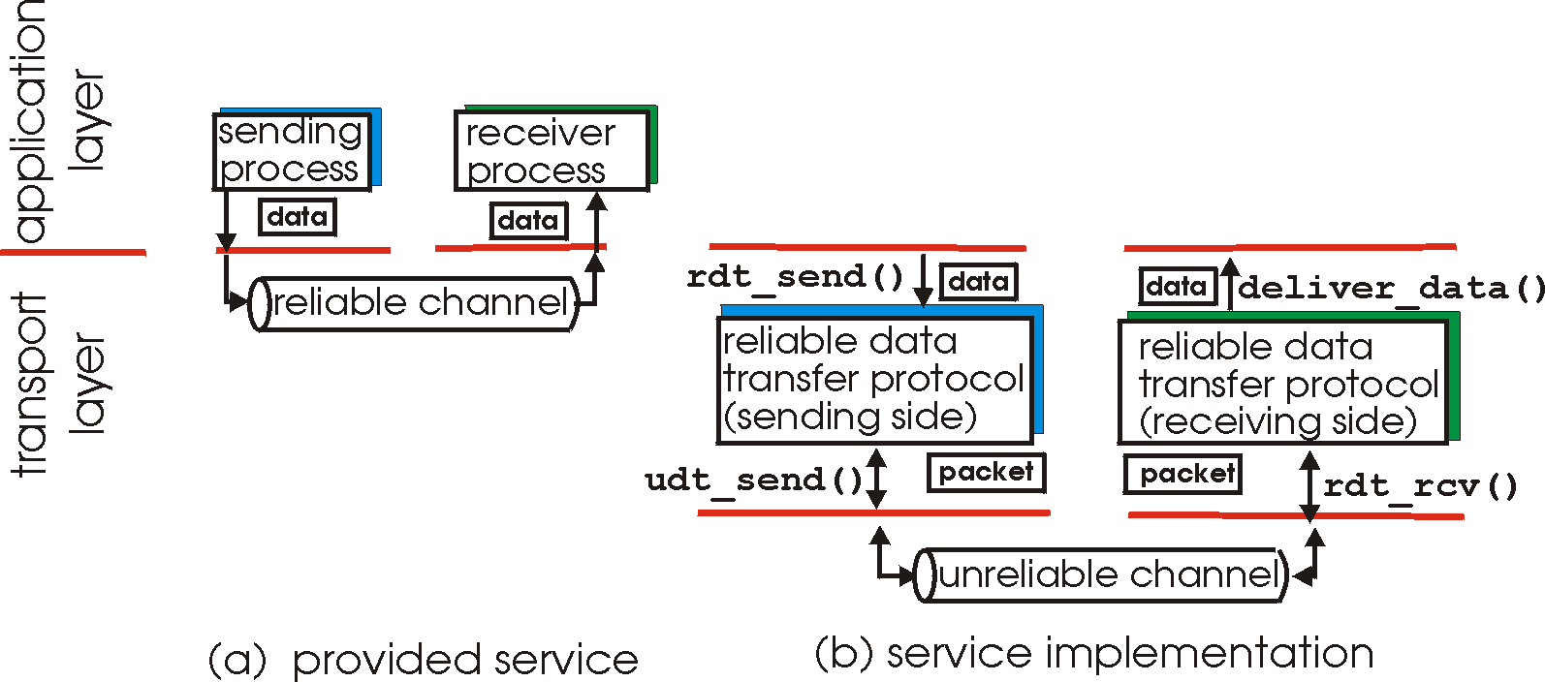
Principles of reliable data transfer
important in application, transport, link layers
top-10 list of important networking topics!
characteristics of unreliable channel will determine complexity of reliable data transfer protocol (rdt)

Slide 30
Principles of reliable data transfer
important in application, transport, link layers
top-10 list of important networking topics!
characteristics of unreliable channel will determine complexity of reliable data transfer protocol (rdt)

Slide 31
Principles of reliable data transfer
important in application, transport, link layers
top-10 list of important networking topics!
characteristics of unreliable channel will determine complexity of reliable data transfer protocol (rdt)

Slide 32
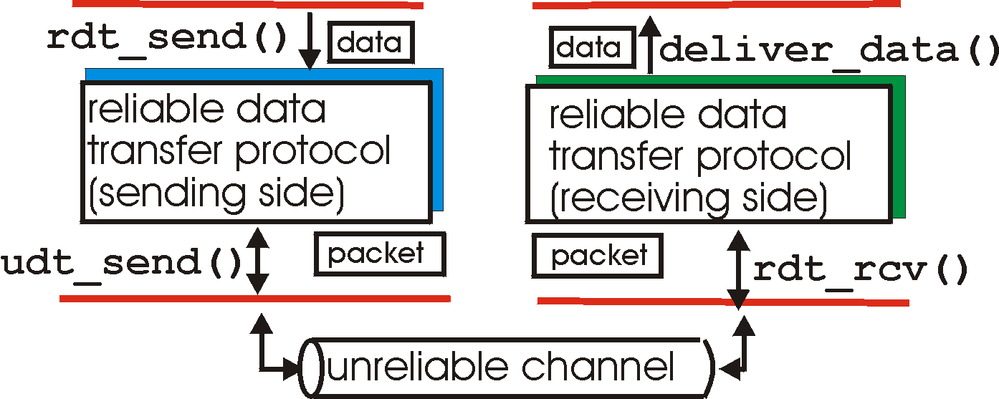
Reliable data transfer: getting started
rdt_send(): called from above (e.g., by app-layer). Passes data to be delivered to receiver’s upper layer
deliver_data(): called by rdt to deliver data to upper
send
side
receive
side
udt_send(): called by rdt,
to transfer packet over
unreliable channel to receiver
rdt_rcv(): called when packet arrives on rcv-side of channel

Slide 33
Reliable data transfer: getting started
We’ll:
incrementally develop sender, receiver sides of reliable data transfer protocol (rdt)
consider only unidirectional data transfer
but control info will flow on both directions!
use finite state machines (FSM) to specify sender, receiver
event causing state transition
actions taken on state transition
state: when in this “state” next state uniquely determined by next event
state
1
state
2
event
actions
Notes:
RDT1.0
for ideal environment
No errors
No losses
Sender always receives all bits and packets
RDT 2.0
Assumption of no packet loss
But there are errors we now look for acknowledgement messages.
ACK= acknowledgment
NAK = Negative Acknowledgements
if there are errors send NAK. Otherwise send ACK

Slide 34
rdt1.0: reliable transfer over a reliable channel
underlying channel perfectly reliable
no bit errors
no loss of packets
separate FSMs for sender, receiver:
sender sends data into underlying channel
receiver reads data from underlying channel
Wait for call from above
rdt_send(data)
Wait for call from below
rdt_rcv(packet)
extract (packet,data)
deliver_data(data)
packet = make_pkt(data)
udt_send(packet)
sender
receiver

Slide 35
rdt2.0: channel with bit errors
underlying channel may flip bits in packet
checksum to detect bit errors
the question: how to recover from errors:
acknowledgements (ACKs): receiver explicitly tells sender that pkt received OK
negative acknowledgements (NAKs): receiver explicitly tells sender that pkt had errors
sender retransmits pkt on receipt of NAK
new mechanisms in rdt2.0 (beyond rdt1.0):
error detection
receiver feedback: control msgs (ACK,NAK) rcvr->sender
How do humans recover from “errors”
during conversation?

Slide 36
rdt2.0: channel with bit errors
underlying channel may flip bits in packet
checksum to detect bit errors
the question: how to recover from errors:
acknowledgements (ACKs): receiver explicitly tells sender that pkt received OK
negative acknowledgements (NAKs): receiver explicitly tells sender that pkt had errors
sender retransmits pkt on receipt of NAK
new mechanisms in rdt2.0 (beyond rdt1.0):
error detection
feedback: control msgs (ACK,NAK) from receiver to sender

Slide 37
rdt2.0: FSM specification
rdt_send(data)
sndpkt = make_pkt(data, checksum)
udt_send(sndpkt)
receiver
rdt_rcv(rcvpkt) &&
isNAK(rcvpkt)
Wait for call from above
Wait for ACK or NAK
rdt_rcv(rcvpkt) &&
corrupt(rcvpkt)
udt_send(sndpkt)
udt_send(NAK)
rdt_rcv(rcvpkt) && isACK(rcvpkt)
Λ
Wait for call from below
sender
rdt_rcv(rcvpkt) &&
notcorrupt(rcvpkt)
extract(rcvpkt,data)
deliver_data(data)
udt_send(ACK)

Slide 38
rdt2.0: operation with no errors
rdt_send(data)
sndpkt = make_pkt(data, checksum)
udt_send(sndpkt)
rdt_rcv(rcvpkt) &&
isNAK(rcvpkt)
Wait for call from above
Wait for ACK or NAK
rdt_rcv(rcvpkt) &&
corrupt(rcvpkt)
udt_send(sndpkt)
udt_send(NAK)
rdt_rcv(rcvpkt) && isACK(rcvpkt)
Wait for call from below
Λ
rdt_rcv(rcvpkt) &&
notcorrupt(rcvpkt)
extract(rcvpkt,data)
deliver_data(data)
udt_send(ACK)

Slide 39
rdt2.0: error scenario
rdt_send(data)
sndpkt = make_pkt(data, checksum)
udt_send(sndpkt)
rdt_rcv(rcvpkt) &&
isNAK(rcvpkt)
Wait for call from above
Wait for ACK or NAK
rdt_rcv(rcvpkt) &&
corrupt(rcvpkt)
udt_send(sndpkt)
udt_send(NAK)
rdt_rcv(rcvpkt) && isACK(rcvpkt)
Wait for call from below
Λ
rdt_rcv(rcvpkt) &&
notcorrupt(rcvpkt)
extract(rcvpkt,data)
deliver_data(data)
udt_send(ACK)

Slide 40
rdt2.0 has a fatal flaw!
what happens if ACK/NAK corrupted?
sender doesn’t know what happened at receiver!
can’t just retransmit: possible duplicate
handling duplicates:
sender retransmits current pkt if ACK/NAK corrupted
sender adds sequence number to each pkt
receiver discards (doesn’t deliver up) duplicate pkt
stop and wait
sender sends one packet,
then waits for receiver
response

Slide 41
rdt2.1: sender, handles garbled ACK/NAKs
rdt_send(data)
sndpkt = make_pkt(0, data, checksum)
udt_send(sndpkt)
rdt_rcv(rcvpkt) &&
( corrupt(rcvpkt) ||
isNAK(rcvpkt) )
Wait for call 0 from above
Wait for ACK or NAK 0
udt_send(sndpkt)
rdt_rcv(rcvpkt)
&& notcorrupt(rcvpkt)
&& isACK(rcvpkt)
rdt_rcv(rcvpkt)
&& notcorrupt(rcvpkt)
&& isACK(rcvpkt)
Λ
Λ
Wait for ACK or NAK 1
Wait for
call 1 from above
rdt_rcv(rcvpkt) &&
( corrupt(rcvpkt) ||
isNAK(rcvpkt) )
rdt_send(data)
udt_send(sndpkt)
sndpkt = make_pkt(1, data, checksum)
udt_send(sndpkt)

Slide 42
rdt2.1: receiver, handles garbled ACK/NAKs
rdt_rcv(rcvpkt) && notcorrupt(rcvpkt)
&& has_seq0(rcvpkt)
extract(rcvpkt,data)
deliver_data(data)
sndpkt = make_pkt(ACK, chksum)
udt_send(sndpkt)
rdt_rcv(rcvpkt) && (corrupt(rcvpkt)
rdt_rcv(rcvpkt) && (corrupt(rcvpkt)
sndpkt = make_pkt(NAK, chksum)
udt_send(sndpkt)
sndpkt = make_pkt(NAK, chksum)
udt_send(sndpkt)
Wait for
0 from below
Wait for
1 from below
rdt_rcv(rcvpkt) &&
not corrupt(rcvpkt) &&
has_seq1(rcvpkt)
rdt_rcv(rcvpkt) &&
not corrupt(rcvpkt) &&
has_seq0(rcvpkt)
sndpkt = make_pkt(ACK, chksum)
udt_send(sndpkt)
sndpkt = make_pkt(ACK, chksum)
udt_send(sndpkt)
rdt_rcv(rcvpkt) && notcorrupt(rcvpkt)
&& has_seq1(rcvpkt)
extract(rcvpkt,data)
deliver_data(data)
sndpkt = make_pkt(ACK, chksum)
udt_send(sndpkt)

Slide 43
(Question) rdt2.1: sender
Please describe the event?
rdt_send(data)
sndpkt = make_pkt(0, data, checksum)
udt_send(sndpkt)
rdt_rcv(rcvpkt) &&
( corrupt(rcvpkt) ||
isNAK(rcvpkt) )
Wait for call 0 from above
Wait for ACK or NAK 0
udt_send(sndpkt)
rdt_rcv(rcvpkt)
&& notcorrupt(rcvpkt)
&& isACK(rcvpkt)
rdt_rcv(rcvpkt)
&& notcorrupt(rcvpkt)
&& isACK(rcvpkt)
Λ
Λ
Wait for ACK or NAK 1
Wait for
call 1 from above
rdt_rcv(rcvpkt) &&
( corrupt(rcvpkt) ||
isNAK(rcvpkt) )
rdt_send(data)
udt_send(sndpkt)
sndpkt = make_pkt(1, data, checksum)
udt_send(sndpkt)

Slide 44
(Question) rdt2.1: receiver
Please describe the event?
rdt_rcv(rcvpkt) && notcorrupt(rcvpkt)
&& has_seq0(rcvpkt)
extract(rcvpkt,data)
deliver_data(data)
sndpkt = make_pkt(ACK, chksum)
udt_send(sndpkt)
rdt_rcv(rcvpkt) && (corrupt(rcvpkt)
rdt_rcv(rcvpkt) && (corrupt(rcvpkt)
sndpkt = make_pkt(NAK, chksum)
udt_send(sndpkt)
sndpkt = make_pkt(NAK, chksum)
udt_send(sndpkt)
Wait for
0 from below
Wait for
1 from below
rdt_rcv(rcvpkt) &&
not corrupt(rcvpkt) &&
has_seq1(rcvpkt)
rdt_rcv(rcvpkt) &&
not corrupt(rcvpkt) &&
has_seq0(rcvpkt)
sndpkt = make_pkt(ACK, chksum)
udt_send(sndpkt)
sndpkt = make_pkt(ACK, chksum)
udt_send(sndpkt)
rdt_rcv(rcvpkt) && notcorrupt(rcvpkt)
&& has_seq1(rcvpkt)
extract(rcvpkt,data)
deliver_data(data)
sndpkt = make_pkt(ACK, chksum)
udt_send(sndpkt)

Slide 45
(Question) rdt2.1: receiver
Please describe the event?
rdt_rcv(rcvpkt) && notcorrupt(rcvpkt)
&& has_seq0(rcvpkt)
extract(rcvpkt,data)
deliver_data(data)
sndpkt = make_pkt(ACK, chksum)
udt_send(sndpkt)
rdt_rcv(rcvpkt) && (corrupt(rcvpkt)
rdt_rcv(rcvpkt) && (corrupt(rcvpkt)
sndpkt = make_pkt(NAK, chksum)
udt_send(sndpkt)
sndpkt = make_pkt(NAK, chksum)
udt_send(sndpkt)
Wait for
0 from below
Wait for
1 from below
rdt_rcv(rcvpkt) &&
not corrupt(rcvpkt) &&
has_seq1(rcvpkt)
rdt_rcv(rcvpkt) &&
not corrupt(rcvpkt) &&
has_seq0(rcvpkt)
sndpkt = make_pkt(ACK, chksum)
udt_send(sndpkt)
sndpkt = make_pkt(ACK, chksum)
udt_send(sndpkt)
rdt_rcv(rcvpkt) && notcorrupt(rcvpkt)
&& has_seq1(rcvpkt)
extract(rcvpkt,data)
deliver_data(data)
sndpkt = make_pkt(ACK, chksum)
udt_send(sndpkt)

Slide 46
rdt2.1: discussion
It allows the receiver to know whether the sender
is resending the previously transmitted packet
(the sequence number of the received packet has
the same sequence number as the most recently
received packet) or a new packet (the sequence
number changes).
sender:
seq # added to pkt
two seq. #’s (0,1) will suffice. Why?
must check if received ACK/NAK corrupted
twice as many states
state must “remember” whether “expected” pkt should have seq # of 0 or 1
receiver:
must check if received packet is duplicate
state indicates whether 0 or 1 is expected pkt seq #
note: receiver can not know if its last ACK/NAK received OK at sender

Slide 47
rdt2.1: discussion
Q. How does the sender check if received ACK/NAK corrupted?
sender:
seq # added to pkt
two seq. #’s (0,1) will suffice. Why?
must check if received ACK/NAK corrupted
twice as many states
state must “remember” whether “expected” pkt should have seq # of 0 or 1
receiver:
must check if received packet is duplicate
state indicates whether 0 or 1 is expected pkt seq #
note: receiver can not know if its last ACK/NAK received OK at sender

Slide 48
rdt2.1: discussion
Q. How does the
receiver check if received packet is duplicate?
sender:
seq # added to pkt
two seq. #’s (0,1) will suffice. Why?
must check if received ACK/NAK corrupted
twice as many states
state must “remember” whether “expected” pkt should have seq # of 0 or 1
receiver:
must check if received packet is duplicate
state indicates whether 0 or 1 is expected pkt seq #
note: receiver can not know if its last ACK/NAK received OK at sender

Slide 49
rdt2.1: discussion
Q. Why does the sender may send duplicated packet? Or in which case?
sender:
seq # added to pkt
two seq. #’s (0,1) will suffice. Why?
must check if received ACK/NAK corrupted
twice as many states
state must “remember” whether “expected” pkt should have seq # of 0 or 1
receiver:
must check if received packet is duplicate
state indicates whether 0 or 1 is expected pkt seq #
note: receiver can not know if its last ACK/NAK received OK at sender

Slide 50
rdt2.2: a NAK-free protocol
same functionality as rdt2.1, using ACKs only
instead of NAK, receiver sends ACK for last pkt received OK
receiver must explicitly include seq # of pkt being ACKed
duplicate ACK at sender results in same action as NAK: retransmit current pkt

Slide 51
rdt2.2: sender, receiver fragments
rdt_send(data)
sndpkt = make_pkt(0, data, checksum)
udt_send(sndpkt)
rdt_rcv(rcvpkt) &&
( corrupt(rcvpkt) ||
isACK(rcvpkt,1) )
Wait for call 0 from above
Wait for ACK
0
udt_send(sndpkt)
sender FSM
fragment
rdt_rcv(rcvpkt)
&& notcorrupt(rcvpkt)
&& isACK(rcvpkt,0)
rdt_rcv(rcvpkt) &&
(corrupt(rcvpkt) ||
has_seq1(rcvpkt))
Λ
Wait for
0 from below
receiver FSM
fragment
udt_send(sndpkt)
rdt_rcv(rcvpkt) && notcorrupt(rcvpkt)
&& has_seq1(rcvpkt)
extract(rcvpkt,data)
deliver_data(data)
sndpkt = make_pkt(ACK1, chksum)
udt_send(sndpkt)

Slide 52
rdts 1.0, 2.0, 2.1, 2.2
rdt 1.0
No pkt loss, No pkt error (corruption)
rdt 2.0
No pkt loss
Pkt error → Use ACK/NAK
No ACK/NAK corruptions
rdt 2.1
No pkt loss
Pkt error, Use ACK/NAK
ACK/NAK corruptions → Use sequence #s on pkts
rdt 2.2
same as rdt2.1, using ACKs only
Use sequence #s on ACKs, too.

Slide 53
rdt3.0: channels with errors and loss
new assumption: underlying channel can also lose packets (data, ACKs)
checksum, seq. #, ACKs, retransmissions will be of help … but not enough
approach: sender waits “reasonable” amount of time for ACK
retransmits if no ACK received in this time
if pkt (or ACK) just delayed (not lost):
retransmission will be duplicate, but seq. #’s already handles this
receiver must specify seq # of pkt being ACKed
requires countdown timer

Slide 54
rdt3.0 sender
rdt_send(data)
rdt_rcv(rcvpkt) &&
( corrupt(rcvpkt) ||
isACK(rcvpkt,1) )
sndpkt = make_pkt(0, data, checksum)
udt_send(sndpkt)
start_timer
rdt_rcv(rcvpkt)
Λ
Λ
Wait for
call 0from above
Wait for ACK0
timeout
udt_send(sndpkt)
start_timer
rdt_rcv(rcvpkt)
&& notcorrupt(rcvpkt)
&& isACK(rcvpkt,1)
rdt_rcv(rcvpkt)
&& notcorrupt(rcvpkt)
&& isACK(rcvpkt,0)
stop_timer
stop_timer
Wait for ACK1
Wait for
call 1 from above
timeout
udt_send(sndpkt)
start_timer
rdt_rcv(rcvpkt)
rdt_send(data)
Λ
rdt_rcv(rcvpkt) &&
( corrupt(rcvpkt) ||
isACK(rcvpkt,0) )
sndpkt = make_pkt(1, data, checksum)
udt_send(sndpkt)
start_timer
Λ

Slide 55

rdt3.0 in action
sender
receiver
sender
receiver
send pkt0
pkt0
send pkt0
pkt0
rcv pkt0
rcv pkt0
ack0
send ack0
ack0
send ack0
rcv ack0
rcv ack0
send pkt1
pkt1
send pkt1
pkt1
rcv pkt1
X
ack1
send ack1
loss
rcv ack1
send pkt0
pkt0
rcv pkt0
timeout
resend pkt1
ack0
send ack0
pkt1
rcv pkt1
ack1
send ack1
rcv ack1
send pkt0
pkt0
(a) no loss
rcv pkt0
ack0
send ack0
(b) packet loss
Notes:
after the timer expires
after a given amount of timer has expired

Slide 56
rdt3.0 in action
sender
receiver
sender
receiver
send pkt0
pkt0
send pkt0
pkt0
rcv pkt0
rcv pkt0
ack0
send ack0
send ack0
rcv ack0
ack0
send pkt1
pkt1
rcv ack0
rcv pkt1
send pkt1
pkt1
send ack1
rcv pkt1
ack1
send ack1
ack1
X
loss
timeout
resend pkt1
pkt1
rcv pkt1
timeout
resend pkt1
rcv ack1
pkt1
rcv pkt1
pkt0
(detect duplicate)
send pkt0
send ack1
ack1
(detect duplicate)
ack1
rcv pkt0
rcv ack1
send ack1
rcv ack1
ack0
send ack0
pkt0
send pkt0
pkt0
send pkt0
rcv pkt0
rcv pkt0
ack0
(detect duplicate)
ack0
send ack0
send ack0
(c) ACK loss
(d) premature timeout/ delayed ACK

Slide 57
rdt3.0 in action
Waits for ACK-1
C
B
A
sender
receiver
sender
receiver
send pkt0
A
pkt0
send pkt0
pkt0
rcv pkt0
A
rcv pkt0
ack0
send ack0
send ack0
rcv ack0
ack0
send pkt1
pkt1
B
rcv ack0
rcv pkt1
B
send pkt1
pkt1
send ack1
rcv pkt1
ack1
send ack1
ack1
X
loss
timeout
resend pkt1
pkt1
B
rcv pkt1
B
timeout
resend pkt1
rcv ack1
pkt1
rcv pkt1
pkt0
(detect duplicate)
send pkt0
C
send ack1
ack1
(detect duplicate)
ack1
rcv pkt0
send ack1
rcv ack1
ack0
C
rcv ack1
send pkt0
send ack0
send pkt0
pkt0
pkt0
C
rcv pkt0
rcv pkt0
C
send ack0
ack0
(detect duplicate)
ack0
send ack0
(c) ACK loss
(d) premature timeout/ delayed ACK
Waits for ACK-0

Slide 58
rdt (reliable data transfer) protocols:
stop and wait protocols!
sender sends one packet,
then waits for receiver response

Slide 59
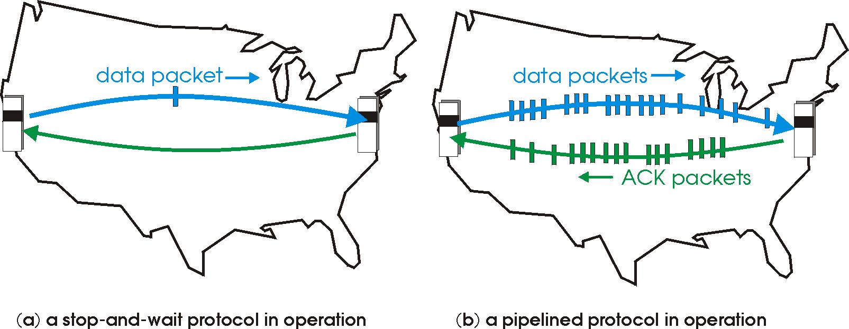

Pipelined protocols
pipelining: sender allows multiple, “in-flight”, yet-to-be-acknowledged pkts
range of sequence numbers must be increased
buffering at sender and/or receiver
two generic forms of pipelined protocols: go-Back-N, selective repeat
Notes:
two generic forms of pipelined protocols:
go-Back-N
selective repeat

Slide 60
Pipelining: increased utilization
sender
receiver
first packet bit transmitted, t = 0
last bit transmitted, t = L / R
first packet bit arrives
RTT
last packet bit arrives, send ACK
last bit of 2nd packet arrives, send ACK
last bit of 3rd packet arrives, send ACK
ACK arrives, send next
packet, t = RTT + L / R
3-packet pipelining increases
utilization by a factor of 3!

Slide 61
Pipelined protocols: overview
Go-back-N:
sender can have up to N unacked packets in pipeline
receiver only sends cumulative ack
doesn’t ack packet if there’s a gap
sender has timer for oldest unacked packet
when timer expires, retransmit ‘all’ unacked packets
Selective Repeat:
sender can have up to N unacked packets in pipeline
receiver sends individual ack for each packet
sender maintains timer for each unacked packet
when timer expires, retransmit only ‘that’ unacked packet

Slide 62
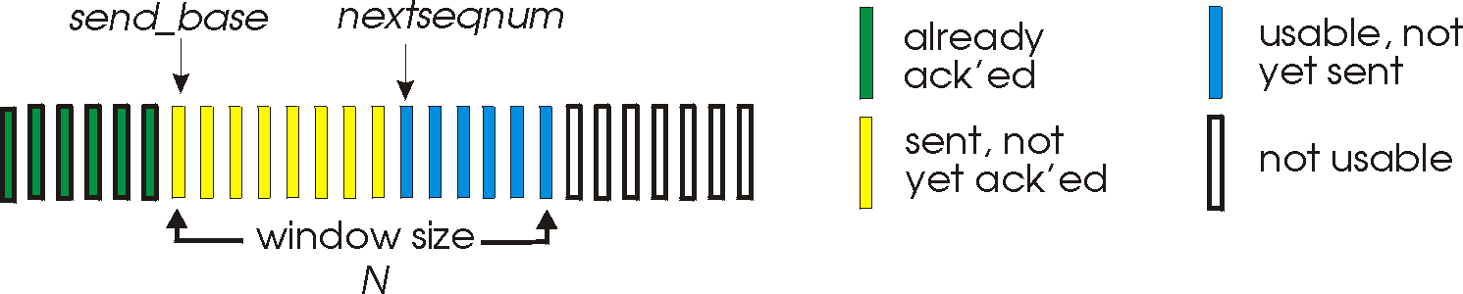
Go-Back-N: sender
k-bit seq # in pkt header
“window” of up to N, consecutive unack’ed pkts allowed
ACK(n): ACKs all pkts up to, including seq # n – “cumulative ACK”
may receive duplicate ACKs (see receiver)
timer for oldest in-flight pkt
timeout(n): retransmit packet n and all higher seq # pkts in window

Slide 63
GBN: sender extended FSM
rdt_send(data)
if (nextseqnum < base+N) {
sndpkt[nextseqnum] = make_pkt(nextseqnum,data,chksum)
udt_send(sndpkt[nextseqnum])
if (base == nextseqnum)
start_timer
nextseqnum++
}
else
refuse_data(data)
Λ
base=1
nextseqnum=1
timeout
Wait
start_timer
udt_send(sndpkt[base])
udt_send(sndpkt[base+1])
…
udt_send(sndpkt[nextseqnum-1])
rdt_rcv(rcvpkt)
&& corrupt(rcvpkt)
rdt_rcv(rcvpkt) &&
notcorrupt(rcvpkt)
base = getacknum(rcvpkt)+1
If (base == nextseqnum)
stop_timer
else
start_timer

Slide 64
GBN: receiver extended FSM
default
udt_send(sndpkt)
rdt_rcv(rcvpkt)
&& notcurrupt(rcvpkt)
&& hasseqnum(rcvpkt,expectedseqnum)
Λ
Wait
extract(rcvpkt,data)
deliver_data(data)
sndpkt = make_pkt(expectedseqnum,ACK,chksum)
udt_send(sndpkt)
expectedseqnum++
expectedseqnum=1
sndpkt =
make_pkt(expectedseqnum,ACK,chksum)
ACK-only: always send ACK for correctly-received pkt with highest in-order seq #
may generate duplicate ACKs
need only remember expectedseqnum
out-of-order pkt:
discard (don’t buffer): no receiver buffering!
re-ACK pkt with highest in-order seq #

Slide 65
GBN in action
sender window (N=4)
sender
receiver
0 1 2 3 4 5 6 7 8
send pkt0
send pkt1
send pkt2
send pkt3
(wait)
0 1 2 3 4 5 6 7 8
receive pkt0, send ack0
receive pkt1, send ack1
receive pkt3, discard,
(re)send ack1
0 1 2 3 4 5 6 7 8
X
0 1 2 3 4 5 6 7 8
loss
0 1 2 3 4 5 6 7 8
rcv ack0, send pkt4
rcv ack1, send pkt5
0 1 2 3 4 5 6 7 8
receive pkt4, discard,
(re)send ack1
ignore duplicate ACK
receive pkt5, discard,
(re)send ack1
pkt 2 timeout
0 1 2 3 4 5 6 7 8
send pkt2
send pkt3
send pkt4
send pkt5
0 1 2 3 4 5 6 7 8
0 1 2 3 4 5 6 7 8
rcv pkt2, deliver, send ack2
rcv pkt3, deliver, send ack3
rcv pkt4, deliver, send ack4
rcv pkt5, deliver, send ack5
0 1 2 3 4 5 6 7 8

Slide 66
GBN in action
Wait for one or more of these packets to be acknowledged before proceeding.
sender window (N=4)
sender
receiver
0 1 2 3 4 5 6 7 8
send pkt0
send pkt1
send pkt2
send pkt3
(wait)
0 1 2 3 4 5 6 7 8
receive pkt0, send ack0
receive pkt1, send ack1
receive pkt3, discard,
(re)send ack1
0 1 2 3 4 5 6 7 8
X
0 1 2 3 4 5 6 7 8
loss
0 1 2 3 4 5 6 7 8
rcv ack0, send pkt4
rcv ack1, send pkt5
0 1 2 3 4 5 6 7 8
receive pkt4, discard,
(re)send ack1
ignore duplicate ACK
receive pkt5, discard,
(re)send ack1
pkt 2 timeout
0 1 2 3 4 5 6 7 8
send pkt2
send pkt3
send pkt4
send pkt5
0 1 2 3 4 5 6 7 8
0 1 2 3 4 5 6 7 8
rcv pkt2, deliver, send ack2
rcv pkt3, deliver, send ack3
rcv pkt4, deliver, send ack4
rcv pkt5, deliver, send ack5
0 1 2 3 4 5 6 7 8
Notes:
The number of sequence numbers must be greater than the window: side N
“ the #. Seq #s >= N”
EXAM QUESTION: WHAT ACK NUMBERS IS THERECEIVER SENDING.

Slide 67
GBN: Example
Click: GBN Animation (YouTube)
Notes:
https://www.youtube.com/watch?v=9BuaeEjIeQI

Slide 68
Selective repeat
receiver individually acknowledges all correctly received pkts
buffers pkts, as needed, for eventual in-order delivery to upper layer
sender only resends pkts for which ACK not received
sender timer for each unACKed pkt
sender window
N consecutive seq #’s
limits seq #s of sent, unACKed pkts

Slide 69
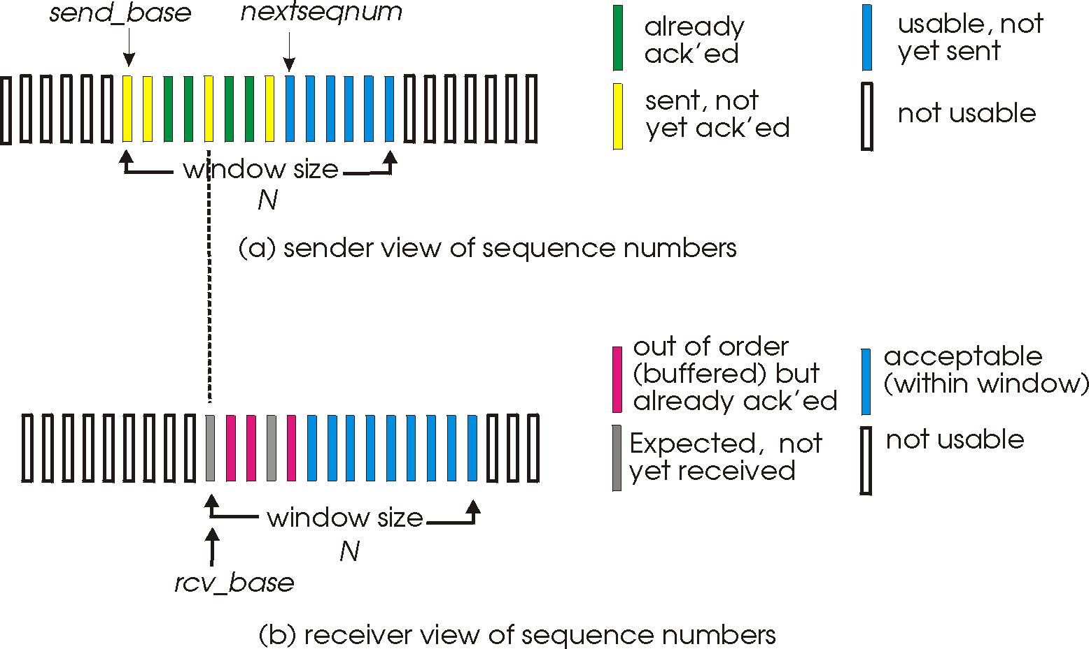
Selective repeat: sender, receiver windows

Slide 70
Selective repeat
sender
receiver
data from above:
if next available seq # in window, send pkt
timeout(n):
resend pkt n, restart timer
ACK(n) in [sendbase,sendbase+N]:
mark pkt n as received
if n smallest unACKed pkt, advance window base to next unACKed seq #
pkt n in [rcvbase, rcvbase+N-1]
send ACK(n)
out-of-order: buffer
in-order: deliver (also deliver buffered, in-order pkts), advance window to next not-yet-received pkt
pkt n in [rcvbase-N,rcvbase-1]
ACK(n)
otherwise:
ignore

Slide 71
Selective repeat in action
sender window (N=4)
sender
receiver
0 1 2 3 4 5 6 7 8
send pkt0
send pkt1
send pkt2
send pkt3
(wait)
0 1 2 3 4 5 6 7 8
receive pkt0, send ack0
receive pkt1, send ack1
receive pkt3, buffer,
send ack3
0 1 2 3 4 5 6 7 8
X
0 1 2 3 4 5 6 7 8
loss
0 1 2 3 4 5 6 7 8
rcv ack0, send pkt4
rcv ack1, send pkt5
0 1 2 3 4 5 6 7 8
receive pkt4, buffer,
send ack4
record ack3 arrived
receive pkt5, buffer,
send ack5
pkt 2 timeout
0 1 2 3 4 5 6 7 8
send pkt2
0 1 2 3 4 5 6 7 8
record ack4 arrived
0 1 2 3 4 5 6 7 8
rcv pkt2; deliver pkt2,
pkt3, pkt4, pkt5; send ack2
record ack5 arrived
0 1 2 3 4 5 6 7 8
Q: what happens when ack2 arrives?
Notes:
The windows size must be less than or equal to half the sequence number space for SR protocols.

Slide 72

Selective repeat: dilemma
sender window
(after receipt)
receiver window
(after receipt)
0 1 2 3 0 1 2
pkt0
0 1 2 3 0 1 2
pkt1
0 1 2 3 0 1 2
example:
seq #’s: 0, 1, 2, 3
window size=3
0 1 2 3 0 1 2
pkt2
0 1 2 3 0 1 2
0 1 2 3 0 1 2
0 1 2 3 0 1 2
pkt3
X
0 1 2 3 0 1 2
pkt0
will accept packet
with seq number 0
receiver sees no difference in two scenarios!
duplicate data accepted as new in (b)
Q: what relationship between seq # size and window size to avoid problem in (b)?
(a) no problem
receiver can’t see sender side.
receiver behavior identical in both cases!
Something’s (very) wrong!
0 1 2 3 0 1 2
pkt0
0 1 2 3 0 1 2
pkt1
0 1 2 3 0 1 2
0 1 2 3 0 1 2
pkt2
0 1 2 3 0 1 2
X
0 1 2 3 0 1 2
X
timeout
retransmit pkt0
X
0 1 2 3 0 1 2
pkt0
will accept packet
with seq number 0
(b) oops!

